Slide 1



• WATS UP 2026 · DEEP-DIVE SESSION •
Test Step Analysis
Your test data already knows.
Reading the signals your test data has been sending all along.
20 min of signals · 40 min live in WATS
Ola Lund Reppe — WATS
WATS UP 2026 · Test Step Analysis

Slide 2

Yield is just the tip
The pass/fail bit hides everything that is about to go wrong.
ABOVE THE WATERLINE — WHAT EVERYONE WATCHES
FPY, pass counts, the red/green verdict — one bit per unit.
the pass/fail waterline
BELOW — WHAT TEST STEP ANALYSIS READS FIRST
Drift — averages walking toward a limit
Leaning measurements — a population parked off-center
Excess spread — the limit window nearly full
Multiple distributions — two processes hiding in one step
Outliers — sentinels and glitches polluting the stats
Near-limit passes — passing today, failing tomorrow
Ola Lund Reppe — WATS
WATS UP 2026 · Test Step Analysis

Slide 3









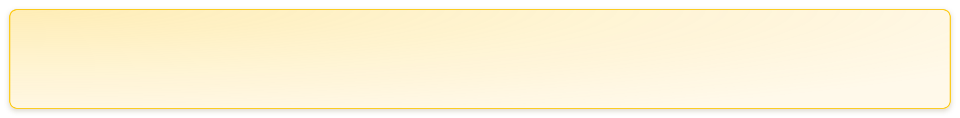
• THE METHOD •
From yield to root cause
One report, four levels down — each level narrows the suspects.
Inspect the batch
➜
Rank failing steps
➜
Correlate the config
➜
Read the step
➜
Name the cause
UUT pass/fail on a product batch: FPY, volume, retest rate.
Step pareto: which steps fail most — and which failures are decisive for the unit verdict?
Split by station, fixture, revision, batch, operator, SW. Who is different?
avg · min/max · σ · Cp · Cpk · WOF — the distribution against its limits.
Process, product, or test system — with the evidence already attached.
TSA turns “yield dropped” into “this fixture, this step, this cause.”
Ola Lund Reppe — WATS
WATS UP 2026 · Test Step Analysis

Slide 4





• THE CAST •
Five families of numbers
Every KPI answers exactly one question. None of them answers alone.
Location
Where does the process sit — and how close to a wall?
avg • min / max • limits & comparator
Spread
How much does it vary, regardless of where the limits are?
stdev • variance • Cp — spread vs window
Position
Spread AND aim, measured against the limits — the headline capability.
Cpk • cpUpper / cpLower • centering
Robustness
The same indices ignoring freak values — your built-in outlier detector.
Cpk WOF • Cp WOF • the Cpk↔WOF gap
Outcome
What actually failed — and whether this step decided the unit's fate.
failure rate • caused-UUT-fail • first-run FPY
Ola Lund Reppe — WATS
WATS UP 2026 · Test Step Analysis

Slide 5
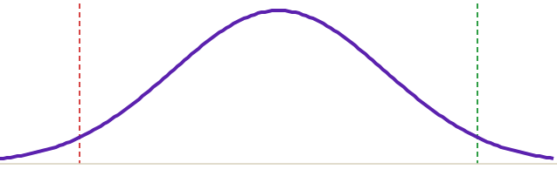
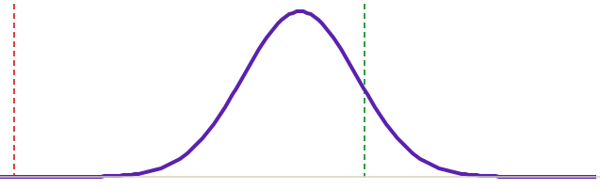
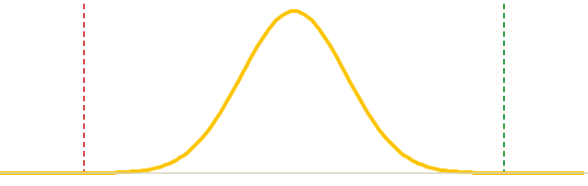

• THE ONLY FORMULA SLIDE •
Cp asks if it fits. Cpk asks if it’s aimed.
Cp: will the car fit the garage. Cpk: will it fit the way you are driving in.
CASE 1 · TOO WIDE
CASE 2 · OFF AIM
CASE 3 · CAPABLE
Spread problem
Aim problem
Fits and aimed
LSL
USL
LSL
USL
LSL
USL
Cp 0.6 — window smaller than the spread
Cp 1.6 · Cpk 0.4 — fits, badly parked
Cp ≈ Cpk ≥ 1.33 — margin both sides
Re-centering can't save this. Reduce variation, or fix unrealistic limits.
The spread is fine. Re-center, trim, or hunt the test-system offset.
The Cp–Cpk gap is pure centering — that gap is free capability.
1.00
1.33
1.67
~2 700 ppm
~63 ppm
~0.6 ppm
Cp = fit. Cpk = fit + aim. Below 1.33 — act.
Ola Lund Reppe — WATS
WATS UP 2026 · Test Step Analysis

Slide 6




• THE KEY HABIT •
Never read one KPI alone
Cpk × failure rate — four squares, four completely different verdicts.
Healthy
Two populations
WHY COMBINATIONS
Fails rarely, wide margins. Leave it alone — and stop re-testing it into the ground.
Fails often, yet passing units look capable. Two processes in one step — split by station / batch / component until it separates.
The habit
A single KPI never diagnoses. Pairs do — and the pair tells you what to do next.
← Cpk (all)
Yield sees today. Cpk sees tomorrow. Read both, always.
Ticking bomb
Broken
Zero failures, no margin. The limits swallow the whole distribution — the next small shift ships failures.
Fails often, no margin. Everyone already knows this one — TSA's job is the three squares around it.
High Cpk with high failure rate is not a paradox — it is a second population hiding in the step.
The five signs coming next are these squares, found in live WATS data.
failure rate →
Ola Lund Reppe — WATS
WATS UP 2026 · Test Step Analysis

Slide 7

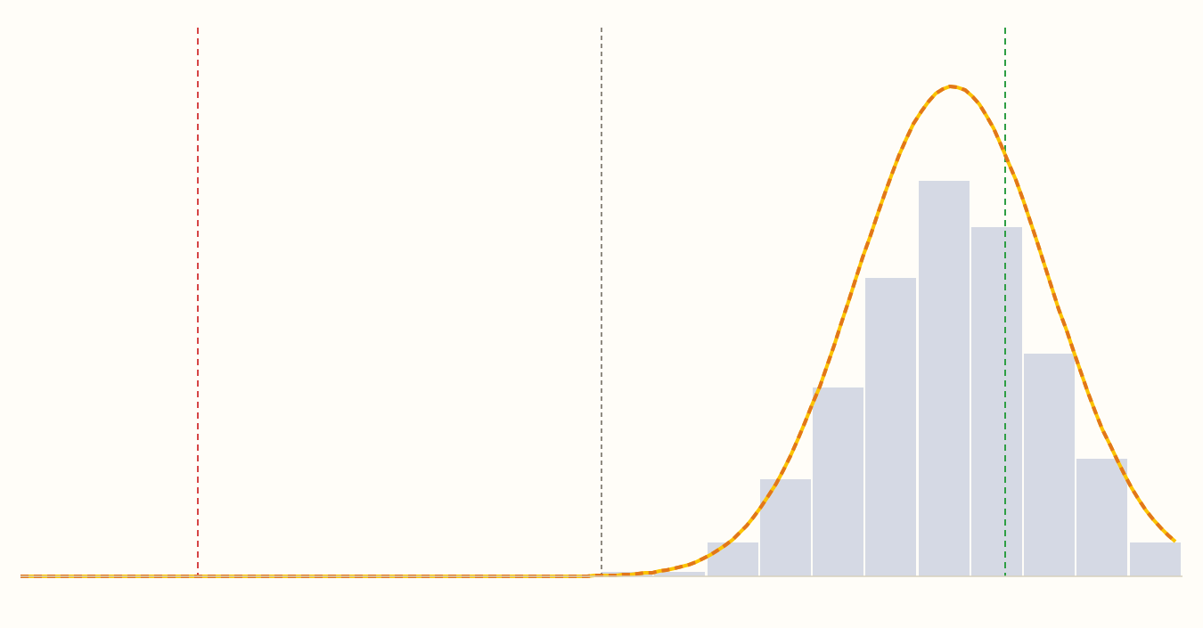
• SIGN 1 OF 5 · AIM •
Good spread, bad aim
A 0.12% failure rate hides a process hugging its upper limit.
Green LED output voltage vs limits
PCBA Test ⌄
Aug 2026 ⌄
HOW TO READ IT
LSL
Target
USL
Cp fine, Cpk poor → aim
Cp
Cpk
1.39
0.18
≥ 1.33
< 1.33
the spread would fit easily
…but it sits at the wall
cpUpper 0.19 vs cpLower 2.60 — the asymmetry names the wall
Fix the aim: re-center, trim — or challenge the limit
Yield today: 99.9%. One drift away from a bad week.
Measurement
Reconstructed from live WATS KPIs — PN 277288 · PCBA Test · n=5 690 · avg 0.129 V · σ 0.036 V
Ola Lund Reppe — WATS
WATS UP 2026 · Test Step Analysis

Slide 8
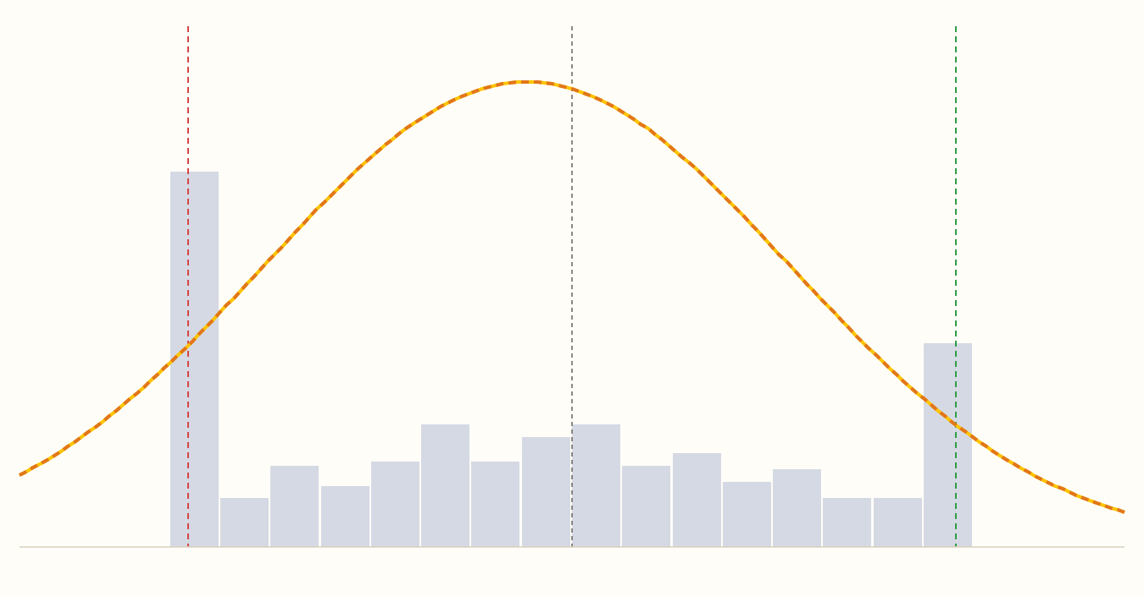
• SIGN 2 OF 5 · SPREAD •
Zero failures. Ticking bomb.
2 900 units, not one failure — and one of the worst steps in the operation.
MAX fan speed vs limits 70–100
Final Function Test ⌄
Aug 2026 ⌄
HOW TO READ IT
LSL
Target
USL
The limits eat everything
0 failures in 2 900 units — FPY 100%
Cp
Cpk
0.49
0.43
< 1.33
< 1.33
spread vs window
what capability sees
min = LSL, max = USL: the window is completely full
Nothing fails — until the next component lot shifts the mean
Measurement
Fix the spread now, or meet this step in a crisis later
Reconstructed from live WATS KPIs — PN 758877.874 · Final Function Test · n=2 900 · avg 81.4 · σ 9.9 · 0 failures
Ola Lund Reppe — WATS
WATS UP 2026 · Test Step Analysis

Slide 9
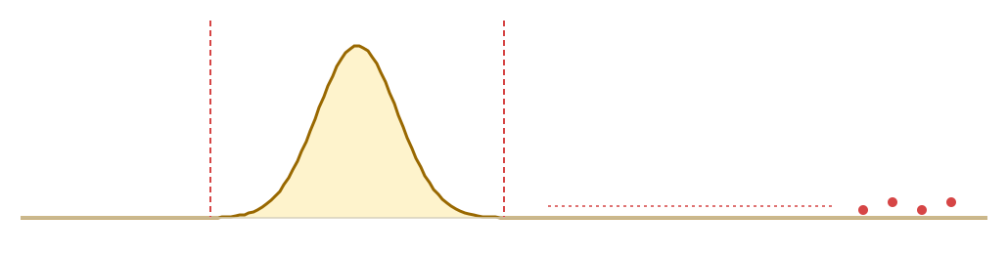
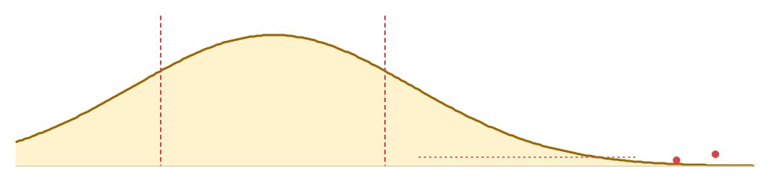

• SIGN 3 OF 5 · OUTLIERS •
Same ugly Cpk — opposite diagnosis
Two ICT steps, both catastrophic on paper. The WOF gap is the tiebreaker.
T101_1_2 · TRANSFORMER WINDING
NTC101 · THERMISTOR
Cpk −0.03 …but WOF 5.56 · fails 1.4%
Cpk −0.01 …and WOF 0.66 · fails 3.8%
LSL
USL
LSL
USL
sentinel readings → “99 999”
a few glitches — but the curve is the problem
The TEST misfires — the product is perfect.
The PROCESS is wide — 111 boards really failed.
Open readings logged as 99 999 wreck avg and σ. Remove them and Cpk is 5.6 — fix contact & sentinel logging, don't chase boards.
Even with outliers removed it cannot hold 40–120 Ω. Top decisive failure of the whole ICT — a genuine capability problem.
The WOF gap decides: WOF fixes it → fix the test. WOF doesn’t → fix the process.
Live WATS data — PN 4494394418 · ICT test · Aug 2026
Ola Lund Reppe — WATS
WATS UP 2026 · Test Step Analysis

Slide 10

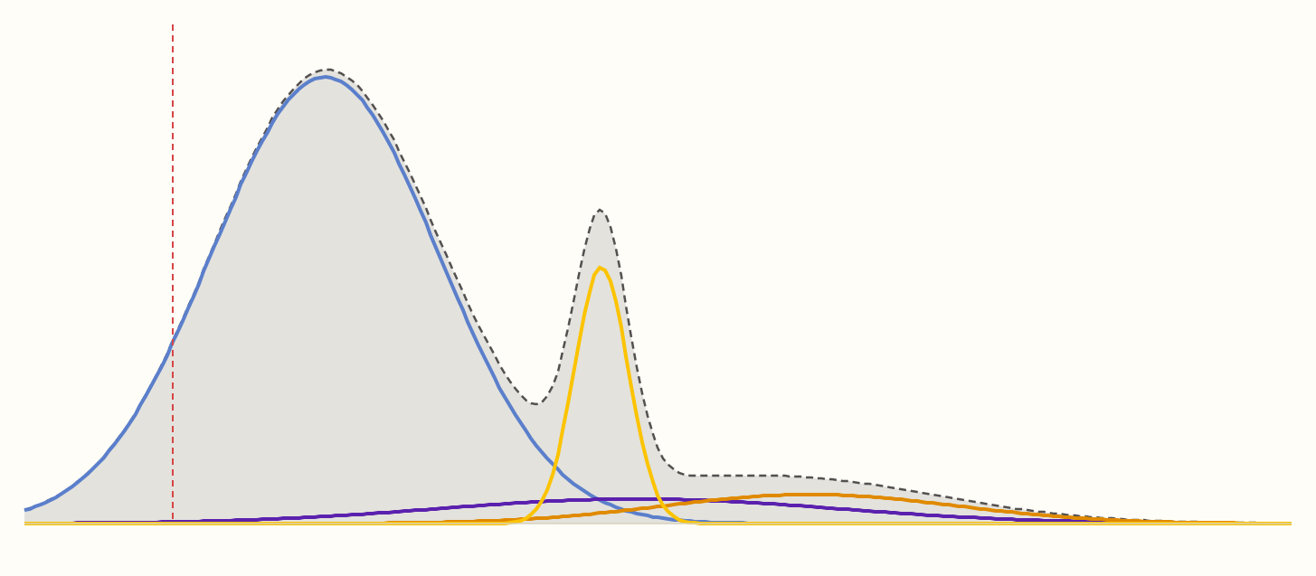
• SIGN 4 OF 5 · MIXTURES •
One histogram, four processes
The “process spread” of this step is mostly four stations disagreeing.
+3.3 V supply current by station
PCBA Test ⌄
Aug 2026 ⌄
HOW TO READ IT
σ across ≠ σ within
LSL 5 mA
USL 130 mA → far off-screen
Aggregate σ 14.4 — looks like a hopeless process
Station averages: 16 · 37 · 39 · 52 mA — four processes
E-002 runs σ 2.0: the product CAN do it
Align the stations before touching the product
0
20
40
60
80
+3.3 V supply current (mA)
Rule: group by station / fixture / rev BEFORE judging spread.
— C-002 (σ 8.4) — A-008 (σ 14.8) — E-001 (σ 10.9) — E-002 (σ 2.0) --- the aggregate
Live WATS data — PN 277288 · PCBA Test · Aug 2026 · per-station avg/σ from step comparison
Ola Lund Reppe — WATS
WATS UP 2026 · Test Step Analysis

Slide 11

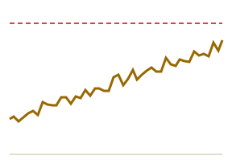
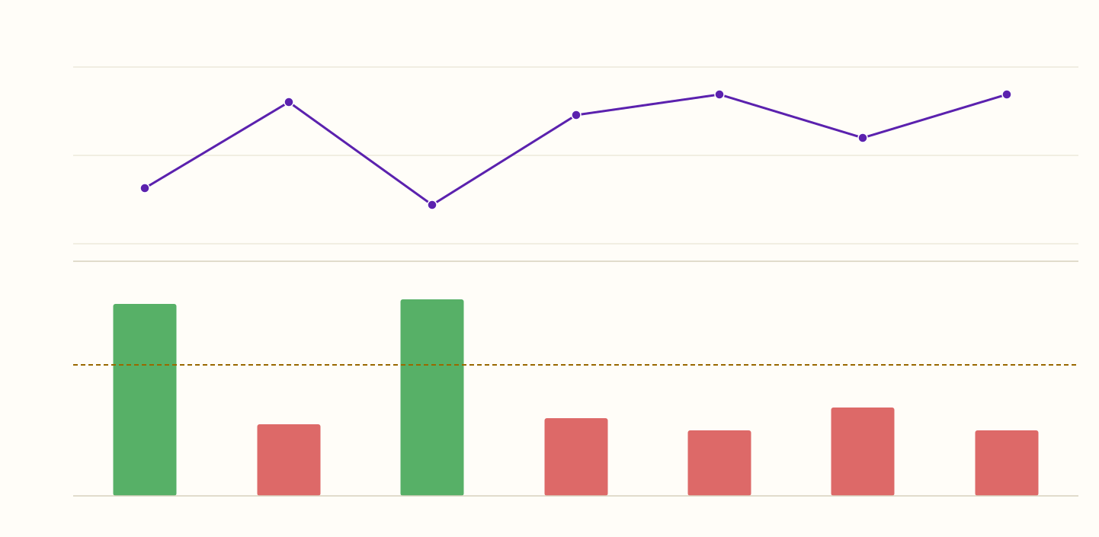
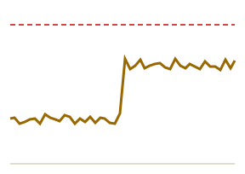
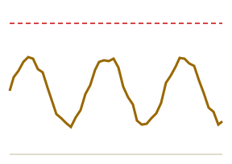
• SIGN 5 OF 5 · TIME •
Numbers that move
The aggregate said “stable”. The time axis said otherwise.
Measure Vout @ 95 VAC — biweekly avg and Cpk
Final Function Test ⌄
Jun–Sep ⌄
Slow drift
wear, aging, contamination
avg (V)
USL 54.00 ↑ · LSL 53.00 ↓ (zoomed view)
53.8
53.7
Step change
new calibration, SW, batch, limit
53.6
1.95
6.39
Cpk
1.33
0.73
0.79
0.90
Oscillation
0.67
0.67
station mix, temperature, shifts
Jun 1
Jun 15
Jun 29
Jul 13
Jul 27
Aug 10
Aug 24
Live WATS data — PN 758877.874 · Final Function Test · biweekly buckets, Jun–Sep 2026
Cpk swings 6.4 → 0.67 while the mean steps 53.64 → 53.77 V. Trend view answers WHEN — the dimension split answers WHO.
Ola Lund Reppe — WATS
WATS UP 2026 · Test Step Analysis

Slide 12





• ALL FIVE LEVELS, ONE CASE •
The hunt, start to finish
A real month of production — and the demo we are about to run live.
1
Inspect the batch
2
Rank failing steps
3
Split by station
4
Corner the fixture
•
2 936 units, one month
•
Vout @ 95 Vac tops the list
•
Z-970: 10.6% fail · Cpk 0.06
•
fixtures #70–72 implicated
•
FPY 88% — a yield tax
•
2.4% fail — every one decisive
•
sister stations: 0% · Cpk ≈ 5
•
~94% of the fails are false
•
retests piling up
•
failed readings near zero volts
•
same step, same product
•
boards were fine all along
UUT level
step level
dimension level
root cause
Root cause isolated without touching a single board — and it was never the board.
Live WATS data — PN 4494394418 · PCBA Test · Aug 2026 · station WVXM-NGH-Z-970
Ola Lund Reppe — WATS
WATS UP 2026 · Test Step Analysis

Slide 13



• FIELD NOTES •
Tips & tricks
The habits that keep the numbers honest.
Before you trust a number
Before you blame the process
1
First runs only
1
Split before you judge
Retests flatter every statistic. WATS defaults to run 1 — keep it that way for capability.
Station, fixture, SW, batch first — much “process drift” is one machine.
2
Enough samples
2
Check the WOF gap
Cpk from fewer than ~30 units is a rumor. Check volume before narrowing the date range.
If removing outliers fixes the index, hunt the test system, not the product.
3
Numeric steps only
3
One limit → one side
Cp/Cpk exist for numeric-limit steps. PassFail and string steps only have a failure rate.
GE/LE steps: read cpLower or cpUpper. A two-sided Cp is meaningless there.
4
Mind the sentinels
4
Trim steps lie
99 999-style error codes destroy avg and σ. Log a fail, not a magic number.
Post-trim Cpk is centered by design. Judge trim steps on Cp — or on pre-trim data.
Ola Lund Reppe — WATS
WATS UP 2026 · Test Step Analysis

Slide 14

• PHOTOGRAPH THIS ONE •
The cheat sheet
Symptom → KPI signature → likely cause → first move.
SIGN
KPI SIGNATURE
LIKELY CAUSE
FIRST MOVE
Off aim
Cp OK · Cpk low · cpUpper ≠ cpLower
process shifted toward one limit
re-center / trim; check test-system offset
1
Too wide
Cp low · Cpk ≈ Cp · WOF ≈ same
genuine process variation
attack variation; sanity-check the limits
2
Outliers
Cpk WOF ≫ Cpk
sentinels, contact & fixture glitches
fix the test; log fails, not 99 999
3
Two populations
failure rate high · Cpk (pass) decent
config / component / station split
split by dimension until it separates
4
On the move
avg or Cpk trending / stepping in time
wear, calibration, SW or batch change
trend view for WHEN; dimensions for WHO
5
Ola Lund Reppe — WATS
WATS UP 2026 · Test Step Analysis

Slide 15


• THE 30-SECOND METHOD •
Five numbers, in order
For any suspicious step — this sequence, every time.
1
Failure rate + caused-UUT-fail
Is this step hurting yield — and is it the decisive failure?
2
Cpk (all)
How much margin does the whole population really have?
3
Cpk vs Cpk WOF
Outliers or true spread? The gap is the tiebreaker.
4
Cp vs Cpk
Too wide — or just badly aimed?
5
Trend + split by dimension
When did it change, and which station / fixture / batch is different?
Thirty seconds per step. That is the whole method.
Ola Lund Reppe — WATS
WATS UP 2026 · Test Step Analysis

Slide 16
• AND NOW — LIVE •
Let’s read live data
Over to WATS →
The same five signs, found in minutes on the Test Step Analysis report.
Demo: TSA on this month’s production
Ola Lund Reppe — WATS
WATS UP 2026 · Test Step Analysis

