Slide 1
Improve yield faster with AI-powered suggestions for Root Cause Analysis
Presenting:
Natanya Sukkot
Drammen, September 2026

Slide 2
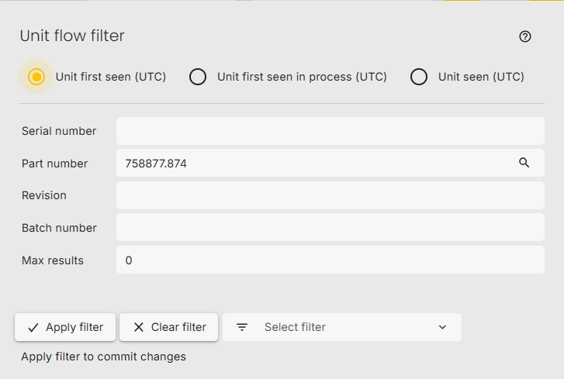
Filter – Units lookup
The unit flow filter supports three different ways of identifying units based on their first occurance:
These units were born inside this period.

Slide 3
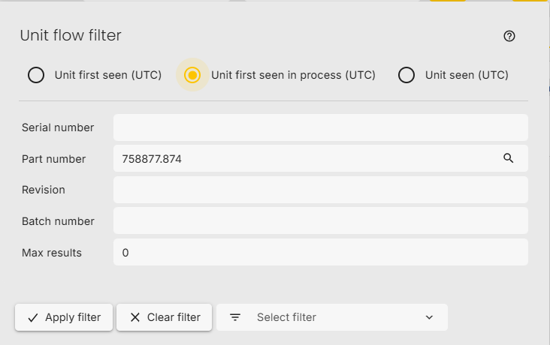
Filter – Units lookup
Units seen in any process in the range excluding products in retest.

Slide 4
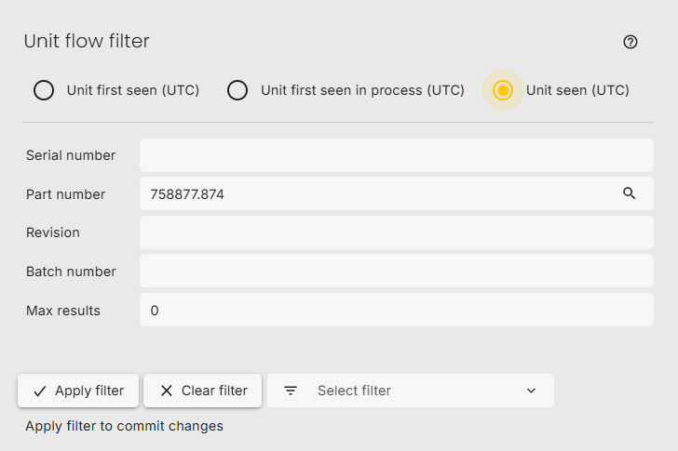
Filter – Units lookup
All units are tested in the selected time range.

Slide 5
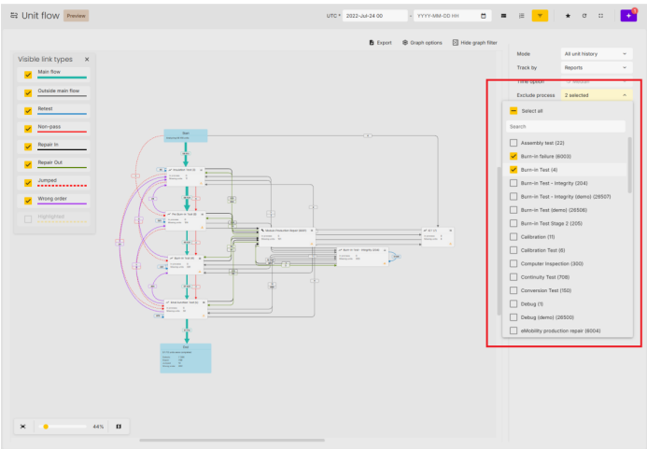
Exclude processes

Slide 6
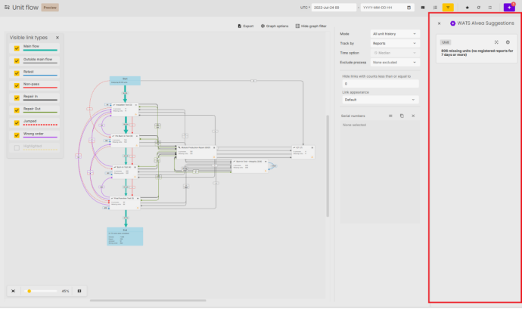
Alvea suggestions

Slide 7
Additional Unit Flow improvements
In addition to the major enhancements, several usability, visualization, and performance improvements have been made:
Improved visualization
• Better link alignment to reduce overlap and improve readability.
• Smoother graph zooming for an improved navigation experience.
• The graph filter can now collapse to provide more space for analysis.

Slide 8
Additional Unit Flow improvements
Enhanced insights
• Added a tooltip on the Start node showing applied filters and the number of units included.
• Added a summary to the End node, providing an overview of completed units, including retests, repairs, jumps, and wrong-order flows.
• Improved repair links to remain visible as repair links when they are part of the main flow

Slide 9
Additional Unit Flow improvements
Expanded process and station views
• Station views now support time mode, displaying time spent per station.
• Link appearance is now supported in both process and station views, with two options:
o Default: Highlights the top three highest-volume links across the entire flow.
o All: Highlights the top three highest-volume links per link type (e.g. retest, jumped, wrong order).
Improved naming and filtering

Slide 10
A preview of some of the new possibilities
WATS UP

Slide 11

WATS feature release note
Modes have been renamed for clarity:
o Historical to All Unit History
o Current to Current Unit Location
Filters have been simplified:
o Removed Test Operations and Run from filters.
o Max Results renamed to Max Units.
o “Hide links with counts less than or equal to” moved into the graph filter.
Alvea skal jobbe mer I WTAS. Finn på noe. Suggestions skal implementers. Samme som heatmap men I Unit flow.
Improved Navigation
o Added support for opening selected serial numbers or all visible serial numbers directly in Serial Number History.
o Removed redundant node and link menu options where equivalent functionality is available in the graph filter.
Performance Improvements
o Significant performance optimizations have been made to better handle large and complex datasets, improving stability when working with larger flows. Further improvements are ongoing.

