Slide 1
Reducing costs with test data

Slide 2


Financial Fundamentals

Slide 3

Customer example: Eltek / Delta Group
4M
9M
97%
98%
Annual UUT Reports
100k
2.9% points decrease in field failures
First Pass Yield
93%
>1M €
Field Failures
3%
<1%
Annual Cash Gained
<0,1%
5 years

Slide 4
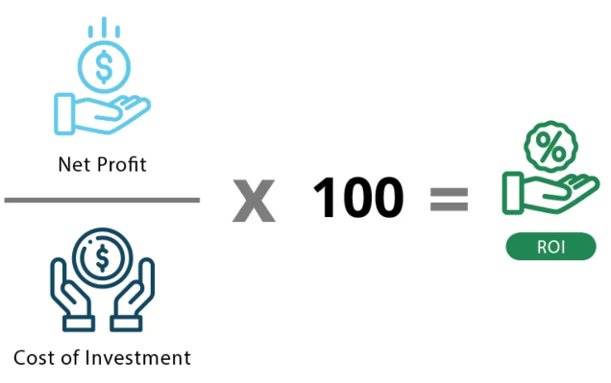

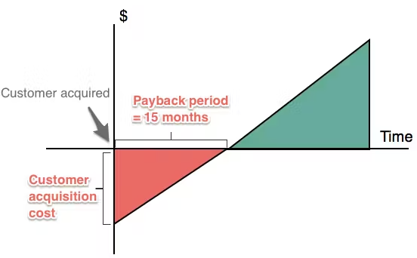
Financial Fundamentals
Net Profit = Reduced Re-test + Reduced Scrap
(operator & machine time)
(lost material cost)
Payback Period = Initial Investment / Annual Cash Flow

Slide 5
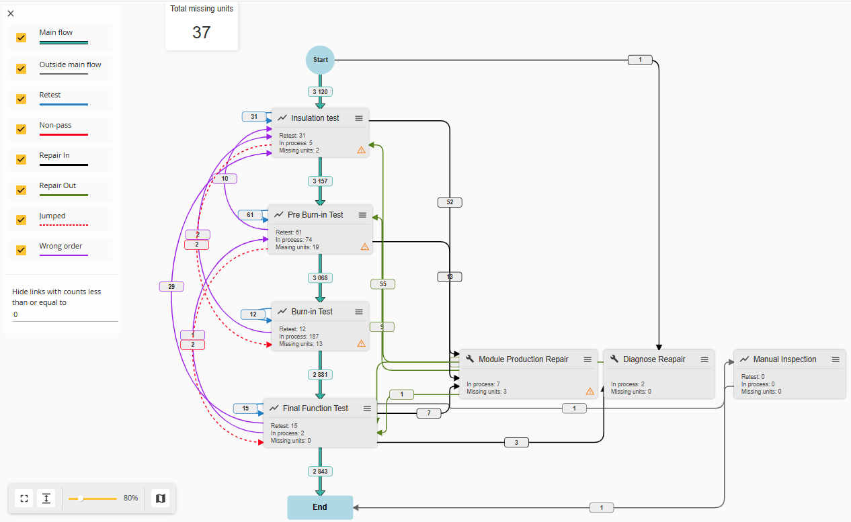
Re-test example (Unit Flow)

Slide 6
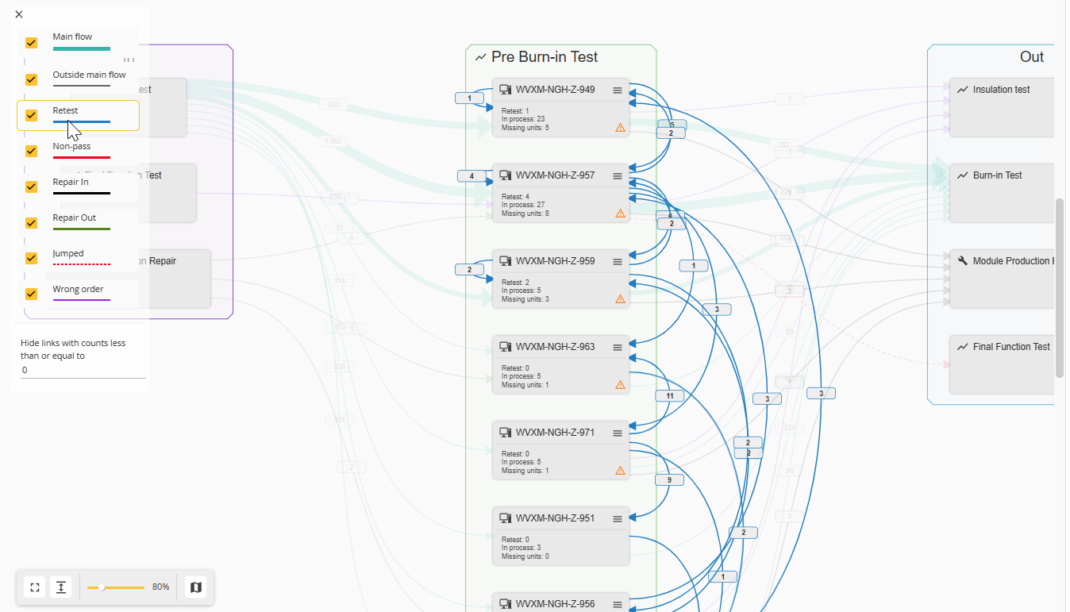

Slide 7
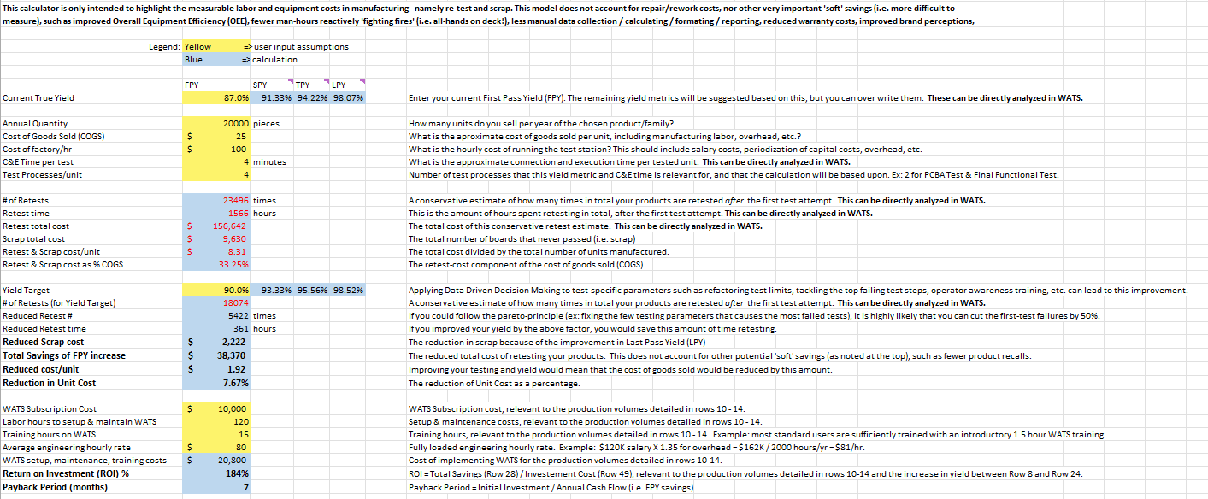
FPY Improvement Savings Calculator.xlsx

Slide 8







• NOT IN THE ROI MODEL •
Escalation costs — the hidden hourly rate
The model prices a defect at one operator's rate. An escalated failure is paid for by 3+ people at once.
Business as usual
Fire-fighting mode
Labor cost of one failure
One operator, one station, one pass of rework.
The same failure, escalated: three roles on one unit.
Operator
$25.00 / hr
Operator
$25.00 / hr
Technician
$30.00 / hr
— No technician callout
— No engineering investigation
Engineer
$60.00 / hr
TOTAL LABOR COST
TOTAL LABOR COST
$35.00
$161.00
4.6× the labor bill for the same defect
1 role involved
$115.00 / hr blended on the problem
Escalation is a cost our ROI model does not capture — and it compounds by the hour.
Notes:
Build: 1) normal fix 2) fire-fighting panel 3) the cost chart 4) closing line.
Numbers are the original keynote's: $15 / $30 / $60 per hour, $20 vs $145 total labour. 145 / 20 = 7.25x.
Say: the ROI model prices rework at one operator's rate. Escalation is what actually happens, and it is invisible in the model.

Slide 9
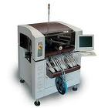
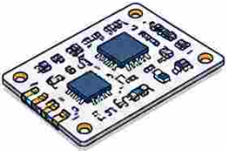
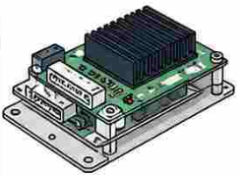
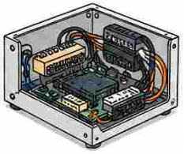
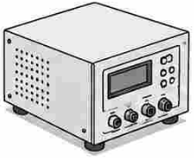


• NOT IN THE ROI MODEL •
The 10× cost factor
Every stage a defect escapes multiplies the cost of fixing it by an order of magnitude.
1
Pick & place
2
PCB level testing
3
Module level testing
4
System level testing
5
Field failure
•
Defect introduced
•
Caught at ICT / FCT
•
Disassembly + retest
•
Disassembly + rework + rebuild + retest
•
Customer RMA and/or recall
Cost baseline
×1
×10
×100
×1000
Cost to fix the same defect, by stage of detection
Logarithmic scale — each step up is one order of magnitude. Illustrative industry figures, not WATS data.
Move detection one stage left and you take a 10× saving on every escaped defect.
Notes:
Build: 1) the five stages 2) the log-scale cost chart 3) closing line.
The chart is a native PowerPoint chart on a log axis — the four bars step evenly, which is the point: one zero per stage.
Replaces the scraped product thumbnails from the old slide with brand hex icons — nothing low-res, nothing licensed.

