Slide 1

Build the view you need
Dashboard & WATS Mobile App

Slide 2
00
AGENDA
Four chapters.
Two live moments.
01
Dashboard recap
Core idea, use case / goal
02
Important Tools
Filters, widgets, sharing, subscriptions, drill-down
03
New features
Factory map, individual measurements , images
04
Mobile app
Scan and get valuable insight on your phone
05
Live Demo
Dashboard & WATS mobile app

Slide 3
Dashboard Recap
1.

Slide 4

01
DASHBOARD RECAP
Build the view
you need.
The dashboard turns test and repair data into a view that matches the question you’re trying to answer.
KPIs
Filters
Widgets
Views
01 Dashboard recap
Notes:
The basic idea is to display the most important KPIs in a way that fits your needs — filtering (Filters) and visualizing (Widgets) the data for your specific area of work.
Goal : A fast and structured overview of the most important metrics. For your self , your team or department.

Slide 5
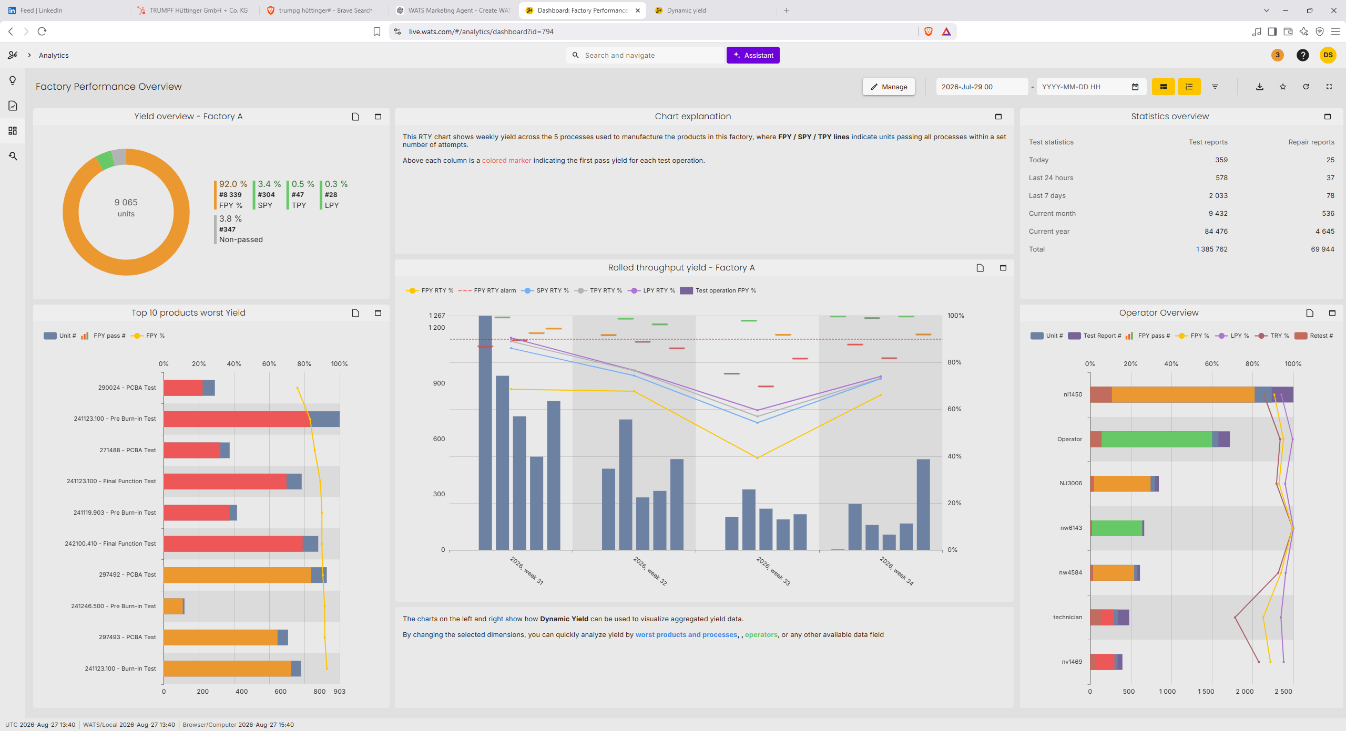
01
DASHBOARD RECAP
Show the KPIs
that matter.
The basic idea is simple: filter the KPIs, visualize them, and adapt the view to your own working area.
1
Filter
2
Visualize
3
Adapt
Select the data that belongs to your task.
Choose the format that makes the metric clear.
Save the view for your role, team, or site.
01 Dashboard recap
Notes:
1.1 Imagine standing in front of a big mountain of data. Now we are going to carve out the data that matters to you using filters. Once we isolated what matters to you we can then use Widgets to visualize the data in a way that appeals to you.

Slide 6
01
DASHBOARD RECAP
Get a fast,
Daily follow-up
structured overview.
Quality review
A good dashboard reduces searching. It gives teams a clean starting point for daily follow-up and deeper analysis.
Production meeting
Test engineering
Less time collecting data. More time deciding what to do next.
01 Dashboard recap
Notes:
1.2 A good dashboard reduces searching. It gives teams a clean starting point for daily follow-up and deeper analysis. I encourage you to use it for: Daily Follow-ups ect.

Slide 7

01
DASHBOARD RECAP
Four use cases.
One dashboard concept.
Production overview
Quality follow-up
Volume, yield, and status
Failures, trends, and escapes
Test engineering
Management view
Process, station, and limits
Site-level KPIs and focus areas
01 Dashboard recap
Notes:
1.4

Slide 8
Important Tools
2.

Slide 9
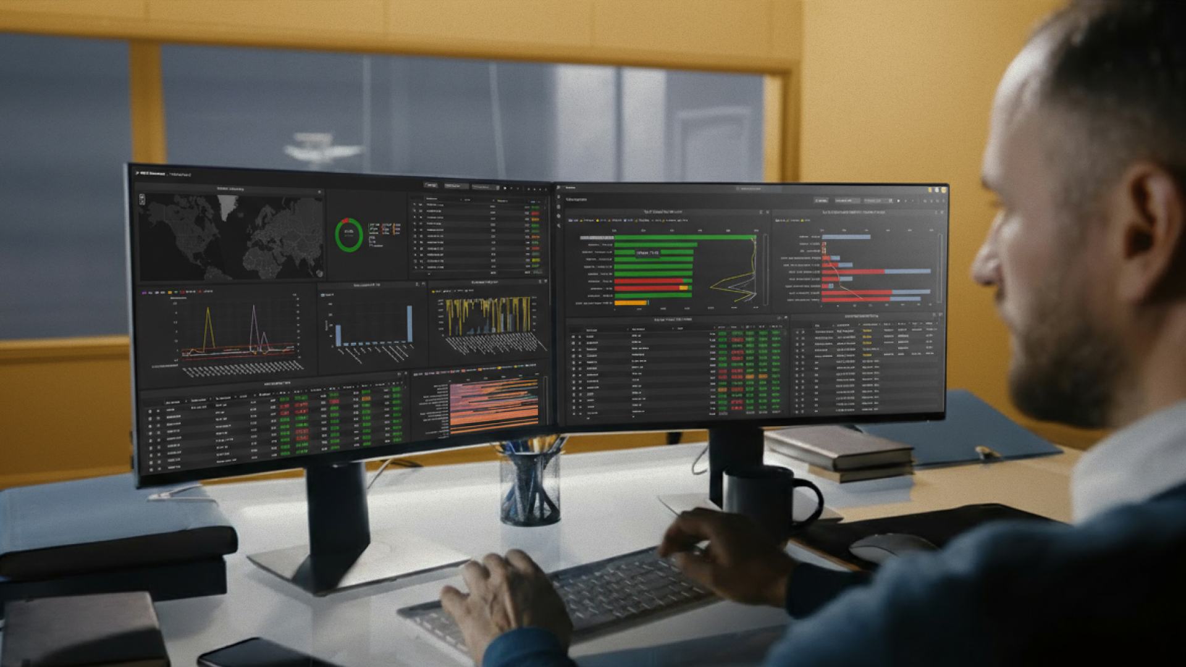
02
IMPORTANT TOOLS
Important tools
you need.
Filters shape the data. Widgets shape the view. Sharing and drill-down turn the view into action.
Filters
Widgets
Sharing
Subscriptions
Drill-down
01 Dashboard recap

Slide 10
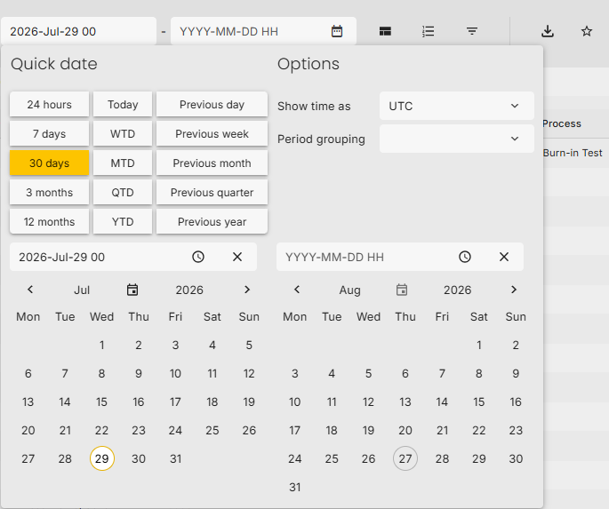
02
IMPORTANT TOOLS
Filter first.
Then analyze.
1
Part
Choose the product or part number.
Start by narrowing the dataset to the scope that matters: part, location, and time period.
2
Location
Focus on a site, line, or area.
3
Time period
Compare today, this week, or a selected range.
02 Important features
Notes:
2.1 Note! Dashboard filters apply to all widgets by default
Widget filters can overwrite the dashboard filter when needed

Slide 11
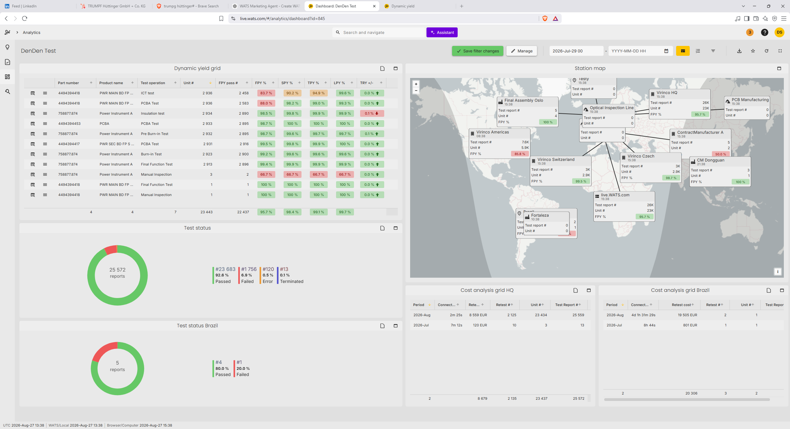
02
IMPORTANT TOOLS
Choose, change,
and edit widgets.
Widgets are the building blocks. Pick the format, tune the settings, and keep the dashboard focused on the job.
1
Choose
2
Change
3
Edit
Select the right visual.
Swap or adjust the widget.
Tune settings
02 Important features
Notes:
2.2 Widgets: choose, change, and edit.

Slide 12
02
IMPORTANT TOOLS
Share the view.
Subscribe to the signal.
01
Sharing views
Make the same dashboard available to the people who need it.
Useful dashboards should not stay with one person. Share views and use email notifications to keep teams aligned.
02
Subscriptions
Send updates by email so important changes do not depend on manual checking.
03
Operational rhythm
Use subscriptions for follow-up meetings, issue tracking, or team awareness.
02 Important features
Notes:
2.3 Sharing views and subscribe/email notifications. Send a dashboard screenshot by email on a schedule
• Useful for daily KPI follow-up without opening WATS
• Dashboard and widget filters define what recipients see
• Triggered alerts belong to Alarms and notifications

Slide 13
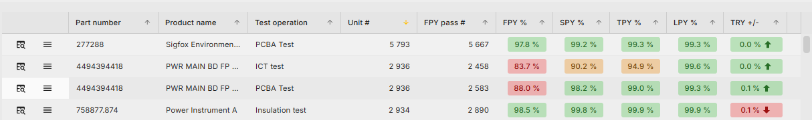
02
IMPORTANT TOOLS
From KPI
to root cause.
Drill-down connects the overview to the details behind it: units, failures, processes, and reports.
KPI
Trend
Details
Yield drop
When did it start?
Which unit or process?
02 Important features
Notes:
2.4 Drill-down.

Slide 14
«WATS» New
3.

Slide 15
03
New Features
What changed
since WATS UP 2025.
01
Factory Map
Floorplan with yield colors
A focused update on dashboard functionality: clearer search, new measurement charts, and a stronger factory-level view.
02
View Individual Measurements
03
Upload Images
01 Dashboard recap

Slide 16
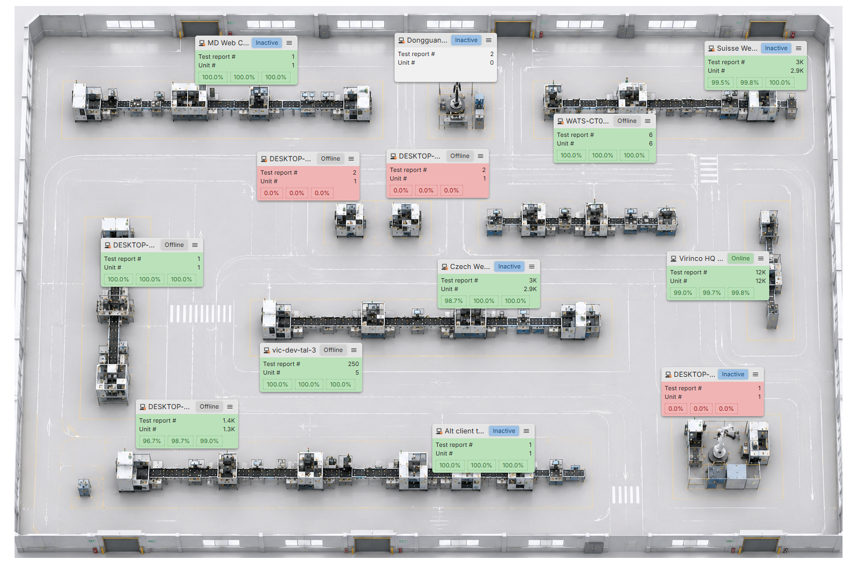
03
New Features
What changed
since WATS UP 2025.
01
Factory Map
Floorplan with yield colors
Floorplan
Yield colors
Visual factory layout
Fast status recognition
Two metrics
Actions
Up to two KPIs per box
Open reports or Alvea directly
01 Dashboard recap

Slide 17
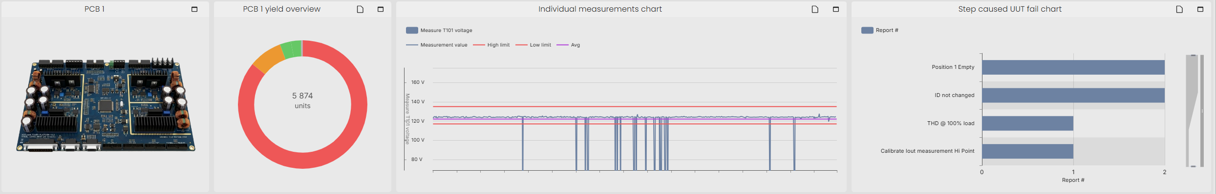
03
New Features
What changed
since WATS UP 2025.
View Individual Measurements
02
03
Add Images
Measurement Chart
Upload Image
Individual measurements chart for unit-level detail
01 Dashboard recap
Notes:
Individual measurements chart for unit-level detail
• Aggregated measurements chart for trends and comparison
• Clearer split between detail view and overview
• Useful for engineering analysis and root-cause work

Slide 18
Mobile APP
4.

Slide 19

WATS Mobile App
Check data where the unit is.
Scan, inspect, and move faster on the spot.

Slide 20

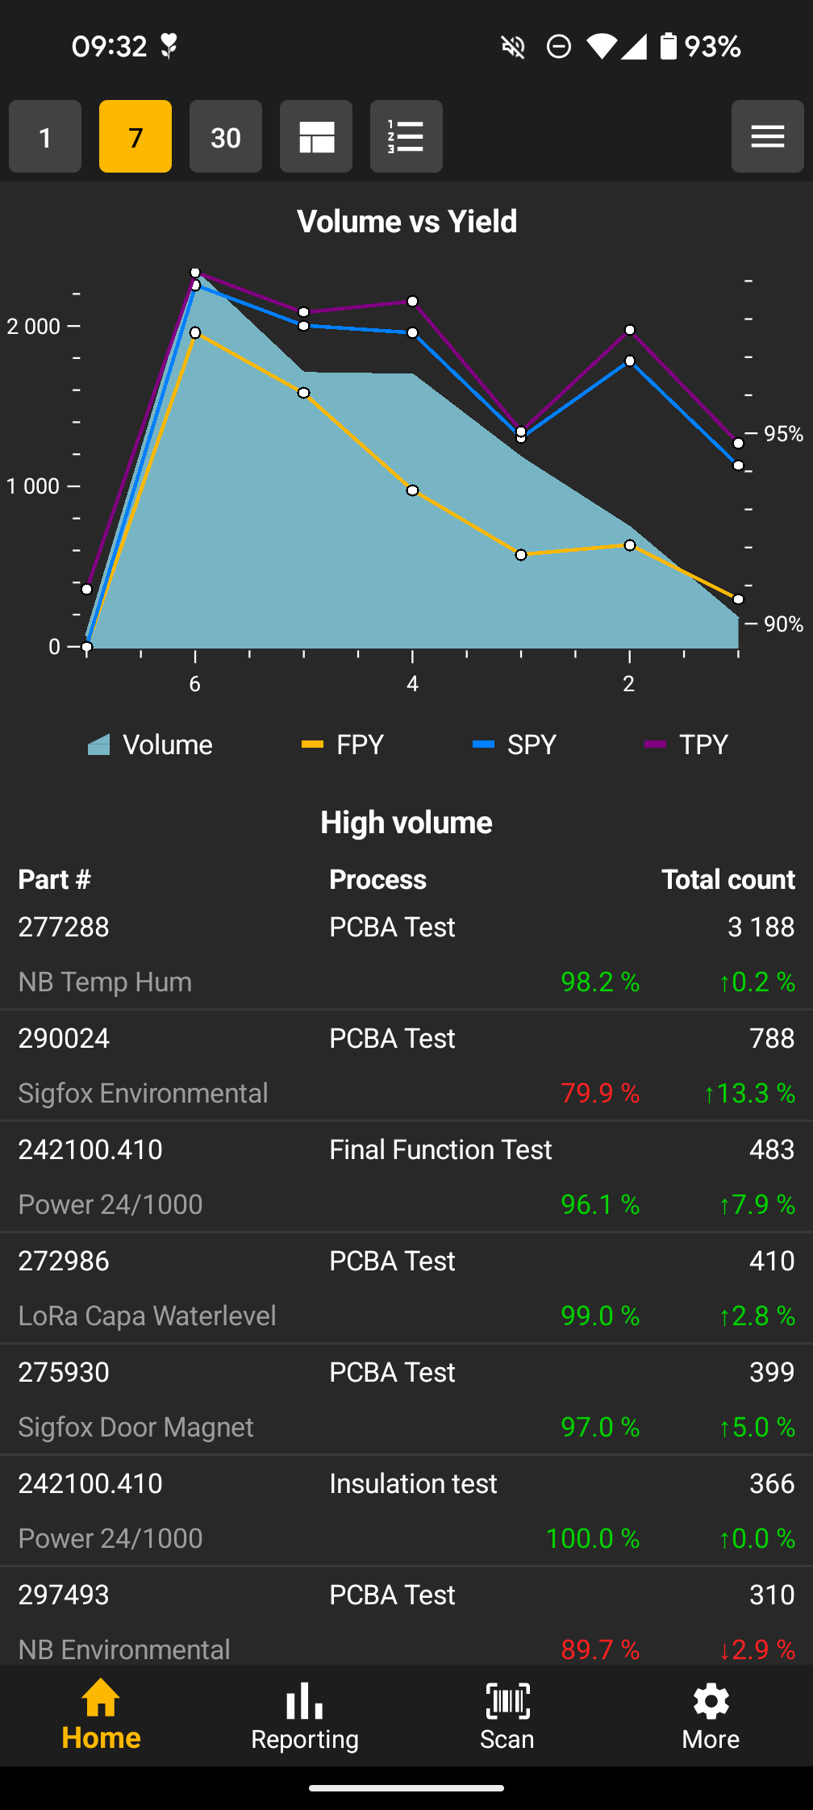
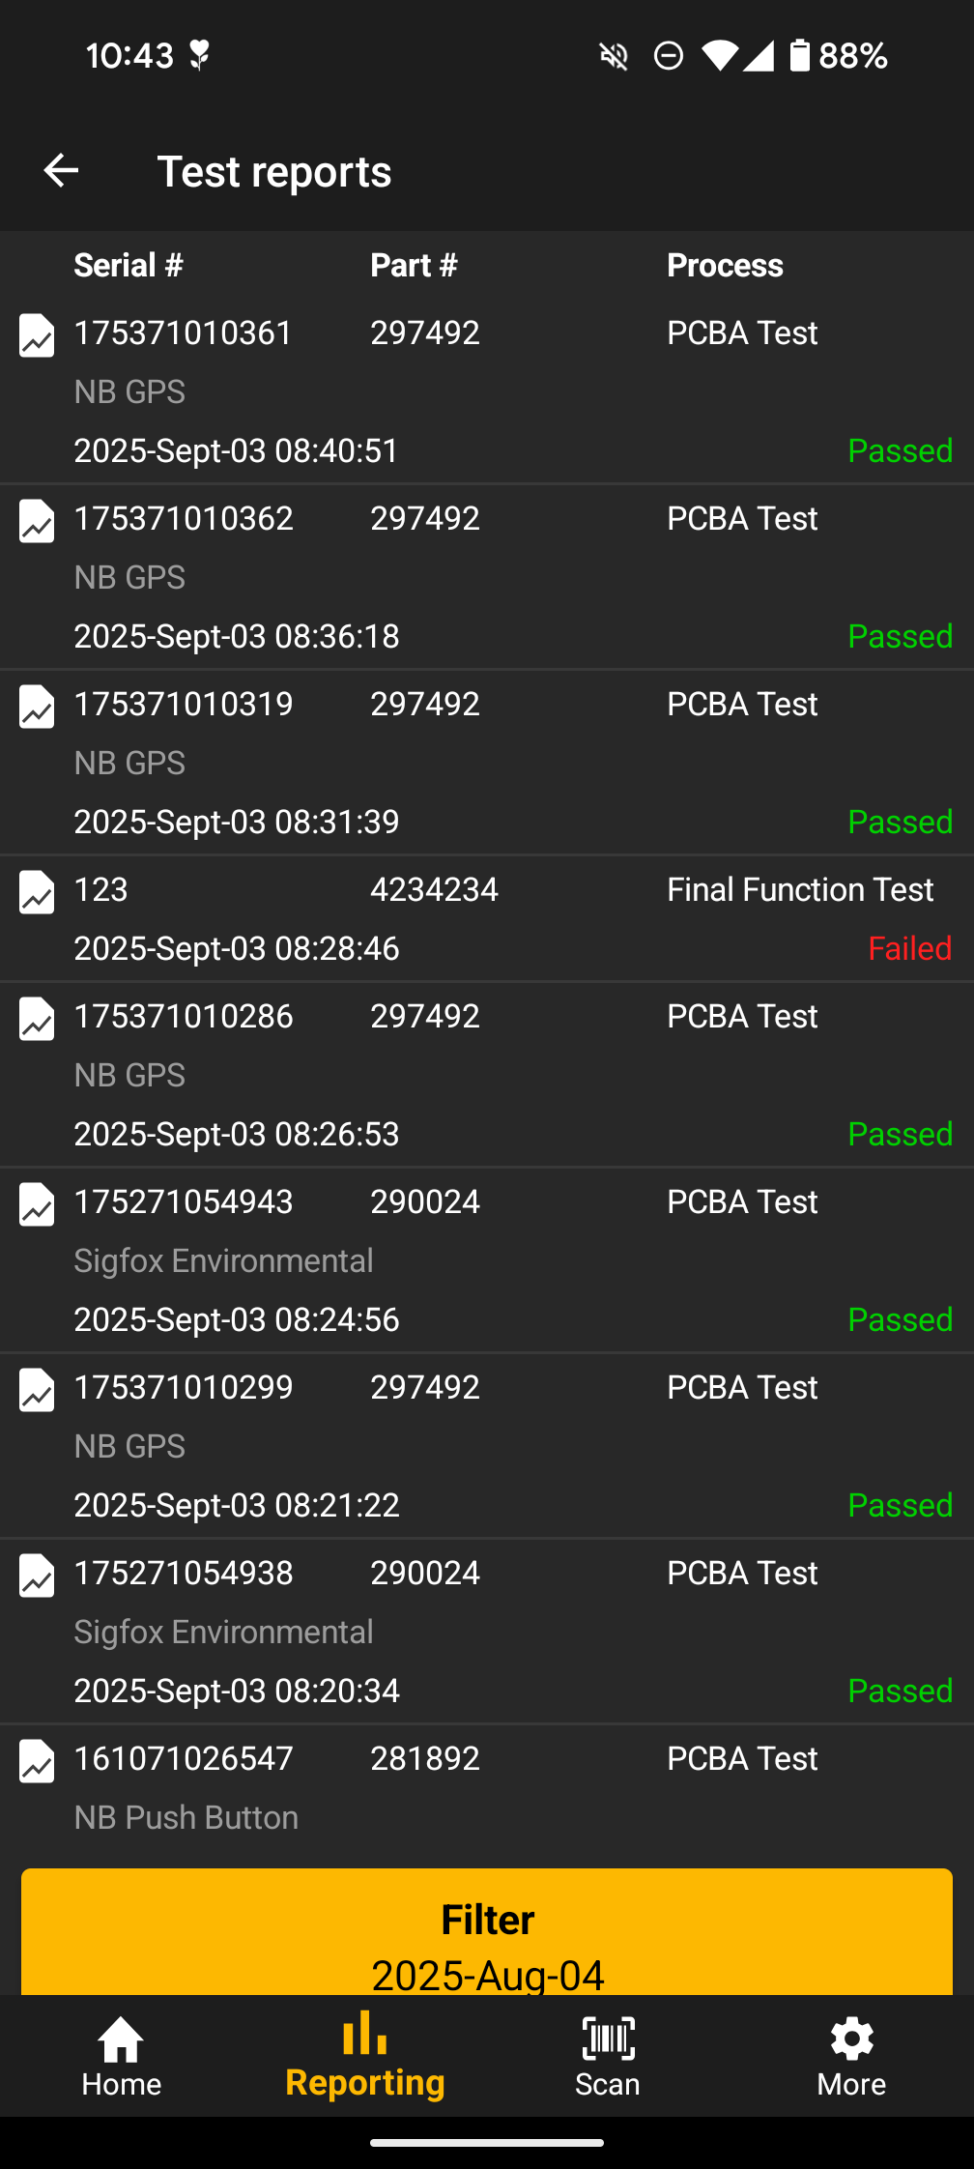
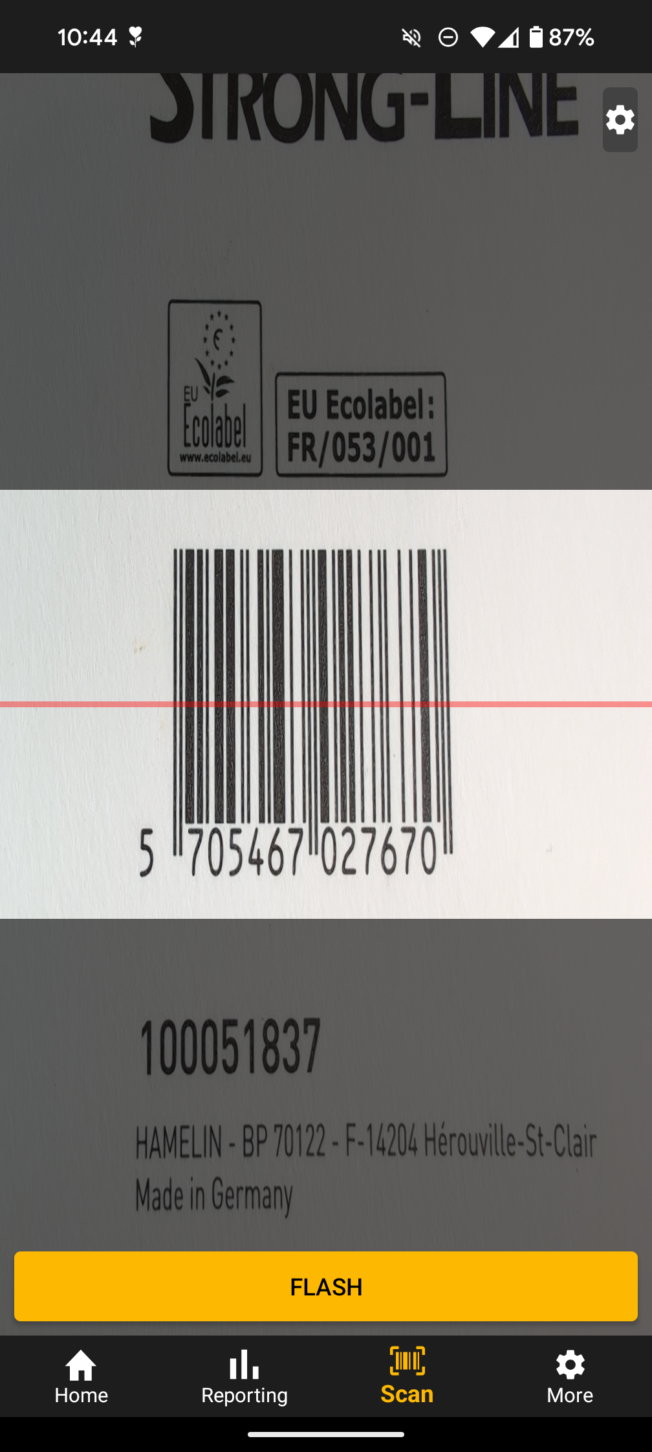
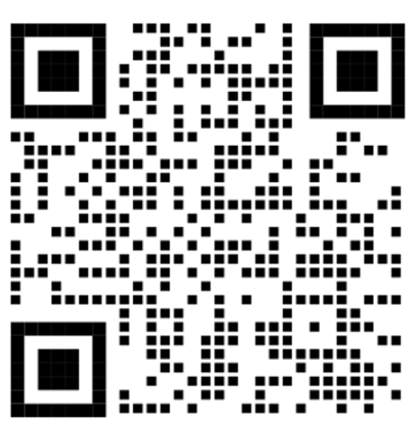
Check data on the go
• Scan a unit or serial number
• Open the unit context immediately
• Check test and repair history
• Make faster decisions on the shop floor
Apple
Notes:
Test reports, Repair reports, Serial Number History, Yield report

Slide 21
Live Demo
5.

Slide 22
Live demo
• Build a dashboard from scratch
• Add filters, widgets, sharing, and subscription
• Move from KPI overview into deeper reports
• Scan a unit in the mobile app

