Slide 1
Unit flow (Preview)
WATS UP 2026
Drammen, September 2026
Notes:
https://unit-flow.wats.dev/#/analytics/unit-flow?filter=XYxNCsIwEIXvkrXKpDULsxUUQXTTC4x1xEDahMnEjXh3Y1NEhLeY%252Bd7PUw1u3IY8irJ6oSTE%252BTEAsFBXFDqkY%252BjRK3tDn6iyHYdBWdVA0y7BLEF3AHaSqoEu%252FNit7prWmk1RsROxQ3%252FKw4W4hAqJyPL9m7XW2qw0mOIwPVxyYay5C0p%252F%252Fy0mQSnuCQeqQCjJORJPeB7ncM297DnkWImnB%252Fl6MkV0%252FNf4rOY0t%252B%252BYpu3XGw%253D%253D&unitDateType=MwAA&quickDate=MzQCAA%253D%253D&processToExclude=i44FAA%253D%253D&mode=MwAA&splitByStation=S0vMKU4FAA%253D%253D&splitByStationType=MwAA&historicalOption=MwAA&timeOption=MwYA&selectedNode=&selectedLink=

Slide 2
Every unit follows a path
Tests, repairs, retests
Recap

Slide 3
The real path not the planned one
Unit flow draws the route your units actually take - test, repair, retest
Built on the data you already send to WATS. Nothing new to install.
Beta showed you the main flow. And the exceptions.
“I didn’t know that loop existed”

Slide 4
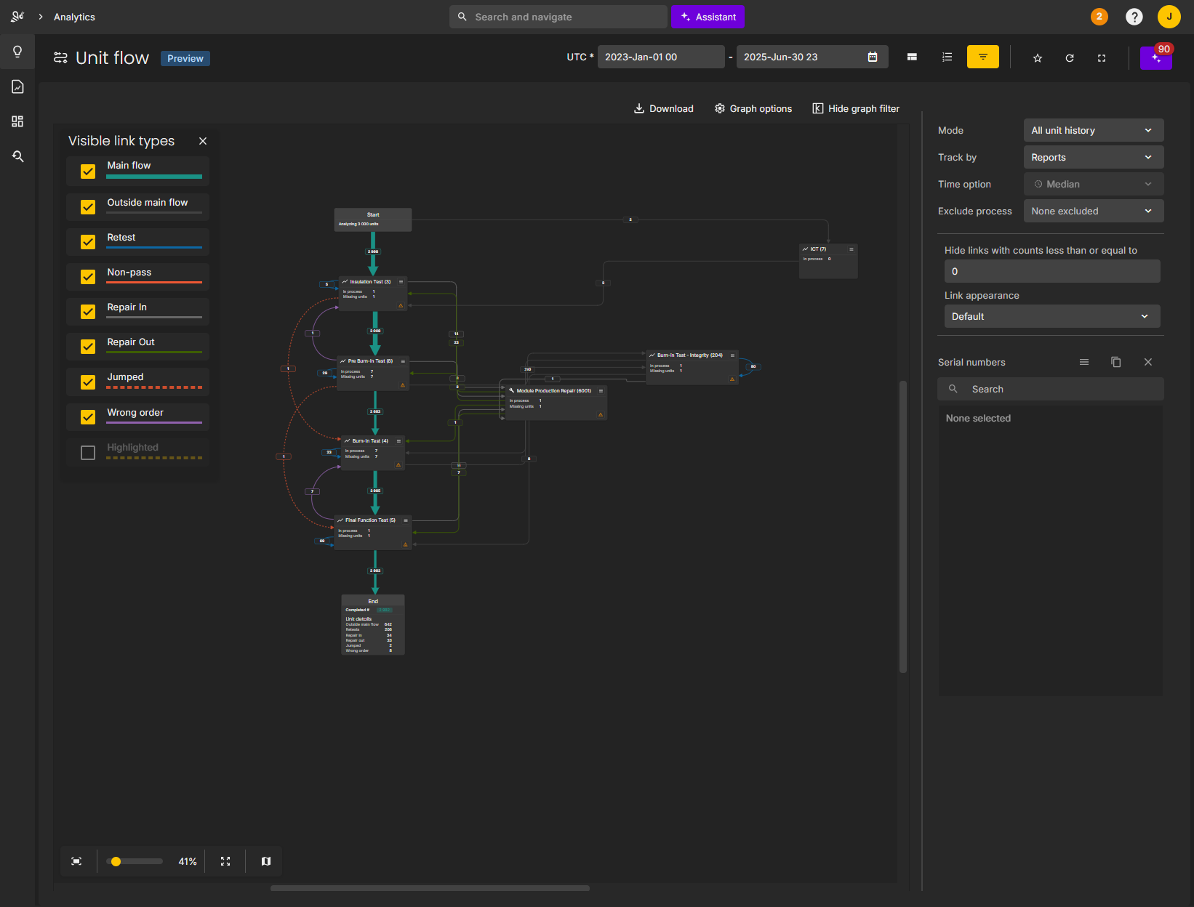
The actual paths units have taken through the line. The main flow and the exceptions.

Slide 5
You can’t fix what you can’t see
The point
Notes:
[WHY IT MATTERS — the cost thread starts here]
And that's exactly the point.
Because if you don't see the loop, you can't fix the loop.
And if you don't fix the loop...
you're paying for it.
[Beat — this line sets up the whole Time = cost ending. Don't rush it.]

Slide 6
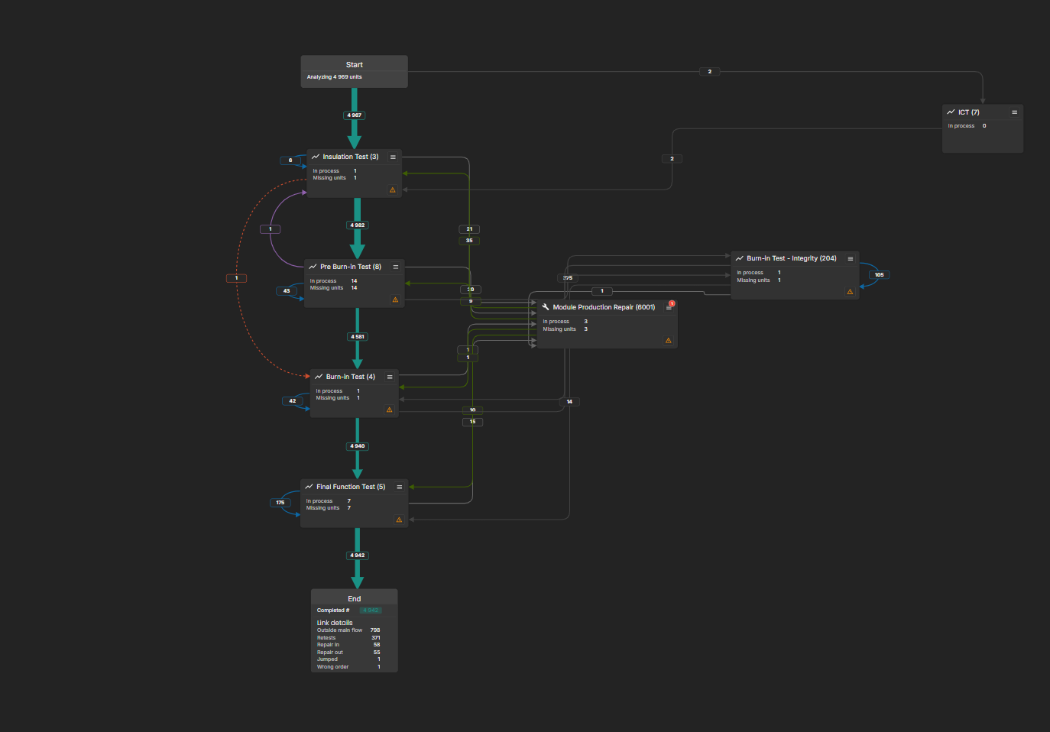
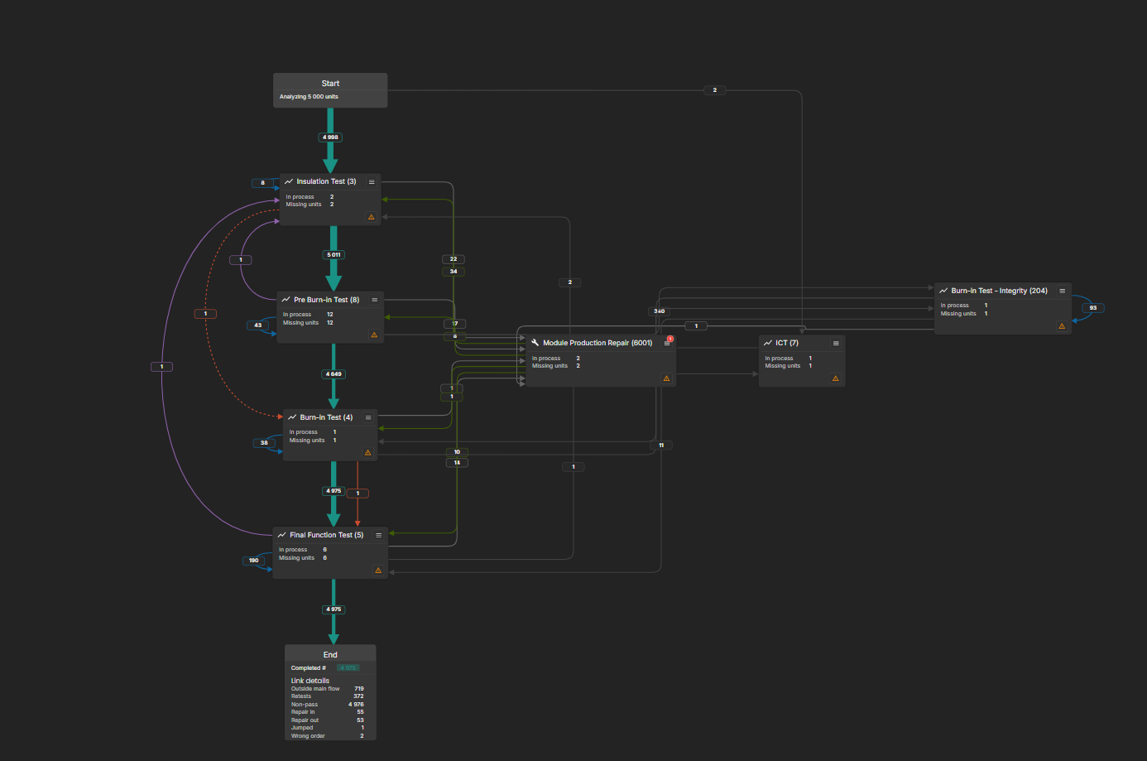
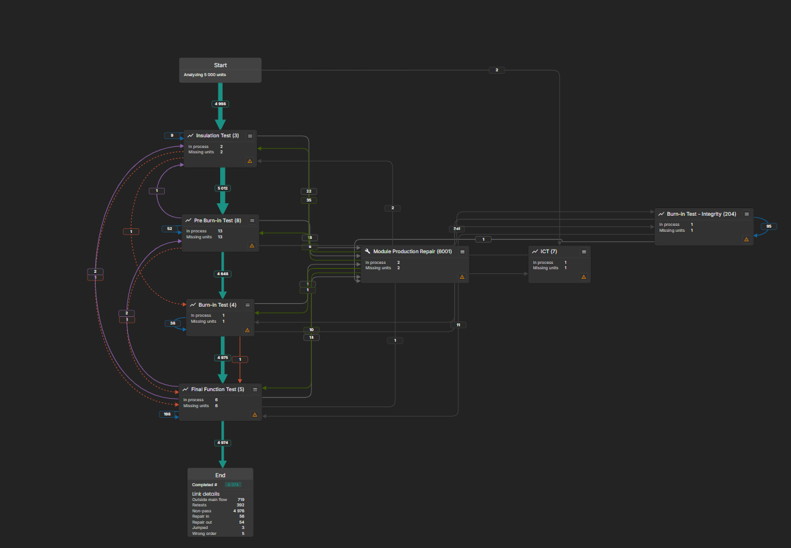
Three ways to identify a unit
Based on when a unit is first observed
Unit first seen
The unit’s first occurrence ever falls inside the time filter - its birth time. These units were born last week: show me everything that happened to them.
Unit first seen in process
Which units entered this process for the first time last week? It reads the unit’s full history, to determine whether this is the first time it has been through that process. So if a unit has already been through the process and comes back for a retest, it doesn't count as a new arrival.
Unit seen
Appeared at least once last week. Doesn’t matter when it was born - if it touched my line, I want to see it.

Slide 7
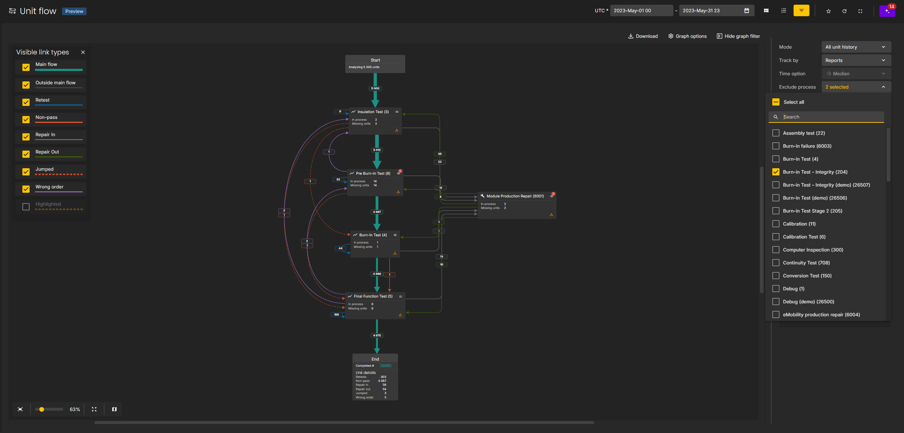
Exclude processes
Same data, minus the noise
Drop the steps that are not part of the question
What you are looking for lands mid-screen
That is visibility.
Notes:
[EXCLUDE PROCESSES]
But we know that real production flows are noisy.
[SHOW BUSY FLOW]
There are processes in here that are technically part of the flow...
but they're not part of the question I'm asking.
And they dominate the picture.
So I can just remove them.
[EXCLUDE PROCESS]
Same data.
Minus the noise.
[PAUSE]
And suddenly... the thing I'm looking for is right in the middle of the screen.
That's visibility.

Slide 8
Alvea points at what matters
What’s next
Notes:
[ALVEA SUGGESTIONS]
But I don't want to spend my day staring at a graph trying to figure out what
matters. I want WATS to help me find it.
And that's where we're taking Unit Flow next.
With Alvea suggestions.
Unit Flow shows me the paths.
Alvea starts pointing at the interesting ones.

Slide 9
Suggestions
What is live, and what is coming
Available now
In development
Missing units
Units that entered the flow and never made it out the other end. Scrapped, parked, or something stopped reporting. Units you assumed were moving - that weren’t.
Queue time
Units taking far longer than baseline to get from one process to the next, with an estimate of what that lost time costs.
Abnormal retests
A process trending badly, with an estimated excess cost. A pattern in the flow becomes a number.
Notes:
[SHOW ALVEA SUGGESTIONS]
Some of these suggestions are already available.
Others are currently in development.
>>> Say this line clearly. It's the honest framing that protects the whole
section — and this slide is the one people will photograph.
Let's start with one that's already available.
[SHOW MISSING UNITS]
This tells me that units entered the flow... but never made it out the other end.
Maybe they were scrapped.
Maybe they're parked somewhere.
Maybe something stopped reporting.
Whatever happened, these are units I might have assumed were moving through
production... but they didn't.
And that's a potential cost.
[BEAT]
Now let's look at what's coming.
[SHOW QUEUE TIME]
This one says: look at the path from <PROCESS 1> to <PROCESS 2>.
<N> units took more than <X hours/days> to get from one to the other.
The baseline is <Y hours/days>.
So those units spent time somewhere.
And that's usually not a test problem.
That's a flow problem.
And Alvea can estimate what that lost time is costing you.
[SHOW ABNORMAL RETEST]
And this one says: this process is trending with abnormal retests.
<N> units. Estimated excess cost: <X EUR>.
>>> Someone will ask how that number is calculated. Have the answer ready, or
say "estimated excess retest volume" instead of a euro figure.

Slide 10
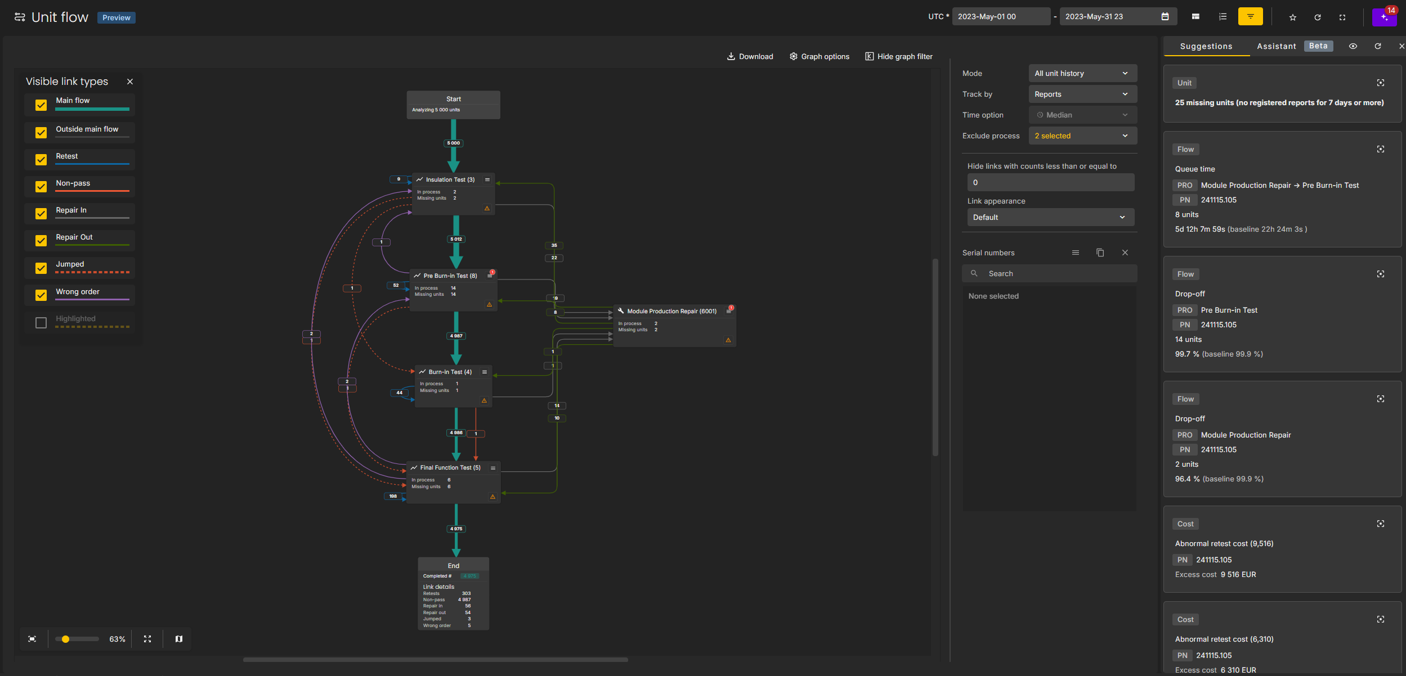
A pattern becomes a number
Not more things to look at. Fewer.
And a better idea of which ones deserve your attention.
Is this worth fixing?
Notes:
[WHY THIS MATTERS]
Now we're getting somewhere.
Because a pattern in the production flow becomes a number.
And a number makes it much easier to ask:
Is this worth fixing?
That's what I want from suggestions.
Not more things to look at.
Fewer things to look at...
and a better idea of which ones are worth my attention.
So let's follow one.

Slide 11
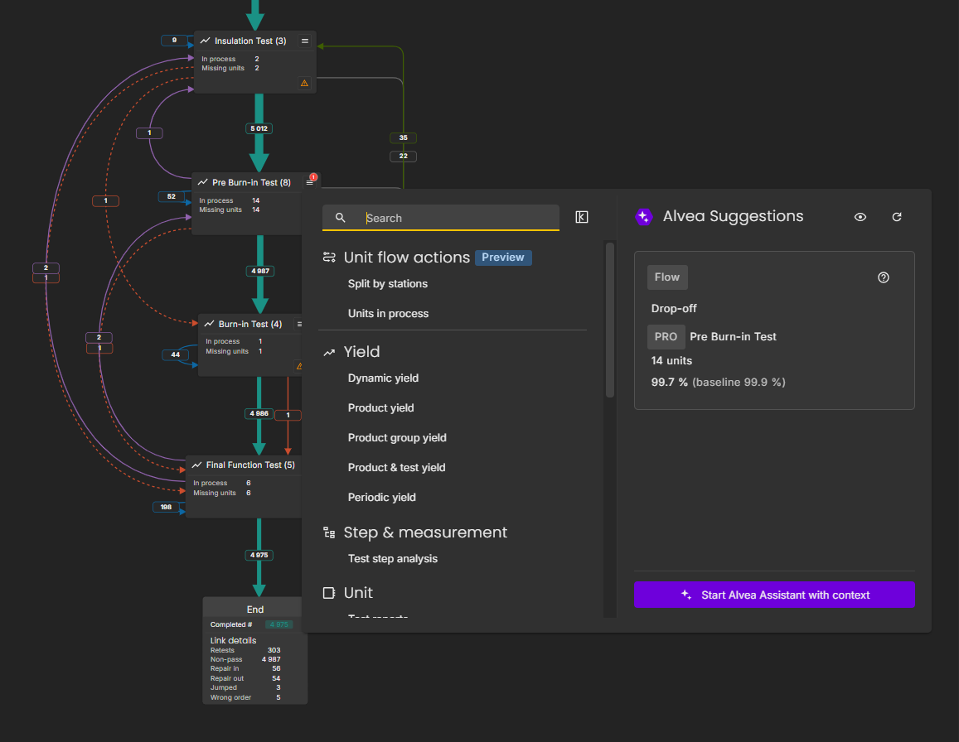
The node grew up
Dynamic action menu
Move straight into the other WATS modules and keep investigating
Unit flow actions still right where they were
Suggestions for this process. Not the whole line.
So you don’t lose the context of what you just found - you take it with you
Notes:
[SELECT SUGGESTION / PROCESS NODE]
I can see the problem.
I can see the impact.
Now I want to understand what's actually happening.
[CLICK PROCESS NODE]
Every process node now has a dynamic action menu.
So I can move straight into the other WATS modules and keep investigating.
The Unit Flow actions are still right here.
But this node also has its own suggestions.
Not the whole line.
This process.
[POINT TO NODE SUGGESTIONS]
And that's important.
Because I don't want to lose the context of what I just found.
I want to take it with me.

Slide 12
From suggestion to action
The Assistant already knows the process, and what was flagged
A summary you can send to your production manager
A root cause ticket, created straight from the process
It links back to the flow, and carries the metrics
Unsolved, it shows up on the related process - nobody rediscovers it
The loop closed
Notes:
[ALVEA ASSISTANT -> SUMMARY -> TICKET]
And this is where Alvea Assistant comes in.
[OPEN ASSISTANT]
The Assistant already knows where I'm standing.
It knows the process.
It knows what was flagged.
So I don't have to start from scratch.
I asked it for something completely unglamorous:
a summary I could send to my production manager.
[SHOW RESPONSE]
I'm not going to read all of this. Just this line:
[PAUSE]
"The repair load isn't coming from the repair step. It's coming from what
happens before burn-in and final test."
That's a conclusion.
Not a chart.
And it took a question... not a week.
But there's a problem.
A summary in a chat window helps nobody on Monday morning if nothing happens
with it. So let's do something about it.
[CREATE ROOT CAUSE TICKET]
Root cause ticket.
Created directly from the process.
The summary comes with it.
[ASSIGN / MENTION PERSON]
I can ask <NAME> to take a look.
And the ticket carries the context with it.
It links back to the flow I was looking at.
It carries the relevant metrics.
And if the problem isn't solved, it shows up on the related process.
So the next person standing where I'm standing doesn't have to rediscover the
problem. They can see: someone is already on it.
--- BEFORE YOU SHOW THE SUMMARY ---
1. Its links point at localhost:4200 — that WILL get noticed on a projector.
Regenerate against a proper environment, or crop the links out of view.
2. Say what the data is: "our demo dataset" or "a real case, anonymised".

Slide 13
In development
Around Q1 2027
Alvea
Notes:
[THE CAVEAT]
This part is still in development.
We're stabilizing it in dev test, and we're targeting around Q1 2027.
[Optional: "And when I say around, I mean around."]

Slide 14
Time = cost
Fail at a station, go to repair, come back, pass on retest
Yield never gets bad enough to trigger an investigation
Test time, repair time, handling, retest, floor space, attention
Plus the time it takes to find the problem
You see it. You confirm it. Alvea helps you understand it. You act.
Minutes, not weeks
Notes:
[TIME = COST]
Now... why does any of this actually matter?
It isn't the graph.
It's the time.
A line can be running fine.
Yield looks acceptable.
Nobody's panicking.
But there's a loop.
Units fail at <PROCESS>.
They go to repair.
They come back.
They pass on retest.
Everybody is doing their job.
The units ship.
And the yield number never gets bad enough to trigger an investigation.
But that loop costs money.
Test time. Repair time. Handling. Retest. Floor space.
And somebody's attention.
But here's the expensive part:
it also costs the time it takes to find the problem.
With Unit Flow, that loop isn't an investigation.
It's a shape on the screen.
You see it. You confirm it. Alvea helps you understand it.
And now you can act on it.
Minutes.
Not weeks.
Because time is cost.
Not just the time your units spend looping.
The time your people spend finding out that they do.

Slide 15
Unit flow is in preview
Go and look at your line
Find the loop you do not know about yet
Find the time you are losing
Find the problems costing you more than you realise
Running on the data you already send to WATS
Notes:
[CLOSE]
So Unit Flow is in Preview.
It's running on the data you're already sending to WATS.
Go and look at your line.
Find the loop you don't know about yet.
Find the time you're losing.
Find the problems that are costing you more than you realize.
Because the first step to saving that money...
is making it visible.

Slide 16
Let’s keep making the invisible visible
Unit flow
Notes:
And with that — let's keep making the invisible visible.
That's what's up.
--- IF THE DEMO DIED ---
"Right. Turns out we do live on the edge. Let me show you this the way I'd show a customer."
Run the filter modes, the lookup and the exclude off the fallback screenshot,
and lean harder on the Time = cost story.
--- TRIM LIST (if running long) ---
1. The beta callback example (slide 3)
2. The middle filter mode — one sentence instead of a demo (slide 8)
3. The exclude commentary — keep the click, drop the talk (slide 10)
4. The feedback ask (slide 12)
5. The caveats on slide 12 down to one line: "no date yet, aiming around Q1 2027"

