Slide 1
WATS Alvea Assistant
How it works, architecture, and live demo
For new and existing customers

Slide 2
Agenda
What we will cover in this session
What Alvea Assistant is
1
How the agent works: architecture, toolsets & domain knowledge
2
Prompting Tips
3
Live demo: built-in AI LLM queries
4
Q&A
5

Slide 3











What is Alvea Assistant?
AI assistant for WATS users and teams
WATS Data
& Reports
Available inside WATS and
through MCP clients
Docs &
Knowledge
Analytics
Tools
ALVEA
ASSISTANT
Connects questions to trusted data,
documents, and workflows
MCP
Clients
APIs &
Integrations
Delivers grounded, permission-aware
answers and next steps
Actions &
Workflow
Ask
You ask a question
in natural language
Orchestrate
The assistant routes your request
to the right tools and data sources
Analyze + Synthesize
It analyzes data, applies context
and reasoning, and synthesizes insights
Respond
You receive a grounded answer
with sources and next steps

Slide 4














Toolsets & Domain Knowledge
From broad overview to unit-level insight
1
Tier 1
Entry overview
Yield
overview
Flow
summary
Key issue
highlights
Built-in domain knowledge
Tier 2
Exploration & slicing
Heatmap
Trend
analysis
Top failing
steps
Yield definitions: FPY, SPY, TPY, LPY
2
First-seen in process rule
3
Tier 3
Scoped analysis
Repair
overview
Measurement
distribution
Step
contribution
Retest counting
Tier 4
Deep dive
Root cause
analysis
Flow
path view
Failure
patterns
Step types & KPIs
4
Flow metrics
5
Tier 5
Single-unit inspection
Verify
unit
Unit
history
Raw
measurements
Knowledge search workflow
Start broad
Get the big picture
Drill down
Narrow and analyze
Verify
Confirm at unit level

Slide 5




A Prompt Template That Works
A simple structure that helps Alvea and MCP pick the right tools faster
[Context] + [Business Question] + [Analysis Goal] + [Desired Output]
Context
Part number, revision,
operation, product scope,
and time range.
Business Question
What changed? What is
failing? Where should
I investigate?
Strong example prompt
“For part 4494394418 on ICT Test over the last 90 days, identify the top failing test steps, show whether failure rate is trending up, and summarize the likely drivers by fixture or operator. Return a short summary, a ranked table, and recommended next questions.”
Analysis Goal
Compare, trend, rank,
correlate, drill down,
or verify.
Desired Output
Short summary, ranked
table, chart, evidence,
and next steps.
Tip: ask the assistant to start broad and drill down only if the evidence supports it.

Slide 6

Prompt Patterns from the Analysis Prompt Pack
Translate analytical intent into strong questions for the current toolset
1
Failure Analysis
2
Process Stability
3
Root Cause Analysis
Prompt pattern:
“Identify the top failing steps for [part] on [operation], show failure concentration, and highlight what should be investigated first.”
Prompt pattern:
“Plot FPY or key KPIs over time, then highlight shifts, unusual dimensions, or worsening trends.”
Prompt pattern:
“Compare yield by fixture, operator, revision, or step behavior to isolate the most likely causes.”
Tools: AnalyzeTopFailingTestSteps · AnalyzeAllTestSteps · AnalyzeStepTrend
Tools: AnalyzeKpiTrend · AnalyzeYieldByDimensions · RankDimensionsByYieldImpact
Tools: CompareStepByFixtureId · CompareStepByDimensions · GetStepCorrelations · CheckBomDeviations
4
Cost & Efficiency
5
Cross-Product & Systemic
Prompt pattern:
“Quantify retest burden, repair patterns, or inefficient process behavior to support improvement actions.”
Prompt pattern:
“Scan the portfolio, rank hotspots, and show where engineering attention should go first.”
Tools: GetRepairOverview · GetRepairCodeBreakdown · AnalyzeStepTrend · GetVolumeAndYieldOverview
Tools: GetProcessPartNumberHeatmap · GetVolumeAndYieldOverview · RankDimensionsByYieldImpact · GetTickets
These prompt themes come from the WATS MCP analysis prompt pack and are adapted to the current tool catalog.

Slide 7

Prompting Do’s and Don’ts
Small changes in wording can dramatically improve the answer
Do this
Avoid this
Give part number, operation, and timeframe.
Ask one main question per prompt.
Request evidence: ranked lists, charts, and breakdowns.
Ask for comparisons: revision, operator, batch, fixture, or step.
Ask the assistant to explain the likely drivers.
Ask for recommended next questions or next steps.
Don’t ask ‘Why is yield bad?’ with no scope.
Don’t mix many products and goals in one long prompt.
Don’t jump to root cause without step-level evidence.
Don’t skip the date range when asking for trends.
Don’t assume one dashboard view proves the answer.
Don’t answer from document search alone without fetching the full content.
Useful prompt openers
Show me…
Compare…
Drill down into…
Summarize the evidence for…

Slide 8




Built-in Assistant or External Client via MCP
Inside the WATS Portal
External Client via MCP
Native chat experience
Claude Desktop connected through MCP
Charts, tables, and inline widgets
Same tool catalog
Deep links and navigation
Same permission-aware access
Page context and guided workflows
Grounded by the same server instructions
Shared ToolRegistry
+ WATS APIs + Domain Knowledge
One source of truth. Two user experiences. One consistent set of tools.

Slide 9
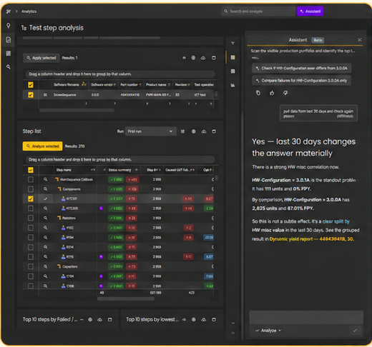
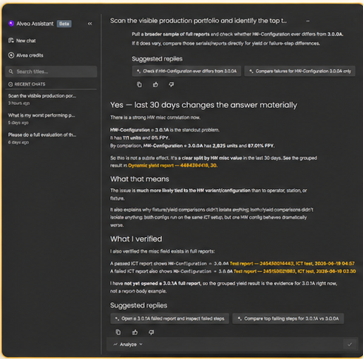
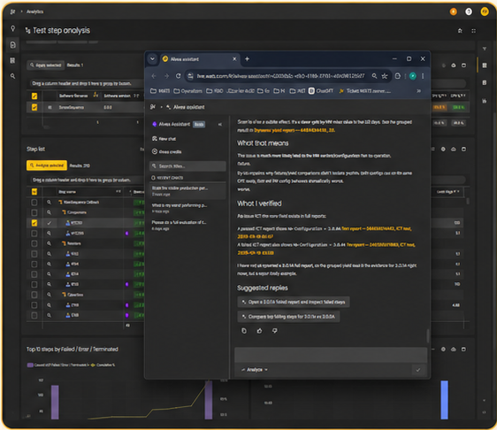
Built-in Alvea Assistant in the WATS Web App
Embedded directly in analytics workflows — page-aware, interactive, and ready for follow-up questions.
1
Side-by-side analysis
Assistant alongside your analytics for
seamless, contextual insights.
2
Full assistant workspace
Immersive, focused experience for deeper
analysis and follow-up.
3
Live workflow in context
Ask, iterate, and act — without leaving
your analytics workflow.
Uses visible page context
Understands the data and widgets you
are looking at.
Supports follow-up prompting
Ask more, refine, and go deeper
without starting over.
Links findings back to WATS reports
Provides direct links to Dynamic yield reports
and full ICT reports.
Works directly inside the web app
Stay in your flow — no switching,
no extra tools.

Slide 10

Demo Prompt 1 — Start Broad
Tier 1 / Tier 2: portfolio overview and hotspot ranking
Live demo prompt
Likely tool path
Scan the production portfolio and identify the top three part-operation combinations that need engineering attention. Rank them by yield loss, retest burden, and volume impact. Start with a broad overview, then show which dimensions appear to explain the biggest differences. Return a short executive summary, a ranked table, and recommended follow-up questions.
GetVolumeAndYieldOverview
GetProcessPartNumberHeatmap
RankDimensionsByYieldImpact
AnalyzeYieldByDimensions
Shows:
overview
hotspot ranking
first evidence

Slide 11
Demo Prompt 2 — Scoped Failure Analysis
Tier 3: step-level evidence for one product and operation
Live demo prompt
Likely tool path
For part 4494394418 on ICT test over the last 90 days, identify the top failing test steps, show whether the failure rate is trending up, and explain which step-level evidence should be investigated first. Return a ranked failure table, a trend summary for the worst steps, and two likely investigation paths.
AnalyzeTopFailingTestSteps
AnalyzeAllTestSteps
AnalyzeStepTrend
Shows:
scoped investigation
ranked failures
trend evidence
investigation paths

Slide 12

Demo Prompt 3 — Root-Cause Drill-Down
Tier 4 / Tier 5: compare dimensions and verify with reports or units
1. Live demo prompt
2. Likely tool path
Fixture
Using the worst failing step found for part 4494394418 on ICT test, compare that step across fixture, operator, revision, and batch.
Highlight any dimension that is clearly worse than the baseline.
If individual failing reports are available, identify example units or reports for follow-up verification.
Return the likely root-cause hypothesis, supporting evidence, and the next action for engineering.
CompareStepByFixtureId
Operator
CompareStepByDimensions
Revision
FindReportsForStep
Batch
GetReportDetails
GetUnitHistory
3. Takeaway Shows:
hypothesis
dimensional comparison
unit/report verification

Slide 13
Demo Prompt 4 — PCBA Root-Cause Drill-Down
Tier 4 / Tier 5: validate the failure hypothesis with step, reports, and units
Live demo prompt
Likely tool path
Using the worst PCBA Test step found for part 4494394418 over the last 30 days, compare that step across the strongest dimensions from the previous analysis. Check whether the same step is correlated with other failing measurements, and identify example reports or units for verification if available. Return the most likely root-cause hypothesis, the evidence supporting it, and the next engineering action.
CompareStepByDimensions
1
2
GetStepCorrelations
3
FindReportsForStep
4
GetReportDetails
5
GetUnitHistory
Shows:
step hypothesis
correlation evidence
report examples
unit verification

Slide 14
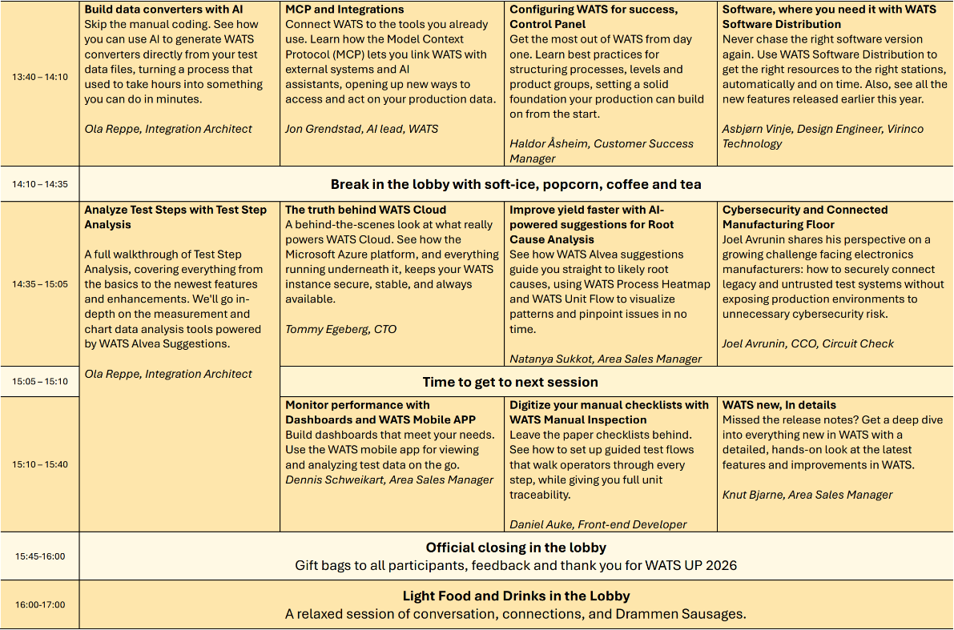
WATS next…
Thank You!!

