Slide 1
The truth behind WATS Cloud
A behind-the-scenes look at what really powers WATS Cloud
WATS UP 2026
Tommy Egeberg, CTO

Slide 2
The WATS.com Journey
The Early Years
  2007 - WATS Express
  Managed hosting before the cloud era
  2013 - skywats.com
  First true cloud offering.
  Self-service sign-up.
  Setup & patching still largely manual.
  2015 - Azure Virtual Machines (IaaS)
  Moved to Microsoft Azure.
  Automated setup & patching.
  Virtual machine infrastructure.
The Modern Platform
  2018 - Platform as a Service (PaaS)
  No more virtual machines. Azure manages the entire platform.
  Focus shifts entirely to the WATS application and operations.
  2019 - Rebranding
  skywats.com → wats.com
  2020 - Regions
  West Europe · Central US · East Asia
  2026 - Today
  3 billion test reports processed
Notes:
WATS has been a cloud-based product for nearly two decades, but the platform underneath it has changed dramatically.
We started in 2007 with WATS Express — effectively pre-cloud, where customers connected to a dedicated server. Good for its time, but manually managed.
In 2013 we launched skywats.com — a real cloud offering with a self-service sign-up flow. The experience for customers improved significantly, but the operations side was still largely manual.
2015 brought us onto Azure virtual machines — the first time we could automate patching, setup, and upgrades at scale. A big step forward.
2018 was the real turning point. We moved entirely to PaaS — Platform as a Service. No more managing virtual machines. Microsoft takes over the platform, and our team focuses on WATS.
2019 brought the wats.com brand, which is where we are today.
The story I want to tell in this presentation is what that platform looks like in 2026, and why it matters to you.

Slide 3
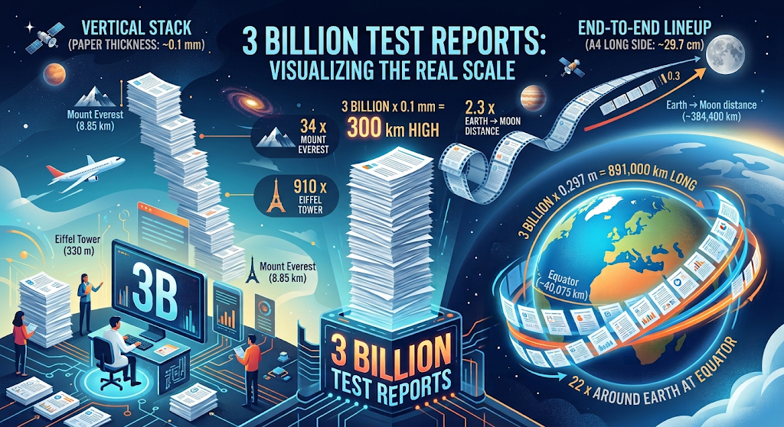
Notes:
Mount Everest x 34
Eifel tower x 910
Around Earth x 22
2,3 x Moon - Earth

Slide 4
You Are Part of Something Growing Fast
Test Reports
  2022: 540 million
  2023: 821 million +52%
  2024: 1,186 million +44%
  2025: 1,702 million +44%
  2026: 3,086 million +81% → 3+ billion
That is nearly 6× growth in four years.
Data Stored
  2022: 38.9 TB
  2026: 153.7 TB 4× growth
Test Results
  2022: 78 billion
  2026: 260 billion 3.4× growth
The 2026 jump: +81% in a single year
  Largest single-year growth in WATS history
  The platform handled it without architectural change
  Cloud elasticity means we scale with the growth
Notes:
real numbers - from the WATS platform
The growth from 2022 to 2026 is almost six times in 4 years.
2026 alone saw 81% growth — the biggest single-year increase in WATS history. From 1.7 billion to over 3 billion reports.
153 terabytes of customer data. 260 billion individual test results.
The reason I am showing you this is not to impress you with big numbers.
the architecture we run on has
absorbed this growth without fundamental change.
managed, elastic platform

Slide 5
The Platform
Why Microsoft Azure - and what PaaS really means for you

Slide 6
Why Choose Microsoft Azure?
Microsoft Partner
  WATS Express (VM), skywats.com (VM, 2013), Fully cloud optimized (PaaS, 2018)
Built on Microsoft Technology
  .Net, VS, C#, MS-SQL
Scalability and Flexibility
  Changing requirements/new services
Azure's reputation, reliability, and global presence
Security
  Microsoft Security Response Center (detect, protect, response)
  DDOS protection, recommendations, automatically patching, zero-day vulnerabilities.
Management Libraries.
  Easy integration (signup, setup, hot-fix)
DevOps
  Git repository, Continuous integration/continuous deployment (CI/CD)
  Test/debug environments
Documentation and certifications
Notes:
Natural choice – MS partner for years
Introduction to AI – Microsoft Foundry (Hosting our LLMs)

Slide 7
What is PaaS?
Platform as a Service
Provider Manages
  Datacenters & hardware
  Servers & virtualization
  Operating systems
  SQL engine
  Storage platform
  Security patching
  Backup
WATS Manages
  The WATS application
  Configurations
  Releases & deployments
  Monitoring & operations
  Application security
Notes:
2018
One of the most important architectural decisions we've made is to build WATS entirely on Platform as a Service technologies.
Microsoft takes responsibility for the infrastructure (datacentres, servers, OS, DB-Engines, storage platforms, and platform security updates.)
We focus on WATS itself:
application quality,
customer experience,
releases,
monitoring,
security controls, and recovery procedures.
This allows us to spend our time improving WATS rather than maintaining infrastructure
Key Principle
Infrastructure is Microsoft's responsibility.
Application quality is ours.
you focus on quality

Slide 8
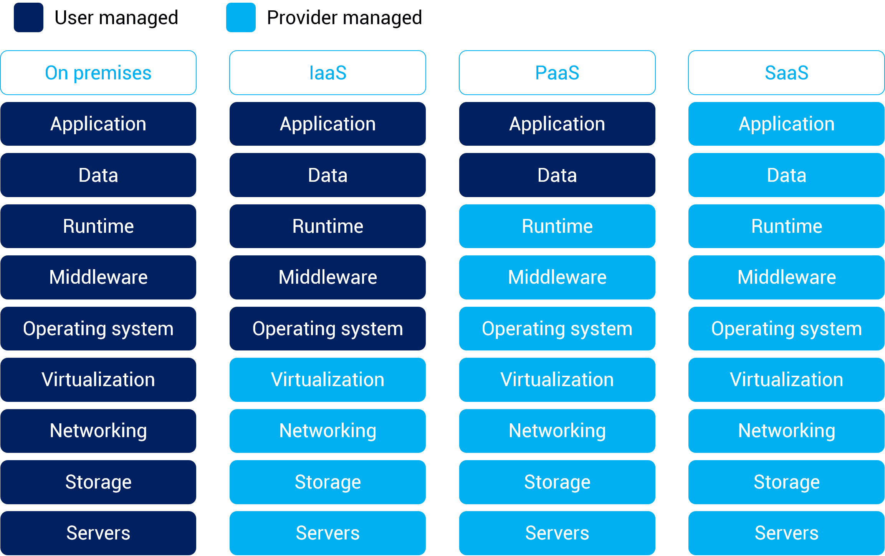
We can focus on WATS
Notes:
Microsoft operates the cloud platform.
We operate WATS.

Slide 9
The Simple View — and the Real View
The Simple View
  Customer → WATS Cloud
The Real View
  Application — per customer
  SQL database — per customer
  Storage container — per customer
  Managed platform services
  Automated deployment and maintenance
  Monitoring, alerting, backup, and recovery
  A WATS operations team
Why Separation Matters
  Each instance monitored, scaled, and updated independently
  No customer data touches another customer’s resources
  Individual recovery without affecting other customers
Key Message
  The WATS Cloud is not one server.
  It is a managed service built from several independent, isolated layers.
Notes:
The simple view is that you connect to WATS Cloud.
several services cooperate every time you use WATS.
Each customer has a separate application and dedicated database. Raw report documents are stored in a dedicated storage container.
Behind those components are deployment services, monitoring, backup, security controls, and our operational procedures.
This separation is important. It allows us to monitor, scale, update, and, if necessary, recover customer instances individually.

Slide 10
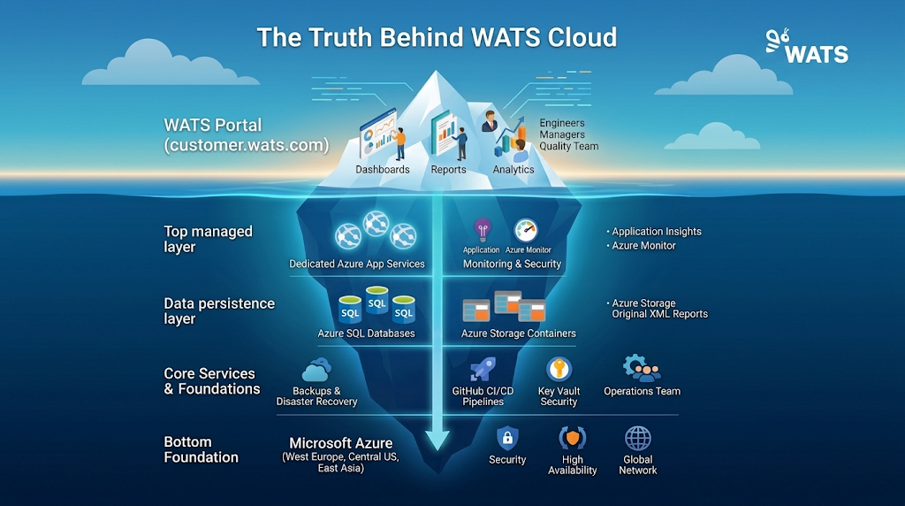
Notes:
Ice-berg inspired infograpichs
The WATS Cloud Architecture
Three main services - per customer, per region:
Azure App Service
Your dedicated WATS web portal (yourname.wats.com)
Fully managed, auto-patched, always on
Azure SQL Database
Your dedicated structured test data & analytics database
Gen5 General Purpose or Hyperscale for large volumes
Azure Blob Storage
Your dedicated container for raw test reports (XML)
Geo-redundant - replicated across two datacenters

Slide 11
App Service – your.WATS.com portal
What You Get
  Fully managed Platform as a Service (PaaS)
  Microsoft handles OS and runtime updates
  Automatic security patching
  HTTPS and TLS enforced by default
  Isolated application environment per customer
  Scale up or out as demand grows
  Auto-heal for automatic recovery
Security Highlight
  Secrets and connection strings stored securely
  Encryption keys rotated regularly
  Continuous monitoring and alerting
  Application Insights for proactive issue detection
  Built-in Azure platform protection
Always up-to-date, secure, and ready to scale.
Notes:
How Updates Reach You
Source code managed in GitHub
Automated build, test, and deployment pipeline
WATS released bi-weekly
App service Plan – Multiple Apps (customers) share the hardware. Demanding workloads may run on its own dedicated plan
Premium v3 P2V3 – 4Cors / 16GB memory – Scale out to max 30 instances – (10 – 30 customers)
Patches and maintains the OS and language frameworks
DevOps optimization - CI/CD – DevOps, GitHub
Scale up or out (automatically/manually)
Staging environments (slots/swapping)
Diagnostic tools and proactive tools - Auto-Heal, Profiler
Web Jobs

Slide 12
SQL Database - Your Structured Data
Fully Managed (PaaS)
  Automatic patching & performance tuning
  Built-in high availability - 99.99% SLA
  Elastic Pools for cost efficiency
  Hyperscale for large datasets and demanding workloads
Encryption
  At rest: Transparent Data Encryption (AES-256)
  In transit: TLS 1.2 for all connections
Automated Backups
  Transaction log backups every 5-10 minutes
  Differential backups every 12-24 hours
  Full backups weekly
  Geo redundant backup storage
  Point-in-Time Restore (PITR): 7 days standard (up to 35 days)
  Long-Term Retention (LTR): up to 10 years
Fast queries, protected data, and rapid recovery when needed.
Notes:
Retention Options
Point-in-Time Restore (PITR): 7 days standard
Short-Term Retention (STR): up to 35 days
Long-Term Retention (LTR): up to 10 years
Transparent Data Encryption (AES-256) protects database files, backups, and storage at rest
TLS 1.2+ enforced for all connections protects data travelling between applications and the database
Up to 192 cors and 995 GB memory single hyperscale db

Slide 13
Storage - Your Original Test Data
What Is Stored
  Raw test reports (WRML)
  Attachments, charts and binaries
  Separate storage container per customer
Data Protection
  Encryption at rest (AES-256)
  Encryption in transit (TLS 1.2+)
  Soft-delete protection against accidental removal
  File versioning
Availability & Durability
  Multiple copies stored automatically
  Replication to paired Azure region (GRS)
  Designed for 99.99999999999999% durability (16 nines)
  No storage infrastructure to manage
  Virtually unlimited scalability (5 PiB)
A permanent archive of your manufacturing history.
Notes:
5 PiB == 5630 TB
Original reports are preserved
Full traceability back to source data
Supports compliance and audits
Enables future reprocessing and analytics
Foundation for disaster recovery
Table storage (supporting service, tracking each test report independently)

Slide 14
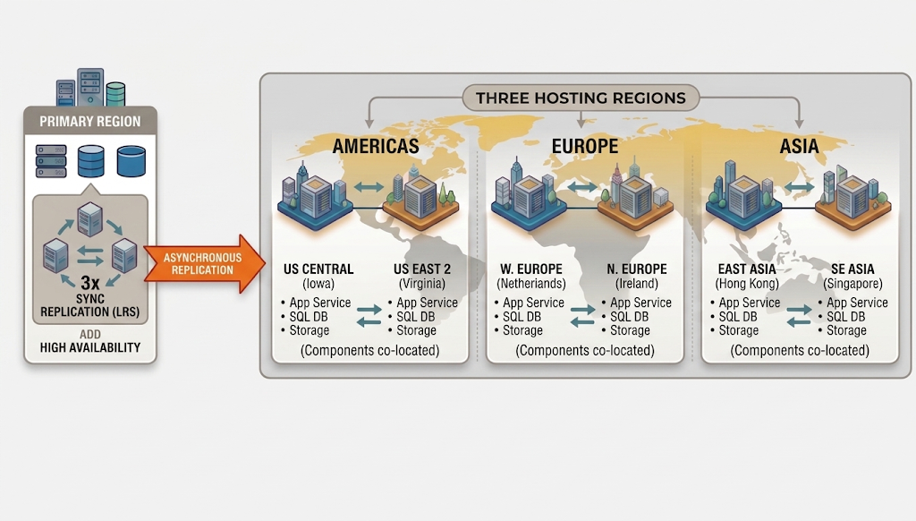
Regions & Global Redundancy
Primary region: 3x synchronous replication (LRS)
Paired region: asynchronous replication
If West-Europe goes offline - automatic failover to North-Europe
Notes:
Regional WATS Instances
Large organizations can run regional instances in US and/or Asia
Test data flows regional - primary, reduces latency globally

Slide 15
What This Means for You
The bottom line for WATS customers

Slide 16
What You Get - Without Thinking About It
Included in WATS Cloud Subscription
  AES-256 encryption everywhere, TLS 1.2
  Continuous backups, 7-day PITR by default
  Geo-redundant storage
  Azure auto-patching, auto-scaling
  SSO / SCIM provisioning integration
  Dedicated DB, storage & app - per customer
  Hosting in Europe, US, or Asia
  Bi-weekly WATS updates + continuous platform patches
Optional - On Request
  Extended backup: up to 35 days STR
  Long-Term Retention: up to 10 years (compliance)
  Web Application Firewall (WAF)
  Regional WATS instances
Our Promise
  You focus on manufacturing quality.
  We keep the platform secure, available,
  and always improving.

Slide 17
Questions?

Slide 18
