Slide 1
University Institute of Technology, Rajiv Gandhi Proudyogiki Vishwavidyalaya, Shivpuri (MP)
PRESENTS

Slide 2
CENTRE OF EXCELLENCE
IN
POWER ENGINEERING
&
RENEWABLE ENERGY

Slide 3
* We are happy to announce that, the (CoE-PERE) Centre of Excellence for Power Engineering and Renewable Energy in UIT RGPV Shivpuri, developed by RGPV, with a fund of around 15 Cr has come up to make Shivpuri a hub of training in power engineering and renewable energy. * Along with NPTI Shivpuri, UIT RGPV Shivpuri will impart training to students, teachers, and professionals of the power sector on the smart grid technology and power engineering.

Slide 4
Requirement of any Laboratory:-
There are two basic work of an Engineer is to manufacture & repair
For studying any machine - one must go through practical knowledge
For better understanding the concept smart machinery needed

Slide 5
World class equipments
Creating Better opportunities for future
06
UIT RGPV SHIVPURI COE CONTAINS
01
Futuristic Technology
Research work environment
05
02
04
03
Emphasizing on Renewal based energy generation
Practical perform from very basic to Advance level
Notes:
© Copyright PresentationGO.com – The free PowerPoint and Google Slides template library

Slide 6
Advance equipment's are easy to understand the complicated concept
Objectives
of
The COE
In Present world we required better practical knowledge, as compare to theoretical one
Better and Advance practical environment
Creats better opportunity in Job Employment.
Notes:
© Copyright PresentationGO.com – The free PowerPoint and Google Slides template library

Slide 7
Benifits
SKILL DEVELOPMENT
NEW IDEAS
ENCOURAGE INNOVATION
OPPORTUNITIES FOR LEARNING & GROWTH

Slide 8
*
Eligibility
1
2
3
For 1 month/ 2 week course: Running Engg Degree/ Diploma students (EE/ME) / Engg. Degree students(EE/ME)/ Working Professionals from the energy sector & power generating sectors can apply
For 1 year/6 months course: Only Engineering Degree completed Students from Electrical Engineering / Mechanical Engineering/ Working Professionals from the energy sector & power generating sectors can apply.
For 3 month course: Diploma students (EE/ME) / Engg. Degree students(EE/ME)/ Working Professionals from the energy sector & power generating sectors can apply

Slide 12
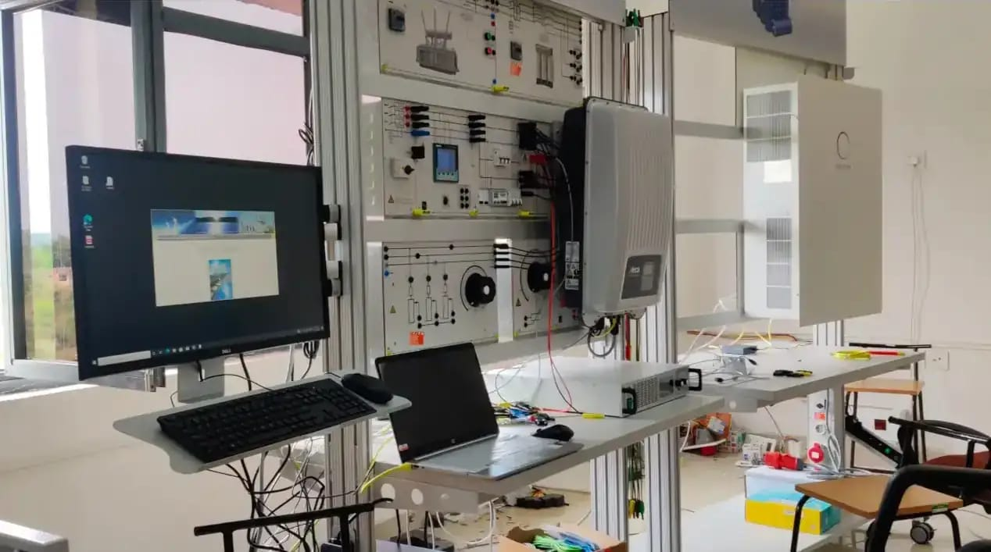

Slide 13
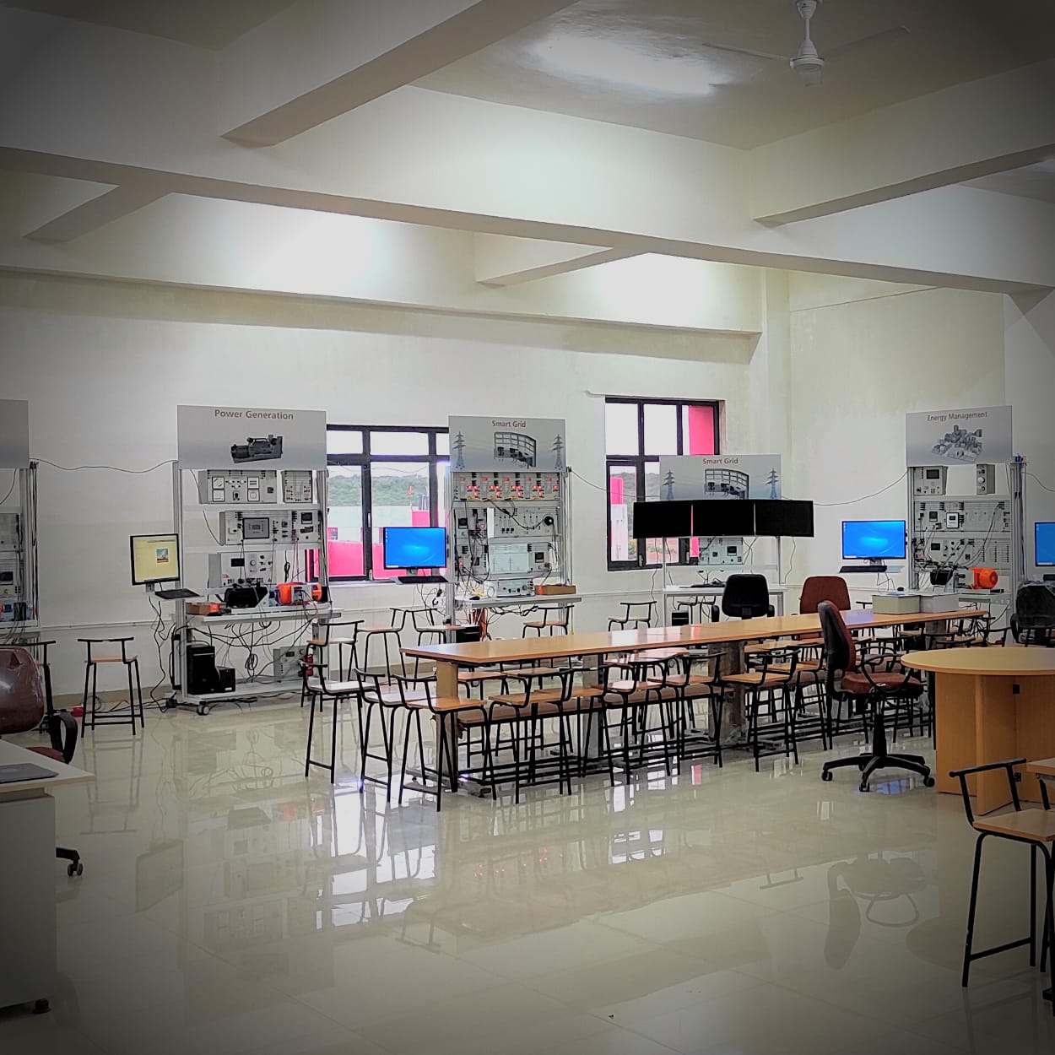

Slide 15
Professional Photovoltaics This solar trainer allows the passage of the sun to be simulated realistically. This makes it possible to conduct experiments in the lab in practical fashion without any need for the sun itself. The design of photovoltaic systems operating in parallel with the electric power grid is realistic. In order to stabilize the electricity grid, the techniques of derating the power inverter and controllable local transformers are used. Knowledge and practical skills along with computer-based assessment of measured data are made possible by the professional photovoltaics multimedia course along with SCADA Power Lab software.

Slide 16
Pumped Storage Power Plant The pumped storage power plant course analyses how electrical energy can be stored by transforming it into potential energy of water and then transforming it back into electrical energy again for feeding to the grid. Pumped storage plants are becoming increasingly necessary due to the increase in renewable energy generation and also provide indispensable energy storage capacity in a high-quality smart grid.

Slide 17
Battery Storage The Battery Storage System is a highly recommended addon to the Professional Photovoltaics. It shows the increasing importance of battery storage in grid networks and households and provides insights of the demands and advantages of systems n advanced networks. • Design and installation of the battery storage unit • Putting the storage unit into operation • Interaction between PV systems and storage units • Boosting intrinsic consumption thanks to energy storage units • Remote control of energy storage units using SCADA software • Optimizing operating response through smart consumers (loads) • Storage unit integration into a smart grid

Slide 18
Energy Management Experiments on reducing peak loads through measurements with active-current and maximum-demand meters demonstrate how the load on an electricity supply network can be reduced and evenly distributed over a 24-hour period. An analysis of the power supply grid and connected consumers (loads) is necessary for effective use of the measurement techniques involved. Accordingly, each experiment permits a detailed investigation of static, dynamic, symmetric and asymmetric loads.

Slide 19
Power Generation The line simulation system is designed for operation at model voltages between 110 V and 380 V. Various voltage levels and line lengths can be selected via corresponding overlay masks. Examinations with the training system can be performed off-load, in normal operating mode, in the presence of a short-circuit or earth fault, with or without earth-fault compensation. The system also permits assembly of complex networks by connecting the line simulation models in parallel or series. The voltage can be supplied via a fixed grid or synchronous generator.

Slide 20
Wind Power Plant This solar trainer allows the passage of the sun to be simulated realistically. This makes it possible to conduct experiments in the lab in practical fashion without any need for the sun itself. The design of photovoltaic systems operating in parallel with the electric power grid is realistic. In order to stabilize the electricity grid, the techniques of derating the power inverter and controllable local transformers are used. Knowledge and practical skills along with computer-based assessment of measured data are made possible by the professional photovoltaics multimedia course along with SCADA Power Lab software.

Slide 21
OPAL RT SIMULATION KIT *DFIG CONTROL PANEL *BATTERY INVERTOR *GRID SIMULATOR *PV EMULATOR - INVERTOR

Slide 22
And Many more…………

Slide 23
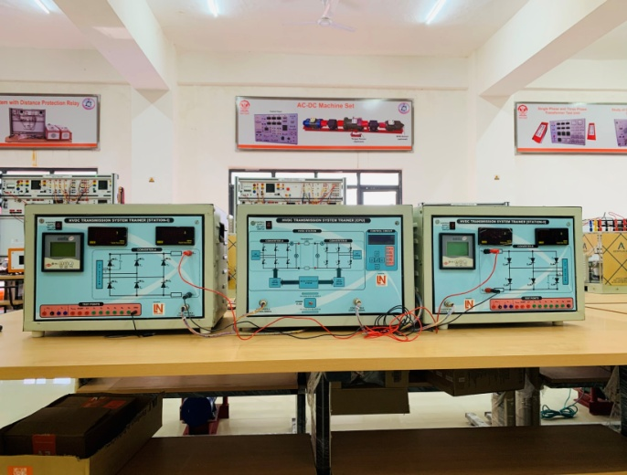
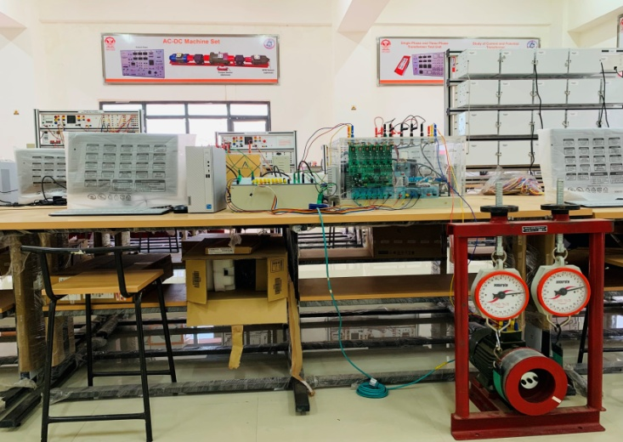
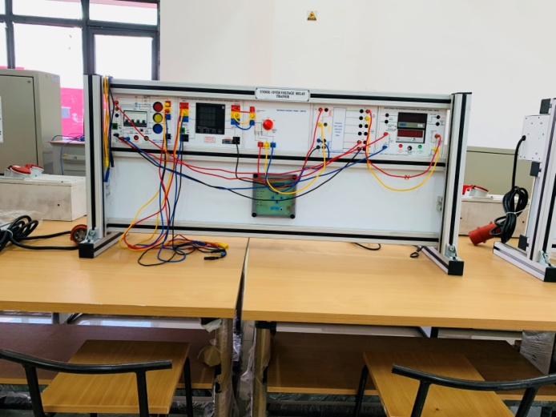
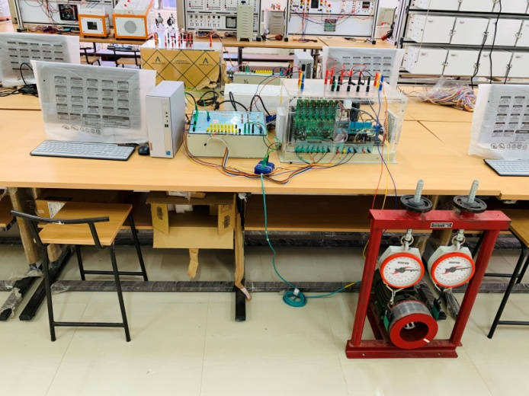
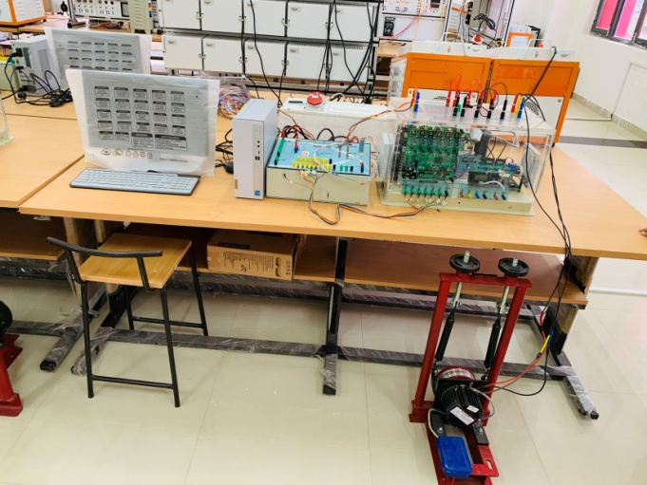
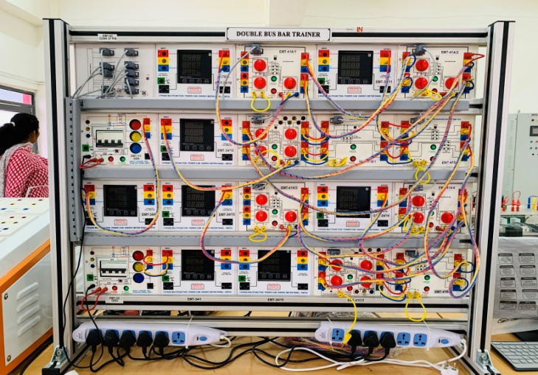
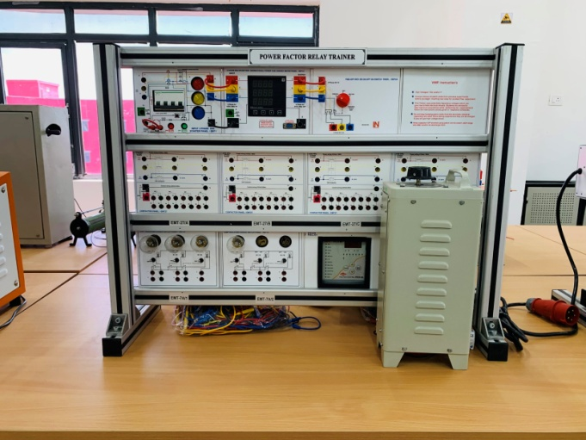
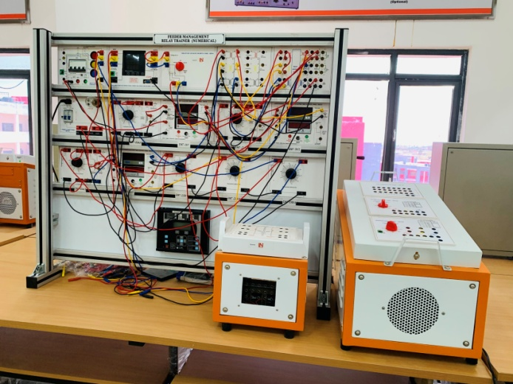
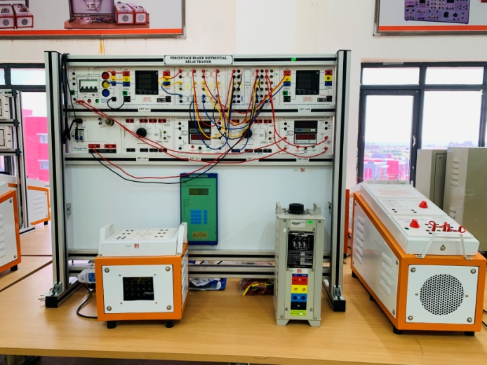
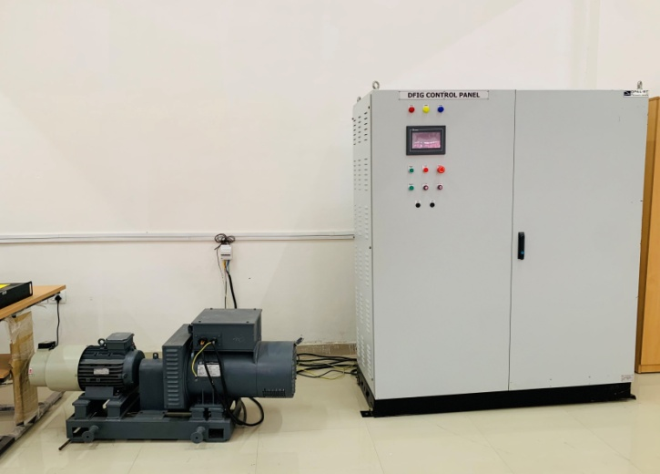
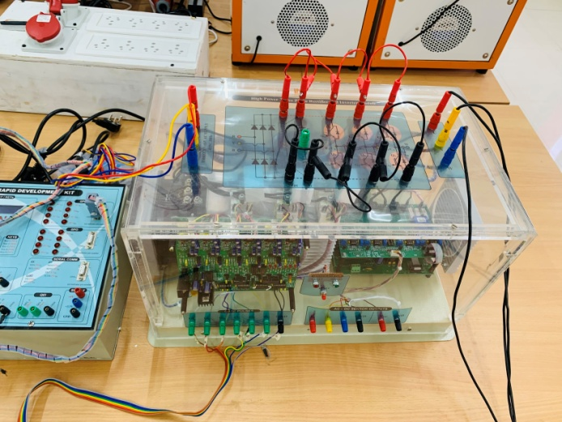

Slide 24
LAB
EQUIPMENTS

Slide 25
LAB 1 (POWER SYSTEM)
1 | HVDC TRANSMISSION SYSTEM | P SYS E
2 | DOUBLE BUSBAR TRAINER | P SYS E
3 | DEMONSTRATION OF CT & PT | P SYS E
4 | POWER TRANSMISSION LINE TRAINER | P SYS E
5 | PERCENTAGE BIASED DIFFERENTAIL RELAY TRAINER | PSP
6 | DISTANCE PROTECTION RELAY TRAINER | PSP
7 | FEEDER MANAGEMENT RELAY TRAINER (NUMERICAL) | PSP
8 | POWER FACTOR RELAY TARINER | PSP
9 | UNDER/ OVER VOLTAGE RELAY TRAINER | PSP
10 | UNDER/ OVER FREQUENCY RELAY TRAINER | PSP
LAB 1 (ADVANCE ELECTRICAL MACHINE)
1 | SWITCH RELUCTANCE MOTOR (RECTIFIER AND INVERTOR MODULE) | AEM
2 | PMSM MOTOR (RECTIFIER AND INVERTOR MODULE) | AEM
3 | BLDC MOTOR WITH HIGH POWER 3 PHASE (RECTIFIER AND INVERTOR MODULE) | AEM
4 | INDUCTION MOTOR (RECTIFIER AND INVERTOR MODULE) | AEM
5 | TEST ON TRANSFORMER | AEM
6 | TEST ON DC MACHINE #3 PHASE # SQIM # 3 PHASE SYNCHRONOUS MACHINE SET | AEM
7 | SYNCHRONIZING PANEL | AEM
LAB 1 (ADVANCE REAL TIME SIMULATION LAB)
1 | OPAL RT | ADVANCE REAL TIME SIMULATION LAB
 | (i) DFIG CONTROL PANEL
 | (ii) BATTERY INVERTOR
 | (iii) GRID SIMULATOR
 | (iv) PV EMULATOR - INVERTOR
LAB 2 (ADVANCE POWER SYSTEM LAB)
1 | FUEL CELL | RE
2 | PROFESSIONAL PHOTOVALTAICS | RE
3 | ENERGY MANAGEMENT | RE
4 | POWER GENERATION | RE
5 | WIND POWER PLANT | RE
6 | BATTERY STORAGE | P SYS E
7 | PUMPED STORAGE POWER PLANT | P SYS E
8 | POWER TRANSMISSION | P SYS E
9 | SMART GRID | P SYS E

Slide 26
Company opportunity

Slide 27
COURSE OFFERED BY
UIT RGPV, SHIVPURI

Slide 29
*
*
*
INTERNSHIP PROGRAM
MODULE - 1 | Introduction of Power Generation Plants
 | Introduction Power System Protection Relays
 | Introduction of Electrical Machines-I
 | Introduction of Electrical Machines-II
 | Introduction of MATLAB SIMULATION
 | Application of Matlab in Power System
MODULE - 2 | MATLAB SIMULATION lab-1
 | MATLAB SIMULATION lab-2
 | Protection Relays Lab-1
 | Protection Relays Lab-2
 | Protection Relays Lab-3
 | Electrical Machines lab-1
 | Electrical Machines lab-2
Viva- Voice/Quiz/ / Presentation
Certificate in PE (1-Months)
MODULE-1 | Introduction of Power Generation Plants | Introduction of Power Generation Plants
MODULE-2 | Introduction of Power system Protection devices | Introduction of Power system Protection devices
MODULE-3 | Energy conservation management | Energy conservation management
MODULE-4 | Advance Power system Protection Lab -I | Advance Power system Protection Lab -I
Viva- Voice/ Project submission/ Presentation
Certificate in RE (1-Months)
MODULE-1 | Introduction of Power Generation Plants /Renewal & Non renewal power generation plants | Introduction of Power Generation Plants /Renewal & Non renewal power generation plants
MODULE-2 | Energy conservation management | Energy conservation management
MODULE-3 | Principle of Management and Managerial Economics | Principle of Management and Managerial Economics
MODULE-4 | Advance Software lab | Advance Software lab
Viva- Voice/ Project submission/ Presentation
Certificate in PE & RE (2-Months)
MODULE -1 | Introduction of Power Generation Plants
 | Introduction of Power system Protection devices
 | Sub station layout
MODULE-2 | Energy conservation management
MODULE-3 | Introduction of all Electrical Machines
MODULE-4 | Advance Software lab-I
 | Advance Electric Machine lab - I
 | Advance Power system Protection Lab -I
 | Visit to Power Plants
Viva- Voice/ Project submission/ Presentation
*

Slide 30
*
*
Certificate Course in PE & RE (2-Months)
MODULE | SUBJECT | TYPE | WEEK | MONTH
MODULE-1 | RENEWAL ENERGY SOURCES: | Theory | 1
MODULE-2 | ENERGY CONSERVATION MANAGEMENT | Theory | 1
MODULE-3 | FUEL CELL | Lab | 2
 | PROFESSIONAL PHOTOVALTAICS | Lab
 | ENERGY MANAGEMENT | Lab
 | POWER GENERATION | Lab
 | WIND POWER PLANT | Lab
MODULE-4 | POWER SYSTEM ENGINEERING | Theory | 1
 |  | Theory | 1
MODULE-5 | POWER TRANSMISSION(2) | Lab | 2
 |  | Lab
 |  | Lab
 |  | Lab
MODULE-6 | POWER SYSTEM PROTECTION | Lab
 |  | Lab
 |  | Lab
 |  | Lab
 |  | Lab
 |  | Lab
(1)Viva- Voice/ Project submission/ Presentation
Certificate in PE & RE (3-Months)
MODULE-1 | Introduction of Power Generation Plants
 | Introduction of Power system Protection devices
 | Sub station layout
MODULE-2 | Energy conservation management
 | Basics of all Electrical Machines
MODULE-3 | Advance Software lab-I
 | Advance Software lab-II
MODULE-4 | Advance Electric Machine lab - I
 | Advance Electric Machine lab - II
 | Advance Power system Protection Lab -I
 | Advance Power system Protection Lab -II
 | Visit to Power Plants
Viva- Voice/ Project submission/ Presentation

Slide 31
Certificate Course in PE & RE (6-Months)
MODULE | SUBJECT | TYPE | WEEK
MODULE-1 | RENEWAL ENERGY SOURCES: | Theory | 1
MODULE-2 | ENERGY CONSERVATION MANAGEMENT | Theory | 1
MODULE-3 | FUEL CELL | Lab | 4
 | PROFESSIONAL PHOTOVALTAICS | Lab
 | ENERGY MANAGEMENT | Lab
 | POWER GENERATION | Lab
 | WIND POWER PLANT | Lab
MODULE-4 | POWER SYSTEM ENGINEERING | Theory | 2
 |  | Theory | 2
MODULE-5 | POWER TRANSMISSION | Lab | 4
 |  | Lab
 |  | Lab
 |  | Lab
MODULE-6 | POWER SYSTEM PROTECTION | Lab
 |  | Lab
 |  | Lab
 |  | Lab
 |  | Lab
 |  | Lab
MODULE-6 | ELECTRICAL MACHINE | Theory | 4
 |  | Theory
MODULE-7 | ADVANCE ELECTRICAL MACHINE | Lab | 2
 |  | Lab
 |  | Lab
 |  | Lab
 |  | Lab
 |  | Lab
 |  | Lab
MODULE-7 | ADVANCE LAB IN POWER SYSTEM | Advance Lab | 2
 |  | Advance Lab
(1)Viva- Voice/ Project submission/ Presentation
*

Slide 32
Certificate Course in PE & RE (1 YEAR)
MODULE | SUBJECT | TYPE | WEEK
MODULE-1 | RENEWAL ENERGY SOURCES: | Theory | 2
MODULE-2 | ENERGY CONSERVATION MANAGEMENT | Theory | 1
MODULE-3 | FUEL CELL | Lab | 8
 | PROFESSIONAL PHOTOVALTAICS | Lab
 | ENERGY MANAGEMENT | Lab
 | POWER GENERATION | Lab
 | WIND POWER PLANT | Lab
MODULE-4 | POWER SYSTEM ENGINEERING | Theory | 3
 |  | Theory | 3
MODULE-5 | POWER TRANSMISSION | Lab | 6
 |  | Lab
 |  | Lab
 |  | Lab
MODULE-6 | POWER SYSTEM PROTECTION | Lab
 |  | Lab
 |  | Lab
 |  | Lab
 |  | Lab
 |  | Lab
MODULE-7 | ELECTRICAL MACHINE | Theory | 6
 |  | Theory
MODULE-8 | ADVANCE ELECTRICAL MACHINE | Lab | 8
 |  | Lab
 |  | Lab
 |  | Lab
 |  | Lab
 |  | Lab
 |  | Lab
MODULE-9 | ADVANCE LAB IN POWER SYSTEM | Advance Lab | 5
 |  | Advance Lab
MODULE-10 | ADVANCE REAL TIME SIMULATION LAB | Advance Lab | 8
 |  | Advance Lab
 |  | Advance Lab
 |  | Advance Lab
 |  | Advance Lab
(1)Viva- Voice/ Project submission/ Presentation
*

Slide 33
These courses will be offered free of cost for UIT RGPV Shivpuri students.

Slide 34
Quick Glance of COE

Slide 35
ANY QUERIES

Slide 36
THANK YOU

