Slide 1
Computing fundamentals Lesson 5
Fundamentals of
computer systems

Slide 2
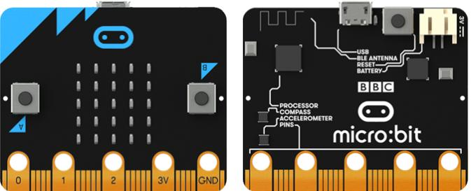
Label your micro:bit

Slide 3
USB connector Button B
Accelerometer Bluetooth antenna
Radio LED lights
Button A Processor
Pins Compass
Battery socket

Slide 4
Label your micro:bit
USB connector
Button B
Battery socket
Radio
LED lights
Bluetooth
antenna
Button A
Processor
Pins
Compass
Accelerometer
Notes:
NB: more recent micro:bits have a combined compass and accelerometer chip

Slide 5
Learning objectives:
to know and understand the common features of computer systems
to know and explain input and output devices, hardware and software
to apply understanding to writing algorithms and programming micro:bit

Slide 6
Hardware
The physical parts of a computer system
Notes:
e.g. plot, setting, characters, scoring system, levels etc

Slide 7
micro:bit hardware: what am I?
There are 25 of me. I can display text, images and numbers.
LED (light emitting diode)
2. I detect the earth’s magnetic field
compass
3. I can be used to communicate wirelessly
radio and/or Bluetooth
4. I can be used to connect micro:bit to a computer
USB connector

Slide 8
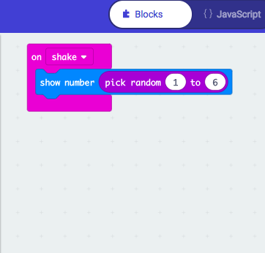
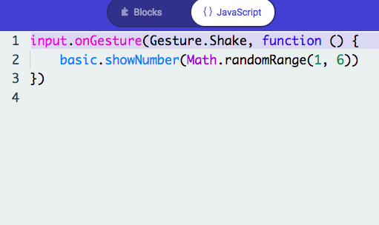
Software
The programs that run on a computer
e.g. a showing random numbers in dice (above) or counting steps in a step counter, points in a game
Notes:
e.g. plot, setting, characters, scoring system, levels etc

Slide 9
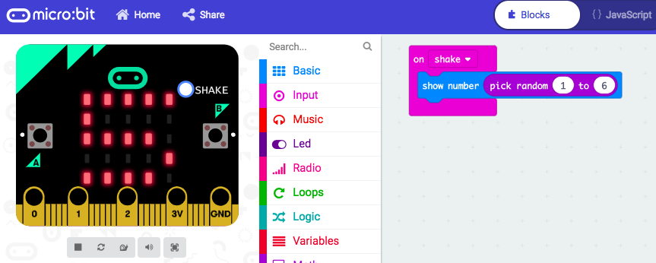
Computer systems
Input
Process
Output

Slide 10
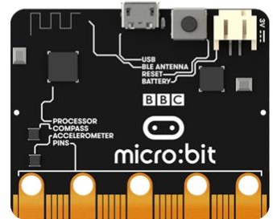
Computer systems
Output
Input
Processor

Slide 11
Input and output devices
Input devices
Hardware that sends data to a computer system.
Output devices
Hardware used to communicate data that has been processed.
You have 2 minutes to label the micro:bit inputs and outputs on your sheet

Slide 12
Algorithm & programming challenge
Write an algorithm to create a program using a micro:bit input and output device.
Swap your algorithm with another team.
Implement the algorithm you have been given, testing and debugging the algorithm and program as you go.
Feedback to the other team.

Slide 13
Using examples, explain the following terms:
input
output
computer system
hardware
software

Slide 14
Learning objectives revisited:
to know and understand the common features of computer systems
to know and explain input and output devices, hardware and software
to apply understanding to writing algorithms and programming micro:bit

Slide 15
Copyright information
Published by the Micro:bit Educational Foundation microbit.org
Licence: Attribution-ShareAlike 4.0 International (CC BY-SA 4.0)

