Slide 1
Health Tech
Teacher lesson guide
Lesson 3

Slide 2
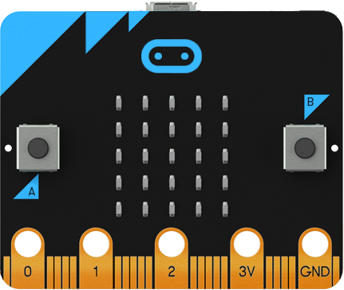
Micro:bit Health Tech Challenge
Create a prototype of a health tech innovation to help address a health problem in the UK using micro:bit

Slide 3
Prototype criteria
You can choose how to present it. Must include:
A visual representation of the design
Explanation about why it will help address the problem & the intended user
Instructions for how it will work
A detailed, accurate algorithm for at least one feature
A working micro:bit program for the same feature

Slide 4
Learning objectives:
to work effectively as a team to develop a prototype for a health tech innovation
to design an accurate, detailed algorithm for at least one prototype feature
to use the algorithm to write, test and debug a working micro:bit program

Slide 5
What does a good prototype look like?
a simple representation of your idea (abstraction)
easy to see what it looks like
simple to understand how it works

Slide 6
Step tracker example algorithm
On START
Set ‘steps’ to 0
OUTPUT ‘steps’ on visual display
REPEAT forever
When sense movement
add 1 to ‘steps’

Slide 7
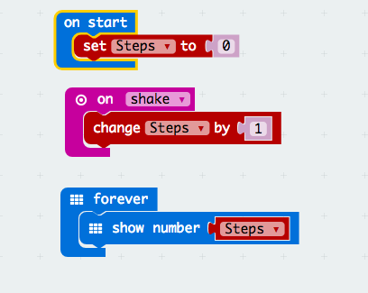
Sample step tracker example code
https://makecode.microbit.org/#pub:_XYuF5dRmC2Tp

Slide 8
Paired programming
2 programmers working together to code
One types the code (driver)
One watched the driver, checks the code, makes suggestions (navigator)
work collaboratively, talking through problems
Why might this be helpful?
more accurate code written in shorter time
can collaboratively work through problems

Slide 9
Testing and debugging
bugs are a normal part of programming, especially in complex code
it is important to test regularly to remove the bugs as you go
testing as you go helps to ensure code is accurate and saves time
when you find a problem, think logically about where the bug is & look at that part of the code
help each other

Slide 10
Prototype presentation
5 minutes max per team
all team members should contribute
be concise and clear
make use of visuals
explain:
what problem you are addressing
how your idea addresses the problem & helps the user
how it will work
the feature you have focused on (show your algorithm and micro:bit program)

Slide 11
Learning review
What computational thinking concepts have you used today and how have you used them?
What other important skills have you used and how have you used them?

Slide 12
Learning objectives revisited:
to work effectively as a team to develop a prototype for a health tech innovation
to design an accurate, detailed algorithm for at least one prototype feature
to use the algorithm to write, test and debug a working micro:bit program

Slide 13
Licensing information
Published by the Micro:bit Educational Foundation microbit.org
Licence: Attribution-ShareAlike 4.0 International (CC BY-SA 4.0)

