Slide 1
Health Tech
Teacher lesson guide
Lesson 5

Slide 2
Learning objectives:
to present your health tech prototype to an audience
to give and receive constructive feedback
to evaluate your health tech prototype, presentation and approach to the challenge

Slide 3
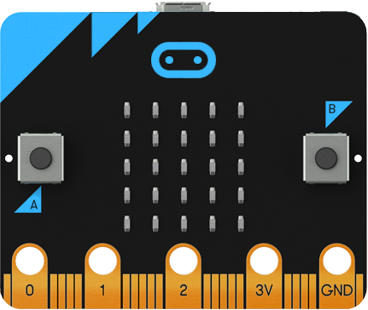
Micro:bit HealthTech Challenge
Create a prototype of a health tech innovation to help address a health problem in the UK using micro:bit

Slide 4
Prototype criteria
You can choose how to present it. Must include:
A visual representation of the design
Explanation about why it will help address the problem & the intended user
Instructions for how it will work
A detailed, accurate algorithm for at least one feature
A working micro:bit program for the same feature

Slide 5
Prototype presentation
5 minutes max per team
all team members should contribute
be concise and clear
make use of visuals
explain:
what problem you are addressing
how your idea addresses the problem & helps the user
how it will work
the feature you have focused on (show your algorithm and micro:bit program)

Slide 6
Health Tech Innovations
Prototype Presentations

Slide 7
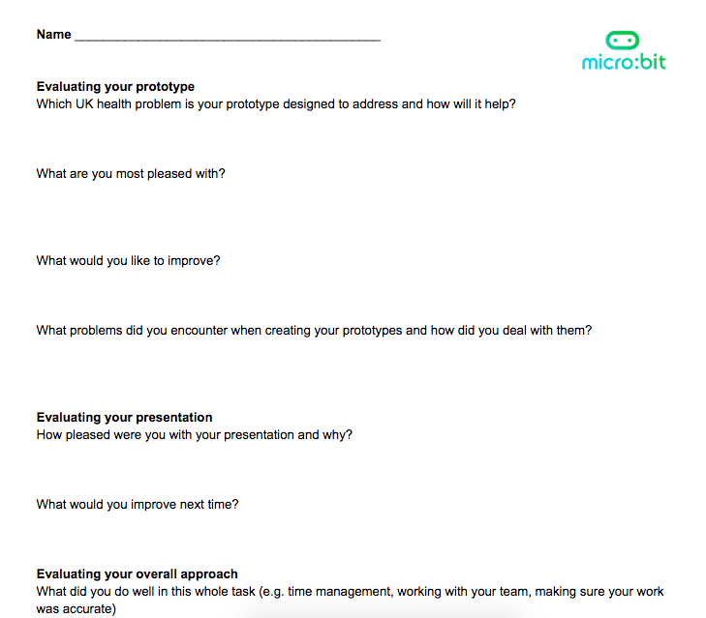
Evaluation

Slide 8
Learning review questions:
how would you describe your learning in this health tech topic to someone else?
what has been the most useful thing you have learnt?
what skills have you developed during this topic?

Slide 9
Learning objectives revisited:
to present your health tech prototype to an audience
to give and receive constructive feedback
to evaluate your health tech prototype, presentation and approach to the challenge

Slide 10
Licensing information
Published by the Micro:bit Educational Foundation microbit.org
Licence: Attribution-ShareAlike 4.0 International (CC BY-SA 4.0)

