Slide 1
Cyber Security
Teacher lesson guide
Lesson 2

Slide 2
Learning objectives:
To understand the need for secure passwords and what makes a password secure.
To plan, test and debug an algorithm for a password generator.
To use selection and variables in an algorithm and explain their use.

Slide 3
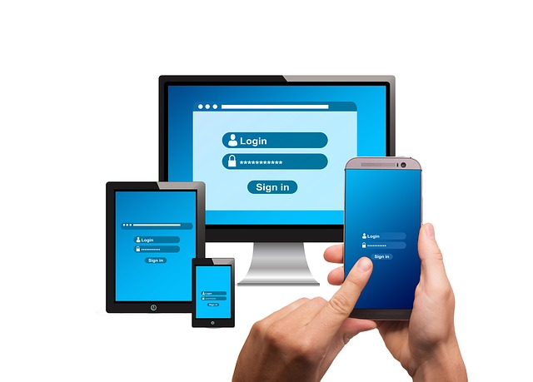
What is a password breach?
When a hacker guesses or finds your password
Allows them to gain access to your accounts
The could gain access to your email, social media, or bank account

Slide 4
Guess the password
Ali was born in 2002 and has a dog called Felix
In pairs, guess what Ali’s password could be.
Answer: Felix02

Slide 5
Why are strong passwords important?
Many passwords are easy for hackers to guess
They let hackers gain access to data easily
Strong passwords make it harder for hackers to guess
They protect personal information, data and computer systems

Slide 6
How strong are your passwords?
Visit https://howsecureismypassword.net/
Check how safe Felix02 is
How safe is your ‘favourite’ password?

Slide 7
What makes a strong password?
Long, strong and complex:
numbers, characters, uppercase and lowercase letters.
At least 8 in length
Hard to guess:
avoid family / pet names, sequential numbers or date of birth
Use different passwords
Why is it unwise to use the same password for everything.

Slide 8
Strong Password Generator Challenge
Create your own password generator using micro:bit
1. Visit https://passwordsgenerator.net
2. What are the key features of the generated passwords?

Slide 9
Strong Password Generator Challenge
What will your password generator need to do?
select random characters, number and letters
be at least 8 characters long
What features will you need to use on the micro:bit?
e.g. buttons and LEDs

Slide 10
Strong Password Generator Challenge
Write a pseudocode algorithm to create a password generator
Example:
INPUT On start: OUTPUT: Display ‘Press A or B’
INPUT When Button A pressed: Set random number 0 to 99
OUTPUT Display ‘ random number’

Slide 11
Computing concept: selection
allows choices/decisions to be included
enables different pathways through an algorithm and program to be included

Slide 12
Selection
When button B is pressed, the program will choose from a random selection of letters (1 - 3). So if letter = number 1 then M will show.
INPUT When Button B Pressed
Set variable to letter = random number (1-3)
IF letter = 1
OUTPUT Show LEDs ‘M’
ELSE
OUTPUT Show LEDs ‘t’

Slide 13
Computing concept: variables
A variable is used in a program to hold the value of information that can change.
E.g in a game, the score, or the timer changes.
What other variables can you think of?

Slide 14
Variables
The letters are variables as their value will change.
Could there be other variables?
INPUT When Button B Pressed Set variable to letter = random number (1-3)
IF letter = 1
OUTPUT Show LEDs ‘M’
ELSE
OUTPUT Show LEDs ‘t’

Slide 15
Testing and debugging algorithms
Share your algorithm another person/pair:
test your algorithms
spot potential problems
debug
retest

Slide 16
Learning review
What makes a password secure?
Why is it important to use secure passwords?
What problems did you encounter when writing your algorithm?
How did you solve them?
Explain what a variable is.
How have you used selection and variables in your algorithm?

Slide 17
Learning objectives revisited:
To understand the need for secure passwords and what makes a password secure.
To plan, test and debug an algorithm for a password generator.
To use selection and variables in an algorithm and explain their use.

Slide 18
Licensing information
Published by the Micro:bit Educational Foundation microbit.org
Licence: Attribution-ShareAlike 4.0 International (CC BY-SA 4.0)

