Slide 1
Electrical conductors
Teacher lesson guide
Lesson 2

Slide 2
Learning objectives:
To understand how selection is represented in flowcharts.
To understand and use decision boxes.
To create flowcharts algorithms.

Slide 3
start
Get a glass
Pour a small amount of squash into the glass
Add cold water to the glass
Add ice cubes
Drink and wash glass
stop
Notes:
An algorithm for making a drink of squash
Patterns: all boxes are connected with arrows; start and stop boxes are oval; action boxes are rectangular; instructions start with a verb in the imperative form; simple word used at beginning and end of program.

Slide 4
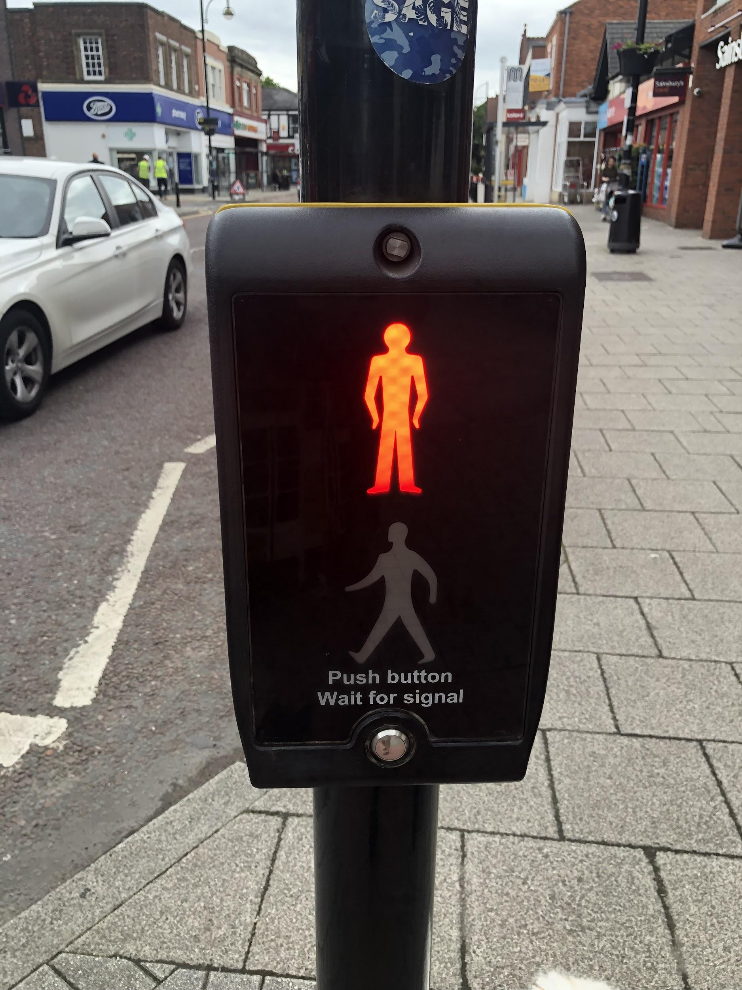
Selection
What does the term selection mean?
How did we use selection in the previous lesson?
What other examples of selection can you give?

Slide 5
Decision boxes
Is the green man on?
Yes
No
Cross the road
Wait
Notes:
The decision box usually takes the form of a question which includes the condition. It has two actions that are carried out if the condition is or isn’t met.

Slide 6
Decision boxes
Is the class working hard?
Yes
No
Go out to break early
Stay in for five minutes at break
Notes:
The decision box usually takes the form of a question which includes the condition. It has two actions that are carried out if the condition is or isn’t met.

Slide 7
Decision boxes
Does the circuit have an output?
Yes
No
Count to 30 in threes
Count back from 20 in twos
Notes:
Disc

Slide 8
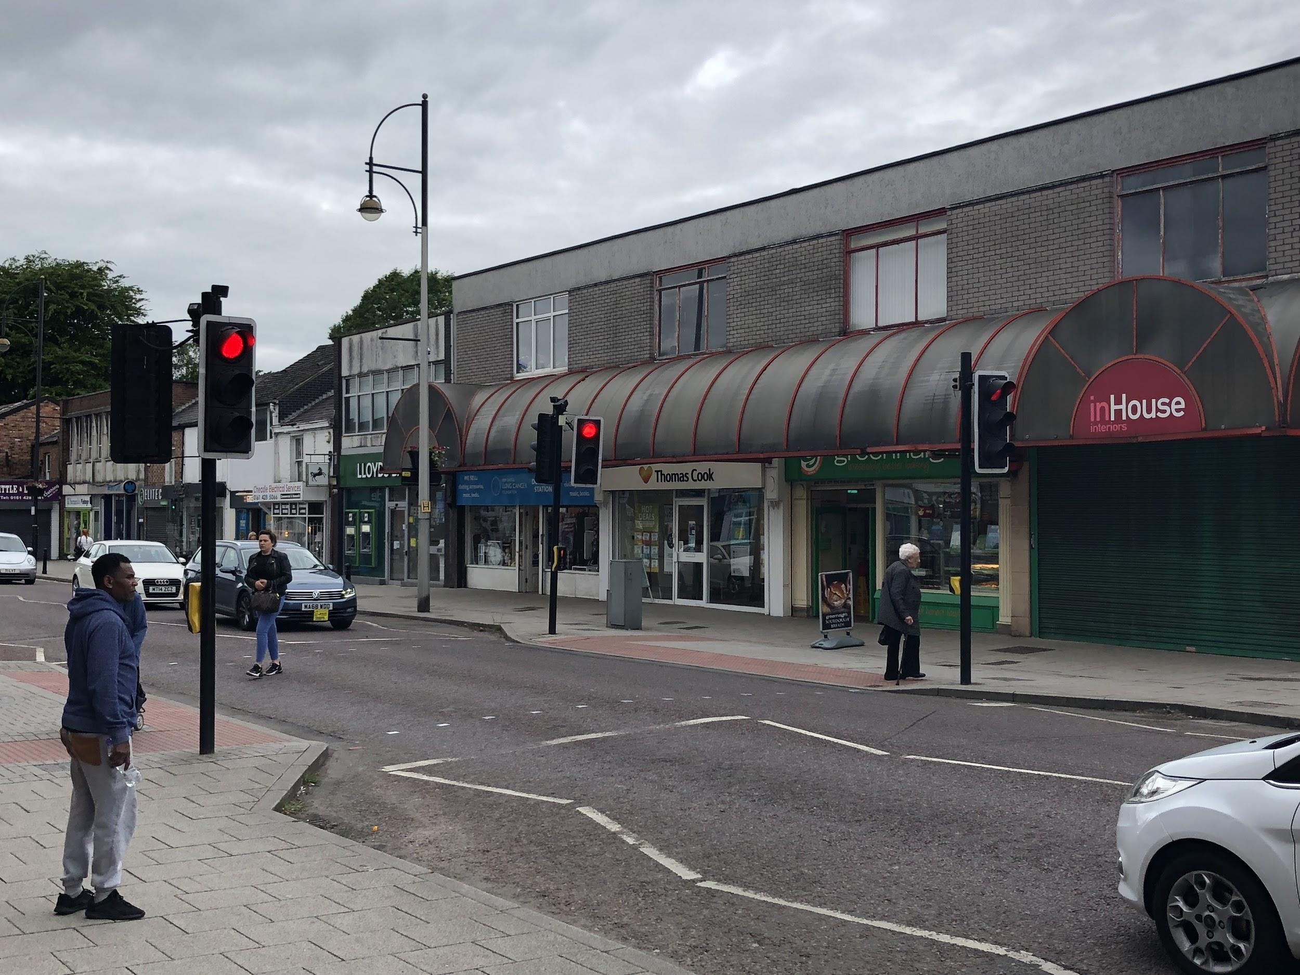
Creating decision boxes
Notes:
Disc

Slide 9
Creating decision boxes
What condition needs to be met in the picture?
What action is carried out if the condition is met?
What action is carried out if the condition isn’t met?
Notes:
Disc

Slide 10
Add the information to this decision box
Yes
No
Notes:
Decision - Is the green light showing? Yes - Drive forward No - Stop and wait

Slide 11
Testing electrical conductivity
How did we test if a material was an electrical conductor in our previous lesson?
How did we know if it was/wasn’t an electrical conductor?
Can you represent this using a decision box?

Slide 12
How to test if a material is an electrical conductor
Yes
No
Notes:
Disc

Slide 13
How to test if a material is an electrical conductor
Does the circuit have an output?
Yes
No
The material is an electrical conductor
The material is not an electrical conductor

Slide 14
Writing algorithms
Create a flowchart algorithm for how to use an electrical circuit to test if a material is an electrical conductor.
What steps did we complete in order to carry out the test?
What rules should we follow when creating our flowchart algorithm?

Slide 15
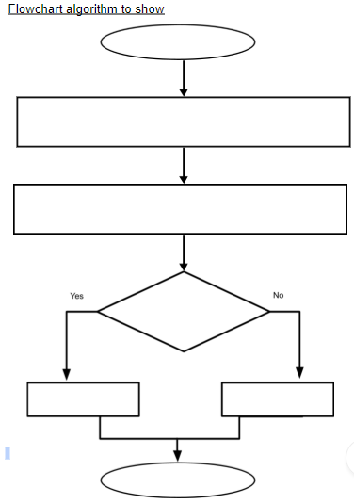

Slide 16
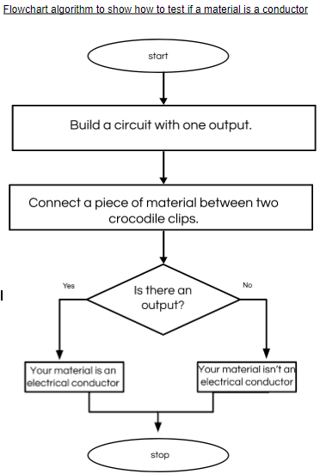

Slide 17
Evaluating algorithms
We can consider our algorithms accurate if other people can use them.
What should we do if someone finds our algorithms are difficult to follow?
Is there only one way of writing a flowchart algorithms for testing if materials are electrical conductors?

Slide 18
Silent selection
Can you explain what selection is?
Yes
No
Stick your thumbs up
Stick your thumbs down

Slide 19
Learning objectives revisited:
To understand how selection is represented in flowcharts
To understand and use decision boxes
To create flowcharts algorithms

Slide 20
Decision boxes
Does the circuit have an output?
Yes
No
Count to 30 in threes
Count back from 40 in fours

Slide 21
Decision boxes
Does the circuit have an output?
Yes
No
Count back from 30 in threes
Count to 40 in fours

Slide 22
Decision boxes
Does the circuit have an output?
Yes
No
Count to 200 in tens
Count back from 65 in fives

Slide 23
Decision boxes
Does the circuit have an output?
Yes
No
Count back from 150 in tens
Count to 150 in thirties

Slide 24
Decision boxes
Does the circuit have an output?
Yes
No
Count to 140 in twenties
Count back from 130 in tens

Slide 25
Decision boxes
Does the circuit have an output?
Yes
No
Count to 30 in threes
Count back from 40 in fours

Slide 26
Decision boxes
Does the circuit have an output?
Yes
No
Count to 500 in fifties
Count back from 200 in twenty-fives

Slide 27
Decision boxes
Does the circuit have an output?
Yes
No
Count to 60 in sixes
Count back from 110 in elevens

Slide 28
Licensing information:
Published by the Micro:bit Educational Foundation microbit.org under the following Creative Commons licence:
Attribution-ShareAlike 4.0 International (CC BY-SA 4.0) https://creativecommons.org/licenses/by-sa/4.0/

