Slide 1
Spot the Species!

Slide 2
What wildlife do we see in our local area?
think about fauna and flora
make a list
find images

Slide 3
Why is our local wildlife important?
Think about:
our ecosystems
different local habitats
changes that are occurring

Slide 4
How could monitoring wildlife help?
Think about:
being more aware
identifying patterns
measuring changes
How could we monitor different wildlife?

Slide 5
What species do we want to spot?
which species can we monitor?
shall monitor the same or different species?
decide individually / in pairs / groups

Slide 6
Creating a micro:bit species counter
How can we use it to help us?
Example algorithm
On start, set counter and display to 0
When button A is pressed,
Increase bird count by 1
Display the new number
Sample counter code.

Slide 7
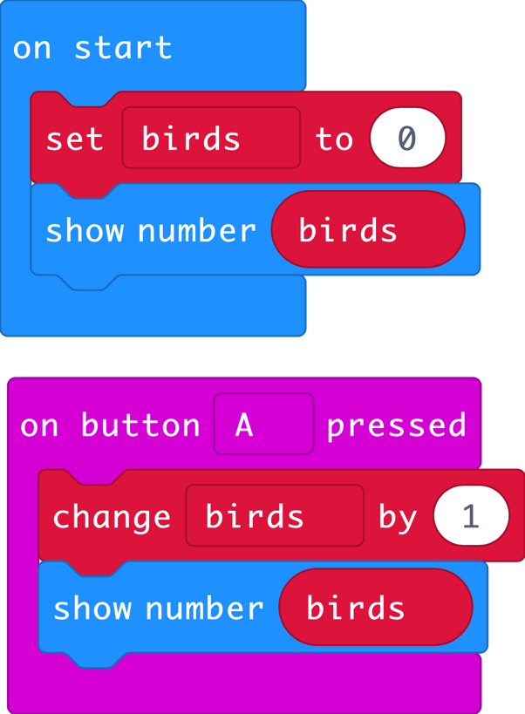
Creating a micro:bit species counter
Sample counter code.

Slide 8
Our results
How will we collect, analyse and present our results?

Slide 9
Licensing information
Published by the Micro:bit Educational Foundation microbit.org under the following Creative Commons licence:
Attribution-ShareAlike 4.0 International (CC BY-SA 4.0)
https://creativecommons.org/licenses/by-sa/4.0/
https://microbit.org/do-your-bit/

