Slide 1
Getting active
Teacher lesson guide
Lesson 4

Slide 2
Learning objectives:
To predict how variables will be used in programs.
To understand how a variable can be set to a random number.
To write algorithms that use random number variables.

Slide 3
Variable times table test
The micro:bit has been programmed to give you a times table test.
The micro:bit will display two numbers (between 0 and 12).
You have ten seconds to write down the product of these two numbers on your mini-whiteboard before the micro:bit displays the answer.
On your mini-whiteboard, create a variable called score.
If you get a question correct change score by 5
If you get a question wrong change score by -2
https://makecode.microbit.org/#pub:_4yp8CzKv0LFt

Slide 4
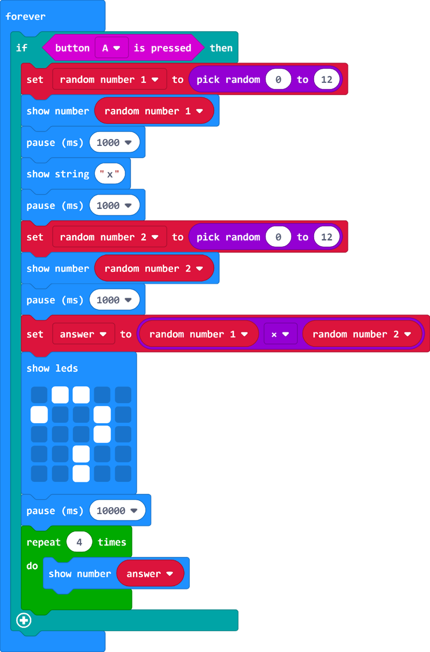
Understanding the program
How many variables are used in this program?
What are the names of the variables used in this program?
How are the values of the variables set?
How are these variables used?
How is the answer calculated?
https://makecode.microbit.org/#pub:_4yp8CzKv0LFt
Notes:
Three variables are used in this program
Variables used are random number 1, random number 2 and answer
Random number 1 and random number 2 are set to random numbers between 0 and 12. Answer is set to the product of random number 1 and random number 2
The value of each variable is displayed on micro:bit’s LEDs
The answer is calculated by multiplying the value of random number 1 and random number 2.

Slide 5
Modifying the program
By modifying the program, we can make the quiz more or less challenging.
Identify ways that you could modify the program to make the quiz more suitable to younger children.
https://makecode.microbit.org/#pub:_4yp8CzKv0LFt
Notes:
Pupils’ modifications make include:
Limited the numbers selected by lowering the larger number in the select random number block
Allowing more thinking time by increasing the value of the wait block (1000 = 1 sec)
Change the operation from multiplication to addition – If pupils suggest this I would be worth exploring if change to subtraction would make it easier. As the second number given could be larger than the first number the answer may end up being negative. Pupils may suggest changing the range from which the random number is selected (10-20; 0-9) to ensure that the second number is always worth less than the first number.

Slide 6
Deciding to get active
A family wishes to do more exercise. However, each member of the family wants to do a different activity.
Mum = walking
Dad = cycling
Seth = geocaching
Thea = climbing
Livvy = yoga
Isaac = scootering

Slide 7
Deciding to get active
Using the equipment on your table, design a solution to help the family decide what activity to do on that day.
Write a simple algorithm to explain to the family how your solution works.
Mum = walking
Dad = cycling
Seth = geocaching
Thea = climbing
Livvy = yoga
Isaac = scootering
Notes:
The idea should make use of the die and the fact that they are six different activities to be selected. A member of the family could roll the die and if the number rolled is one the family go walking, if the number rolled is two the family go cycling, etc.

Slide 8
Solving the problem with micro:bit
How could micro:bit be used with your solution?
What part of your solution could micro:bit replace?
How could variables be used?
How will the user(s) find out which activity has been selected?

Slide 9
Learning objectives revisited:
To predict how variables will be used in programs
To understand how a variable can be set to a random number
To write algorithms that use random number variables

Slide 10
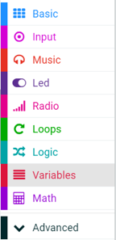
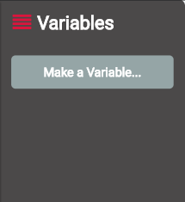
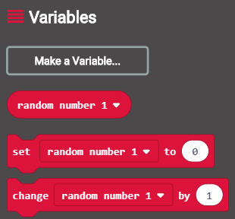
Before you can use a variable it needs to be created. This can be done by selecting make a variable from the variable menu.
When your variable has been created, you will have access to blocks that use, set and change the variable. .

Slide 11
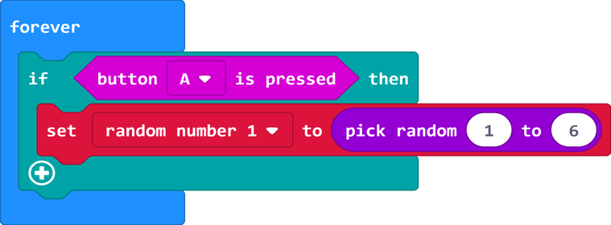
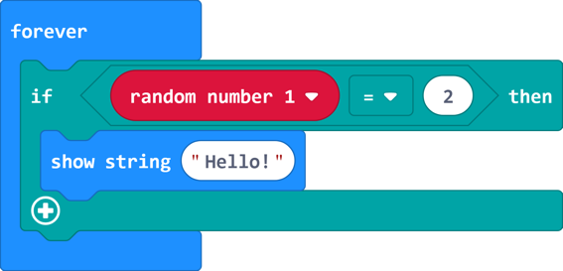
Micro:bit will set the value of the variable random number 1 to a randomly selected number between 1 and 3 when button a is pressed.
Micro:bit displays the word hello if the value of the variable random number 1 equals 2

Slide 12
Select which activity the family will do when the die is rolled.
If the number 1 or 2 is rolled on the dice
Then the family will
If the number 3 or 4 is rolled on the dice
Then the family will
If the number 5 or 6 is rolled on the dice
Then the family will

Slide 13
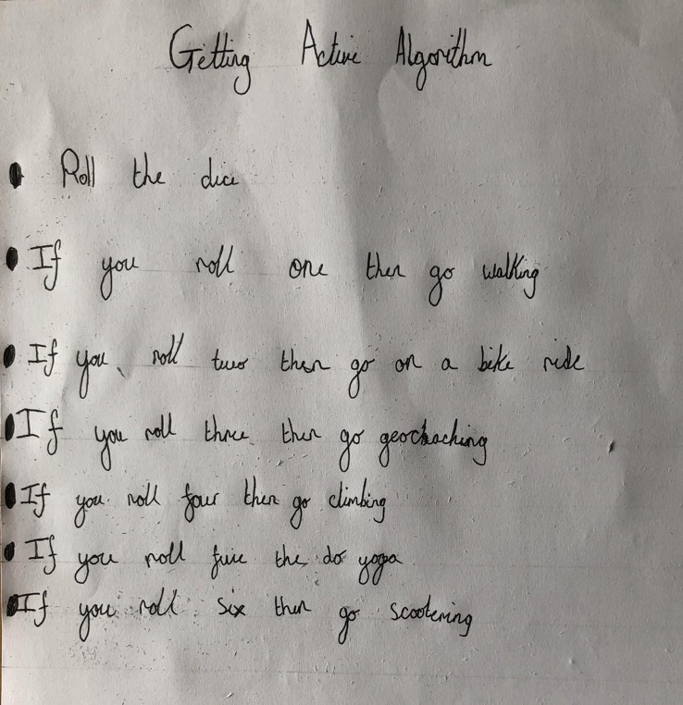
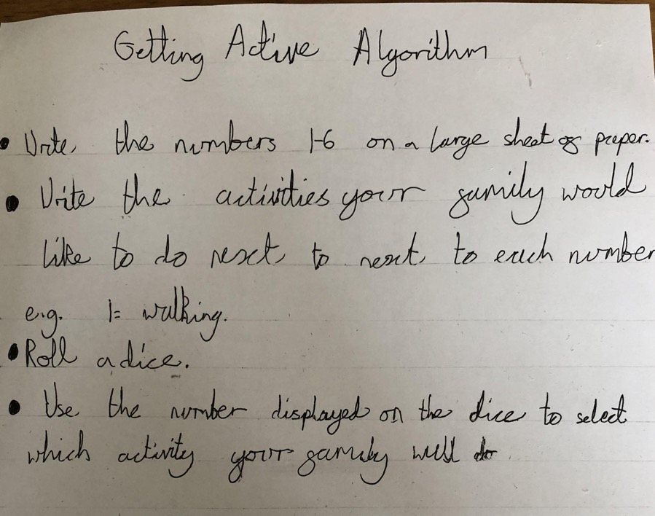
Examples of algorithms

Slide 14
Licensing information
Published by the Micro:bit Educational Foundation microbit.org
Licence: Attribution-ShareAlike 4.0 International (CC BY-SA 4.0)

