Slide 1
Cyber Security
Teacher lesson guide
Lesson 1

Slide 2
Learning objectives:
to understand about the importance of cyber security in the world today
to be able to explain what is meant by the term ‘ethical hacking’
to understand how to recognise potential malware attacks and how to protect data and devices.

Slide 3
What is Malware?
Short for malicious software
Attacks computers & digital devices
Can:
harm software
steal users’ data
cause harm to the host computer
Types include:
viruses
worms
trojan horses
spyware

Slide 4
Malware or made up?
You have a pack of 20 cards
Sort your cards into 2 piles - malware or made up
You only have 2 mins

Slide 5
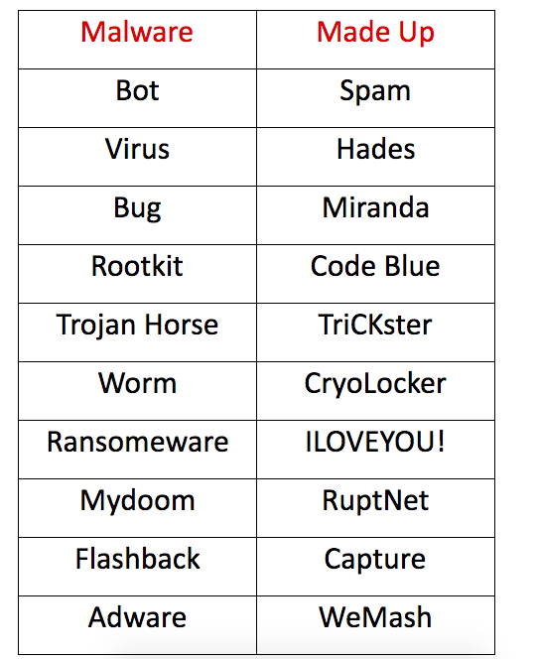
Malware or made up solution
Notes:
Bot: a program on the Internet that interacts with systems or users, can act like a player in some video games. Virus: a piece of code which is capable of copying itself, can corrupt a computing system or destroy data.
Bug: an error in a computer program or system.
Rootkit: a set of software tools that enable an unauthorised user to gain control of a computer system without being detected.
Trojan Horse: a dangerous program that hides within other applications, can be hidden in a program that states it can clean your computer but instead introduces viruses

Slide 6
In pairs, consider:
What is Cyber Security?
Why does it matter?

Slide 7
Cyber security questions:
What is Cyber Security?
the protection of internet systems (hardware, software, data etc) from cyber attacks.
Why does it matter?
It is important because without it you are leaving yourself open to cyber attacks e.g. you could have your identity stolen or your even your money.

Slide 8
The National Cyber Security Centre
Publishes weekly details of cyber security threats

Slide 9
Cyber security is a global problem!
Where are risks coming from and why?
What examples of cyber threats do you know of?
What are the security implications for all of us?

Slide 10
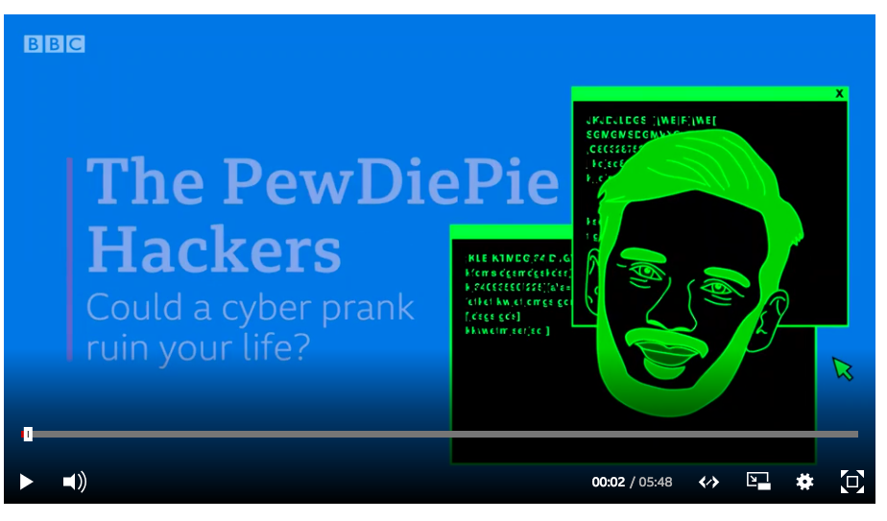
Hacking
Computer Misuse Act (UK): you can be sent to prison for up to 14 years and / or face a large fine for malicious hacking.
Watch this BBC video about 2 teenage hackers

Slide 11
Cyber Security: A Career?
Ethical Hacking is now a career. What do you ‘ethical hacking’ means?
Ethical or white hat hackers locate weaknesses and vulnerabilities of computer systems by trying to hack them.
This helps companies to protect their computer systems from hackers.
An ethical hacker’s starting salary can be £30K+

Slide 12
Ethical or ‘White Hat’ Hacking

Slide 13
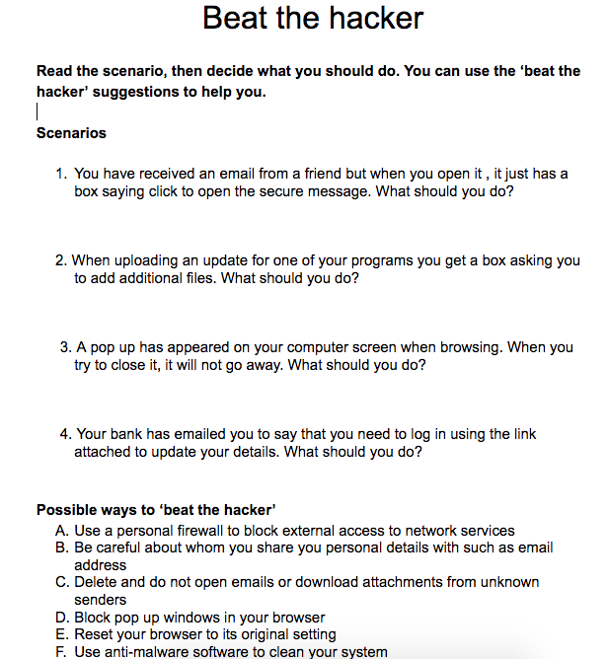
Beat the hacker

Slide 14
Learning objectives revisited:
to understand about the importance of cyber security in the world today
to be able to explain what is meant by the term ‘ethical hacking’
to understand how to recognise potential malware attacks and how to protect data and devices.

Slide 15
Licensing information
Published by the Micro:bit Educational Foundation microbit.org
Licence: Attribution-ShareAlike 4.0 International (CC BY-SA 4.0)

