Slide 1
Data handling
Teacher lesson guide
Lesson 4

Slide 2
Learning objectives:
To know that data can be used as a condition in selection.
To explore the effects of changing the value of data in programs.
To write programs that use data as a condition.

Slide 3
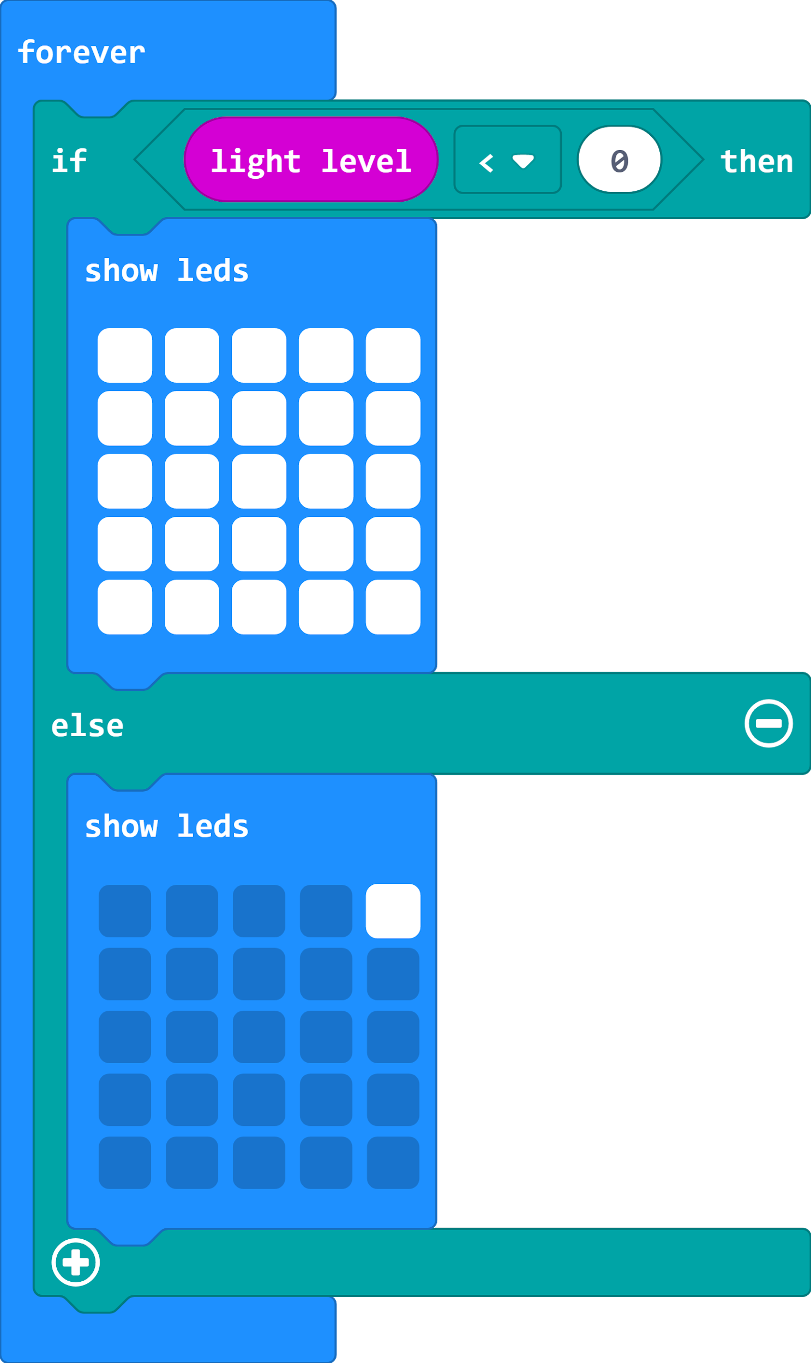
Algorithms and programs
FOREVER
IF it is dark
THEN turn light on
ELSE turn light off

Slide 4
repetition
Algorithms and programs
FOREVER
IF it is dark
THEN turn light on
ELSE turn light off
data
selection

Slide 5
Recapping computing concepts
Can you identify where in the program the following computing concepts have been used?
Selection
Repetition
Data

Slide 6
Predicting a program output
Predict what will happen when this program runs on a micro:bit
What will happen if we turn off the classroom lights?
Notes:
The light sensor keeps checking the light level.
If the light level is less than zero, then all the LEDs will be displayed.
Otherwise (else) only one LED will be displayed.

Slide 7
Explaining the program
The program tells the micro:bit to show all the LEDs if the light level is less than zero.
Can you modify the program so that all the LEDs come on when the classroom lights are turned off?

Slide 8
Everyday uses of sensors
Motor vehicles make use of sensors to help keep the driver and the passengers safe.
Click here to see an example of how motor vehicles use sensors.

Slide 9
Everyday uses of sensors
Create an algorithm to show how your temperature system warning light will work.
Use the LED planner to show the image your micro:bit will display.
Turn your algorithm into a program using the MakeCode editor.

Slide 10
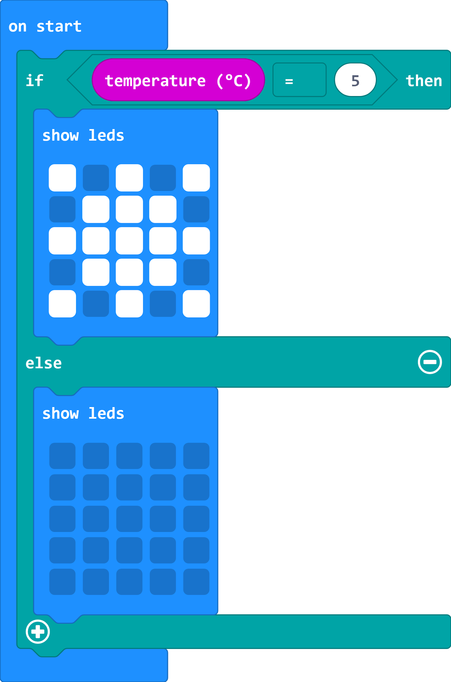
Debugging with sensors
Can you debug and fix the code so that the image shows when the temperature falls below 5 degrees Celsius?
Notes:
A forever loop has not been added so the temperature is only checked once. The condition is If temperature is equal to 5 rather than less than 5. Therefore, even if the forever loop is added, the image will only be displayed when the temperature is exactly 5 degrees.

Slide 11
Learning objectives:
To know that data can be used as a condition in selection.
To explore the effects of changing the value of data in programs.
To write programs that use data as a condition.

Slide 12
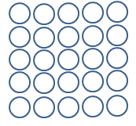
LED planner

Slide 13
Sample pupil algorithm

Slide 14
Licensing information:
Published by the Micro:bit Educational Foundation microbit.org under the following Creative Commons licence:
Attribution-ShareAlike 4.0 International (CC BY-SA 4.0) https://creativecommons.org/licenses/by-sa/4.0/

