Slide 1
Tree protector

Slide 2
Global goals

Slide 3
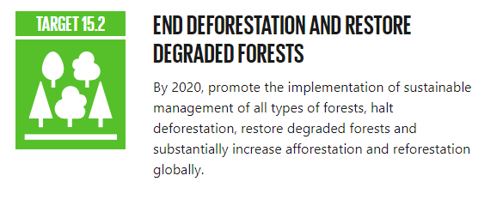

Slide 4
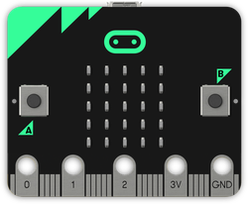
Success criteria
Can be attached to a tree securely
Alerts the authorities if the tree is cut down
Gives the authorities the location of the fallen tree

Slide 5
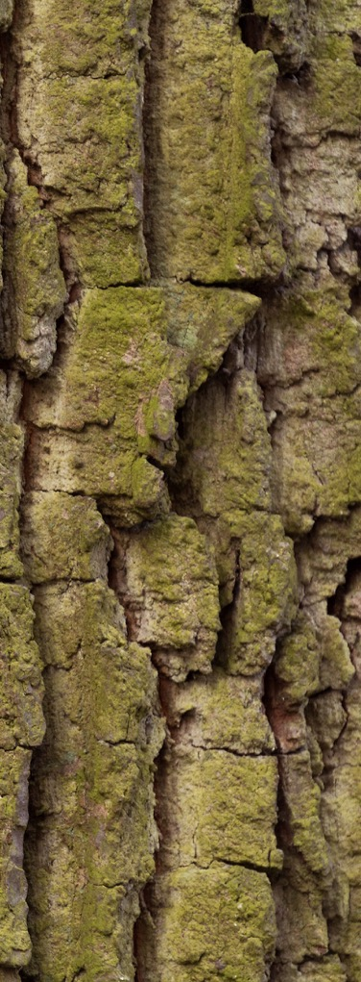
NODE
GATEWAY
(to the internet)
Radio blocks
Is attached to the tree
With the authorities

Slide 6
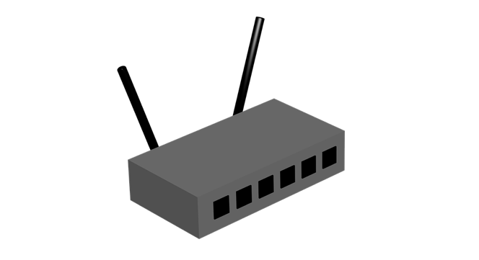
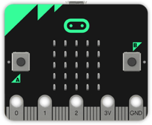
3/4/5G
WiFi
LoRa
Sigfox
Long range
GATEWAY
(to the internet)
Authorities
In Real Life:
Node transmits to gateway over a long range using 3G (mobile network) or LoRa/SigFox
Gateway receives data and then transmits it to the internet
The authorities receive the data on a PC or mobile device
NODE

Slide 7
What are we going to sense?
After
Before

Slide 8
Input process output
Input | Process | Output
Acceleration and tilt sensor data to sense if tree is falling over | If acceleration of angle of sensor exceeds a threshold then output | Send message to authorities including location data
Input | Process | Output
Receive alert from node | Format the data | Message on screen showing alert and GPS co-ordinates

Slide 9
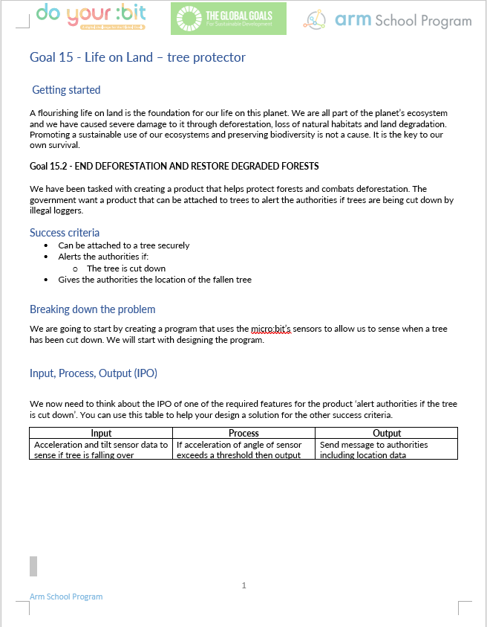
Group task:
Get into pairs/groups
Use the Tree Protector worksheet to help you design and create your product
The product must meet the success criteria
Use the IPO (input-process-output) worksheet to design further features
Make a model tree to test your product

Slide 10
Success criteria
Can be attached to a tree securely
Alerts the authorities if the tree is cut down
Gives the authorities the location of the fallen tree

Slide 11
Licensing information
Published by the Micro:bit Educational Foundation microbit.org under the following Creative Commons licence:
Attribution-NonCommercial-ShareAlike 4.0 International (CC BY-NC-SA 4.0)
https://creativecommons.org/licenses/by-nc-sa/4.0/
https://microbit.org/do-your-bit/

