Slide 1
Night safety
Night sensor

Slide 2
Night safety for children
What are the main issues around road safety for children?
What risks are increased at night?
What groups of children might be especially at risk?

Slide 3
How can technology help?
Technology can help children stay safer at night on roads.
How?
Think of ideas in groups – be creative!

Slide 4
How can the BBC micro:bit help?
What types of device could be created with the micro:bit to help?
Think of ideas in your groups.

Slide 5
Night sensor
How could a night sensor help children?
Why might it be especially useful for children with hearing or visual impairments?

Slide 6
Night sensor algorithm
Write an algorithm to create a Night sensor using the micro:bit
When finished, share and debug your algorithms

Slide 7
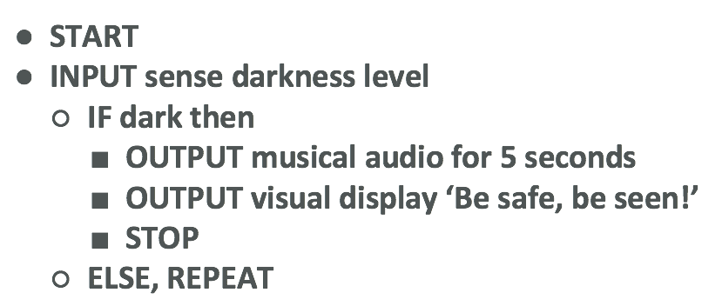
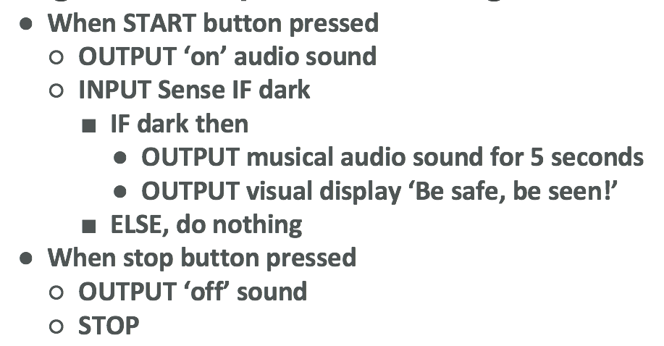
Night sensor algorithm examples
Simple Night sensor algorithm
Night sensor with stop-start buttons
algorithm

Slide 8
Programming your Night sensor
Using the MakeCode editor and your algorithm, write your Night sensor program.
Remember to test and debug regularly.
Once finished, download and copy to your micro:bit to test and run.
Compare your programs and Night sensors.

Slide 9
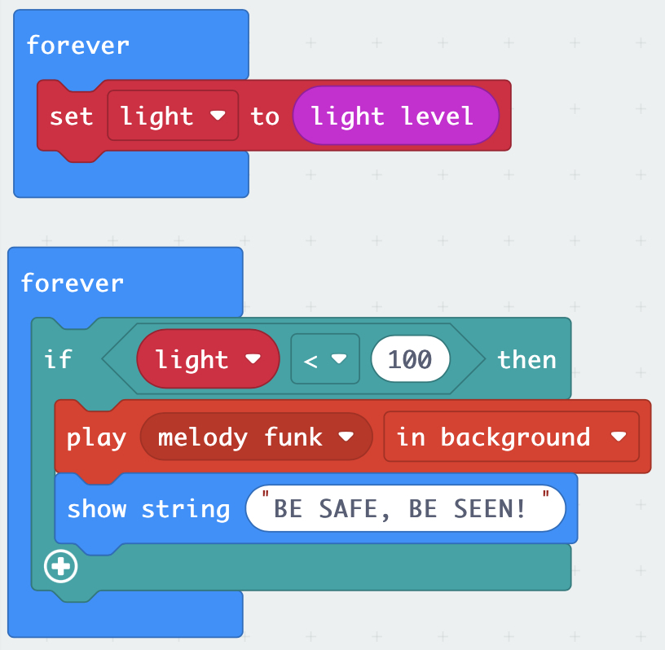
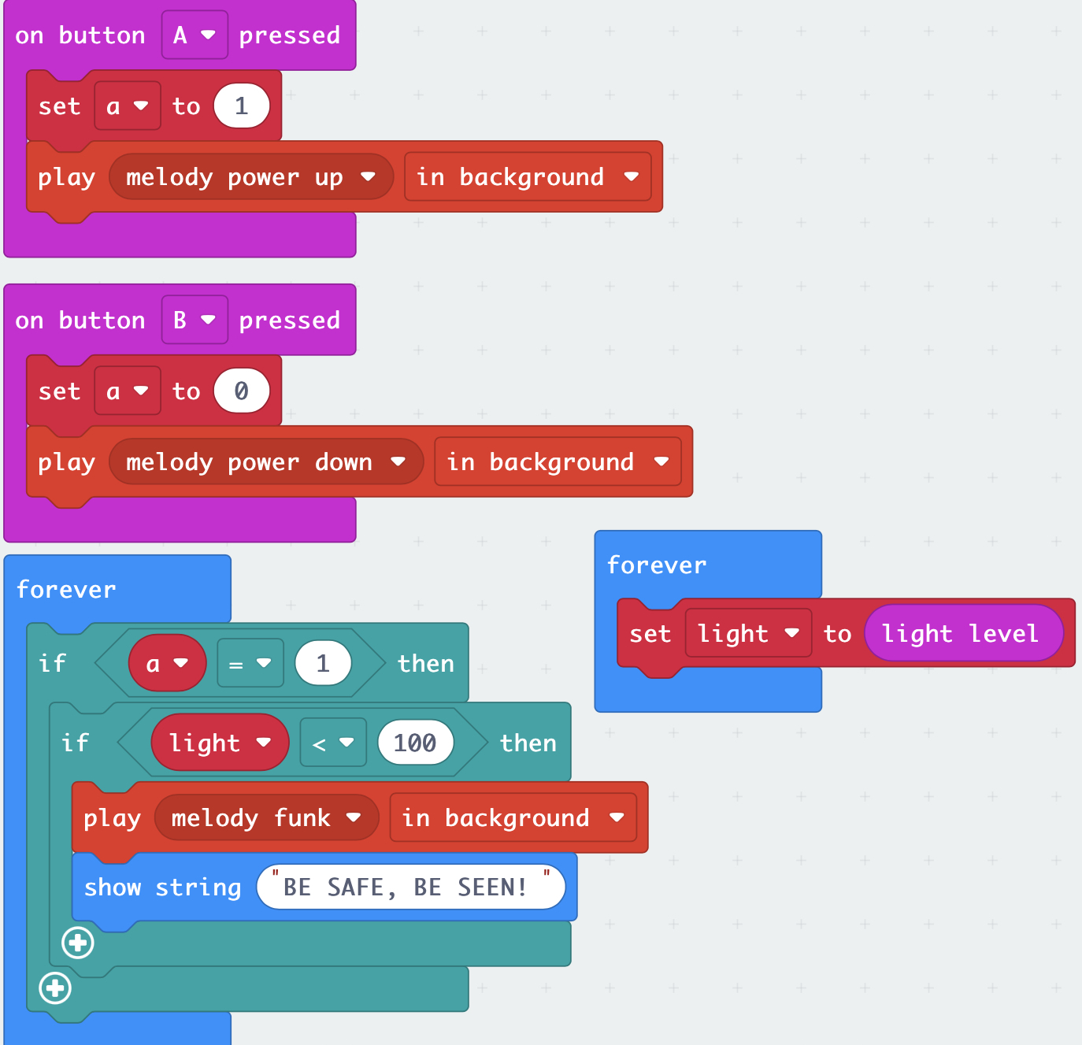
Night sensor program examples
Simple Night sensor program
Night sensor with stop-start buttons

Slide 10
Review
What problems did you have and how did you solve them?
What have you learnt from this project?

Slide 11
Licensing information
Published by the Micro:bit Educational Foundation microbit.org
Licence: Attribution-ShareAlike 4.0 International (CC BY-SA 4.0)

