Slide 1

Digital flashcards
Teacher lesson guide
Lesson 4

Slide 2
Learning objectives
To use logical reasoning to identify the output of a program.
To tinker (experiment) to develop understanding.
To plan algorithms that met a criteria.

Slide 3
What’s my program?
Look at the programs on your sheets and make notes on them to predict what you think will happen and why.
Watch the program’s output on micro:bit simulator and identify which program from the set was used.
Why do you think it is that program?

Slide 4
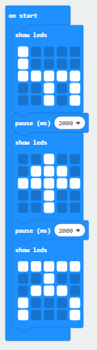
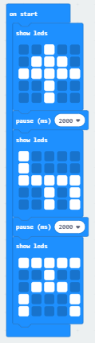
Icons 1
https://makecode.microbit.org/#pub:_H17cj8d19Fj3
Notes:
Use https://makecode.microbit.org/#pub:_H17cj8d19Fj3 to access micro:bit simulator to display the output

Slide 5
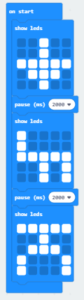
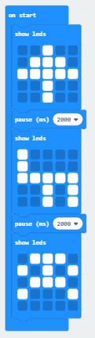
Icons 2
https://makecode.microbit.org/#pub:_Mgg4kadqFbYa
Notes:
Use https://makecode.microbit.org/#pub:_Mgg4kadqFbYa to access micro:bit simulator to display the output

Slide 6
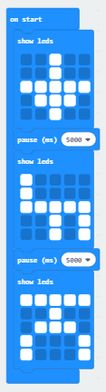
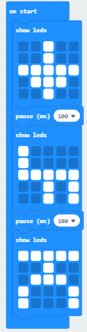
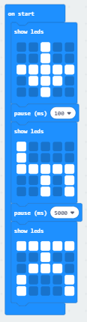
Icons 3
https://makecode.microbit.org/#pub:_2z80hm0CVWKJ
Notes:
Use https://makecode.microbit.org/#pub:_2z80hm0CVWKJ to access micro:bit simulator to display the output

Slide 7
Tinkering with LEDs
There are other blocks in the ‘basic’ menu that can be used to control the LEDs.
Tinker (experiment) with the blocks using the MakeCode editor to find other ways of programming the LEDs.
Notes:
.

Slide 8
Tinkering
Tinkering is a process by which we find out things, including how things work, by exploring new items and test things out.
Tinkering also allows us to find out how to do things in different ways to find the most effective method.
Notes:
.

Slide 9
Feedback from tinkering 1
How else can the LEDs be programmed?
Notes:
In addition to the show leds block, the pupils can also use the show number block to display a digit and show string block to scroll a word or phrase across the LEDs.

Slide 10
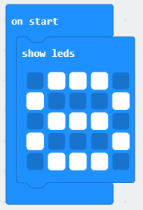
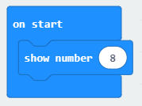
Feedback from tinkering 2
Which is the most effective way of representing the digit 8?
Notes:
Using the show number block is more effective as it only requires the eight key to be pressed. The show leds block requires the 13 lights to be selected.

Slide 11
Creating digital number flashcards
We are going to create digital flashcards to help some practice recalling the numbers from one to ten.
How could we use the the different block to create representations of a number?
Notes:
Pupils should use the show leds block to represent the number by turning on the same number of LEDs not constructing the digit.

Slide 12
Design criteria
Write an algorithm to show how you will create digital flashcards that:
  Represents at least four numbers between 1-10
  Uses word, digits and images to represent the numbers
  Allows appropriate time to think and respond
  Lets the user know they have finished

Slide 13
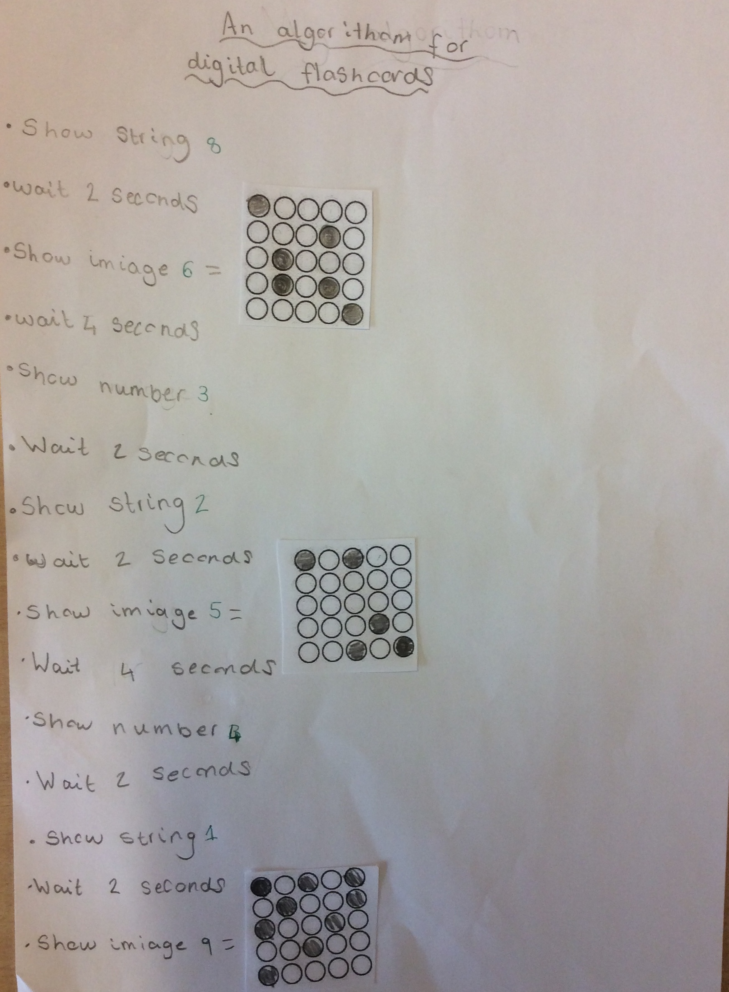
Planning your program 1
Write an algorithm to show how you represent the numbers in digits, words and images.
Do we need to give the same amount of thinking for each representation?

Slide 14
Planning your program 2

Slide 15
Meeting the design criteria
Highlight on your algorithm where you have met the design criteria:
  Represents at least four numbers between 1-10
  Uses word, digits and images to represent the numbers
  Allows appropriate time to think and respond
  Lets the user know they have finished

Slide 16
Learning objectives revisited
To use logical reasoning to identify the output of a program
To tinker to develop understanding
To plan algorithms that met a criteria

Slide 17

LED planner
representation of
____________
representation of
____________
representation of
____________
representation of
____________
representation of
____________
representation of
____________
representation of
____________
representation of
____________
Notes:
Pupil should sequence their representations by using the boxes to place the step number in.

Slide 18
Licensing information
Published by the Micro:bit Educational Foundation microbit.org under the following Creative Commons licence:
Attribution-ShareAlike 4.0 International (CC BY-SA 4.0)
https://creativecommons.org/licenses/by-sa/4.0/

