Slide 1
Night safety
A bag for Juliane

Slide 2
Juliane’s story

Slide 3
Juliane’s story
How do you think Juliane felt at different times in her life and journey?
How do you think Juliane feels now?
How does being at school help Juliane?
Why might Juliane feel scared when walking to school?
When might this be worse?
What ways could she be helped to feel safer?

Slide 4
A bag for Juliane
Design a bag for Juliane to use on her journey to school to help her feel safer in the dark.
Use a micro:bit to create an LED light
Consider how the light will fit on the bag
Design other features to help Juliane

Slide 5
Your bag for Juliane
Draw your design on paper
Annotate it to explain how the features will work & help Juliane
Write an algorithm for the light using micro:bit
Program the micro:bit light
Create your bag if you have the materials

Slide 6
Sample algorithm for a flashing light
INPUT when ON button pressed
INPUT ‘on’ sound
Start
INPUT Sense IF dark
IF dark then
INPUT Sense IF moving
If moving then
OUTPUT light 1 second
Pause 1 second
Repeat until STOP button pressed
ELSE, do nothing
ELSE, do nothing
When STOP button pressed
OUTPUT ‘off’ sound
STOP

Slide 7
Coding the light for the bag
Using the MakeCode editor and your algorithm, write your program for the light
Remember to test and debug regularly.
Once finished, download and copy to your micro:bit to test and run.

Slide 8
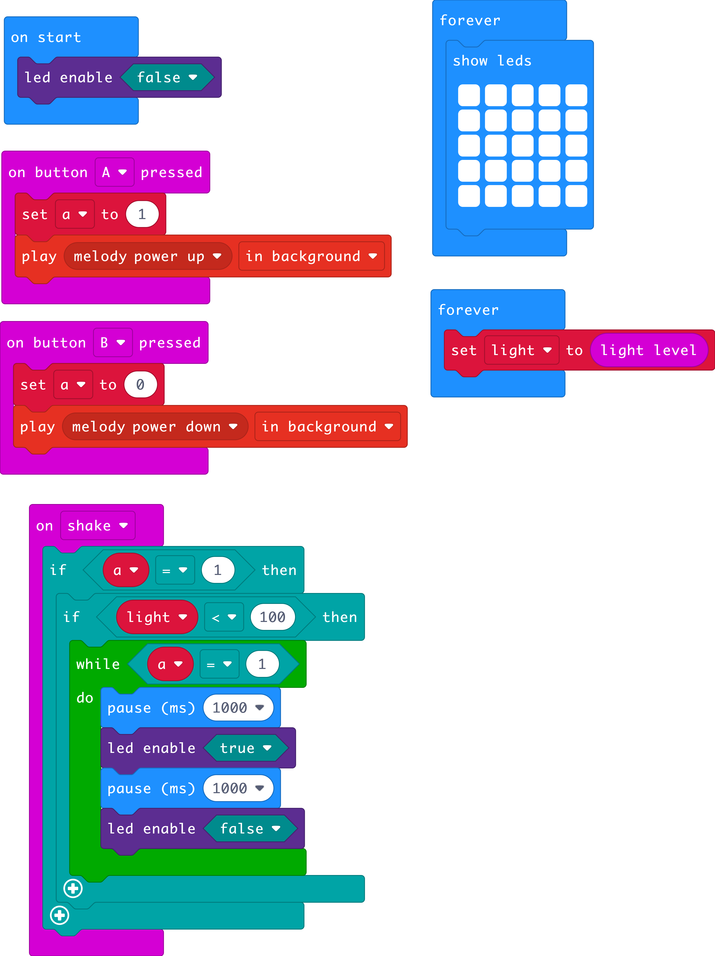
Light up bag example program

Slide 9
Evaluating your bag for Juliane
How do you think your bag will help Juliane?
What has worked well with?
What would you like to improve?
What problems did you encounter and how did you solve them?
What have you learnt from this project?
What would you like to learn more about?

Slide 10
Licensing information
Published by the Micro:bit Educational Foundation microbit.org
Licence: Attribution-ShareAlike 4.0 International (CC BY-SA 4.0)

