Slide 1
Cryptography
Teacher lesson guide
Lesson 2

Slide 2
Recap
What can you recall about cryptography?
What can you recall about ciphers?
What is a Caesar cipher?

Slide 3
Learning objectives:
to create and use a paper-based Caesar cipher to encrypt and decrypt messages
to use logical reasoning to write algorithms to encrypt and decrypt messages using a Caesar cipher
to test and debug algorithms effectively

Slide 4
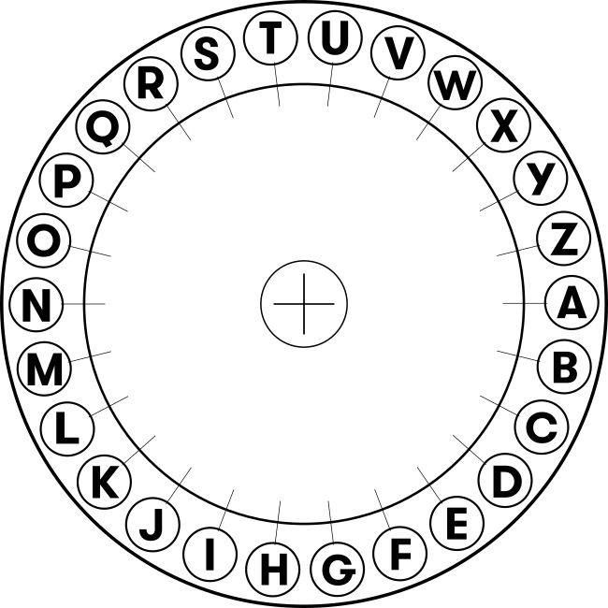
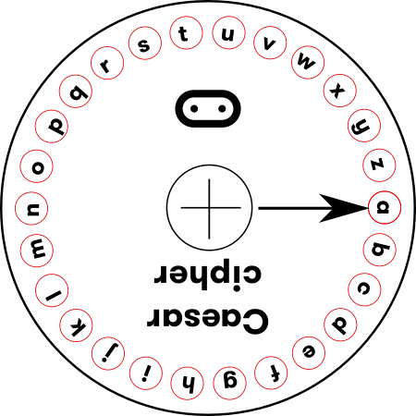
Creating a Caesar cipher
Your task A:
Cut out two circles from card, one smaller than the other (see template)
Put the smaller circle on top of the larger circle
Use a split pin through the centre of both circles to secure them together.
Line them up, then move the top (smaller) circles round by 3 letters.
You have created a Caesar cipher.
Note: while Caesar used a 3 letter shift, you can use any number.
Your task B:
Decide on the number of letters you will shift (create your cipher).
Write your own message in the space below
Share it with a partner
Can you decipher each other’s codes and work out the message?

Slide 5
Logical reasoning
Applying rules to solving problems
Using existing knowledge to make predictions
Explaining why something is the way it is
How did you use logical reasoning to crack the code?

Slide 6
Caesar cipher algorithm: encryption
Sample algorithm: Store letters as numbers: A=1, B=2, C=3 etc
START
INPUT message
take first letter
change letter to number
add 3 to number
change number back to letter
display letter
Repeat until end of message
STOP

Slide 7
Caesar cipher algorithm: decryption
Sample algorithm:
Store letters as numbers: A=1, B=2, C=3 etc
START
IF receive message
take first letter
change letter to number
add 3 to number
change number back to letter
display letter
Repeat until end of message
STOP

Slide 8
Review
How did you use logical reasoning to write your algorithms?
How have you used iteration and selection in your algorithm?
What problems did you have and how did you solve them?
How important was testing (and debugging) your algorithm?
How could a computer program store the alphabet do you think?
How could the Caesar cipher be improved?

Slide 9
Learning objectives revisited:
to create and use a paper-based Caesar cipher to encrypt and decrypt messages
to use logical reasoning to write algorithms to encrypt and decrypt messages using a Caesar cipher
to test and debug algorithms effectively

Slide 10
Licensing information
Published by the Micro:bit Educational Foundation microbit.org
Licence: Attribution-ShareAlike 4.0 International (CC BY-SA 4.0)

