Slide 1
Computing fundamentals Lesson 1
Fundamentals of
computational thinking

Slide 2
Team Giant Aeroplane Challenge
In your teams:
Create a giant paper aeroplane
Use only the materials you have been given
You have 10 minutes
Prizes for the aeroplanes that:
fly furthest
fly longest
look most stylish
& best problem solving as a team

Slide 3
Paper aeroplane instructions:
create instructions for someone else to follow to create a giant paper aeroplane
they must be accurate and easy to follow
you can use any format you wish
you have 10 minutes

Slide 4
Computational thinking
Computational thinking means considering a problem in a way that a computer can help us to solve it.
We need to:
understanding what the problem is
consider possible solutions
use a computer to help solve the problem

Slide 5
Computational thinking
There are 5 main components to computational thinking:
Decomposition
Abstraction
Pattern recognition
Algorithms
Evaluation
Notes:
Note: Students may have also included ‘logic’ from the Barefoot Computing primary level definition of Computational Thinking - that is a skill used across all 5 areas. Some Computational Thinking definitions also do not include evaluation (e.g. Google’s CT for educators course).

Slide 6
Learning objectives:
to understand what ‘computational thinking’ is
to develop computational thinking skills
to write an accurate algorithm

Slide 7
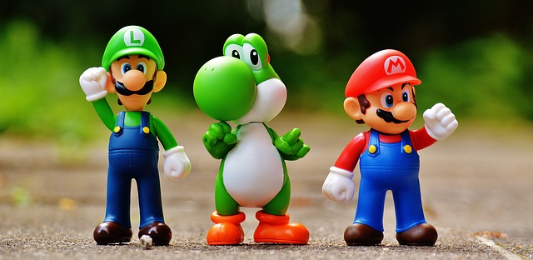
Decomposition
Breaking down a complex problem into smaller parts.
Each of these parts can then be considered in detail.
Think about all the different elements of creating a computer game…
Notes:
e.g. plot, setting, characters, scoring system, levels etc

Slide 8
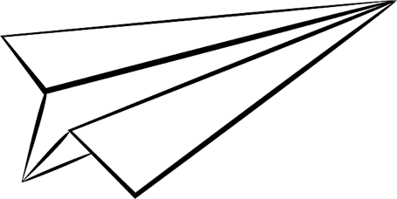
Decomposition
How did you use decomposition in the giant paper aeroplane challenge?
You decided how to fold the paper to make the main shape, then the wings, then how to decorate it.

Slide 9
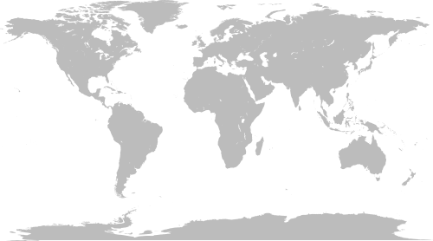
Abstraction
Reducing unnecessary detail and focusing on the important parts of a system.
Creating a representation or generalisation.
Notes:
World maps (or any map) is a good example of abstraction - creating a generalisation/representation of something complex.
A tube map is another classic example https://commons.wikimedia.org/wiki/File:London_Underground_Overground_DLR_Crossrail_map.svg

Slide 10
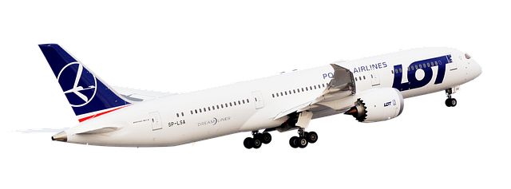
Abstraction
How did you use abstraction in the giant paper aeroplane challenge?
You created a representation of an aeroplane.

Slide 11
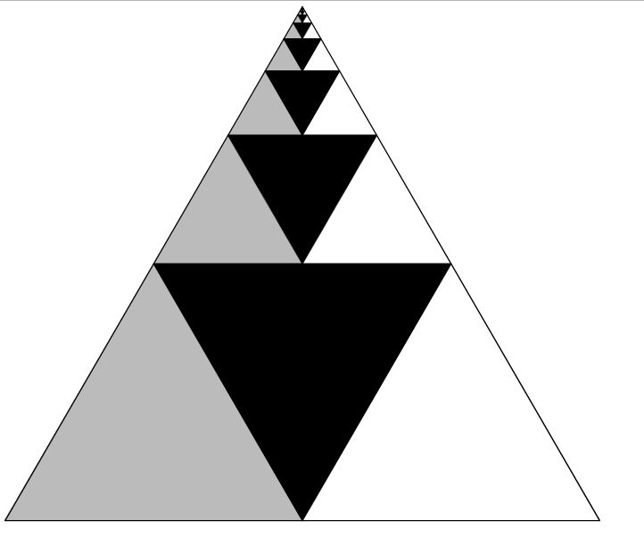
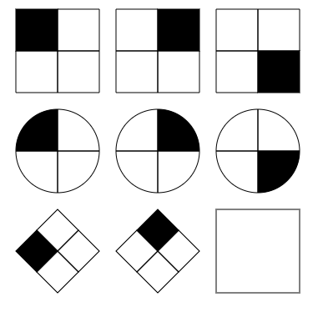
Pattern recognition
Recognising and finding patterns or trends.
Looking for similarities.
Koch snowflake
Raven matrix
Geometric series triangle

Slide 12
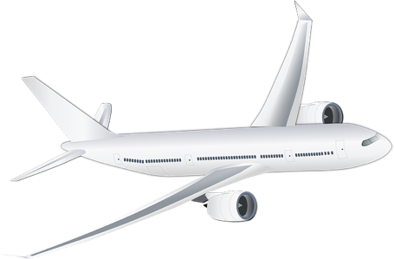
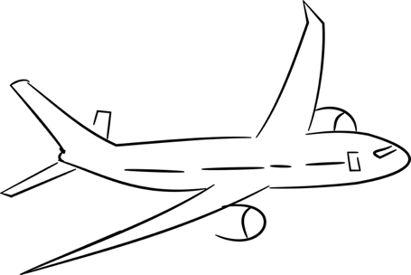
Pattern recognition
How did you use pattern recognition in the giant paper aeroplane challenge?
You recognised what planes usually look like (the shape).
You identified common features (e.g. wings, nose, windows etc).

Slide 13
Algorithms
Developing instructions to solve a problem.
The steps or rules to complete a task.
E.g. Multiplication or division ‘rules’ in maths. What are the rules/steps for multiplying decimals by 10?
You move the decimal point one space to the right - that’s the algorithm!

Slide 14
Algorithms
How did you use algorithms in the giant paper aeroplane challenge?
The instructions you created for someone to follow to create a giant paper aeroplane is an algorithm.

Slide 15
Evaluation
Evaluation means considering if a solution is ‘fit for purpose’.
Is it:
suitable for the user?
easily understood?
efficient?
the best that can be done with the resources available?

Slide 16
Evaluation
How did you use evaluation in the giant paper aeroplane challenge?
Checking your plane flies
Making the best use of the resources you have
Ensuring your instructions (algorithm) was easy to follow

Slide 17
Learning objectives revisited:
to understand what ‘computational thinking’ is
to develop computational thinking skills
to write an accurate algorithm

Slide 18
Copyright information
Published by Micro:bit Educational Foundation microbit.org
Licence: Attribution-ShareAlike 4.0 International (CC BY-SA 4.0)

