Slide 1
Oil Spill Cleaner-upper

Slide 4
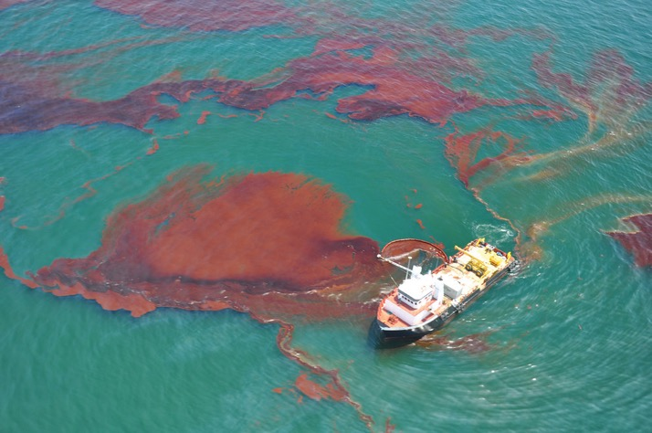
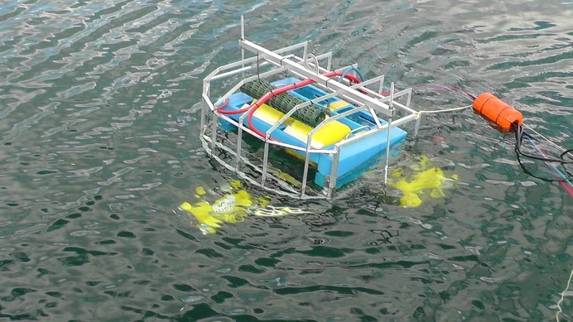
Setting the scene
A group of marine scientists have asked you to develop an algorithm that could be used on a boat drone to drag around a sheet of this smart material to clean up an oil spill.

Slide 5
There are two versions of this activity:
Without building:
Focus on algorithmic thinking
Go to slide 6
With building:
Creating a robot drone
Programming the drone robot
Go to slide 14

Slide 6
Success criteria (no build):
Build a prototype oil spill cleaner upper boat drone that starts with a button press
The prototype should demonstrate an algorithm that moves a sprite autonomously over an area (5x5 LEDs)
The prototype should be able to take in larger areas to cover larger spills

Slide 7
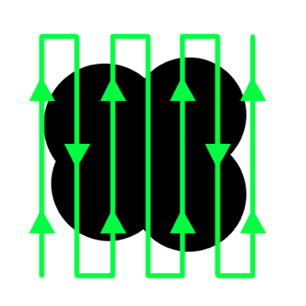
Input process output
Input | Process | Output
Button press | Algorithm to control the movement of the boat drone in a path to clean up oil: Increase or decrease the size of the grid | Show the sprite on the screen completing the algorithm Larger LED screens could display the larger grid, smaller grids can be represented on the micro:bit

Slide 8
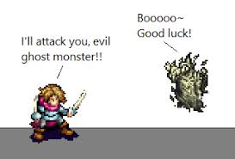
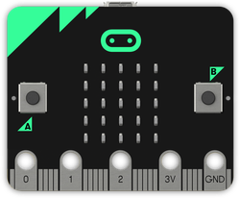
Sprites
Sprites are usually animated pictures used to represent people and things in games
Sprites can be programmed to do more than just be animated, such as respond to button presses and take damage as well as anything else you can think of!
On the micro:bit a sprite is represented as a single LED but can be programmed to behave like a more complex sprite for games

Slide 9
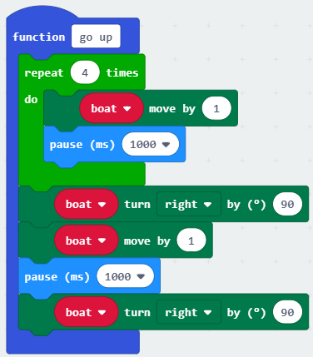
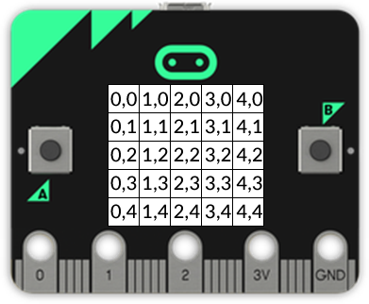
Co-ordinates

Slide 10
Functions, loops and variables
Function
Loop
Variable
Sprite blocks
Basic blocks

Slide 11
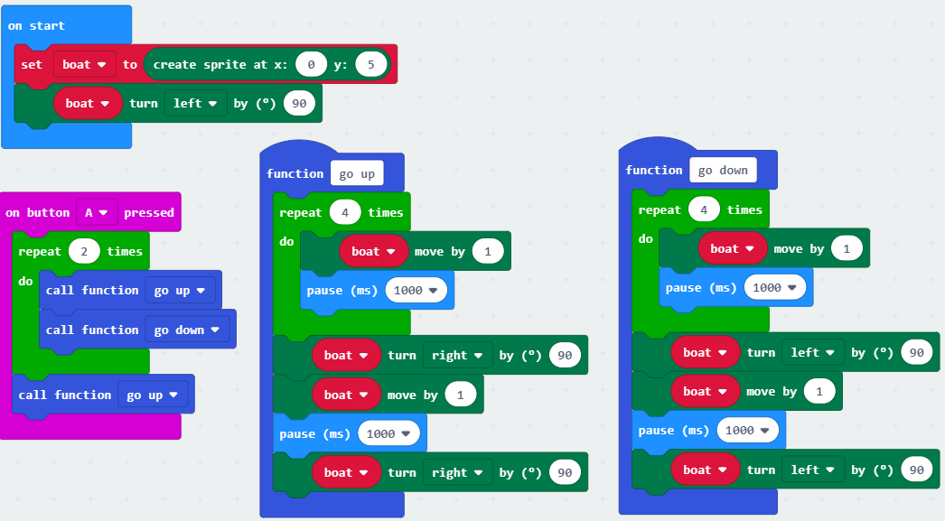
Creating a mock-up
These blocks create an on-screen mock-up using a sprite.
We can use this to test our algorithm on the micro:bit or in MakeCode.

Slide 12
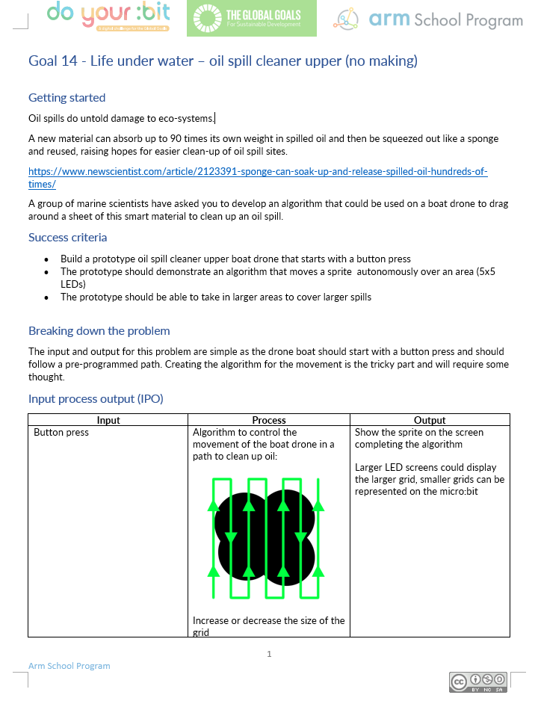
Group task:
Get into pairs/groups
Use the Oil Spill Cleaner Upper worksheet to help you design and create your product
The product must meet the success criteria
Use the IPO worksheet to design further features
Make a model tree to test your product

Slide 13
Success criteria (no build):
Build a prototype oil spill cleaner upper boat drone that starts with a button press
The prototype should demonstrate an algorithm that moves a sprite autonomously over an area (5x5 LEDs)
The prototype should be able to take in larger areas to cover larger spills

Slide 14
Success criteria (with build):
Build a floating oil spill cleaner-upper boat drone that starts with a button press
The product should be able to autonomously navigate over an area
The product should be made to clean up an oil spill by dragging a ‘smart material’

Slide 15
Input process output
Input | Process | Output
Button press | Algorithm to control the movement of the boat drone in a path to clean up oil: | Servo motor control

Slide 16
Creating a mock-up
These blocks create an on-screen mock-up using a sprite.
We can use this to test our algorithm on the micro:bit or in MakeCode.

Slide 17
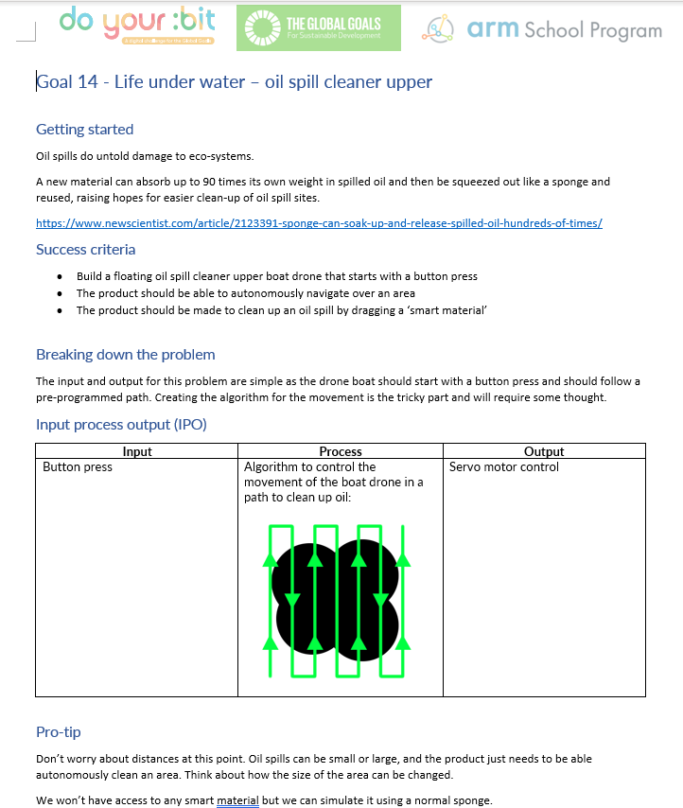
Group task:
Get into pairs/groups
Use the Oil Spill Cleaner Upper worksheet to help you design and create your product
The product must meet the success criteria
Use the IPO worksheet to design further features
Make a model tree to test your product

Slide 18
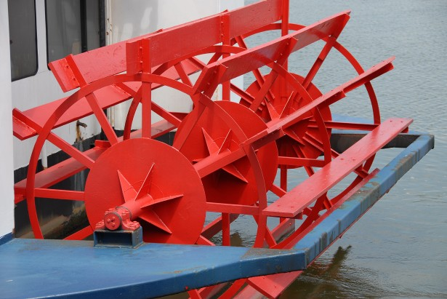
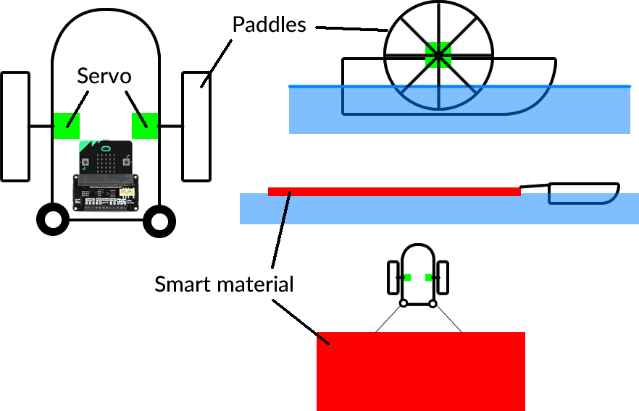
The paddle wheel:

Slide 19
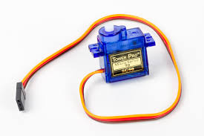
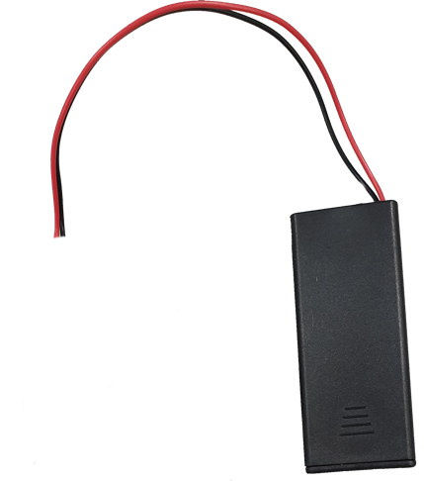
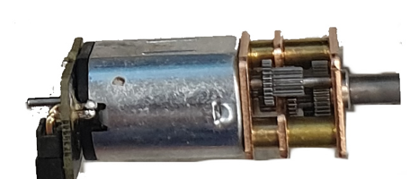
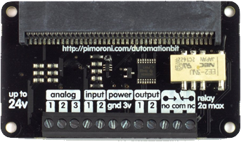
Hardware needed:
micro:bit(s)
battery peripheral and batteries
materials to make the floating body and paddles
servo control board
servo motors
a sponge to simulate the smart material

Slide 20
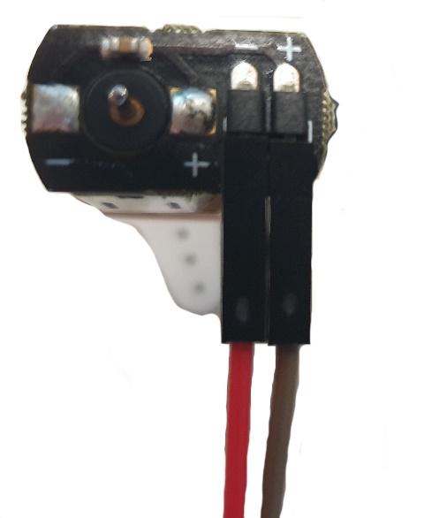
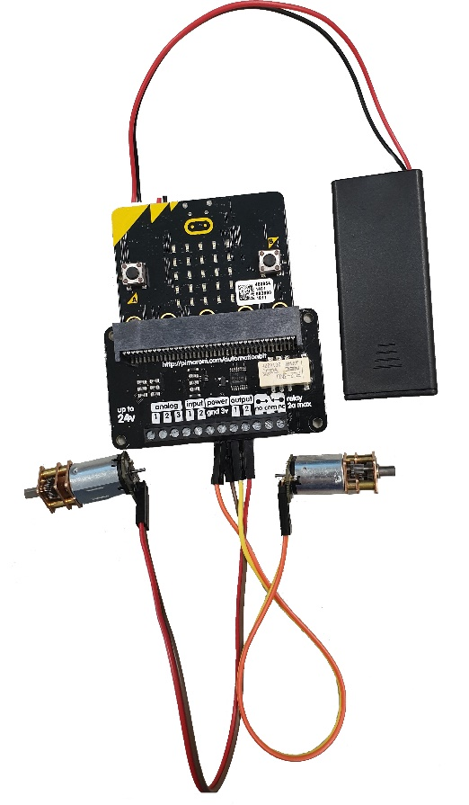
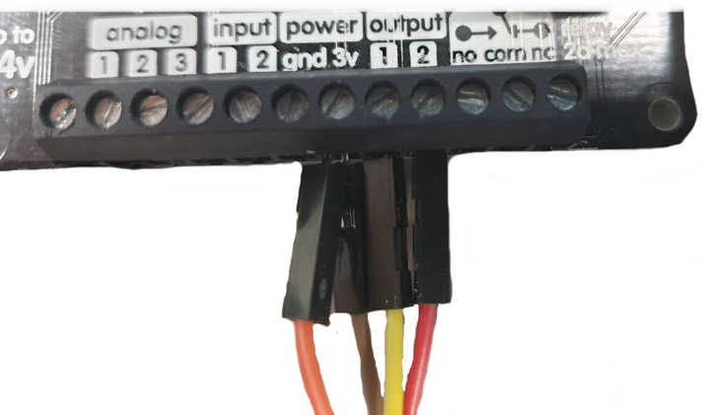
Note:
The motors need power from the batteries
The + wires from both servos go into the 3v terminal
Output one is right
Output two is left
Ground (GND) wires got to the GND terminal

Slide 21
Success criteria (with build):
Build a prototype oil spill cleaner upper boat drone that starts with a button press
The prototype should demonstrate an algorithm that moves a sprite autonomously over an area (5x5 LEDs)
The prototype should be able to take in larger areas to cover larger spills

Slide 22
Licensing information
Published by the Micro:bit Educational Foundation microbit.org under the following Creative Commons licence:
Attribution-NonCommercial-ShareAlike 4.0 International (CC BY-NC-SA 4.0)
https://creativecommons.org/licenses/by-nc-sa/4.0/
https://microbit.org/do-your-bit/

