Slide 1
Being active
Walking for water

Slide 2
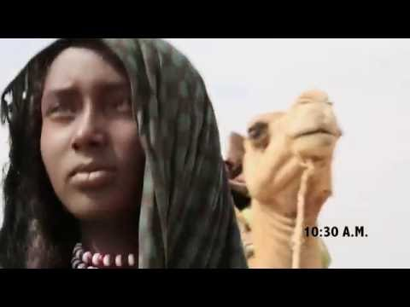
Aysha’s story

Slide 3
Walking for water
How do you think walking for 8 hours a day impacts on Aysha’s life?
Why does the ‘Water Burden’ impact women & girls most?
Estimate how far Aysha walks every day (8 hours, 4 stops of 15 minutes, average pace of 4k per hour, 1km = approx 1500 steps).

Slide 4
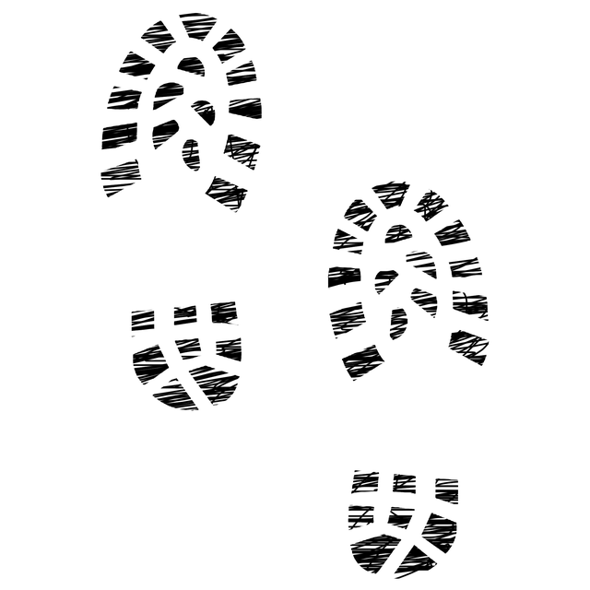
Your ‘walking for water’ challenge
Walk as many steps as Aysha does in 1 day over 4 days.

Slide 5
Your walking for water challenge
Write an algorithm to create a step counter using micro:bit
Program your micro:bit step counter
Consider how you will attach your step counter to you
Use your micro:bit step counter to track your steps and complete the ‘walking for water’ challenge

Slide 6
Step counter algorithm example
ON start
Set ‘steps’ to 0
Show ‘steps’
REPEAT forever
WHEN sense step,
Add 1 to ‘steps’

Slide 7
Coding your step counter
Using the MakeCode editor and your algorithm, write your step counter program
Remember to test and debug regularly.
Once finished, download and copy to your micro:bit to test and run.

Slide 8
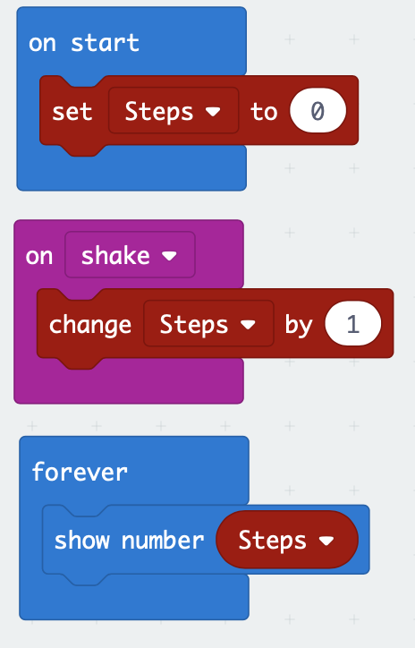
Step counter example program

Slide 9
Your ‘walking for water’ challenge
Walk as many steps as Aysha does in 1 day over 4 days.

Slide 10
Evaluating your step counter & challenge
How effective was your step counter?
What could you improve and how?
What problems did you have and how did you solve them?
How did you get on with the ‘walking for water’ challenge?
What have you learnt from this project?
What else would you like to learn?

Slide 11
Licensing information
Published by the Micro:bit Educational Foundation microbit.org
Licence: Attribution-ShareAlike 4.0 International (CC BY-SA 4.0)

