Slide 1
Electrical conductors
Teacher lesson guide
Lesson 1

Slide 2
Learning objectives:
To identify the output in an electrical circuit.
To understand the term selection.
To use selection when describing the output of an electrical circuit.

Slide 3
Identifying outputs
Look at the electrical components on your table.
Can you name them?
How could they be grouped?

Slide 4
Outputs
An output is something that is made by a person, a system or a machine.
Stories written in English, graphs drawn in science, timelines sequenced in history are all outputs.
Which of the electrical components have outputs?
Can you think of any other examples of outputs?

Slide 5
Creating and representing circuits
Use the electrical components to create circuits that have an output.
Represent each of your circuits by drawing a simple picture and labelling the output.
What do you remember about abstraction and how could we use it to help create our simple drawings?
Notes:
Abstraction in the process of focussing on the most important information and ignore that details that are not important. Pupils should use this to decide which details of each component to add and which to leave out. A battery can be represented by an oblong with a positive and negative symbol at opposing ends. The graphics on the battery are not important and therefore can be ignored.

Slide 6
You select what to do
IF you have brown hair,
Stand up.
Otherwise, put your hands on your head.

Slide 7
You select what to do
IF you have blue eyes,
Clap your hands.
Otherwise, cover your ears with your hand.

Slide 8
You select what to do
IF you were born in January, February or March,
Put your head on your desk.
Otherwise, hold your elbows.

Slide 9
Selection
You have just been using selection.
Selection is a computing concept.
It is used in algorithm and programs.
What does selection mean do you think?

Slide 10
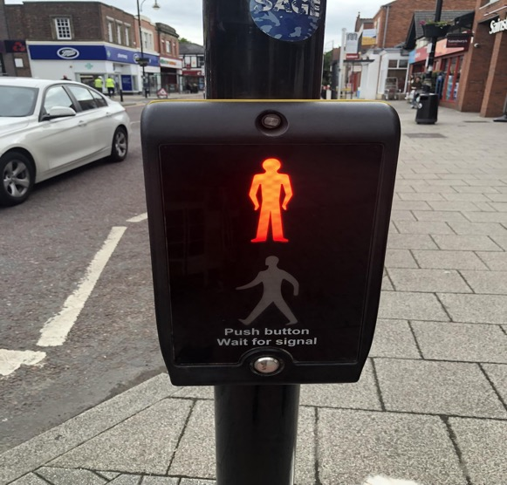
Introducing selection
Selection is when a set of actions are carried out when a certain condition is met.
What condition needs to be met before we can cross the road?
What action should be carried out when the ‘red man’ is showing?
Notes:
.

Slide 11
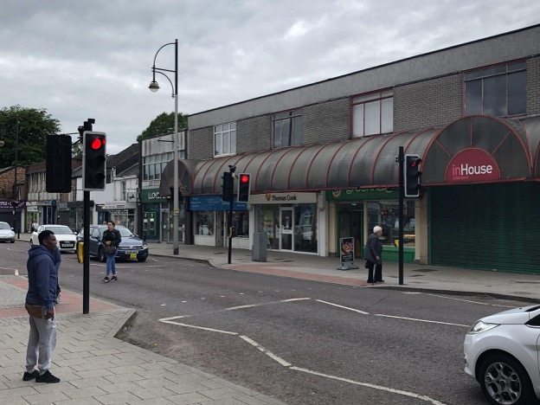
Selection
What is the condition that needs to be met?
What actions should be carried out if the condition is met?
What actions should be carried out if the condition isn’t met?

Slide 12
Testing electrical conductivity
We are going to test a range of materials to see if they allow electricity to follow through them - if they are electrical conductors.
How could we do this using the electrical components we already have?

Slide 13
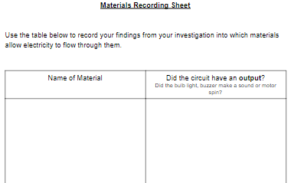
Testing electrical conductivity
Test the electrical conductivity of each materials.
Record your findings on your sheet.

Slide 14
Reviewing learning
You used selection to help you identify if the materials were electrical conductors.
What condition needed to be met?
What could you say about the material if the condition was met?
What could you say about the material if the condition wasn’t met?

Slide 15
Learning objectives revisited:
To identify the output in an electrical circuit
To understand the term selection
To use selection when describing the output of an electrical circuit

Slide 16
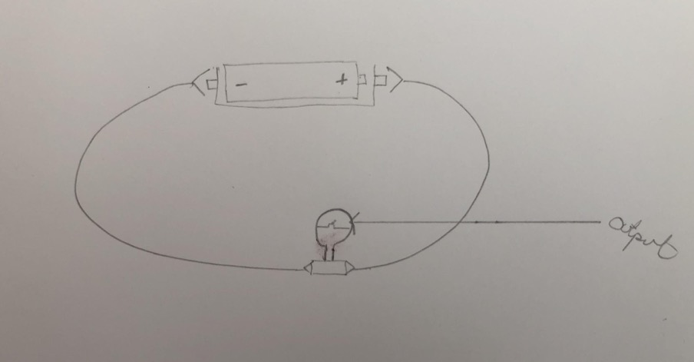
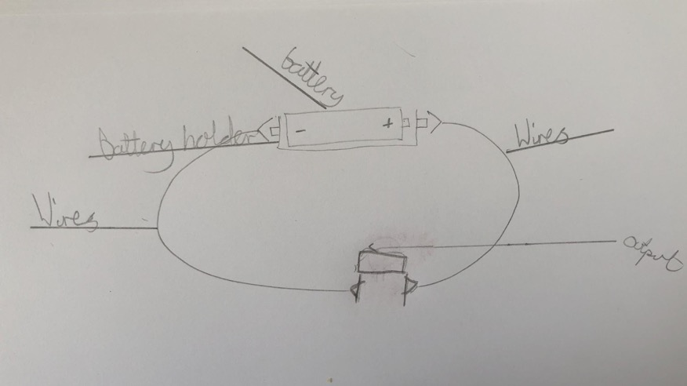
Examples of simple drawings of circuits

Slide 17
Licensing information:
Published by the Micro:bit Educational Foundation microbit.org under the following Creative Commons licence:
Attribution-ShareAlike 4.0 International (CC BY-SA 4.0) https://creativecommons.org/licenses/by-sa/4.0/

