Slide 1
Computing fundamentals
Lesson 4
Fundamentals of
programming lesson 2

Slide 2
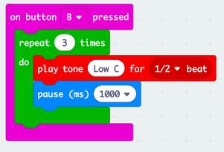
Write the algorithm for the program
INPUT when button B pressed
REPEAT 3 times
OUTPUT Low C for ½ beat
Pause for 1 beat

Slide 3
Learning objectives:
to understand iteration and selection and why they are used
to develop algorithms and programs using iteration and selection
to experiment with graphical and text-based programming languages.

Slide 4
What do you know about...?
Iteration
Repeating steps in an algorithm or program. Also called repetition and loops.
Selection
A decision or a question that tells a program to look at the answer, then follow a particular sequence.

Slide 5
Iteration
INPUT when button B pressed
REPEAT 3 times
OUTPUT Low C for ½ beat
Pause for 1 second

Slide 6
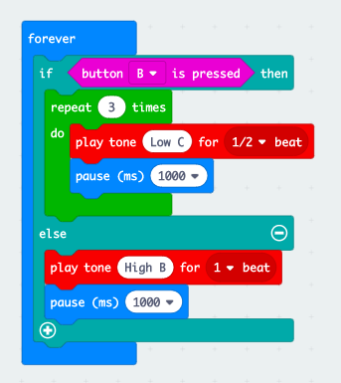
Selection
REPEAT continuously
INPUT IF button B pressed
REPEAT 3 times
OUTPUT Low C for ½ beat
Pause for 1 second
ELSE
Play High B for 1 beat
Pause for 1 second

Slide 7
Why do we use iteration and selection?
Iteration
Makes algorithms and programs quicker and simpler to write.
Removes unnecessary steps
Makes programs more efficient to run
Selection
allows choices/decisions to be included
enables different pathways through an algorithm and program to be included

Slide 8
Iteration challenge
Design an algorithm using iteration
Then write a program using the algorithm
Remember to regularly test and debug!

Slide 9
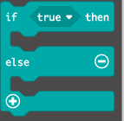
Selection challenge
Design an algorithm using selection
Then write a program using the algorithm
Remember to regularly test and debug!

Slide 10
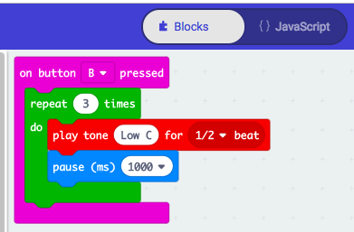
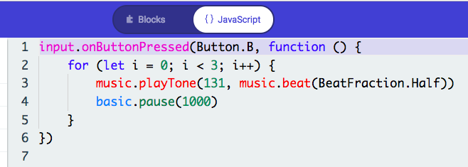
Programming languages
A language we can use to write the steps of the algorithm so the computer can understand and run it.
Graphical Text-based

Slide 11
What do you now know about...
Algorithms
Programming
Programming languages
Iteration
Selection
Debugging

Slide 12
Learning objectives revisited:
to understand iteration and selection and why they are used
to develop algorithms and programs using iteration and selection
to experiment with graphical and text-based programming languages

Slide 13
Copyright information
Published by the Micro:bit Educational Foundation microbit.org
Licence: Attribution-ShareAlike 4.0 International (CC BY-SA 4.0)

