Slide 2
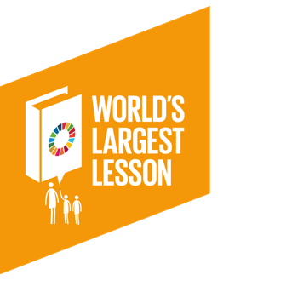
What are some of the biggest problems facing our oceans?

Slide 4
How to save our Coastal Seas

Slide 5
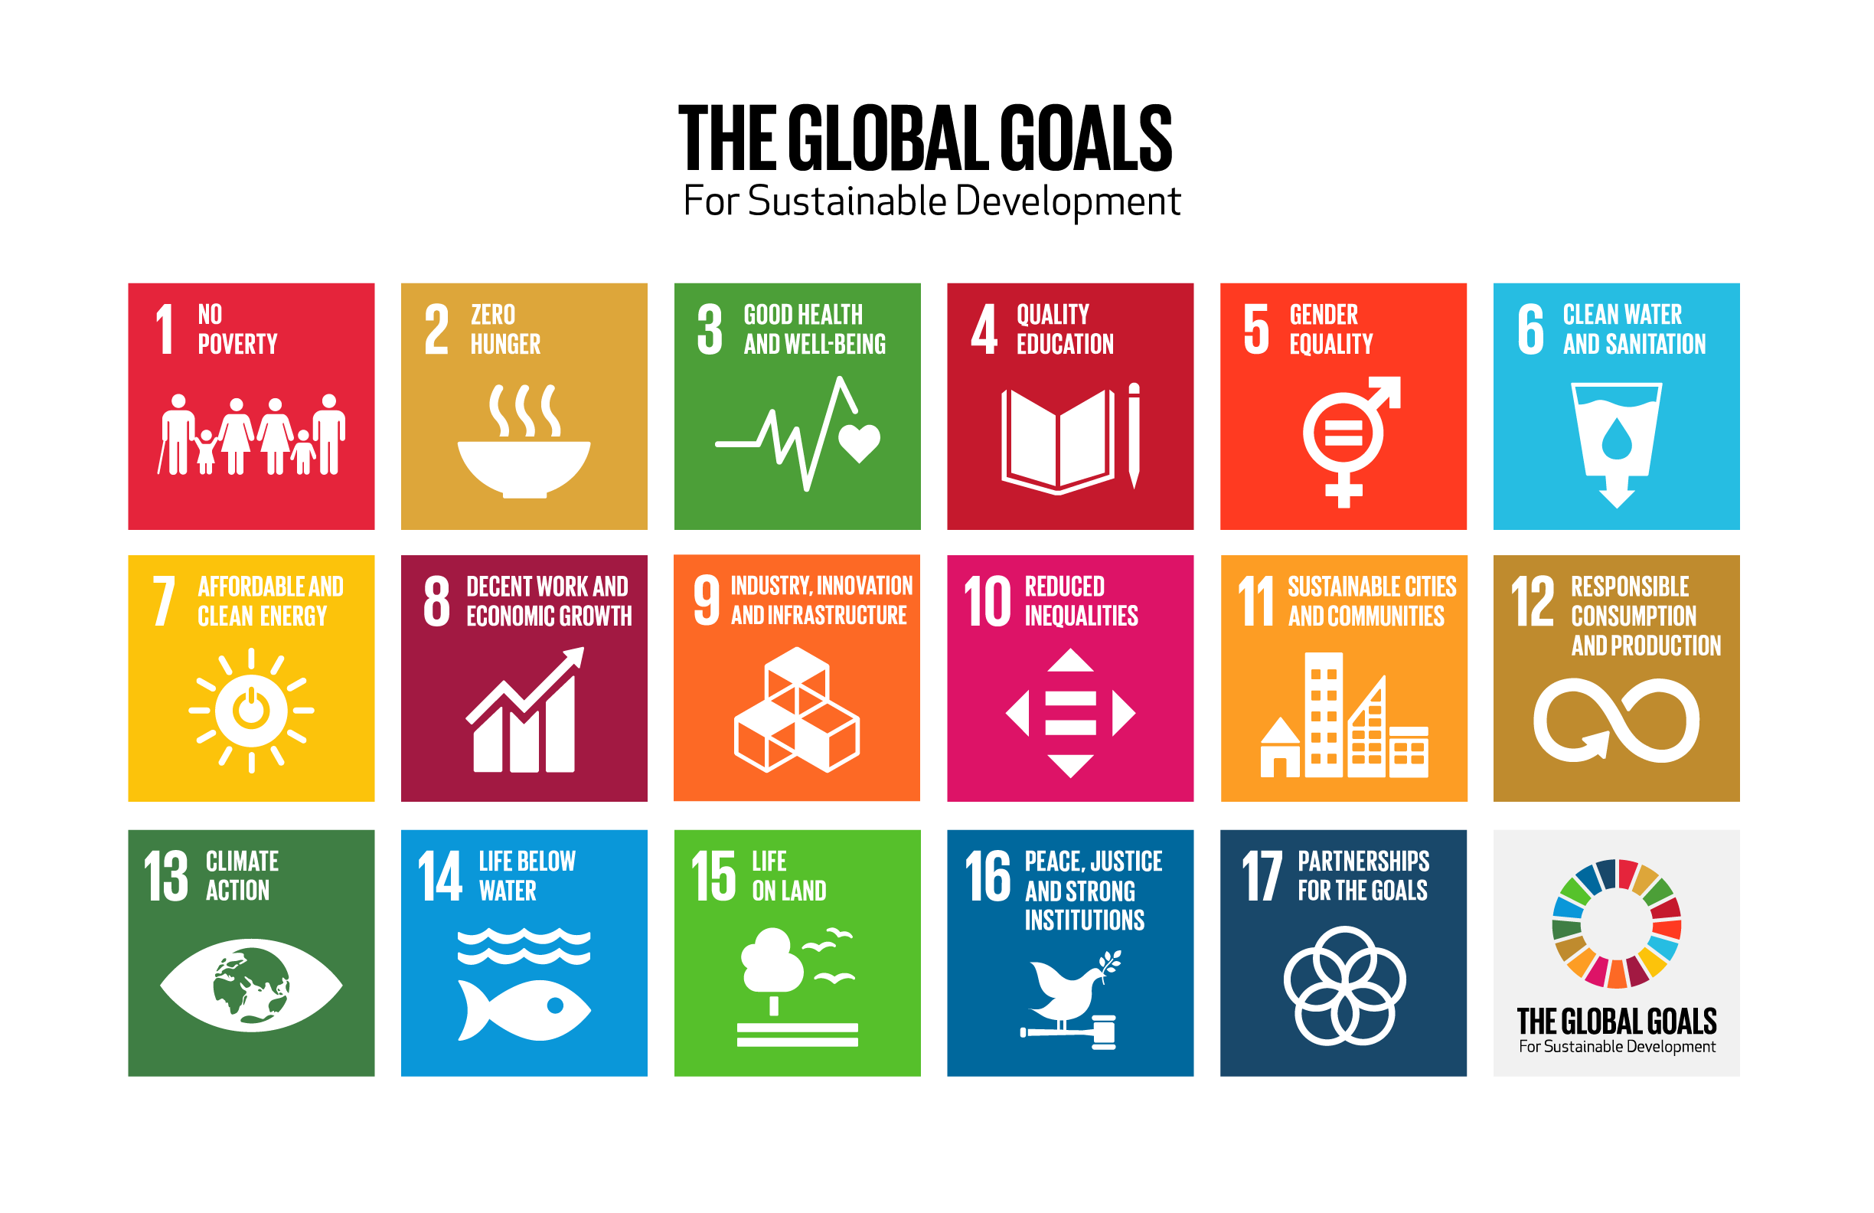
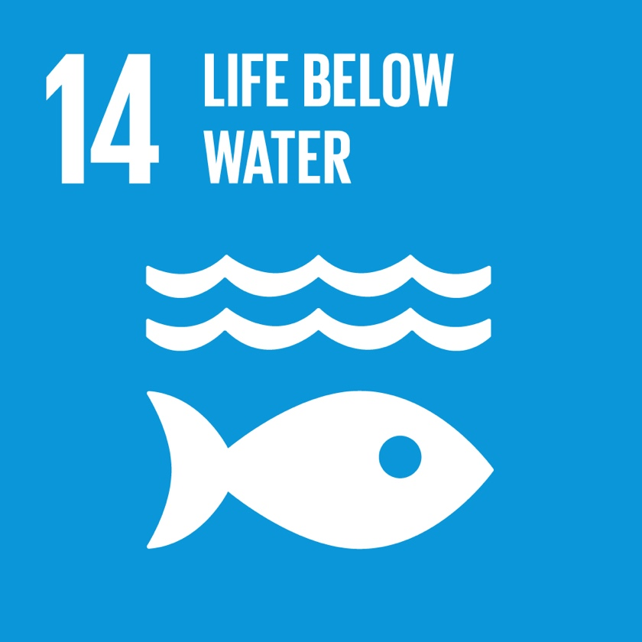
Looking at Global Goal 14
Conserve and sustainably use the oceans, seas and marine resources for sustainable development.

Slide 6
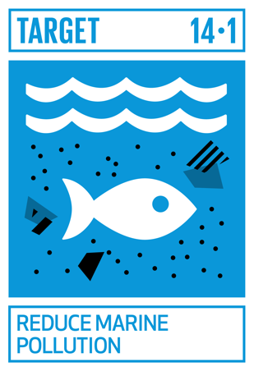
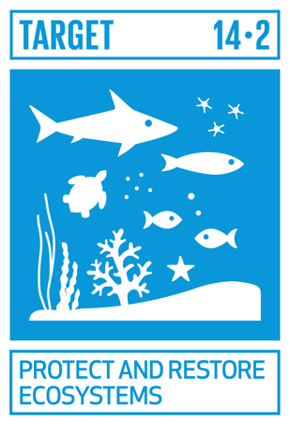
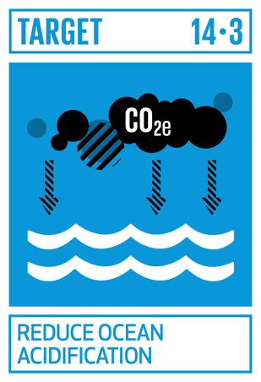
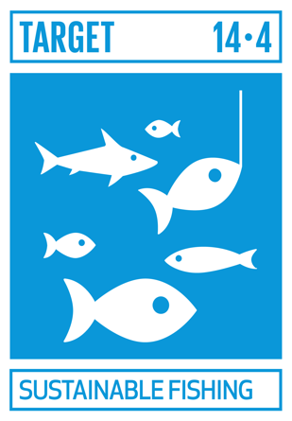
If you could rewrite the targets for Global Goal 14 what would you include and why?
Explore Global Goal 14 targets here

Slide 7
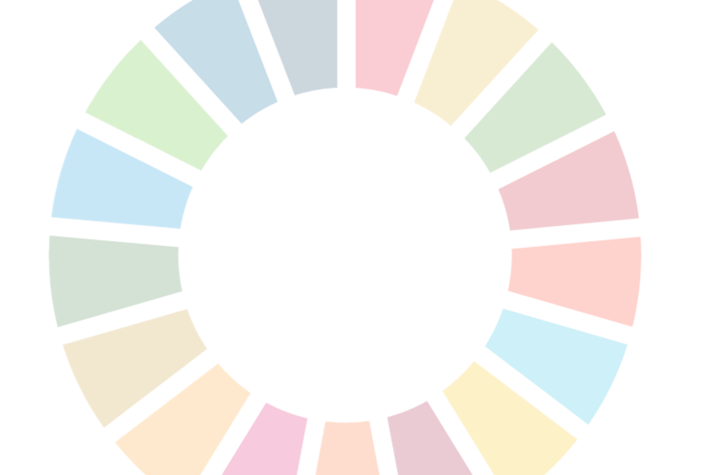
Action & Reflection
What actions could we take for Global Goal 14?
What is one thing you learnt today?
What is something you would like to learn more about?
What questions do you have about the Global Goals?

