Slide 1
Autofarmer

Slide 2
Global goals

Slide 4
Setting the scene
A group of farmers have asked you to develop a prototype device that can monitor the conditions of soil in remote areas and automatically turn on irrigation pumps and grow lights set up to help plants grow in poor conditions.

Slide 5
Success criteria
Design and build a prototype that uses a light sensor to turn on a grow light when the light level drops below a certain level
The prototype should also use a moisture sensor to turn on irrigation pumps when the soil is dry
The prototype needs to have a ‘kill switch’ to turn off the lights and pumps

Slide 6
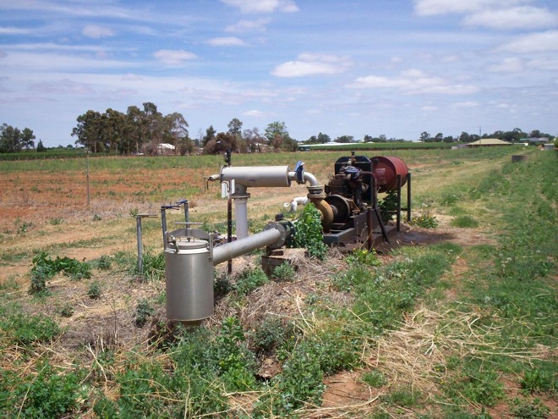
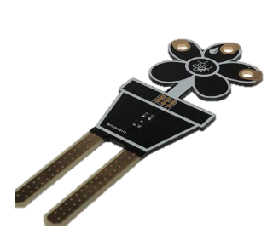
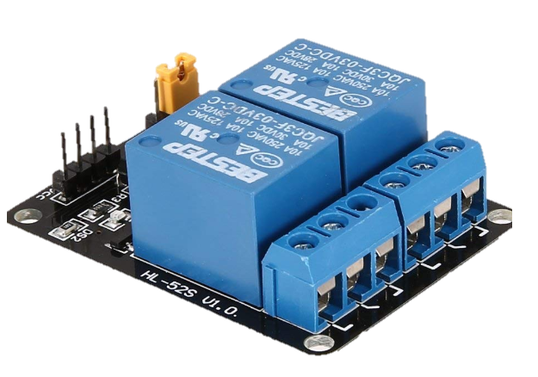
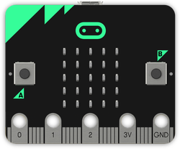
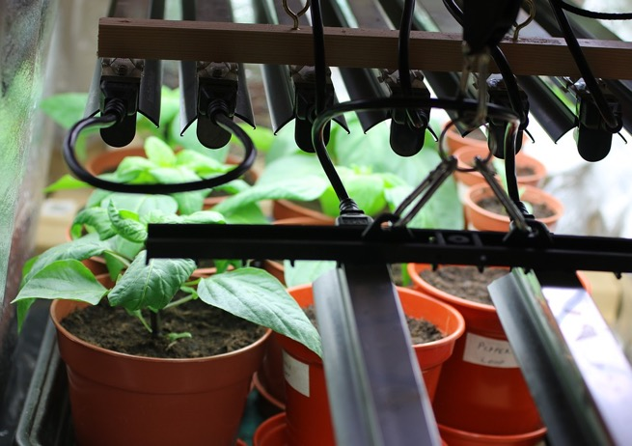
Irrigation pump
Electricity
Moisture sensor
Relay
(controllable switch)
Signal
The relay turns the power to the irrigation pump and grow lights on and off
The relay is controlled by the micro:bit
For our prototype the power for the relay will come from the micro:bit
LED grow light

Slide 7
Input process output
Input | Process | Output
Light intensity | If light intensity drops below 45 | Turn on relay 1
Moisture reading | If moisture reading drops below | Turn on relay 2
Kill switch (button) | Turn off both outputs | Turn off both outputs

Slide 8
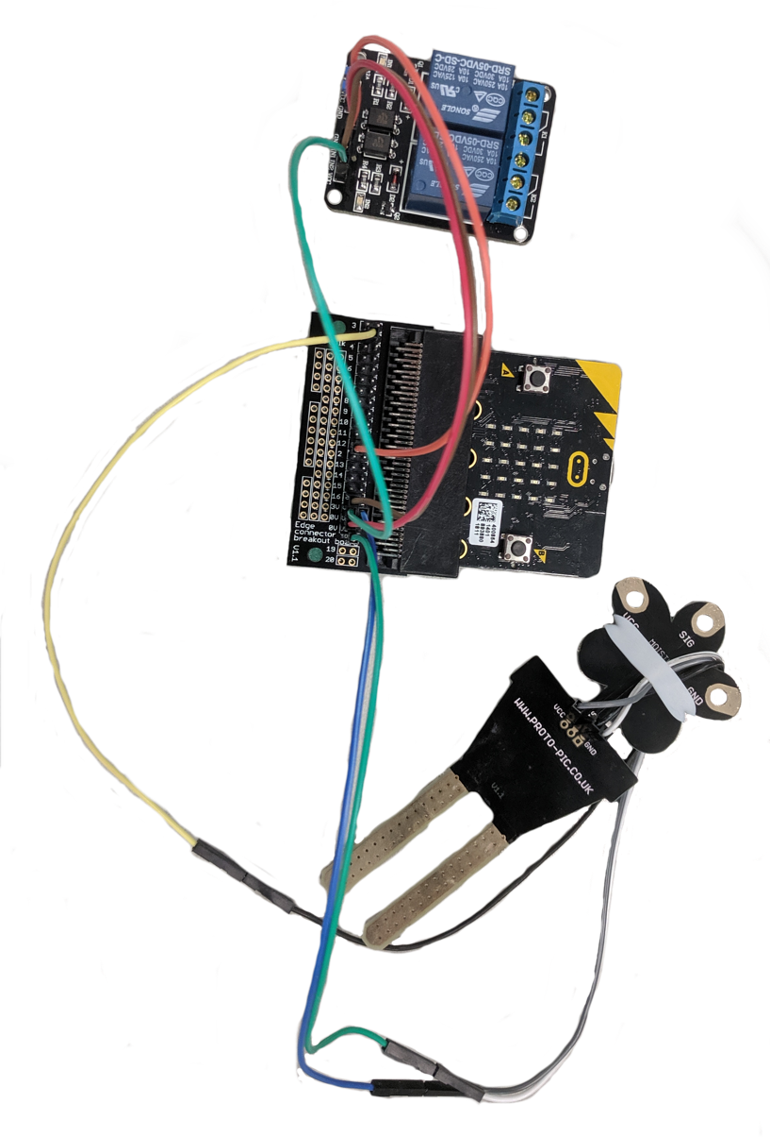
Hardware needed:
A moisture sensor (you can make your own!)
A micro:bit
A breakout board
A 3v dual relay
Header wires (male and female)
Power for the micro:bit (USB or battery)

Slide 9
The prototype
The moisture sensor gives us a value between 0 (dry) and 1023 (very wet)
Power to grow irrigation pump
Power to grow lights
The 3v relay is controlled by the micro:bit and can switch the power to the lights and pumps on and off
The breakout board lets us attach header wires to the pins which connect the relay and moisture sensor

Slide 10
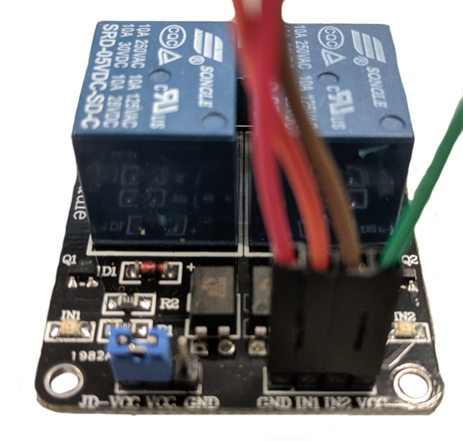
The relay
On the relay | On the micro:bit (breakout pins)
GND | 0V (ground)
IN1 | Pin 12 (P12)
IN2 | Pin 16 (P16)
VCC | 3v (power)
Please note:
Some relays are ‘active low’ which means they are ‘off’ when set to 1 and ‘on’ when set to 0 (in MakeCode/Python). This may seem odd as 0 usually means off and 1 usually means on.

Slide 11
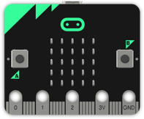
Moisture sensor
3v
PIN 16
You can use a pre-made moisture sensor or you can make your own!
To make a moisture sensor all you need is 2 nails or anything that conducts electricity (paper clips!).
Place them about 2 cm apart in the soil.
Attach the 3v wire to one and the PIN 16 wire to the other.
The water in the soil also conducts electricity and so the micro:bit can sense how much electricity is passing between the nails (conductors).
If it senses nothing then the soil must be very dry!
2cm
Water in soil conducts electricity!

Slide 12
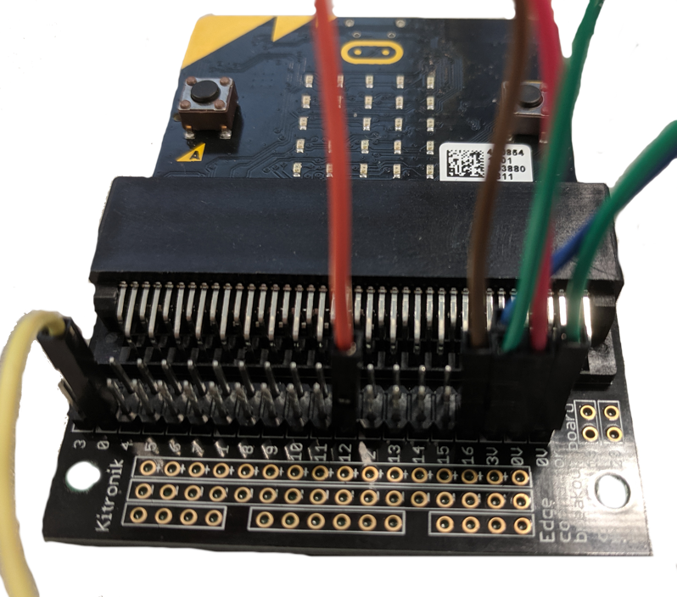
Breakout board
On the relay | On the micro:bit (breakout pins)
GND | 0V (ground)
IN1 | Pin 12 (P12)
IN2 | Pin 16 (P16)
VCC | 3v (power)

Slide 13
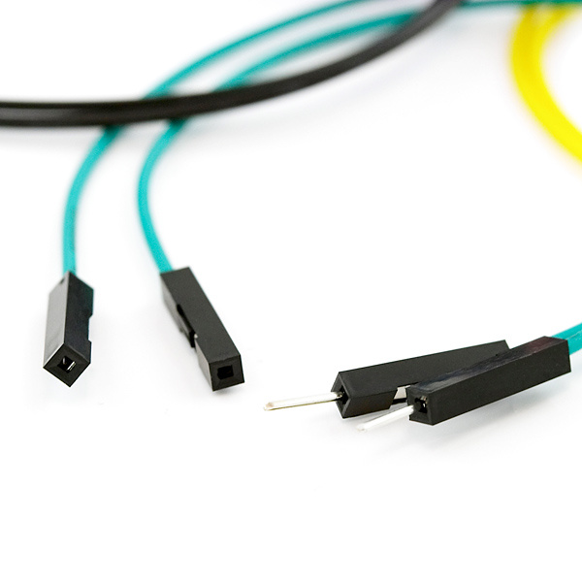
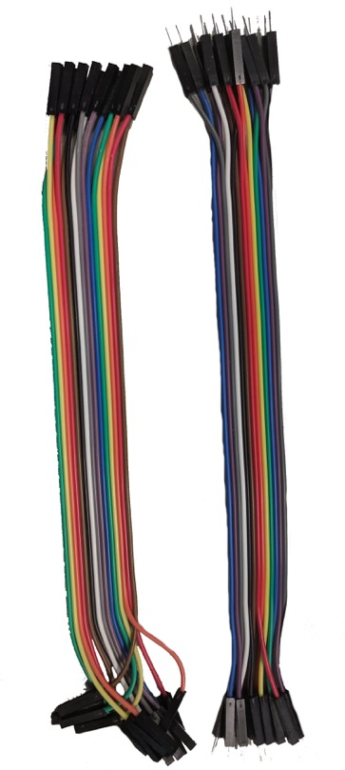
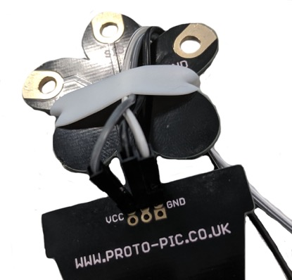
Header cables
You get both male and female headers, usually with both ends the same so you have to use two to join a male to a female
Header cables come in lots of colours. They can be fiddly to use!
Sometimes you may need to improvise to secure the pins in holes! Metal needs to touch metal to conduct electricity

Slide 14
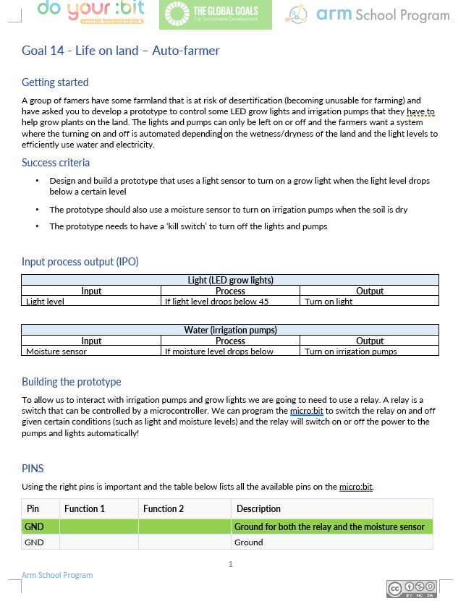
Group task:
Get into pairs/groups
Use the Auto-farmer worksheet to help you design and create your product
The product must meet the success criteria
Use the IPO (input-process-output) worksheet to design further features
Make a prototype to test your product

Slide 15
Success criteria
Design and build a prototype that uses a light sensor to turn on a grow light when the light level drops below a certain level
The prototype should also use a moisture sensor to turn on irrigation pumps when the soil is dry
The prototype needs to have a ‘kill switch’ to turn off the lights and pumps

Slide 16
Licensing information
Published by the Micro:bit Educational Foundation microbit.org under the following Creative Commons licence:
Attribution-NonCommercial-ShareAlike 4.0 International (CC BY-NC-SA 4.0)
https://creativecommons.org/licenses/by-nc-sa/4.0/
https://microbit.org/do-your-bit/

