Slide 1
Getting active
Teacher lesson guide
Lesson 3

Slide 2
Learning objectives:
To identify the uses of a step-counter.
To write a algorithm for a step-counter.
To program the BBC micro:bit as a step-counter.

Slide 3
How many steps?
What devices are commonly used by people to track their physical activity?
What types of data do these devices record?
How might these devices have a positive impact on people’s health?
Notes:
Examples of devices: fitbit, garmin, galaxy fit-e, moov now, etc.
Examples of data recorded - steps taken, flights of stairs climbed, heart rate, distance walked, time spent doing sport
Devices may have an impact on people’s health by make them aware of how little exercise they have done that day and encouraging them to do more and/or challenging people to meet daily goals e.g. 10 000 steps.

Slide 4
Counting steps
How do activity trackers count the number of steps a person does daily?
How can variables be used when counting steps?
What actions do activity trackers carry out when counting the steps a person takes daily? Record these in a thinking map.

Slide 5
Reviewing ideas
What actions do activity trackers carry out when counting steps?
How can variables be used in these actions?
Identify the order the actions on your thinking map will be carried out.
How could we represent the actions on the class thinking map in an algorithm?

Slide 6
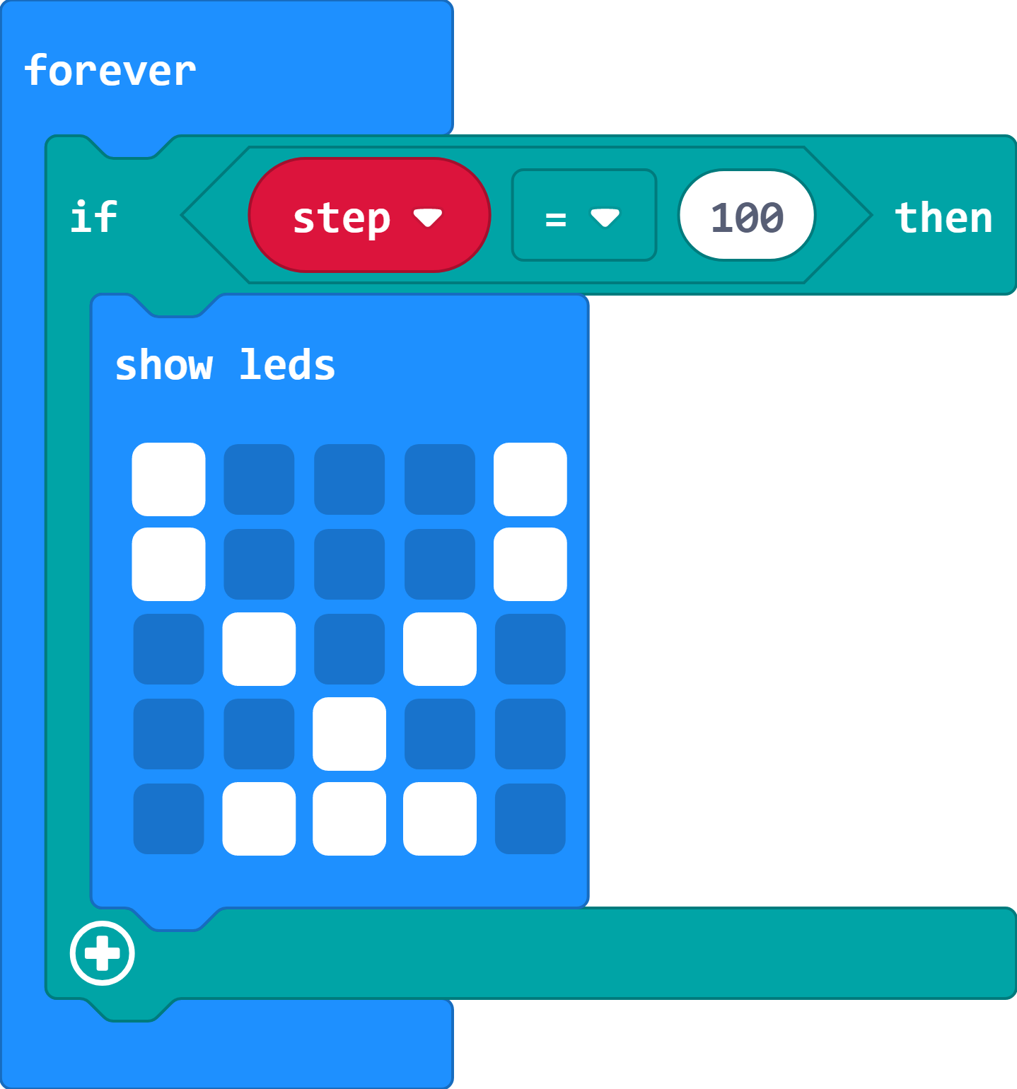
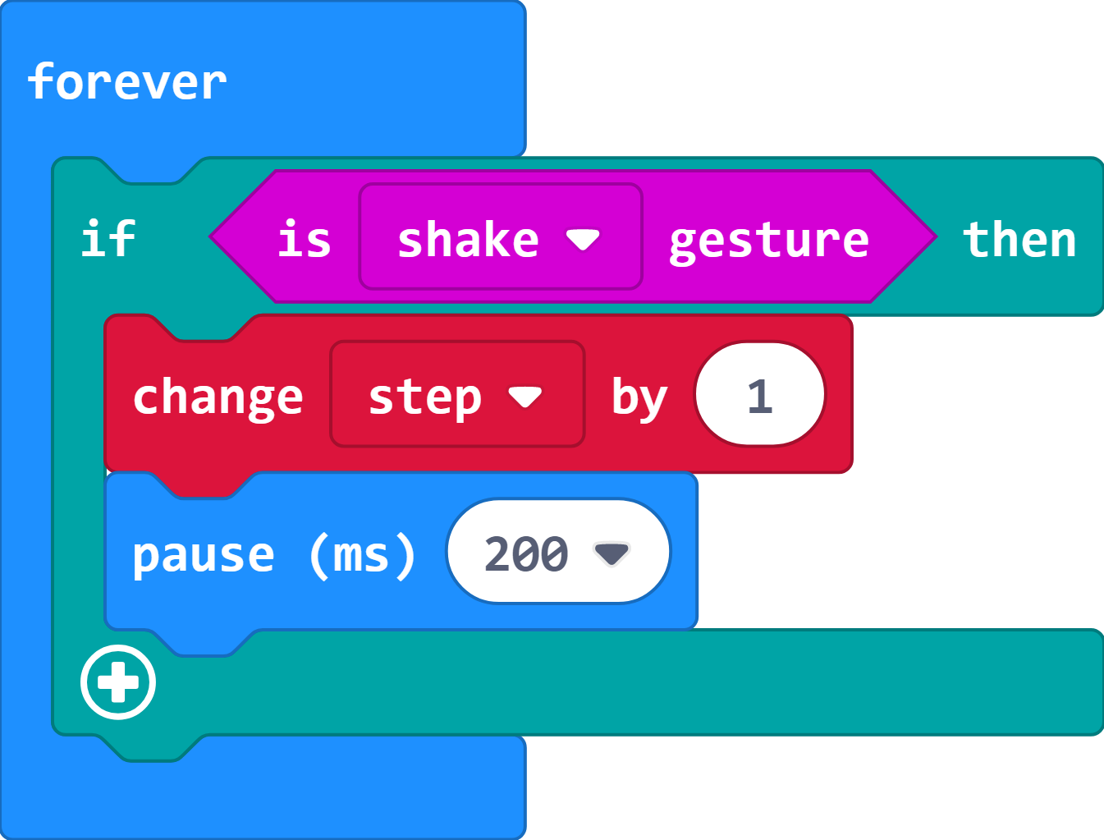
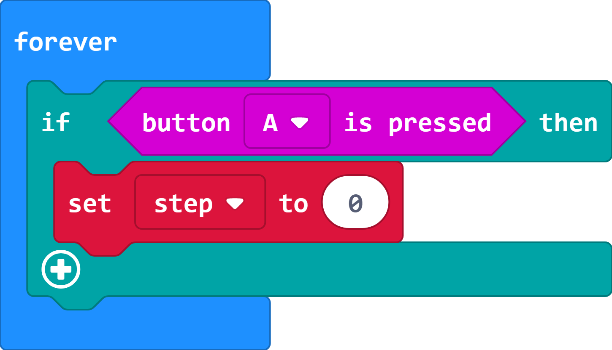
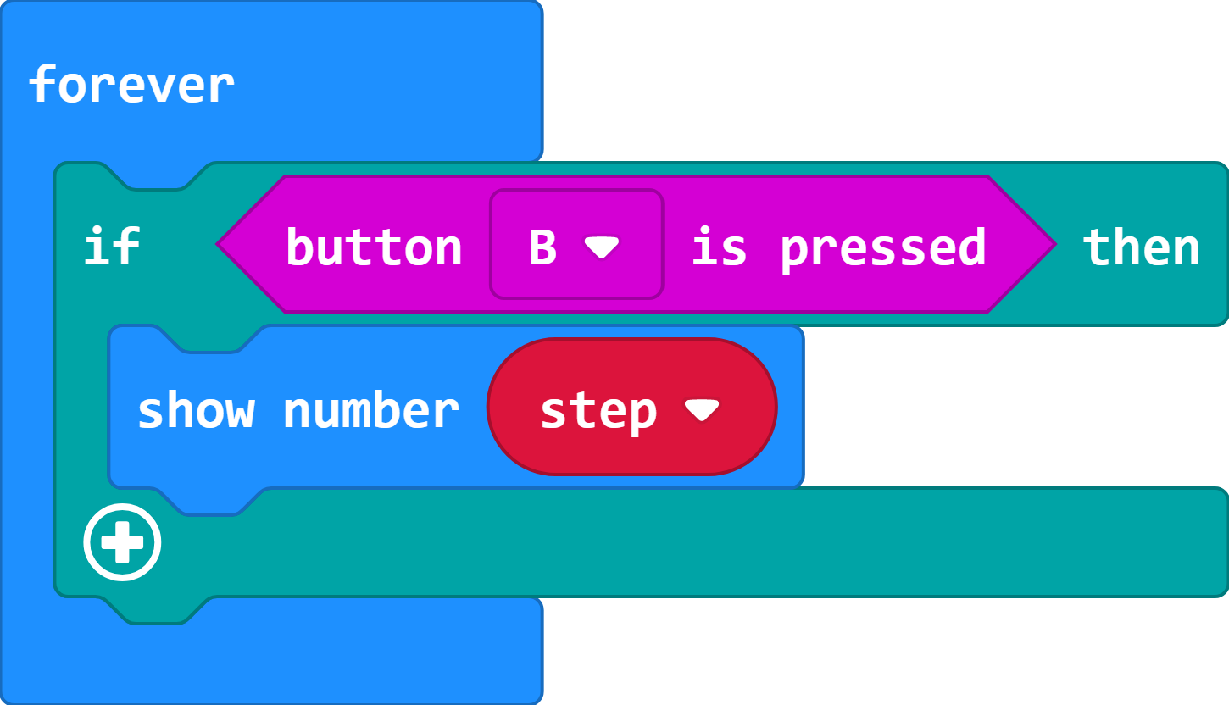
Identifying actions
For each part of the program on your sheet, think about:
The name of the variable
How the variable is used
When the variable is used

Slide 7
Identifying actions
The variable used is called step.
The variable is increased by 1.
This happens every time your micro:bit is shaken.

Slide 8
Identifying actions
The variable used is called step.
The variable is set to 0.
This happens every time button A is pressed.

Slide 9
Identifying actions
The variable used is called step.
The value of the variable is displayed.
This happens every time button B is pressed.

Slide 10
Identifying actions
The variable used is called step.
The variable is used as a trigger to display an image of a trophy.
This happens when the value of the variable is 100.

Slide 11
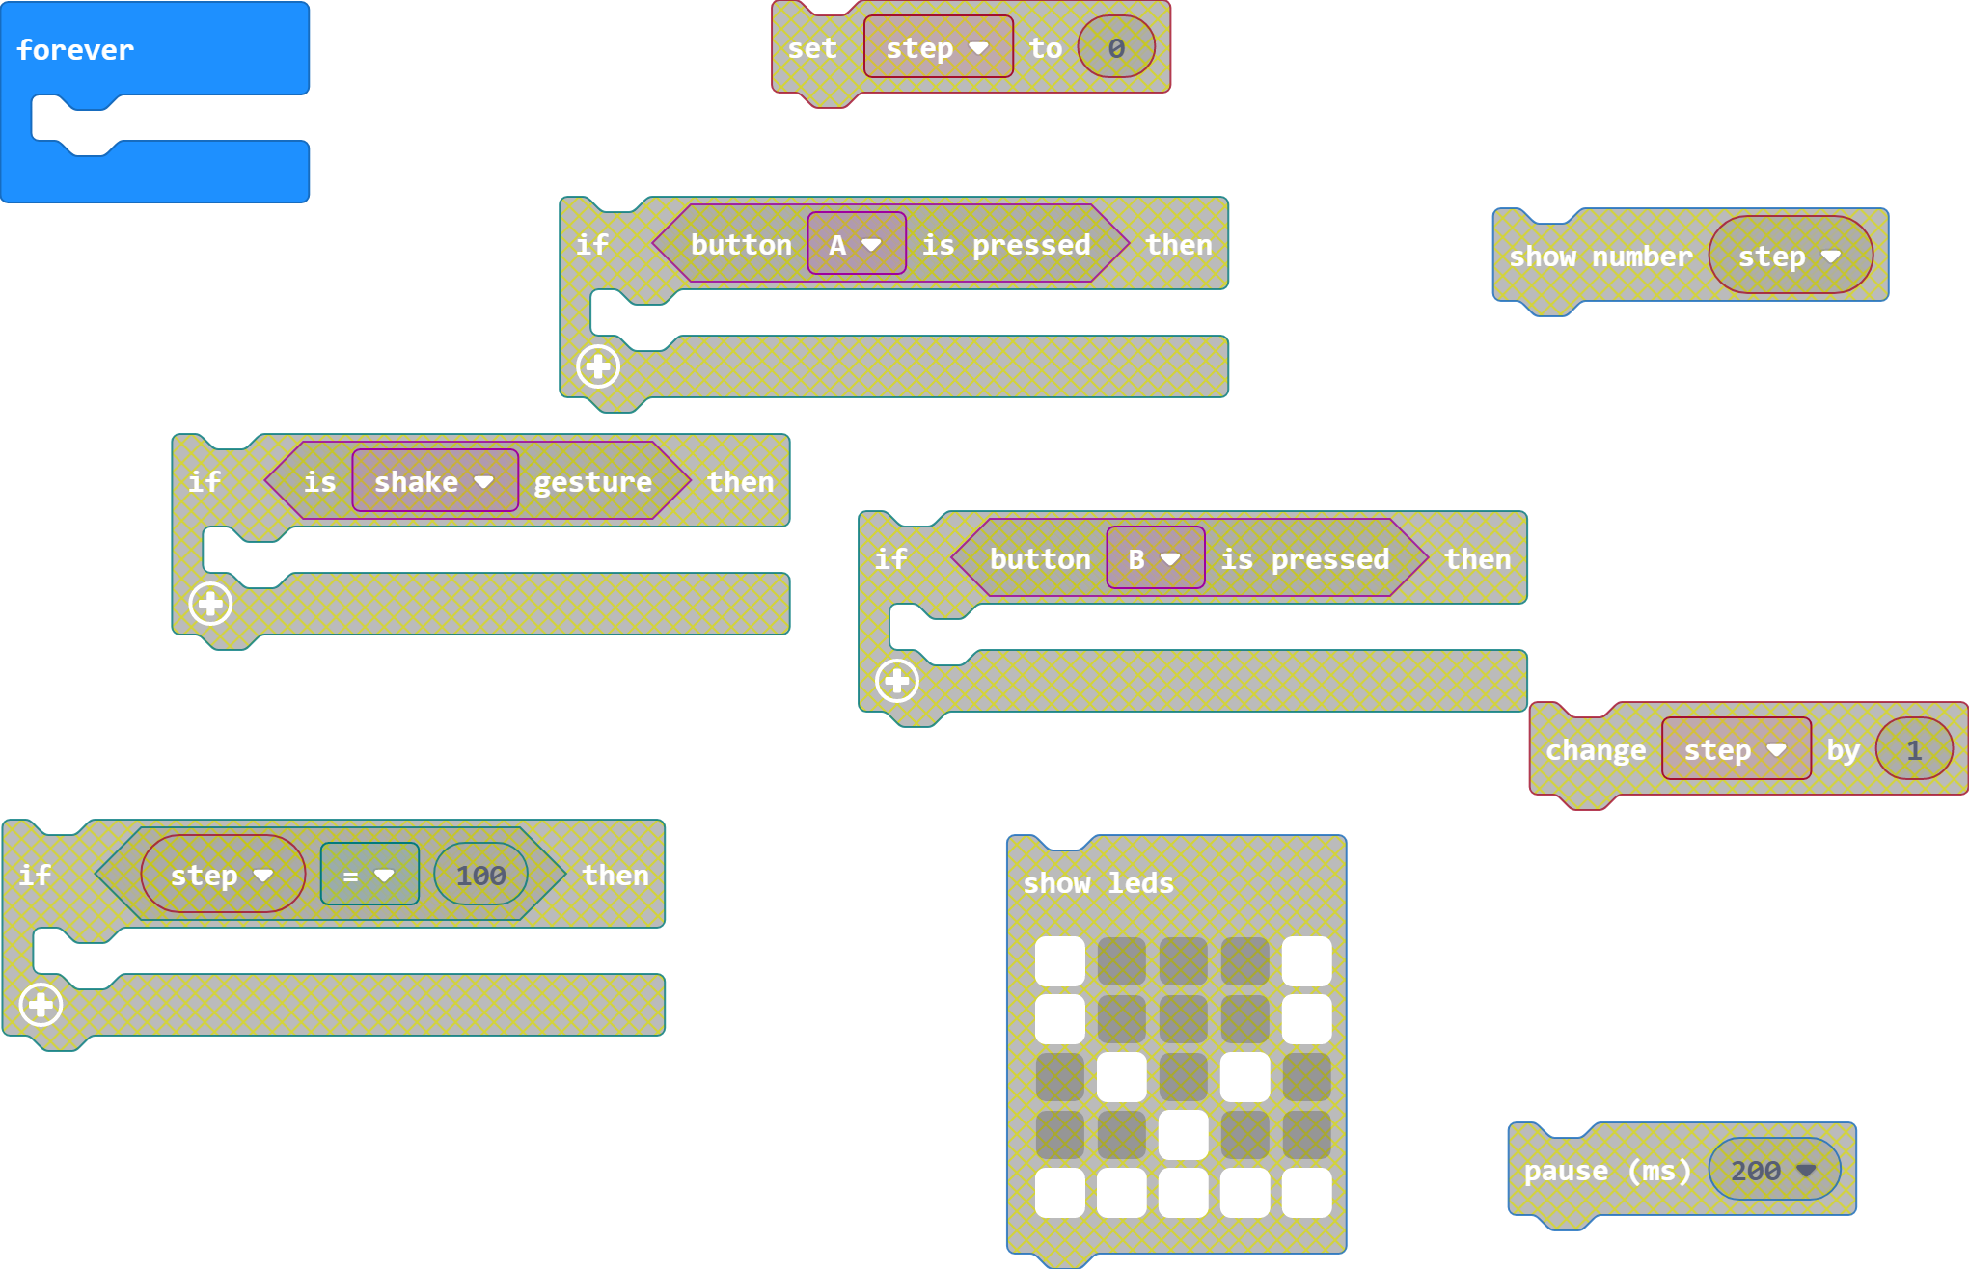
Program a step counter
Use the blocks to write a program that uses a micro:bit as a step counter.
The analysis of the parts of the program you have just completed will help you to structure the program.
https://makecode.microbit.org/#pub:_eVFDrchss0od

Slide 12
Reviewing the micro:bit as a step counter
Now that you have programmed a micro:bit to be a step-counter, think about the other improvements you would make so it can compete with other step-counters.
Consider:
Design
Comfort
Power source
Notes:
S

Slide 13
Learning objectives revisited:
To identify the uses of a step-counter.
To write a algorithm for a step-counter.
To program the BBC micro:bit as a step-counter.

Slide 14
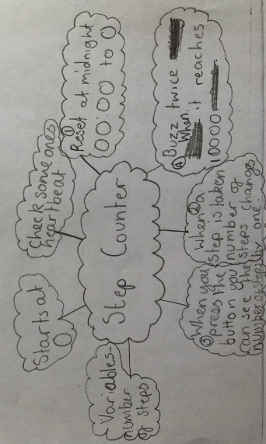
Example thinking map
Notes:
S

Slide 15
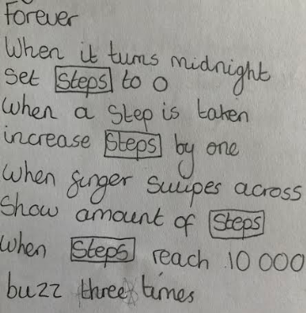
Example class algorithm
Notes:
S

Slide 16
Licensing information
Published by the Micro:bit Educational Foundation microbit.org
Licence: Attribution-ShareAlike 4.0 International (CC BY-SA 4.0)

