Slide 1
Sensory Classroom
Teacher lesson guide
Lesson 1

Slide 2
Learning objectives:
To understand that some learners are sensitive to sensory stimulus
To know some benefits of sensory classrooms
To evaluate sensory aids

Slide 3
Describing Classrooms
What do your classrooms look and sound like?
What learning activities take place in your classrooms?
Write words to describe what learning is like in your classrooms.

Slide 4
Classroom environments
Classroom environments can be busy places
For some learners, this can be difficult.
The classrooms provide too many sensory stimuli.
Students who are sensitive to sensory stimuli can find it difficult to concentrate
They can become over-stimulated

Slide 5
Think/pair/share
Which senses are most commonly stimulated by classroom environments?
What things in your classrooms stimulate different senses?
Notes:
Senses to focus on are visual, auditory and touch (tactile) . The latter is less readily identified by students, prompt them to think of the various pieces of equipment that they use across their different lessons.

Slide 6
Sensory Rooms
What do you think sensory rooms are?

Slide 7
Sensory Classrooms
Sensory classrooms can be helpful for students who find standard classrooms too stimulating.
They can help them explore their senses through different ‘sensory aids’ in a safe way.
Giving students the chance to focus on one sense at a time can help them feel relaxed and more engaged with learning.

Slide 8
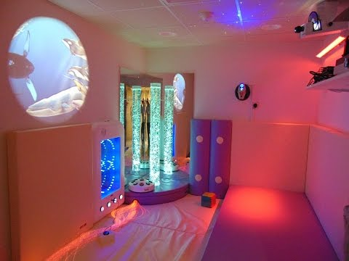
Sensory Classrooms
Make notes on the sensory aids that this sensory room contains.
how are the aids used?
what sense do they stimulate?
how do they stimulate that sense?

Slide 9
Evaluating Sensory Aids
Annotate the sensory aid image you have been given.
Use the questions on the Evaluating a Sensory Aid sheet to help you.

Slide 10
Evaluating Sensory Aids
Inform the class about your given sensory aid and your evaluation of it.
While listening, think of questions to ask.

Slide 11
Reviewing learning
What 3 words would you use to describe standard classrooms?
Why are standard classrooms problematic for some learners?
What is a sensory classroom and what benefits can it provide for learners?

Slide 12
Learning objectives revisited:
To understand that some learners are sensitive to sensory stimulus
To know some benefits of sensory classrooms
To evaluate sensory aids

Slide 13
Licensing information
Published by the Micro:bit Educational Foundation microbit.org
Licence: Attribution-ShareAlike 4.0 International (CC BY-SA 4.0)

