Slide 1
Computing fundamentals
Lesson 2
Fundamentals of
computational thinking

Slide 2
Learning objectives:
to develop a deeper understanding of computational thinking concepts
to understand the steps in computational thinking
to develop and present a prototype for a computerised paper aeroplane
to write an accurate algorithm

Slide 3
Computational thinking
Computational thinking means considering a problem in a way that a computer can help us to solve it.
We need to:
understanding what the problem is
consider possible solutions
use a computer to help solve the problem

Slide 4
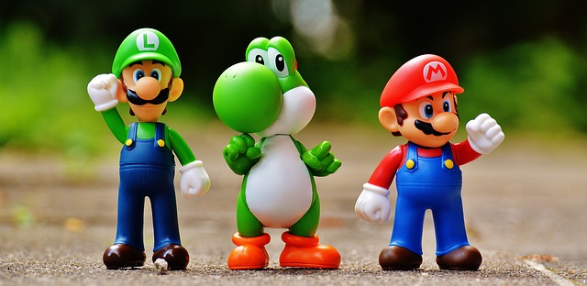
Decomposition
Breaking down a complex problem into smaller parts.
Each of these parts can then be considered in detail.
Notes:
e.g. plot, setting, characters, scoring system, levels etc

Slide 5
Abstraction
Reducing unnecessary detail and focussing on the important parts of a system.
Creating a representation or generalisation.

Slide 6
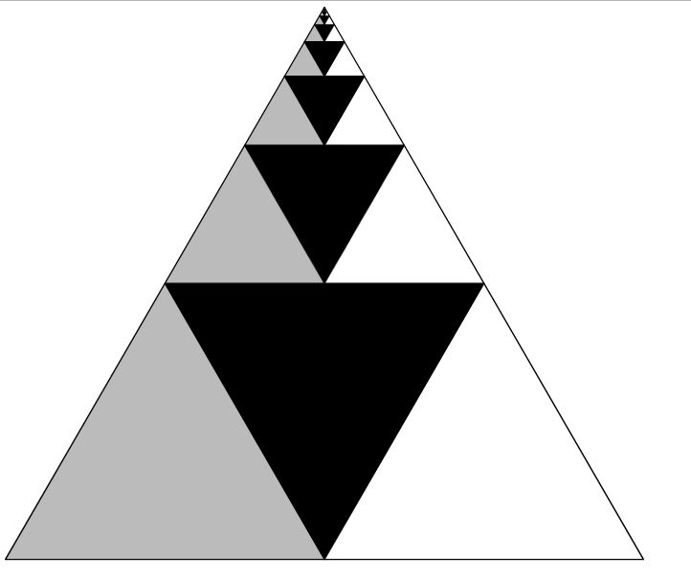
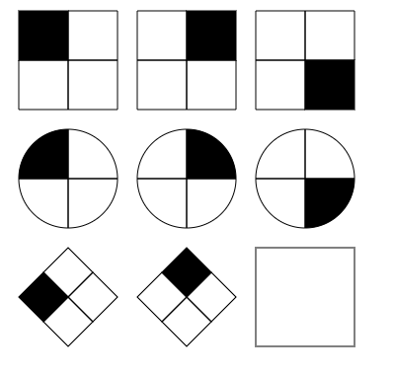
Pattern recognition
Recognising and finding patterns or trends.
Looking for similarities.
Koch snowflake
Raven matrix
Geometric series triangle

Slide 7
Algorithms
Developing instructions to solve a problem.
The steps or rules to complete a task.
E.g. Multiplication or division ‘rules’ in maths. What are the rules/steps for multiplying decimals by 10?
You move the decimal point one space to the right - that’s the algorithm!

Slide 8
Evaluation
Considering if a solution is ‘fit for purpose’.
Is it:
suitable for the user?
easily understood?
efficient?
the best that can be done with the resources available?

Slide 9
Computational thinking in other subjects
How do you use these concepts in other subjects?
Decomposition
Abstraction
Pattern recognition
Algorithms
Evaluation

Slide 10
Computational thinking in other subjects
Decomposition
Breaking down the study of climate change in the history of the Earth into smaller timescales to examine each more closely in Geography
Abstraction
Creating a mind map for an English or History essay, creating a model of the heart in Biology
Pattern recognition
Analysing a graph to find trends in the data in Science or Maths.
Algorithms
Following or creating instructions for an experiment in Science, a recipe in Food Technology or a score in Music
Evaluation
Evaluating data in Science or Maths, weighing up arguments in an English essay

Slide 11
Computational thinking
Computational thinking means considering a problem in a way that a computer can help us to solve it.
We need to:
understanding what the problem is
consider possible solutions
use a computer to help solve the problem

Slide 12
How can computers help create a ‘better’ paper aeroplane?
Perhaps…
adding a lightweight motor to the plane that turns on when it senses it is dropping below a certain speed
being able to control the plane remotely
creating a computer simulation to find the ‘ultimate’ design

Slide 13
Prototyping
An initial, basic version of an innovation
It allows you to quickly and easily:
show how your innovation would work
test and trial it
get feedback
decide what works and what doesn’t

Slide 14
Creating a paper prototype
Using the materials :
Sketch or make a representation of your prototype (abstraction).
Add feature labels and explanations as appropriate
Include instructions (an algorithm) of how it will work
You have 20 minutes

Slide 15
Learning objectives revisited:
to develop a deeper understanding of computational thinking concepts
to understand the steps in computational thinking
to develop and present a prototype and algorithm for a computerised paper aeroplane

Slide 16
Exit ticket
how well did you understand today’s learning?
what did you learn in the lesson today?
how would you explain computational thinking to someone else?
Exit ticket

Slide 17
Copyright information
Published by the Micro:bit Educational Foundation microbit.org
Licence: Attribution-ShareAlike 4.0 International (CC BY-SA 4.0)

