Slide 1
Sensory Classroom
Teacher lesson guide
Lesson 4

Slide 2
Criteria for the Classroom Sensory Aid
Provides a visual stimulus
Allows user interaction
Uses micro:bit
Conceals wires and power-supply

Slide 3
Learning recap
What are you making?
Who is it designed for?
How will you meet the needs of the user?
What steps will you need to undertake to make it?

Slide 4
Learning objectives:
To follow a design plan to create a classroom sensory aid that meets a given criteria
To follow an algorithm to code a program using inputs, outputs, iteration and selection
To test and debug code and develop solutions to problems that may arise
To evaluate the classroom sensory aid effectively

Slide 5
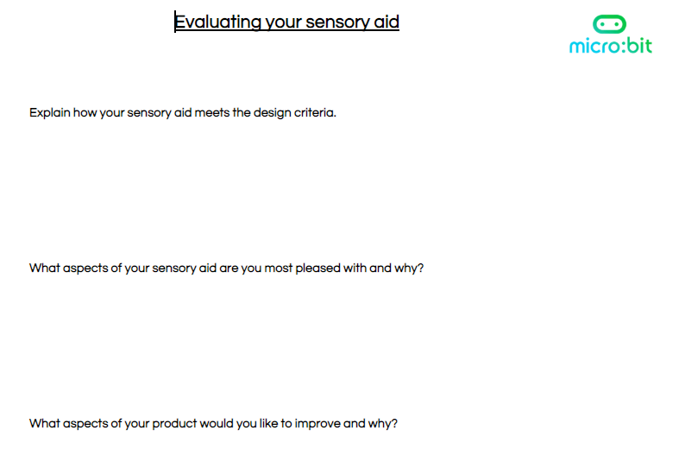
Sensory aid evaluation

Slide 6
Sensory classroom learning review
What have you learnt during this project about sensory classrooms?
What would you still like to learn?
What have you learnt about computing during this sensory classroom project?
What Computational Thinking skills have you developed?

Slide 7
Learning objectives revisited:
To follow a design plan to create a classroom sensory aid that meets a given criteria
To follow an algorithm to code a program using inputs, outputs, iteration and selection
To test and debug code and develop solutions to problems that may arise
To evaluate the classroom sensory aid effectively

Slide 8
Licensing information
Published by the Micro:bit Educational Foundation microbit.org
Licence: Attribution-ShareAlike 4.0 International (CC BY-SA 4.0)

