Slide 1
Health Tech
Teacher lesson guide
Lesson 4

Slide 2
Learning objectives:
to complete your health tech prototype
to prepare an effective way to present your prototype
to practice delivering your presentation

Slide 3
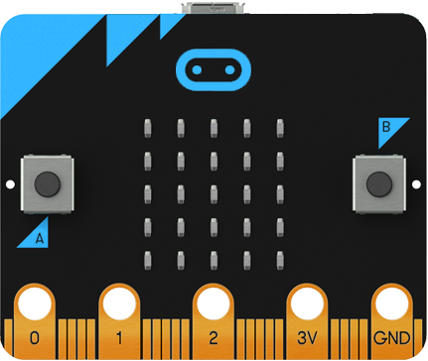
Micro:bit Health Tech Challenge
Create a prototype of a health tech innovation to help address a health problem in the UK using micro:bit

Slide 4
Prototype criteria
You can choose how to present it. Must include:
A visual representation of the design
Explanation about why it will help address the problem & the intended user
Instructions for how it will work
A detailed, accurate algorithm for at least one feature
A working micro:bit program for the same feature

Slide 5
Prototype presentation
5 minutes max per team
all team members should contribute
be concise and clear
make use of visuals
explain:
what problem you are addressing
how your idea addresses the problem & helps the user
how it will work
the feature you have focused on (show your algorithm and micro:bit program)

Slide 6
What makes a good presentation
make it interesting for your audience
keep it clear and concise
use images effectively
if you use slides:
stick to one or two fonts only
bullet points only
don’t read from slides
be selective with animation and colour

Slide 7
Learning objectives revisited:
to complete your health tech prototype
to prepare an effective way to present your prototype
to practice delivering your presentation

Slide 8
Licensing information
Published by the Micro:bit Educational Foundation microbit.org
Licence: Attribution-ShareAlike 4.0 International (CC BY-SA 4.0)

