Slide 1
Getting active
Teacher lesson guide
Lesson 5

Slide 2
Learning objectives:
To debug programs involving random number variables.
To write programs that use random number variables.
To evaluate a solution effectively.

Slide 3
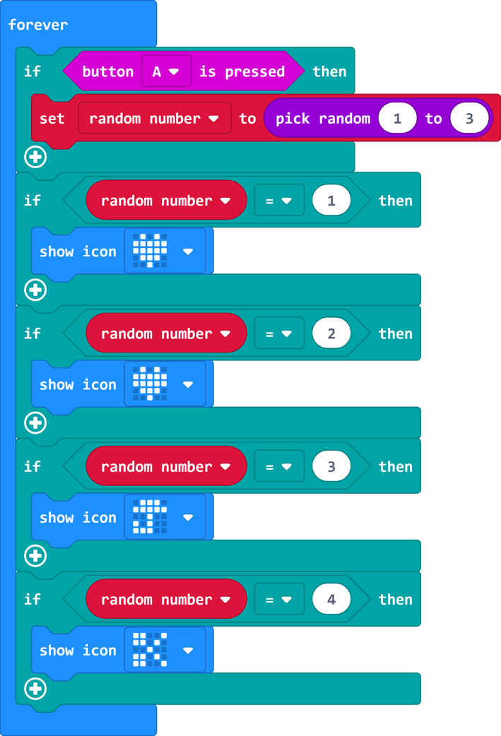
Image predictions
Describe what will happen when this program is executed?
Which image is most likely to be chosen?
Which image will not be chosen?
How could you debug the program to make it equally likely that each image could be chosen?
https://makecode.microbit.org/#pub:_MaphAJEVDhYK
Notes:
When button a is pressed variable ‘random number’ is set to a randomly selected number between 1 and 3. The value of the ‘random munber’ is then used to select which image to show on micro:bit’s LEDs.
The image of the heart is most likely to be chosen because it is selected if the value of ‘random number’ is 1 or 2.
The image of the scissors will not be chosen because it is only selected if the value of ‘random number’ is 4. However, the value of ‘random number’ is set to a randomly selected number between 1 and 3 meaning its value cannot be 4.
To make it equally likely that each image is chosen there needs to be three different images. The first image will be selected if the value of ‘random number’ is 1. The second image will be selected if the value of ‘random number’ is 2. The third image will be selected if the value of ‘random number’ is 3.
If pupils suggest changing the range from which the number is randomly selected to 4 point out that the heart image still has a greater chance of being chosen.

Slide 4
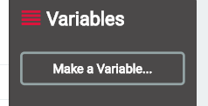
Programming the micro:bit
Today you will work with your partner to program a micro:bit to be an activity selector.
Use the algorithm that you wrote last lesson to guide your program.
Test and debug your program as you work.
Remember before you can use a variable they have to be created.

Slide 5
Evaluating your solution
Once you are happy with how your program works, transfer it to a micro:bit.
Test how your solution works on a micro:bit
What are the strengths of your solution?
What would you like to improve about your solution?

Slide 6
Learning objectives revisited:
To debug programs involving random number variables.
To write programs that use random number variables.
To evaluate a solution effectively.

Slide 7
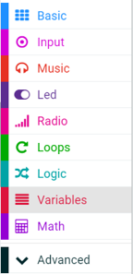
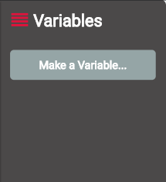
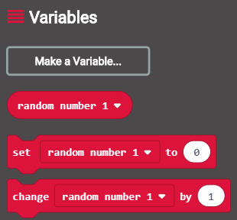
Before you can use a variable it needs to be created. This can be done by selecting make a variable from the variable menu.
When your variable has been created, you will have access to blocks to use, set and change the variable. .

Slide 8
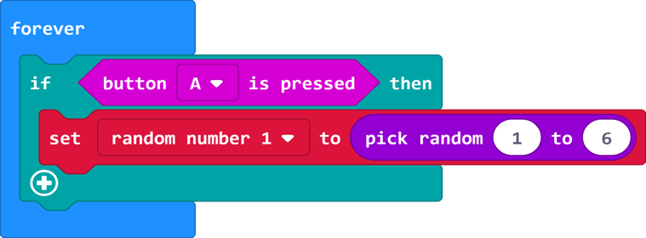
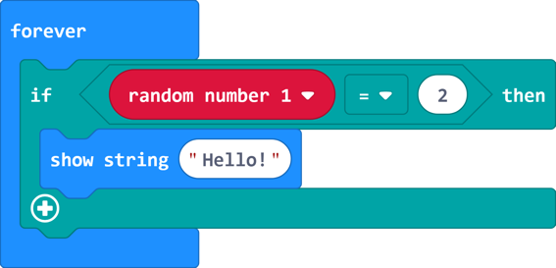
The micro:bit will set the value of the variable random number 1 to a randomly selected number between 1 and 3 when button a is pressed.
The micro:bit displays the word hello if the value of the variable random number 1 equals 2

Slide 9
Licensing information
Published by the Micro:bit Educational Foundation microbit.org
Licence: Attribution-ShareAlike 4.0 International (CC BY-SA 4.0)

