Slide 1

Digital flashcards
Teacher lesson guide
Lesson 2

Slide 2
Learning objectives
To use abstraction when planning LED images.
To write programs that create LED images.
To sequence programs.

Slide 3
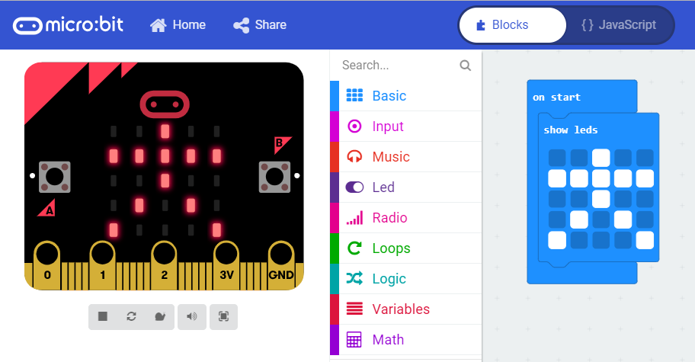
Recapping LED images
How can we program LED images?

Slide 4

Creating LED images
Use the MakeCode editor to create an LED image of a tree

Slide 5

Creating LED representations
Use the MakeCode editor to create an LED image of a house

Slide 6
Using abstraction
When creating your images, you used abstraction.
What can you remember about abstraction in computing?
When we use abstraction we identify the most important details and ignore the details that are less important.

Slide 7
Planning digital flashcards
We are going to create digital flashcards.
What nouns do we know in French we could represent using micro:bit’s LEDs?
Notes:
.

Slide 8

LED planner
representation of
____________
representation of
____________
representation of
____________
representation of
____________
representation of
____________
representation of
____________
representation of
____________
representation of
____________
Notes:
Pupil should sequence their representations by using the boxes to place the step number in.

Slide 9
Planning LED images
Pick four words from the vocabulary list and plan your LED images.
Place your images in a sequence by numbering the order you want to display them.

Slide 10
Programming digital flashcards
Use the MakeCode editor to program the micro:bit to show your images
Sequence your program to show the order on your plan.
Notes:
https://makecode.microbit.org/#editor

Slide 11
Sequence
When we write algorithms and programs, we make use of sequencing.
What does sequence mean?
How have you used it in previous algorithms and programs?

Slide 12
Evaluating our programs
How have we used the computing concept of sequence?
Swap plans and programs, does the simulator show the same sequence as the plan?

Slide 13
Learning objectives revisited
To use abstraction when planning LED images.
To write programs that create LED images.
To sequence programs.

Slide 14
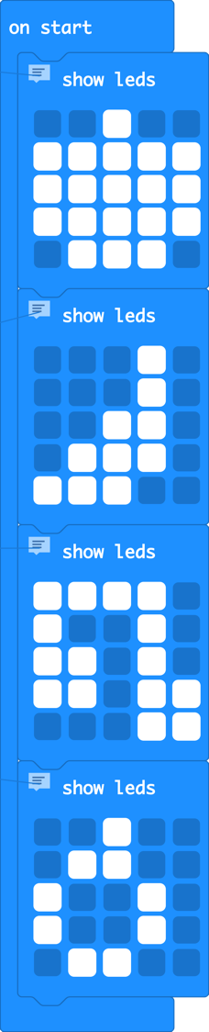
Sample DigitalFlashcard1 program
apple
banana
cherries
pear
https://makecode.microbit.org/#pub:_Ye9W9wdPPCEj

Slide 15
Licensing information
Published by the Micro:bit Educational Foundation microbit.org under the following Creative Commons licence:
Attribution-ShareAlike 4.0 International (CC BY-SA 4.0)
https://creativecommons.org/licenses/by-sa/4.0/

