Slide 1
Data handling
Teacher lesson guide
Lesson 2

Slide 2
Learning objectives:
To understand that some devices use sensors.
To write simple programs using sensors.
To use the BBC micro:bit to collect data.

Slide 3
School data
What data could we collect about the school?

Slide 4
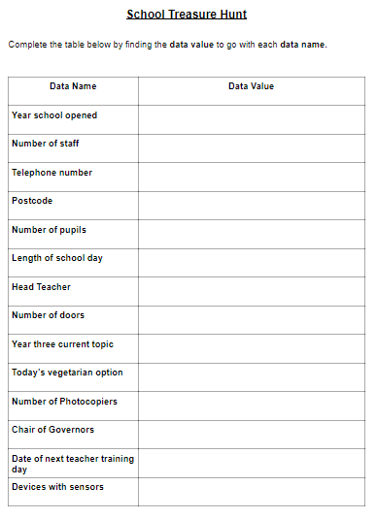
School data treasure hunt
How could we collect the data needed to complete the sheet?

Slide 5
What are sensors?
Sensors are devices that monitor a given thing. Temperature sensors monitor temperature. Rain sensors monitor rain.
When a change is sensed in the thing it is monitoring, the sensor can make something happen.

Slide 6
Reviewing our data
What value did you get for each data name?
Which data did you find the most difficult to collect?

Slide 7
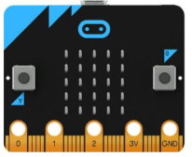
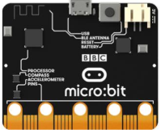
The micro:bit sensors
We are going to make use of some of the micro:bit’s sensors.
What sensors do you think the micro:bit has?
Notes:
Establish that the micro:bit has sensors for light, temperature and movement. Explain that in this unit, the pupils will be making use of the light and temperature sensors.

Slide 8
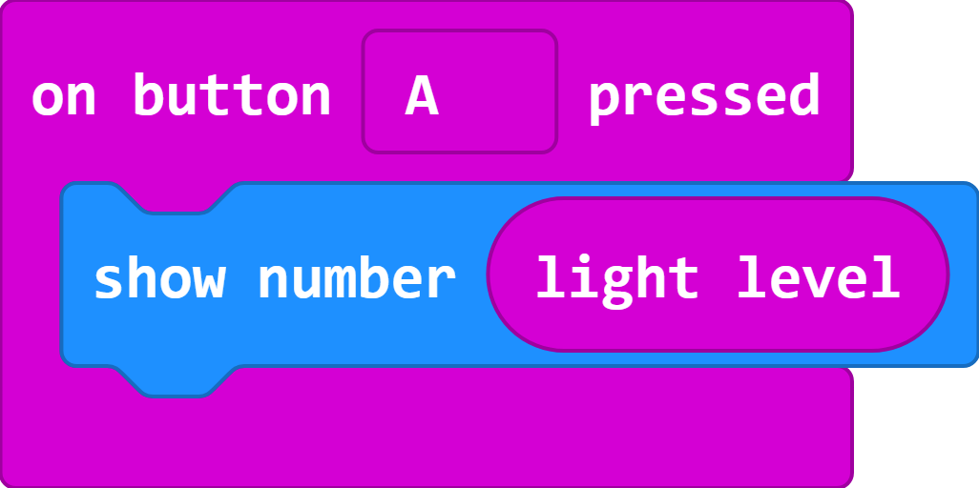
What do you think this program will do?
Link to code in MakeCode editor: https://makecode.microbit.org/#pub:_Fbmc40R6FACT

Slide 9
Collecting data with the micro:bit
Which areas of the school do you think are the warmest or coolest?
How could we use the micro:bit to find out which area in the school is the warmest or coolest?
How could we modify the light sensor program to get the micro:bit to display the temperature?

Slide 10
What do you think this program will do?

Slide 11
Collecting data
Modify the program to use the micro:bit as a temperature recorder
Download and transfer to your micro:bit
Connect the battery pack to the micro:bit
Visit selected areas of the school and record the temperature

Slide 12
Using our data
What temperatures did you record at your locations?
What do our results tell us?
Are there any patterns in our results?
Do any of the results look incorrect?
Why might we have recorded incorrect results?

Slide 13
Learning objectives revisited:
To understand that some devices use sensors.
To write simple programs using sensors.
To use the BBC micro:bit to collect data.

Slide 14
Licensing information:
Published by the Micro:bit Educational Foundation microbit.org under the following Creative Commons licence:
Attribution-ShareAlike 4.0 International (CC BY-SA 4.0) https://creativecommons.org/licenses/by-sa/4.0/

