Slide 1
Computing fundamentals Lesson 6
Fundamentals of computer systems lesson part 2

Slide 2
Talk for 30 seconds (no hesitation or pauses!) about:
micro:bit
hardware
software
input devices
output devices
computer systems

Slide 3
Learning objectives:
to plan and create a short explainer video about micro:bit
to follow criteria and use criteria to evaluate
to review and evaluate learning

Slide 4
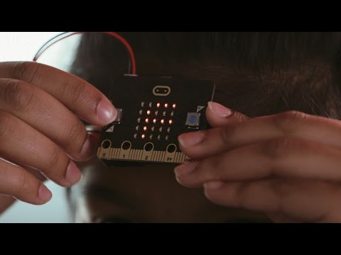
What is an explainer video?
A short video to explain something clearly

Slide 5
Explainer video challenge criteria:
Plan and record an explainer video that:
gives a brief overview of what micro:bit is OR
explains one aspect of micro:bit (e.g. an input or output device).
is aimed at first time micro:bit users
is maximum of 1 minute long
features you talking to camera and/or screen recording with voiceover
is creative!

Slide 6
Learning objectives revisited:
to plan and create a short explainer video about micro:bit
to follow criteria and use criteria to evaluate
to review and evaluate learning

Slide 7
Copyright information
Published by the Micro:bit Educational Foundation microbit.org
Licence: Attribution-ShareAlike 4.0 International (CC BY-SA 4.0)

