Slide 1

Nature art
Teacher lesson guide
Lesson 3
Updated July 2026. Visit https://microbit.org/teach/ for the most up-to-date resources.

Slide 2
Learning objectives
To understand that LEDs can be used to create image representations.
To plan LED image representations.
To construct programs to display LED image representations with the micro:bit.

Slide 3
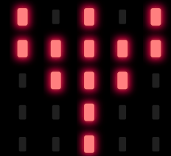
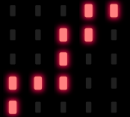
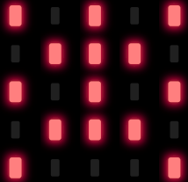
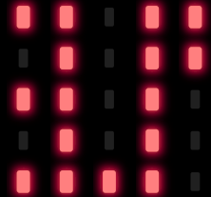
micro:bit representations of wildlife 1
Image 1
Image 2
Image 3
Image 4
Notes:
Image 1 is a flower with the stem, petals and the stamen represented.
Image 2 ia a worm with the wiggly shape of the body represented.
Image 3 is a spider with eight legs represented by sharing LEDs
Image 4 is a squirrel with its bushy tail represented

Slide 4
micro:bit representations of wildlife 2
What do the images below have in common?
How do you think these images have been created?
Image 1
Image 2
Image 3
Image 4

Slide 5
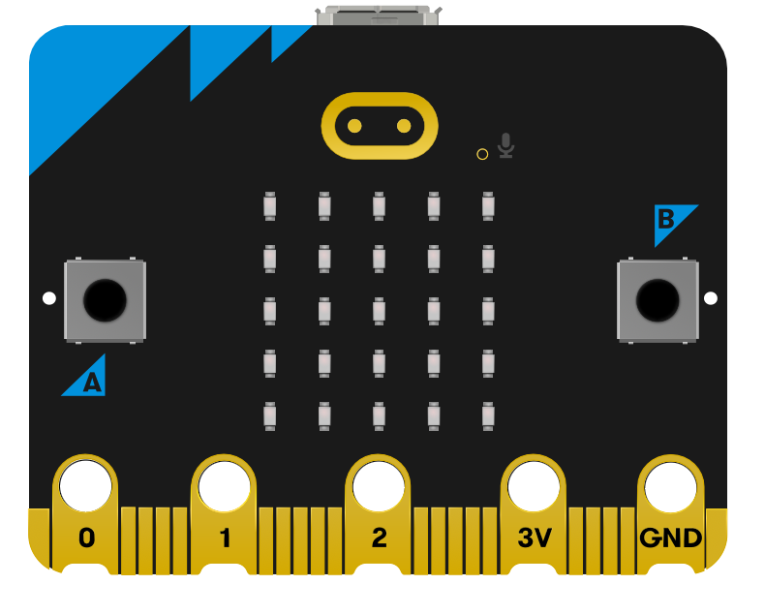
LED representations
LED lights
The micro:bit is a handheld programmable computer
It has 25 Light Emitting Diodes (LED) that can be turned on or off
Predict what image is being represented by micro:bit in this program
Notes:
Use the simple images hex file contained in the folder to program a micro:bit and show images to the class or use the program with the simulator using the link https://makecode.microbit.org/#pub:_97wWYsARaetH

Slide 6
Output
When a computer program tells something to happen
e.g. a character to move in a game, a printer to print a page or a light to turn on.

Slide 7
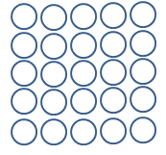
LED planner
representation of
____________
representation of
____________
representation of
____________
representation of
____________
representation of
____________
representation of
____________
representation of
____________
representation of
____________

Slide 8
Using the LED planner
Use the LED planner to create a representation of a sad face.
What details could we abstract to support this representation?
What should we do if we shade in the wrong LED?

Slide 9
Programming LED representations 1
What does the word ‘program’ mean in Computing?
  a set of sequenced instructions in a language that a computer understands that will solve a problem
What computer programs have you written?
We are going to program the micro:bit to display your planned image representations.

Slide 10
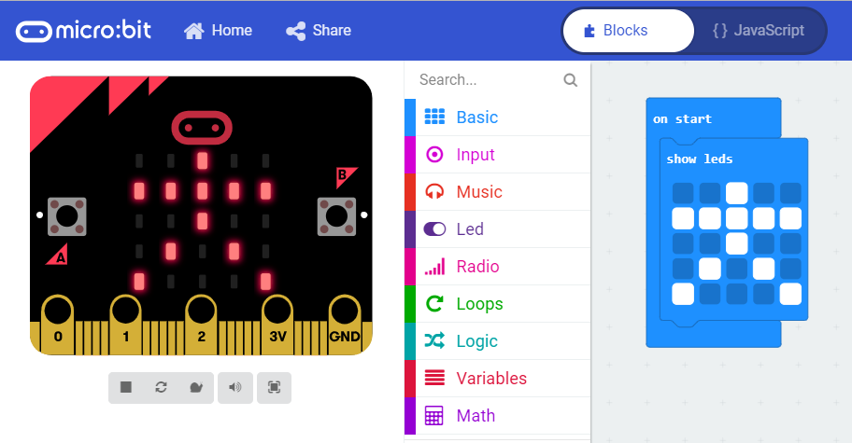
Programming LED representations 2
LED representation (output)
Program

Slide 11
Paired programming
With your partner, use the MakeCode editor to construct a program to show an LED representation from your plan.
Compare the image on the simulator to the image on your plan.
Debug your program as necessary.

Slide 12
Sharing LED representations
Look at representation created by other pairs.
What plant/animal is being represented?
What made you think it was the plant/animal you identified?

Slide 13
Evaluating LED representations
Discuss with another pair, the programs you constructed, the success you had and the problems you overcame.
Why is evaluating our computer programs useful?

Slide 14
Learning objectives revisited
To understand that LEDs can be used to create image representations.
To plan LED image representations.
To construct programs to display LED image representations using the micro:bit.

Slide 15
LED planner 2
representation of
____________
representation of
____________
representation of
____________
representation of
____________
representation of
____________
representation of
____________
representation of
____________
representation of
____________

Slide 16
Licensing information
Published by the Micro:bit Educational Foundation
microbit.org under the following Creative Commons licence:
Attribution-ShareAlike 4.0 International (CC BY-SA 4.0)
https://creativecommons.org/licenses/by-sa/4.0/
Notes:
This slide must be kept.

