Slide 1
ages 7-9
Barefoot meets micro:bit
Wildlife animations - Lesson 2

Slide 2
Learning objectives
I can use repetition within the micro:bit MakeCode editor
I can design and code an animation using the micro:bit’s LEDs
I can evaluate my work and suggest improvements

Slide 3
Can you remember?
We’ll be using the MakeCode programming environment - makecode.microbit.org
How do we?
Create a new project
Place ‘show icon’ blocks into the programming area
Download the program
Transfer the program file to micro:bit

Slide 4
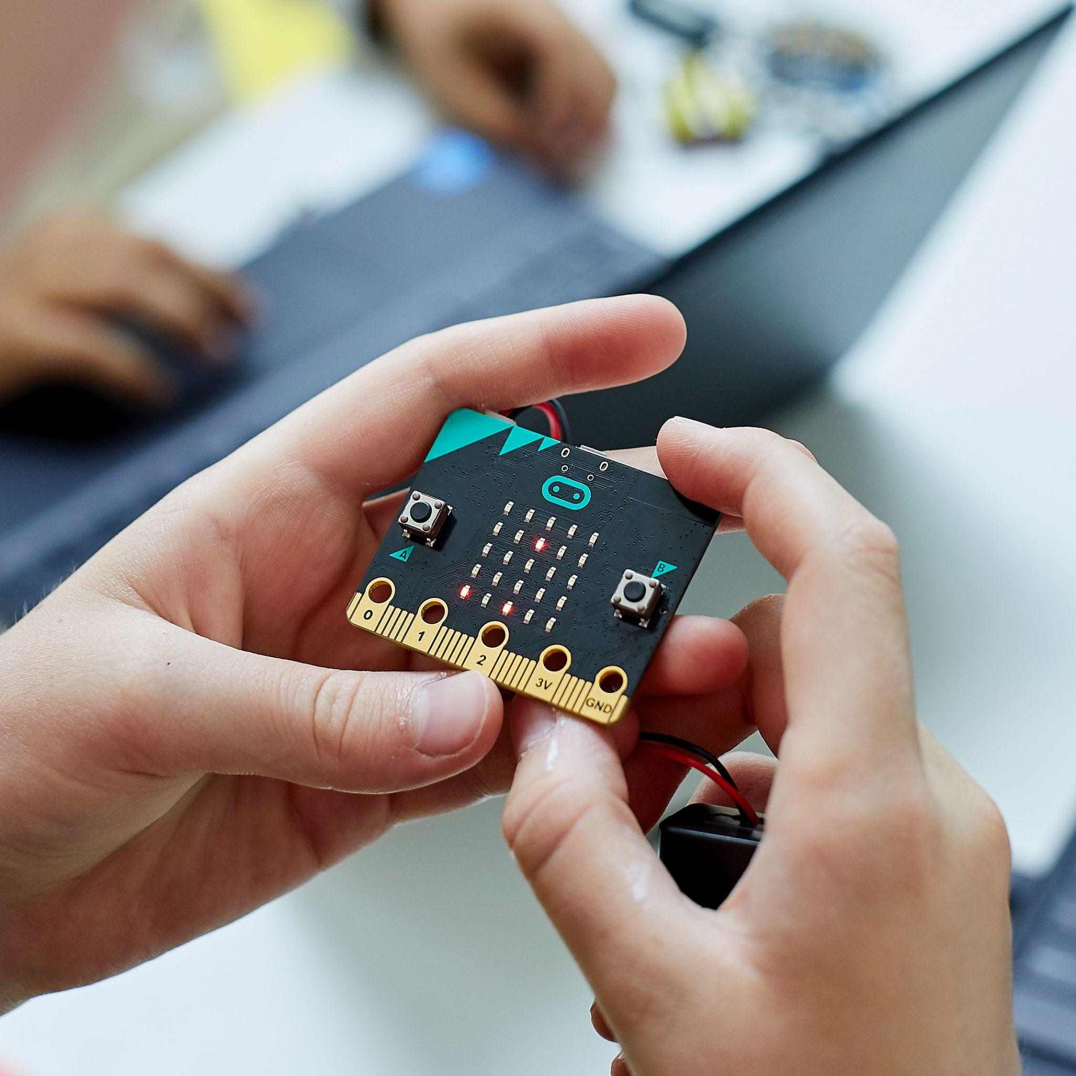
Keeping safe
Hold the micro:bit carefully by the edges
Avoid touching the components
Keep liquids away from the micro:bit
Notes:
Image © Micro:bit Educational Foundation

Slide 5
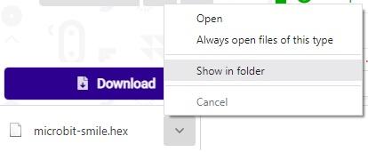
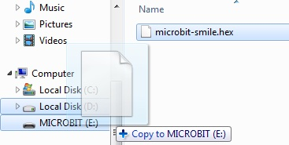
Transferring a program
Download the program, then select ‘Show in folder’
Drag the file from the ‘Downloads’ folder onto the micro:bit

Slide 6
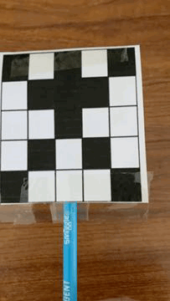
Moving images
We can make a moving image, or animation, by making quickly flicking between two still images.

Slide 7
Moving images
We can make a moving image, or animation, by making quickly flicking between two still images.

Slide 8
Thaumatrope
We are going to make a thaumatrope containing our own nature related animation. Two images will need to be completed using the LED templates.

Slide 9
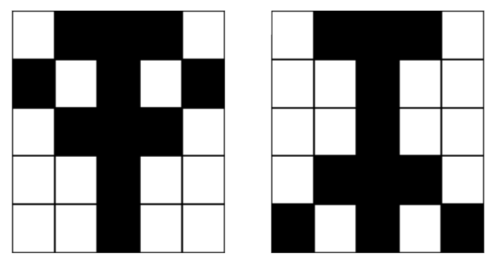
Thaumatrope
Could you make an animation involving nature?
For example, we could make an animation of an insect flapping its wings.
What ideas do you have for an animation after going outside?

Slide 10
Thaumatrope
Could you make an animation involving nature?
Maybe you could make:
A plant grow
A flower bloom
A tree sway
An insect’s wings flap
A frog jump

Slide 11
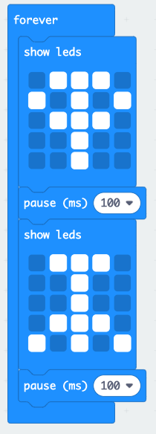
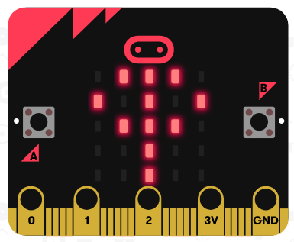
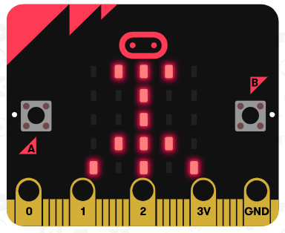
Programming our animation
We can use two ‘show leds’ blocks, with a ‘pause’ after each block, to program our animation.
Why do we need the ‘pause’ block?
What do you think the ‘forever’ block does?
Example program - https://makecode.microbit.org/_TgwajDYK1bPC

Slide 12
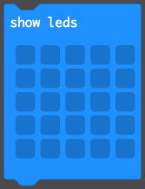
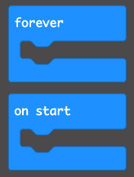
Your turn!
Make your own animation using MakeCode.
Once complete, try to tinker with these ‘Basic’ blocks to:
Make a different animation using two different images
Add some text when your program first starts to explain what your animation shows (e.g. “Plant growing”)
Add a third image to make a more complex animation

Slide 13
Plenary
Share your program with someone near you
Explain to them which blocks you have used in your program

