Slide 1
Cryptography
Teacher lesson guide
Lesson 3

Slide 2
Recap
What did you learn about writing an algorithm for a Caesar cipher last lesson?
How did you use selection, iteration and variables?
How did you use logical reasoning to solve problems?

Slide 3
Learning objectives:
To develop practical understanding of text-based programming
To understand and use selection, variables and functions
To analyse JavaScript code
To program a Caesar cipher with Python (if you have micro:bits)

Slide 4
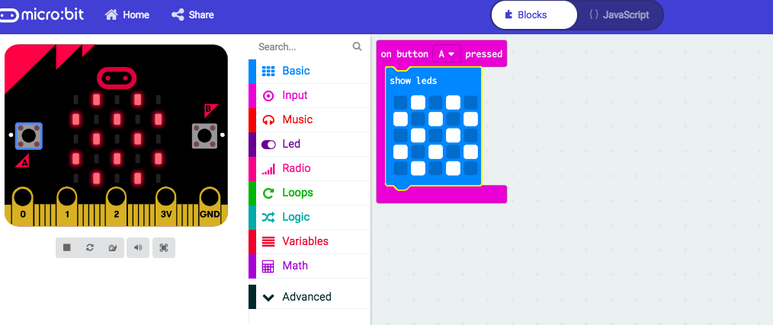
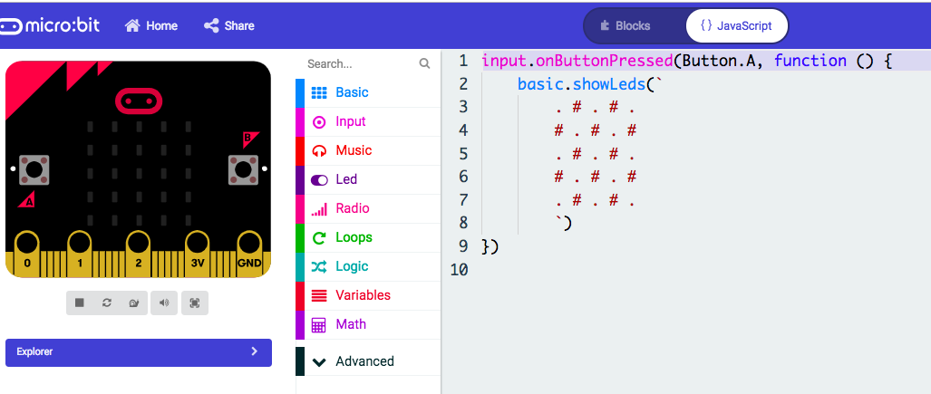
Graphical and text-based programming
What can you see in the image below? What does it show?

Slide 5
Text-based programming
What do you already know about text-based programming?
Visit MakeCode: https://makecode.microbit.org
Experiment:
create a simple program in the blocks editor
how does it look in the JavaScript editor
Can you change the JavaScript code?

Slide 6
JavaScript Caesar cipher
Visit https://codepen.io/MattCK/pen/OyQyxE
Try the Caesar cipher
Try to decipher the JavaScript code

Slide 7
Selection
Allows a decision to be made in a program.
Find an example of selection. What do you think it does?

Slide 8
Variables
Containers for storing data values.
Find an example of a variable. What do you think it does?

Slide 9
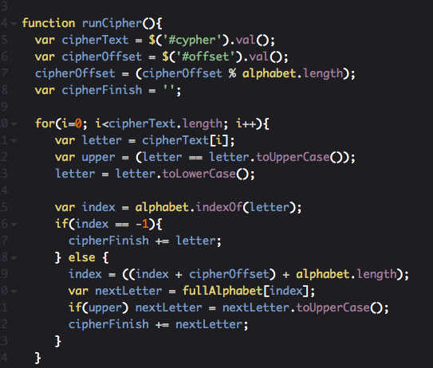
Functions
A small section of code.
Performs a specific task, then returns a value.
Can be used repeatedly
in a program
Find an example of a function.
What do you think it does?

Slide 10
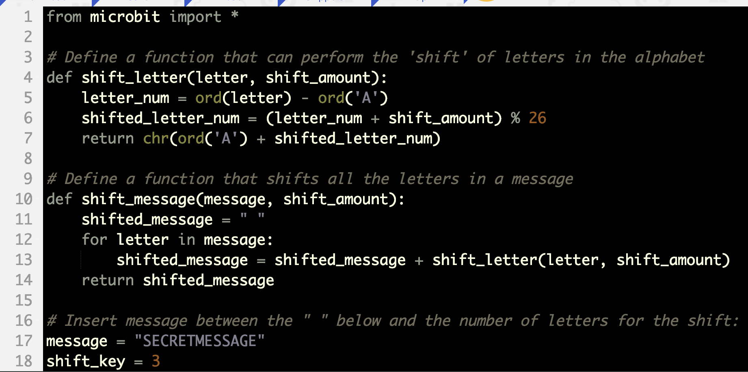
Python full Caesar cipher
https://python.microbit.org/

Slide 11
Python full Caesar cipher (continued)

Slide 12
Simplified Python Caesar cipher
Notes:
‘key’ is a numerical variable – you can only scroll strings (text variables) so we convert it to a string using str() before scrolling it on the LED display.
This program also uses the modulo function - % 26 means ‘divide by 26 and only take the remainder’ to make the cipher loop back to the start of the alphabet after it gets to Z.
Delay = 300 is used to slow down the scrolling to make it easier to read the cipher.

Slide 13
Learning objectives revisited:
To develop practical understanding of text-based programming
To understand and use selection, variables and functions
To analyse JavaScript code
To program a Caesar cipher with Python (if you have micro:bits)

Slide 14
Lesson and cryptography review
Which method created the most efficient Caesar cipher?
How would you describe text-based programming (with examples)?
What is a function?
What is logical reasoning and how have you used it?
How would you explain to someone what Cryptography is using examples.
What are ciphers and what types of ciphers can you explain?
Why do we still need encryption in our world today?

Slide 15
Licence information
Published by the Micro:bit Educational Foundation microbit.org under the following Creative Commons licence:
Attribution-ShareAlike 4.0 International (CC BY-SA 4.0)
https://creativecommons.org/licenses/by-sa/4.0/

