Slide 2
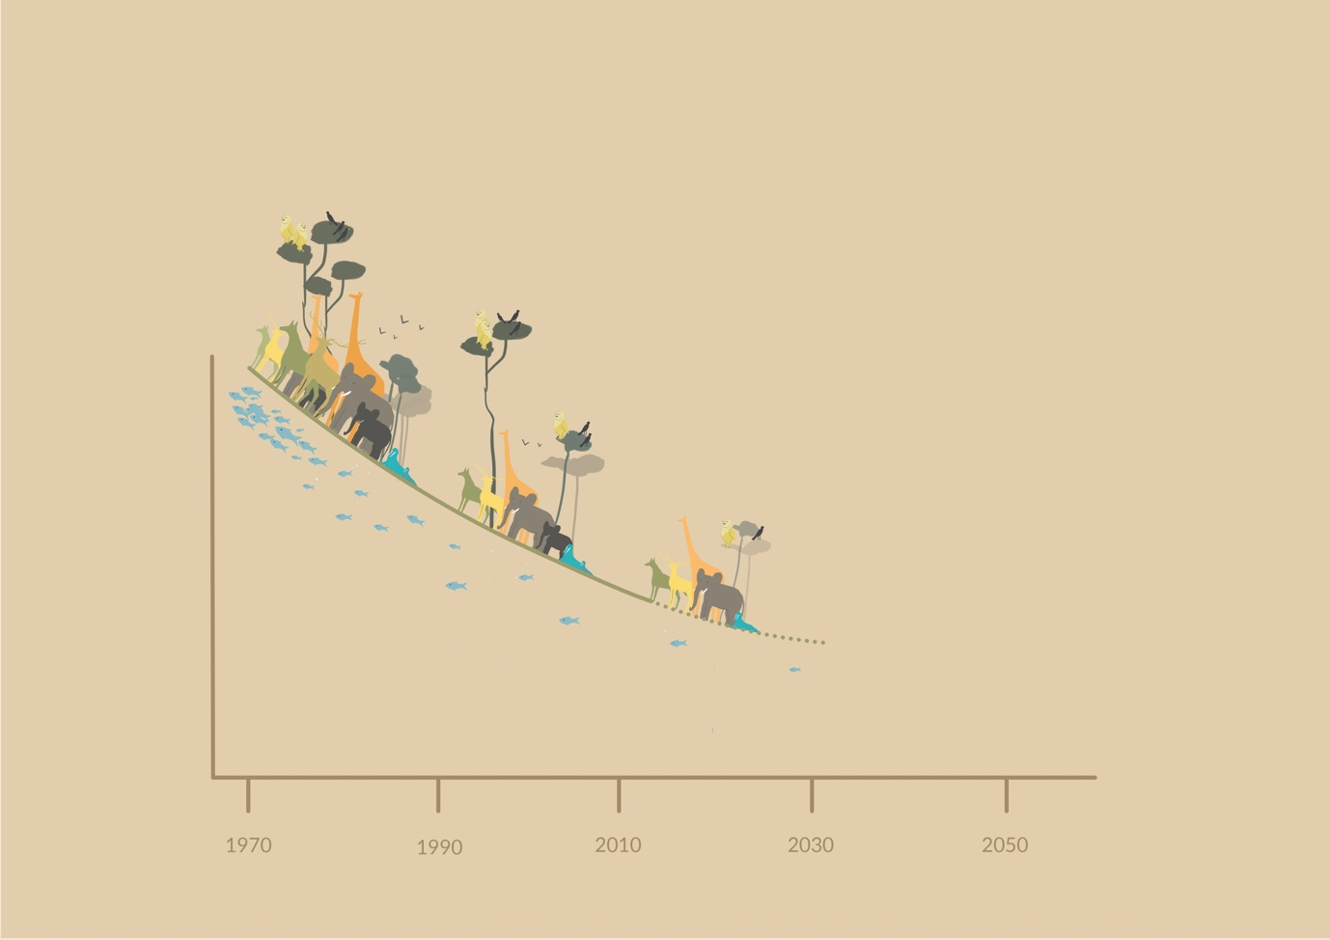
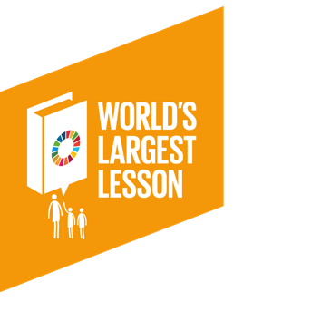
What do you think this graph might show?
What impact might this have on the planet?

Slide 4
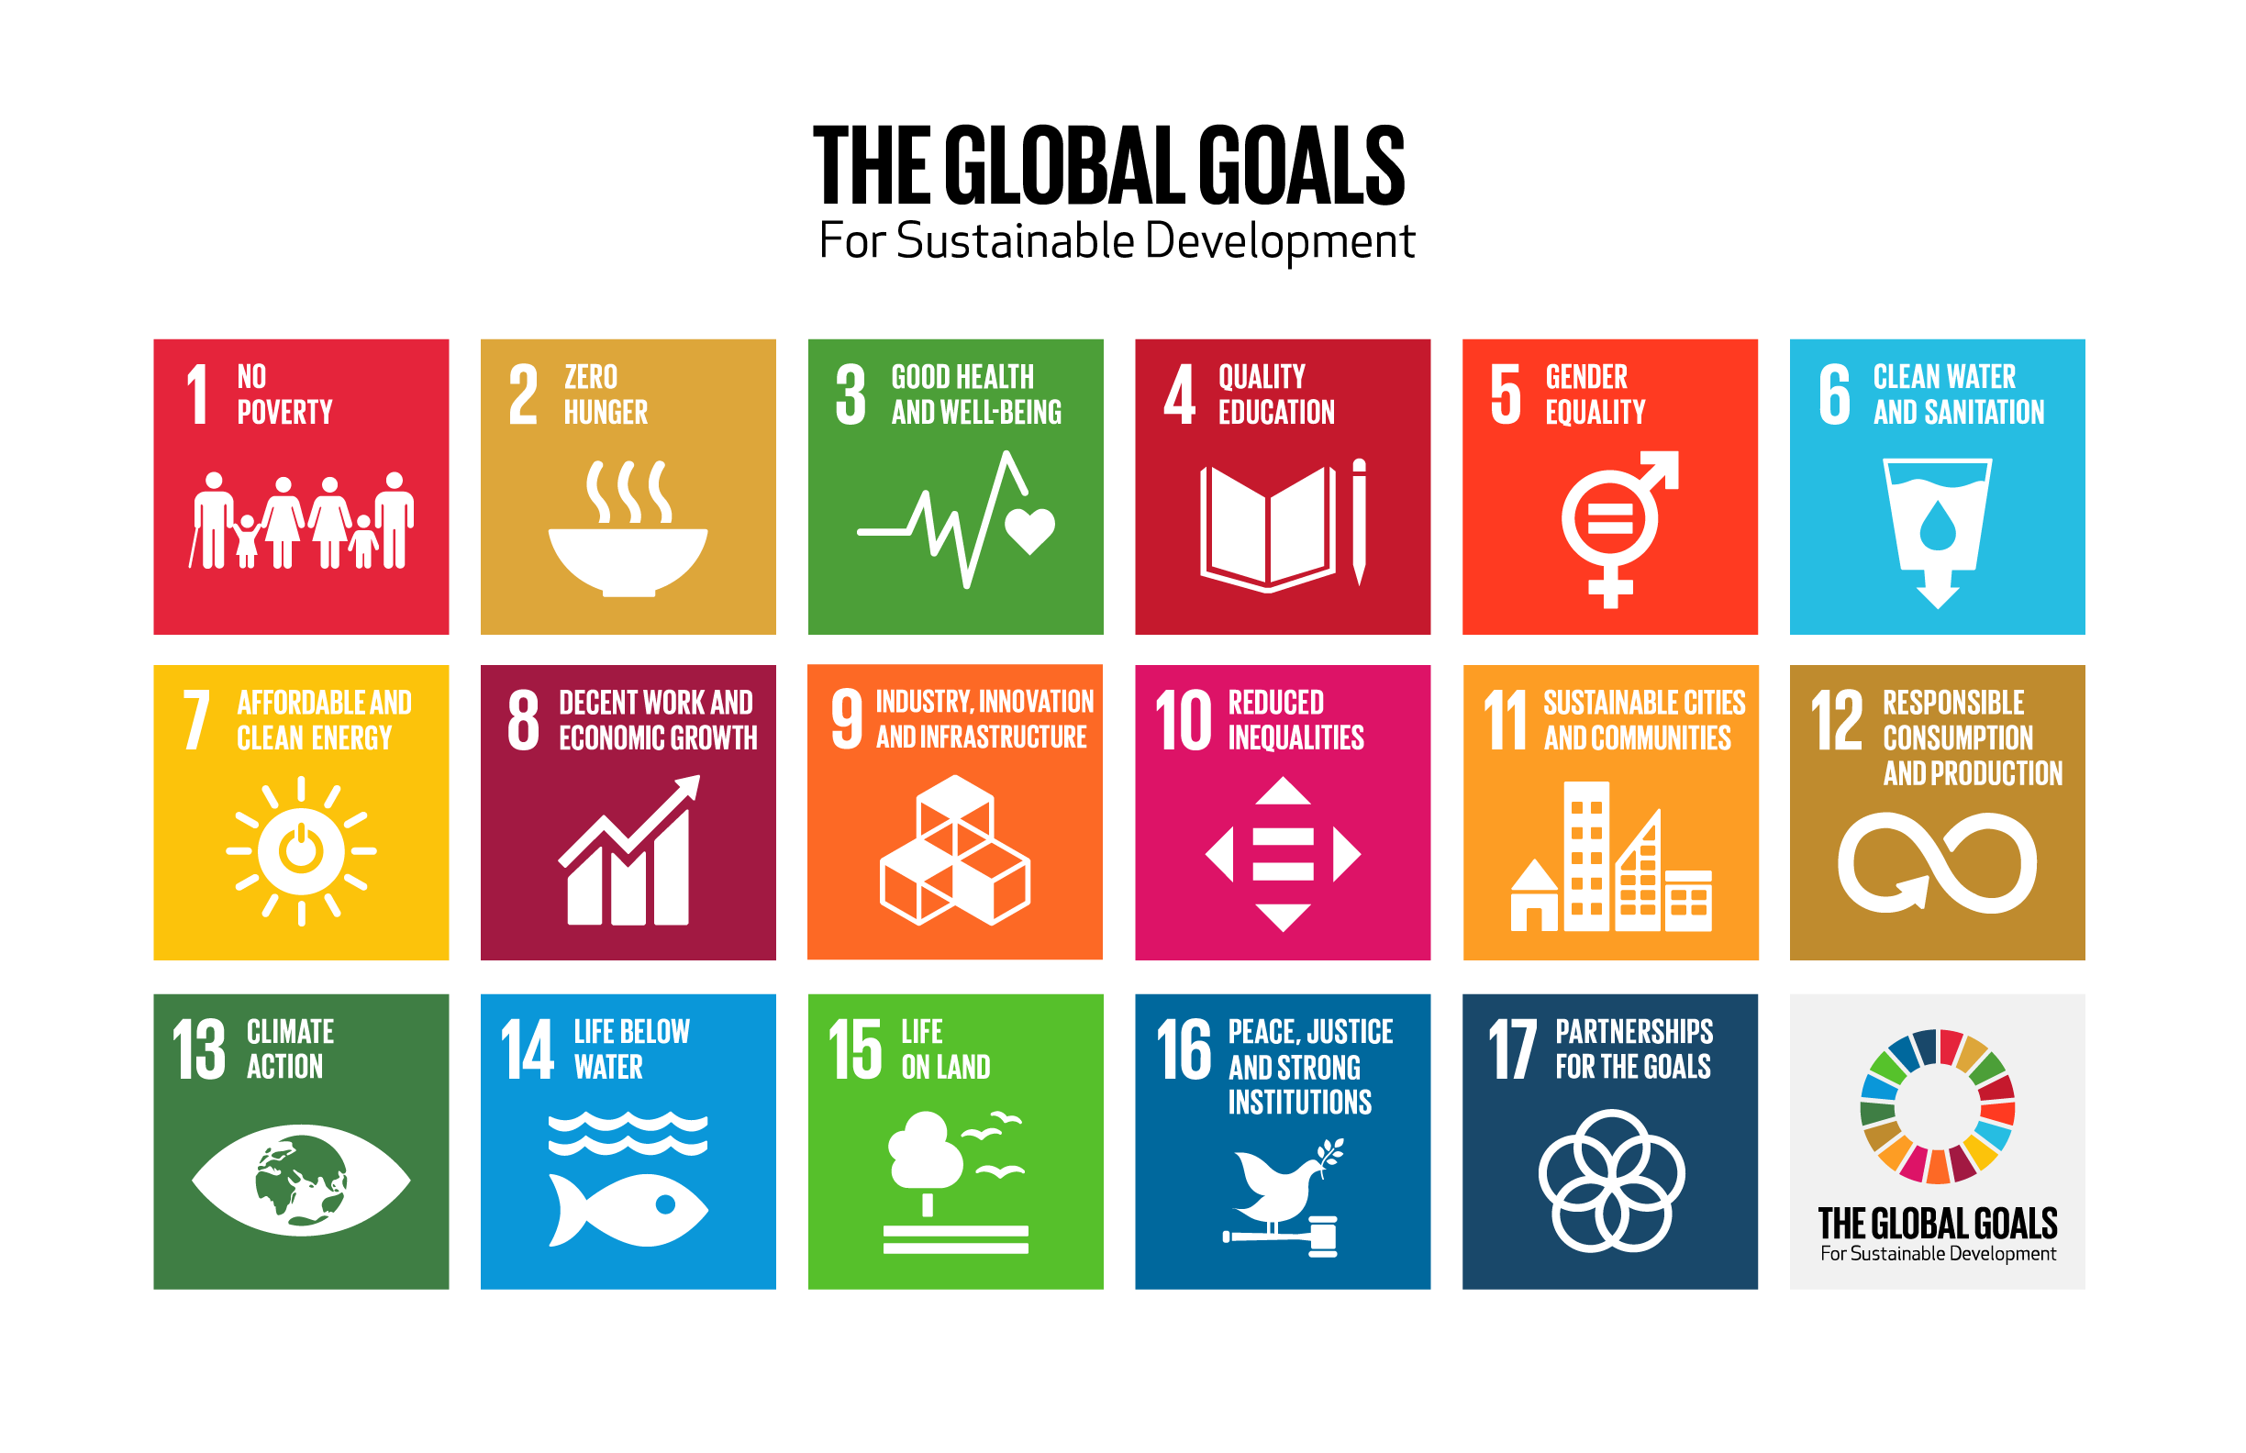
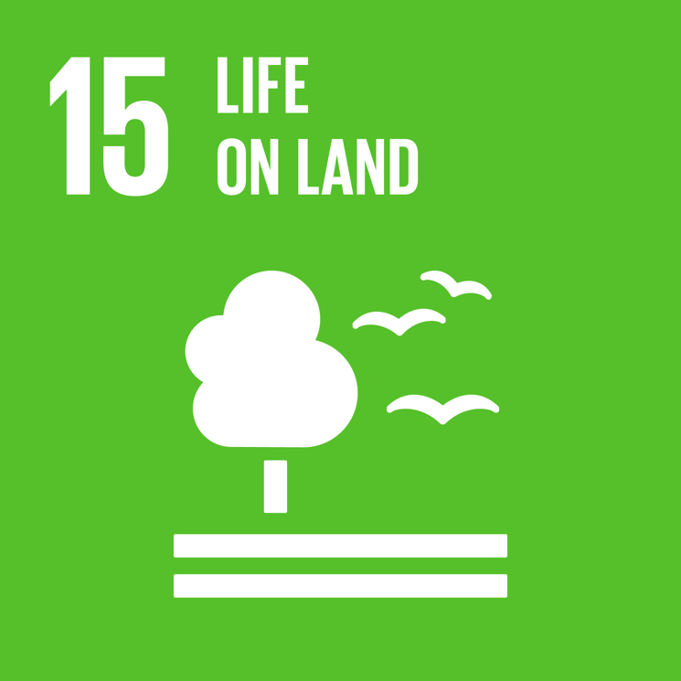
Global Goal 15 Life on Land
Protect, restore and promote sustainable use of terrestrial ecosystems, sustainably manage forests, combat desertification, and halt and reverse land degradation and halt biodiversity loss.

Slide 5
Debate: Should palm oil be banned?
Can palm oil help our jungles?
Iceland Advert

Slide 6
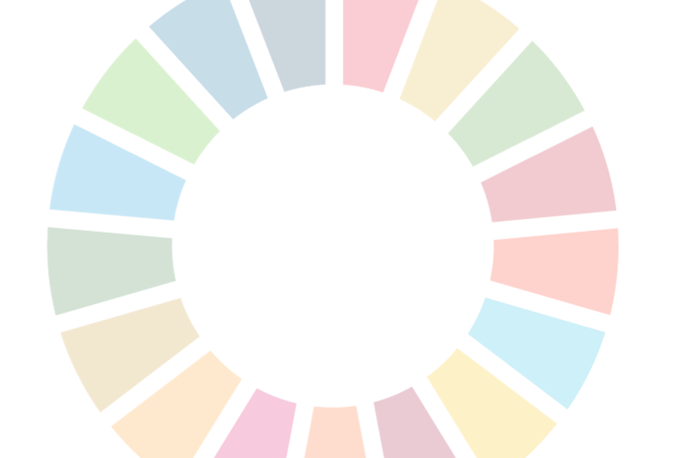
Action & Reflection
What action could you take for Global Goal 15?
What is one thing you learnt today?
What is something you would like to learn more about?
What questions do you have about the Global Goals?

