Slide 1
Ocean health monitor

Slide 2
Global goals

Slide 4
Setting the scene
A group of marine scientists have asked you to develop a prototype floating sensor node that they can leave in the ocean and that transmit data to them so they can study climate change in the sea.

Slide 5
Success criteria
Design and create a floating sensor node using a micro:bit
The beacon must transmit sensor data to a gateway micro:bit every 10 seconds
The beacon must also transmit its unique ID number (there will be lots of nodes!)
The gateway micro:bit must be able to show the data on its LED screen

Slide 6
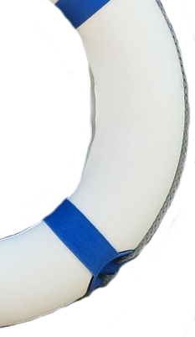
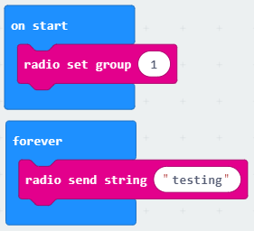
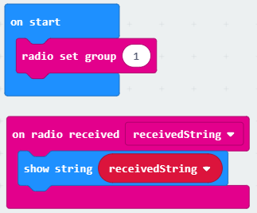
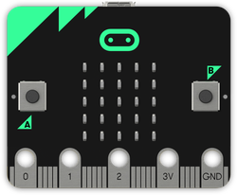
NODE
GATEWAY
(to the internet)
Radio blocks
On floating sea sensor
With the scientists on a ship

Slide 7
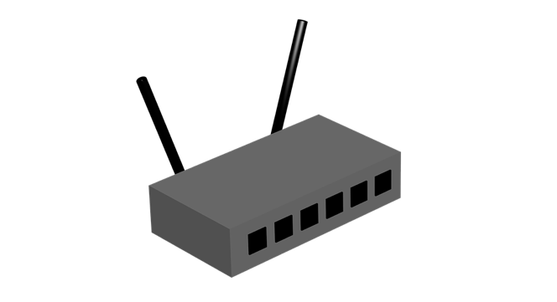
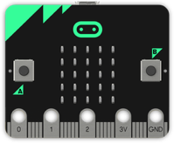
3/4/5G
WiFi
LoRa
Sigfox
GATEWAY
(to the internet)
Scientists
Long range
(up to 20km)
NODE
IRL:
Node transmits to gateway over a long range using 3G (mobile network) or LoRa/SigFox
Gateway receives data and then transmits it to the internet
The scientists receive the data on a PC or mobile device
What you are prototyping

Slide 8
Input process output
Input | Process | Output
Water temperature Air temperature Air pressure Humidity Air quality Light intensity Accelerometer (waves) Compass | Format data Unique ID number | Transit data via radio Transmit unique ID number
Input | Process | Output
Data via radio Unique ID number via radio | Format the data | Display the data on the LEDs

Slide 9
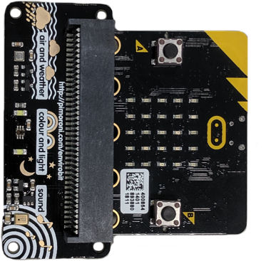
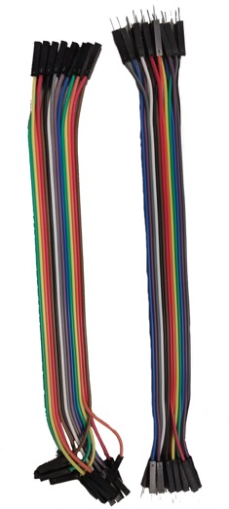
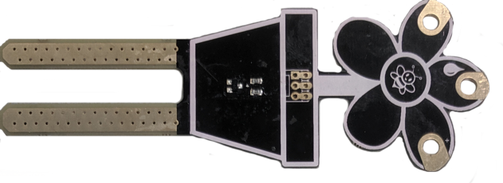
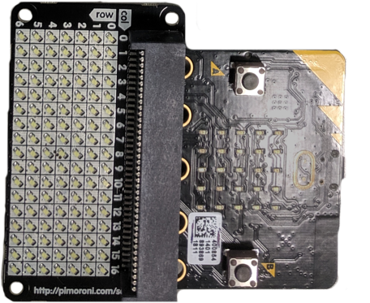
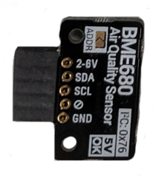
Other ideas using peripherals
Enviro bit
Additional sensors for:
Air and weather
Colour and light
Sound
Moisture sensor
Could be used to measure rainfall or to alert the scientists if the node sinks
Needs crocodile clips
Scroll bit (for Gateway)
LED matrix
More LEDs to display data
Air quality sensor
Combined pressure and
Humidity
Needs extra cables and soldering

Slide 10
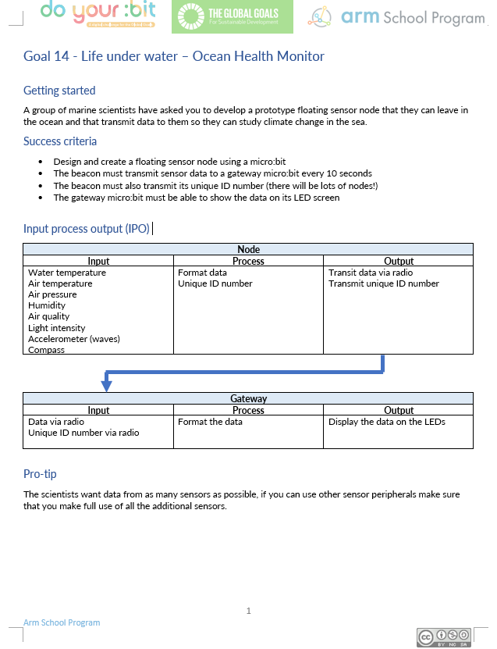
Group task:
Get into pairs/groups
Use the Ocean Health Monitor worksheet to help you design and create your product
The product must meet the success criteria
Use the IPO worksheet to design further features
Make a prototype to test your product
Please note:
The prototype does not need to be tested on water! The scientists are only interested in the sensor data and not whether your prototype can actually float at sea.
micro:bits are not waterproof!

Slide 11
Success criteria
Design and create a floating sensor node using a micro:bit
The beacon must transmit sensor data to a gateway micro:bit every 10 seconds
The beacon must also transmit its unique ID number (there will be lots of nodes!)
The gateway micro:bit must be able to show the data on its LED screen

Slide 12
Licensing information
Published by the Micro:bit Educational Foundation microbit.org under the following Creative Commons licence:
Attribution-NonCommercial-ShareAlike 4.0 International (CC BY-NC-SA 4.0)
https://creativecommons.org/licenses/by-nc-sa/4.0/
https://microbit.org/do-your-bit/

