Slide 1
Health Tech
Teacher lesson guide
Lesson 2

Slide 2
Health tech recap
What is health tech?
Name an example of health tech and how it helps address a health problem in the UK
State one benefit and one drawback of health tech

Slide 3
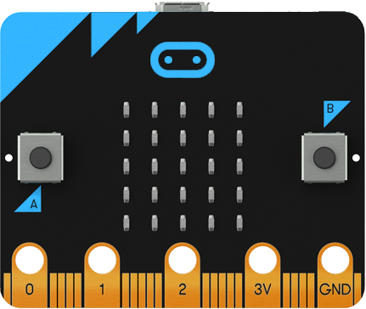
Micro:bit Health Tech Challenge
Create a prototype of a health tech innovation to help address a health problem in the UK using micro:bit

Slide 4
Possible first steps
Find out what is meant by a prototype
Decide which health problem we want to address
Brainstorm different innovation ideas
Choose one innovation idea
Develop the prototype

Slide 5
Learning objectives:
to develop ideas for health tech innovations to meet a UK healthcare need
to understand the importance of prototyping
to select an innovation idea and begin to develop a prototype

Slide 6
What is a prototype?
An initial, basic version of an innovation
Why is a prototype important?
It allows you to quickly and easily:
show how your innovation would work
test and trial it
get feedback
decide what works and what doesn’t
saves time (and money in real-life!)

Slide 7
Prototype criteria
You can choose how to present it. Must include:
A visual representation of the design
Explanation about why it will help address the problem & the intended user
Instructions for how it will work
A detailed, accurate algorithm for at least one feature
A working micro:bit program for the same feature

Slide 8
Learning review
Explain what prototyping is and why it is important.
How effective was your approach to choosing an innovation and how could you make it more effective?

Slide 9
Learning objectives revisited:
to develop ideas for health tech innovations to meet a UK healthcare need
to understand the importance of prototyping
to select an innovation idea and begin to develop a prototype

Slide 10
Licensing information
Published by the Micro:bit Educational Foundation microbit.org
Licence: Attribution-ShareAlike 4.0 International (CC BY-SA 4.0)

