Slide 1
Being Active
Heart rate monitor

Slide 2
Activity and a healthy heart
Why is regular activity important for a healthy heart?
increases the heart rate
exercises the heart muscle
helps keeps the heart fit
helps the heart pump blood efficiently around the body
can help reduce coronary heart disease by 35%

Slide 3
Higher or lower heart rates?

Slide 4
Different activities
Walking on the spot
Jumping jacks
Running on the spot
Deep breathing
Resting heart rate
Do each for 15 seconds, then measure and record your heart rate.

Slide 5
Heart rate monitor
How could a heart rate monitor help people to keep their heart healthy?
How could it work?
Look at the prototype using the micro:bit. How do you think it has been programmed to work?

Slide 6
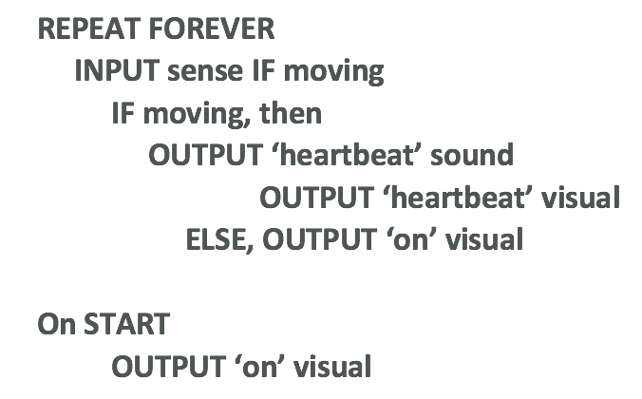
Designing a heart rate monitor
Design your heart rate monitor on paper.
Include labels and algorithm to show how it works.

Slide 7
Coding your heart rate monitor
Using the MakeCode editor and your algorithm, write your heart rate monitor program
Remember to test and debug regularly.
Once finished, download and copy to your micro:bit to test and run.
Compare your programs and devices. Have you used the same code?

Slide 8
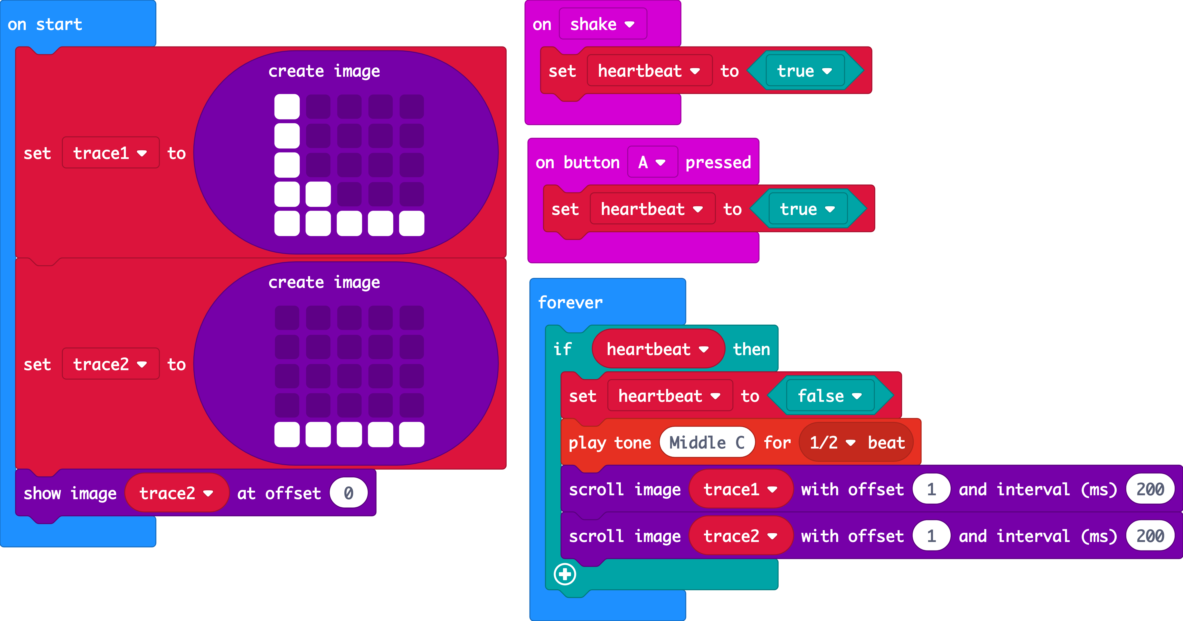
Heart rate monitor program example

Slide 9
Reviewing heart rate monitors
What has worked well with?
What would you like to improve?
What problems did you encounter and how did you solve them?

Slide 10
Licensing information
Published by the Micro:bit Educational Foundation microbit.org
Licence: Attribution-ShareAlike 4.0 International (CC BY-SA 4.0)

