Slide 1

micro:bit CreateAI taster lessons
Lesson 2
Introduction to machine learning (ML)
Updated April 2026. Visit https://microbit.org/teach/ for most up-to-date resources.
This content is published by the Micro:bit Educational Foundation under a Creative Commons Attribution-ShareAlike 4.0 International (CC BY-SA 4.0) licence
Notes:
This content is published by the Micro:bit Educational Foundation under a Creative Commons Attribution-ShareAlike 4.0 International (CC BY-SA 4.0) licence

Slide 2


Learning objectives
I can collect data, and train and test a machine learning (ML) model to react to different kinds of movements.
I can describe that an ML model matches new data to types of data it has been trained on.
I know an ML model can only match movements it has been trained on.

Slide 3

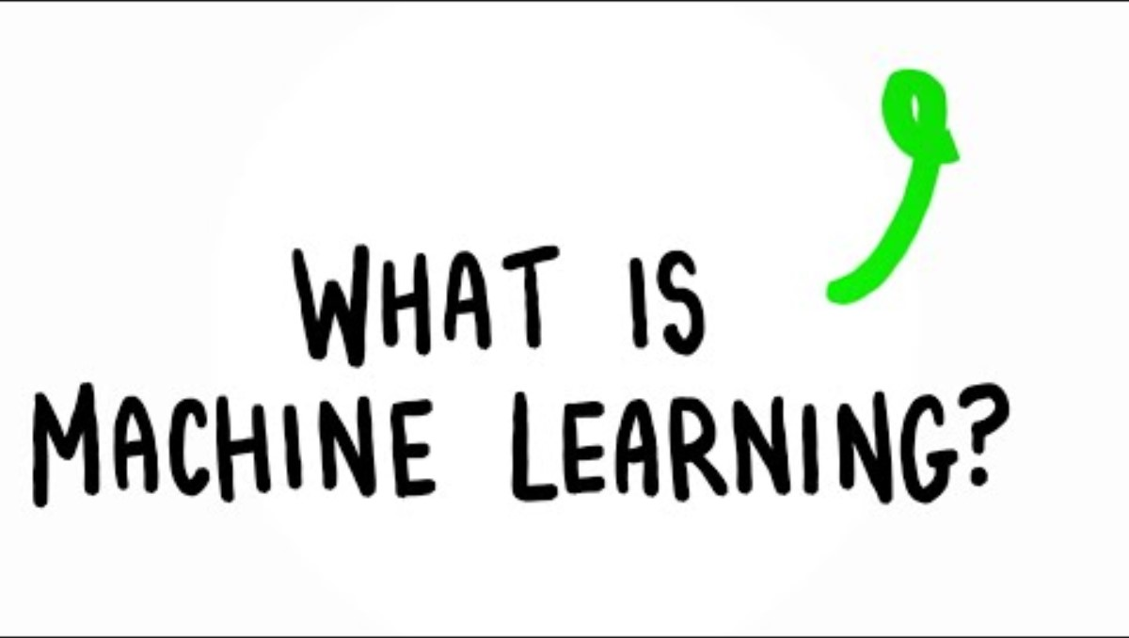
What is ML?
Click the image to play the video or play video with captions using this YouTube link: https://youtu.be/joHWdyE9VI0
Notes:
Please be aware when playing YouTube videos via PowerPoint, recommended content may appear at the end of playback. Teachers should supervise playback or stop the video before it ends to avoid unwanted content appearing in class.

Slide 4

Types of AI
ML (machine learning) is a type of AI used in fitness trackers and other tech. It is a type of AI where computers can learn from and make decisions based on data.
GenAI (generative AI) is a type of AI that is trained on huge sets of data such as text, still or moving images, or sounds, usually collected from the internet. The output is usually generated from a written question (prompt).
An AI system is a collection of technologies – software, data, and hardware – that work together using AI to generate outputs.

Slide 5
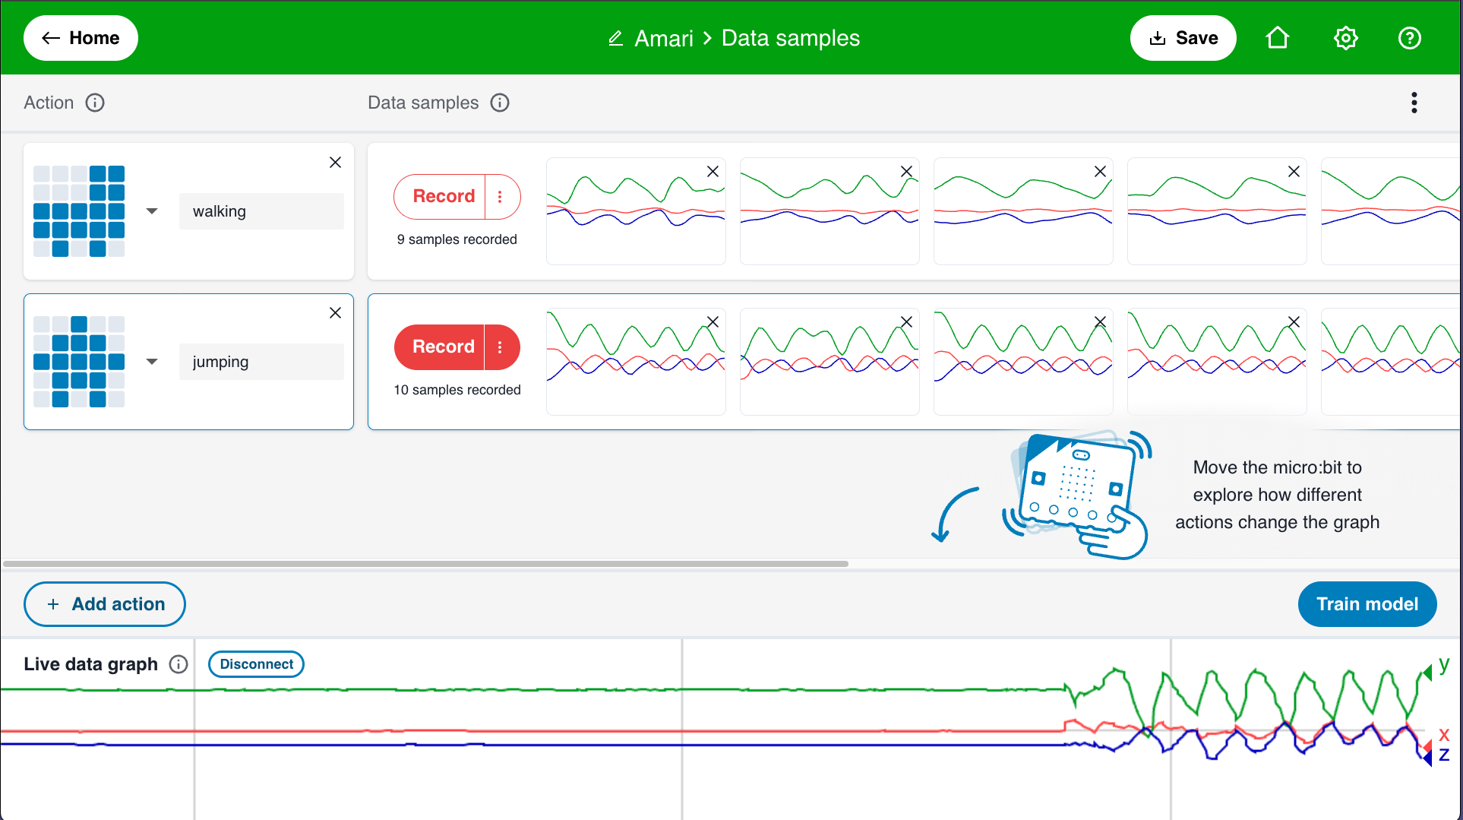
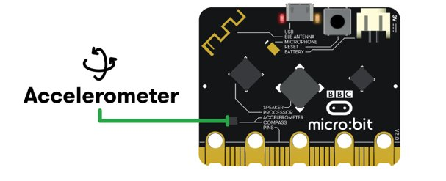
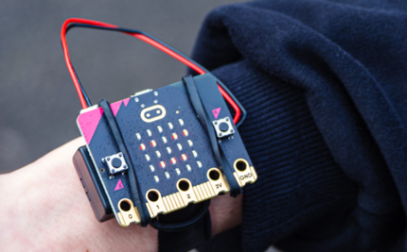
micro:bit CreateAI
micro:bit CreateAI allows you do make your own AI device to respond to different kinds of movements.
Using micro:bit CreateAI, you can learn some key ideas about how all kinds of AI apps and devices are made using the micro:bit’s accelerometer motion sensor.
In this lesson you will make a micro:bit project that responds to walking and jumping and discover some of the ways devices like fitness trackers are made.

Slide 6
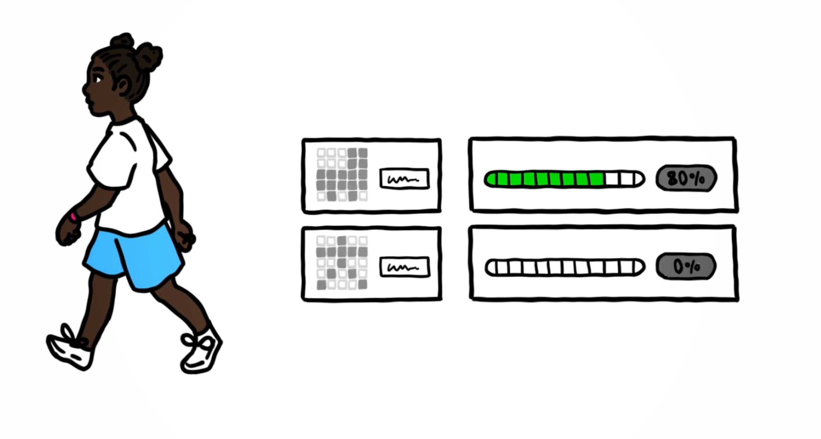
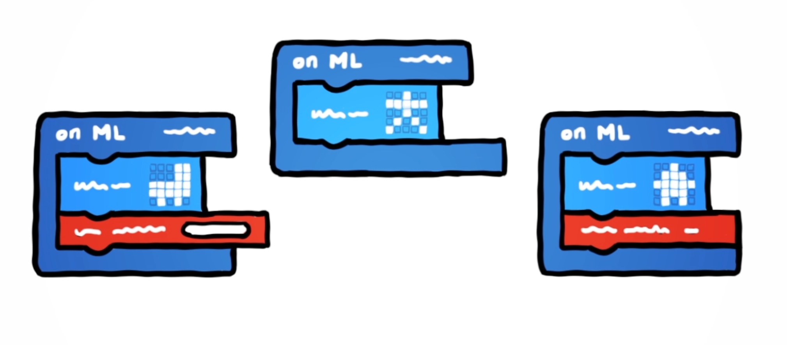
Machine learning models
Machine learning (ML) models are made by people collecting data, training a model, testing it, and then using it in code on a physical device.
In this lesson you will:
Collect data for different types of movement or ‘actions’ using the micro:bit.
Use micro:bit CreateAI to train an ML model to match new movement data to one of the actions you trained the model on.
Test the model and improve it.
Use the model in code to respond to different physical actions just like a fitness tracker.

Slide 7

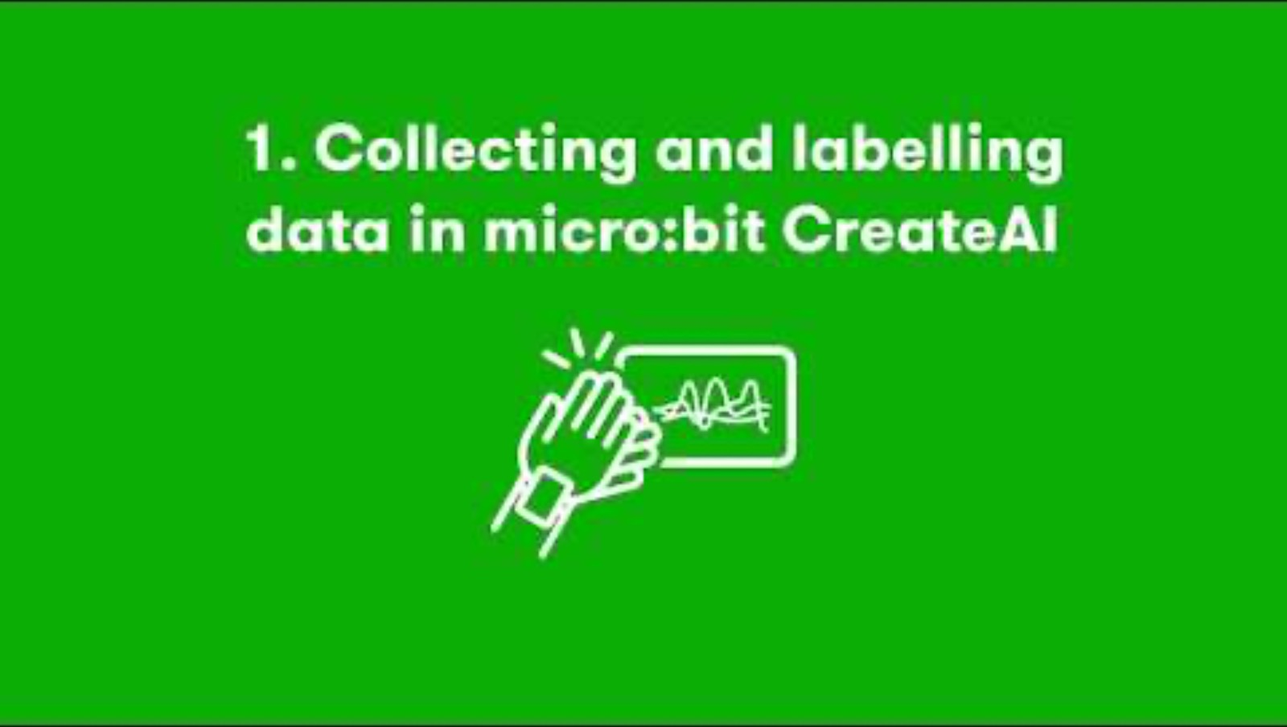
Collecting and labelling data - watch
Click the image to play the video or play video with captions using this YouTube link: https://youtu.be/KVlYsXnWLwE
Notes:
Please be aware when playing YouTube videos via PowerPoint, recommended content may appear at the end of playback. Teachers should supervise playback or stop the video before it ends to avoid unwanted content appearing in class.

Slide 8

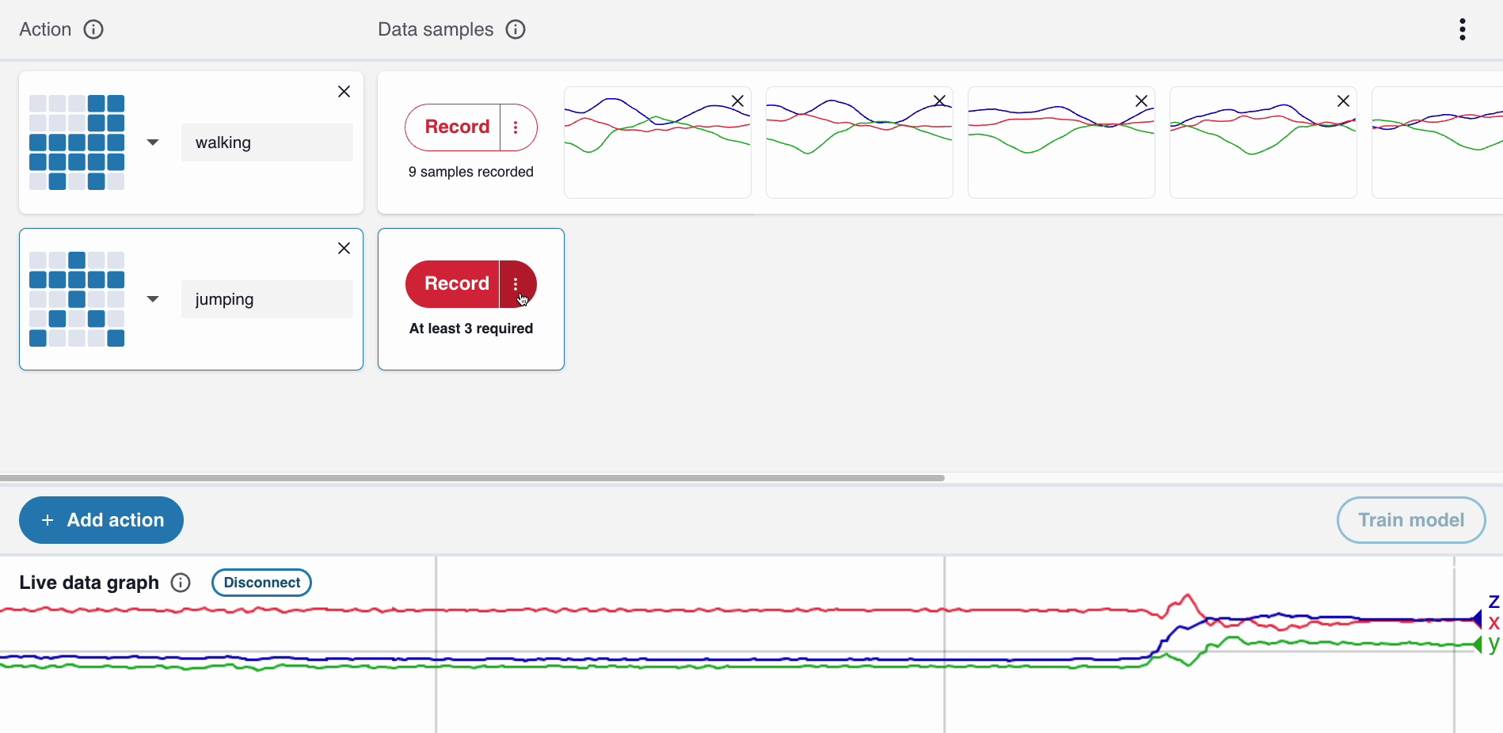
Collecting and labelling data - steps
Step 1: Go to https://createai.microbit.org/ and create a new project.
Step 2: Connect your data collection micro:bit to your computer.
Step 3: Wear or hold your micro:bit, making sure you are holding it the same way throughout.
Step 4: Observe your movements as live data on the computer screen. The graph shows movement in three dimensions or directions.
Step 5: Create actions and collect data for walking and jumping, choosing your own icons. Collect samples using the option to record for ten seconds.
createai.microbit.org

Slide 9
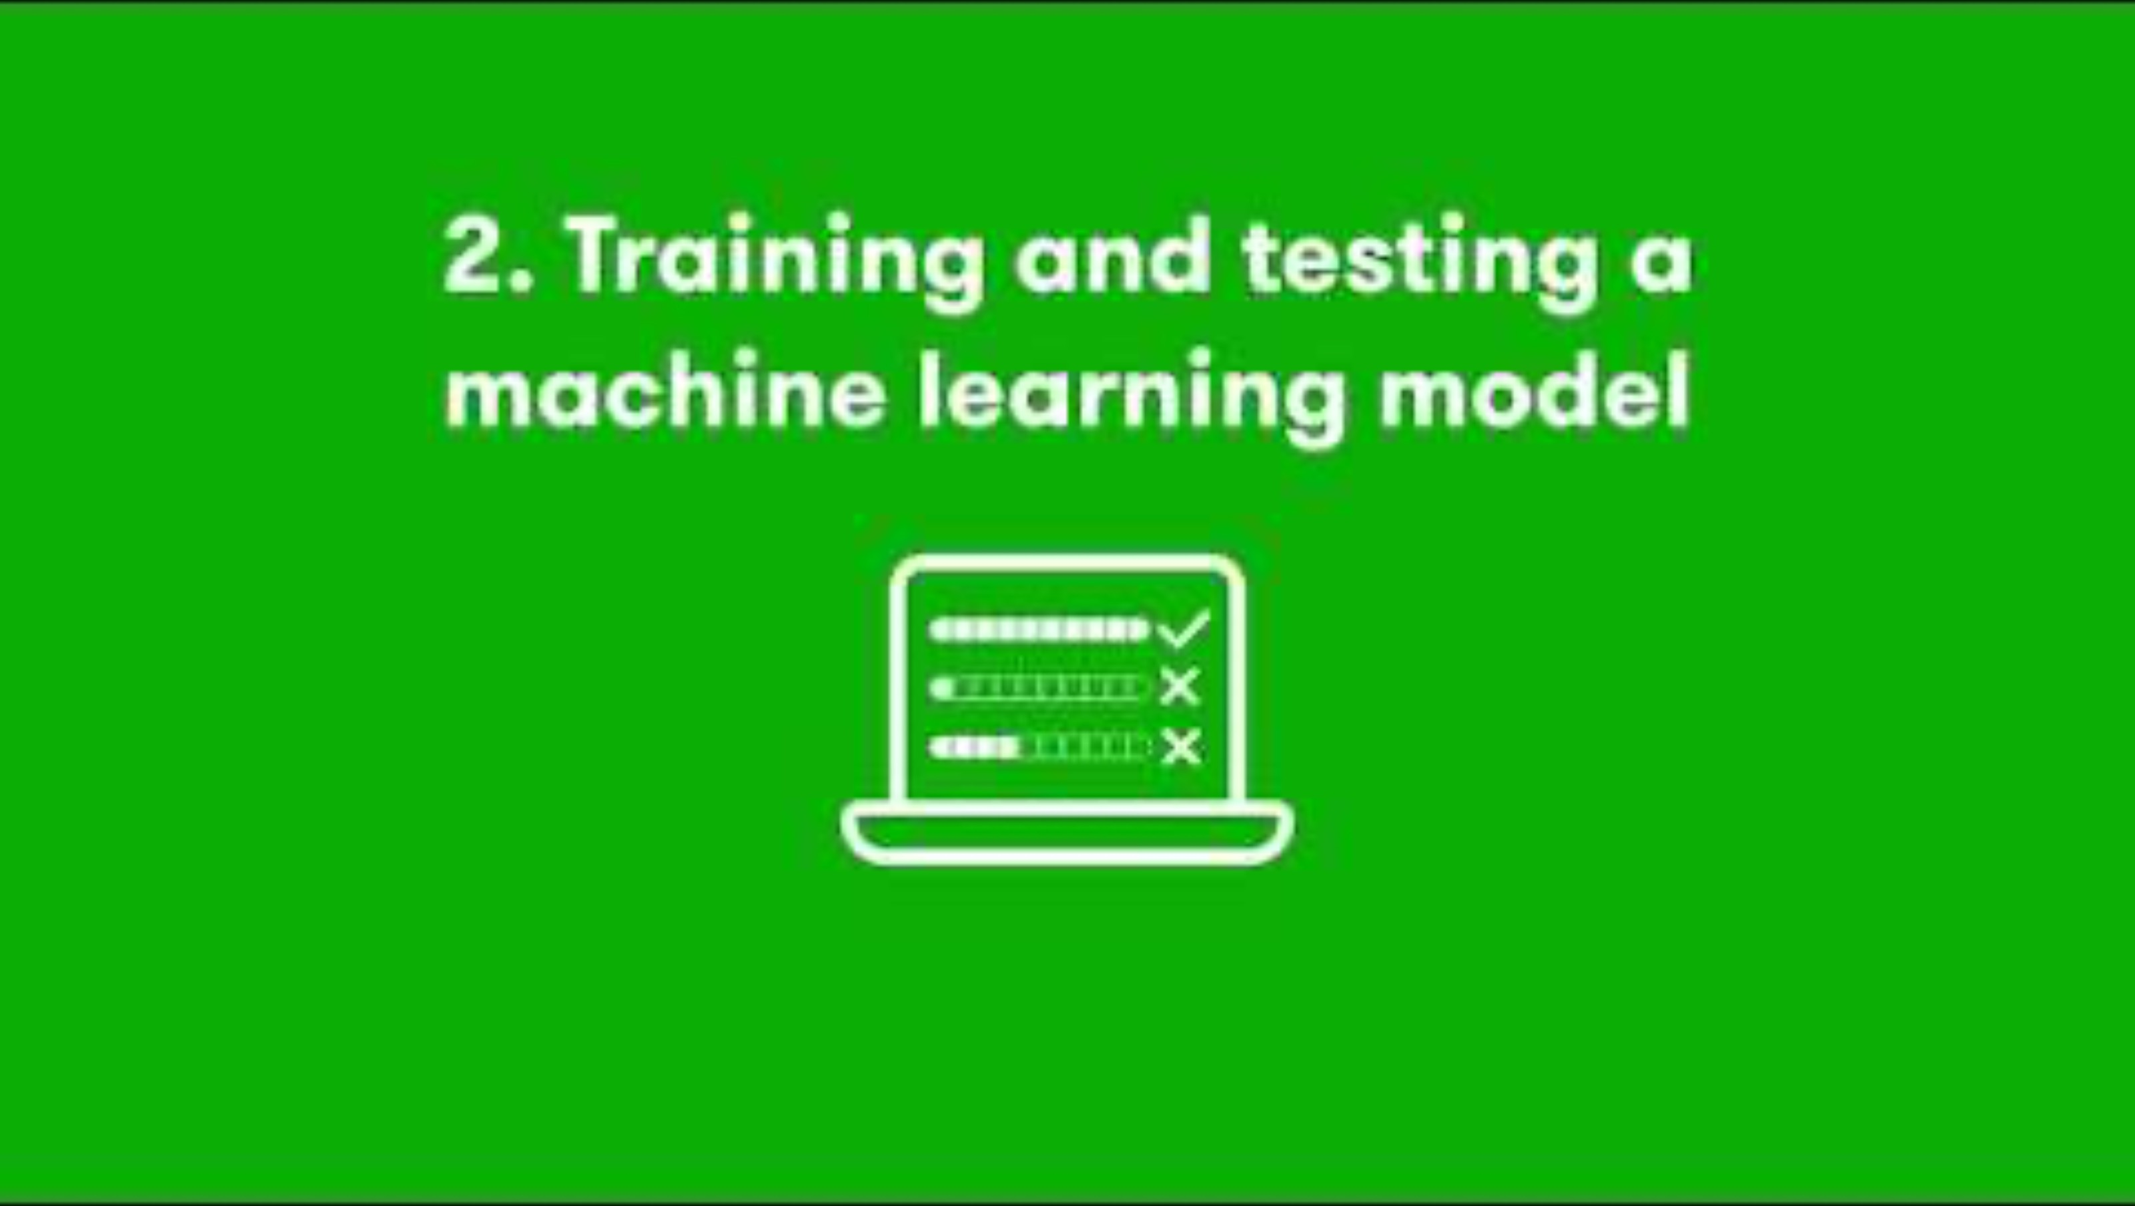
Training and testing ML models - watch
Click the image to play the video or, optionally, play video with captions using this YouTube link: https://youtu.be/JW2Kduu8s_c
Notes:
Please be aware when playing YouTube videos via PowerPoint, recommended content may appear at the end of playback. Teachers should supervise playback or stop the video before it ends to avoid unwanted content appearing in class.

Slide 10
Training and testing ML models - steps
Step 1: Select the ‘Train model’ button.
Step 2: Use the data collection micro:bit to test the model with new movement data.
Step 3: Test the model:
  How accurate is the ML model at matching the new movement data to one of your actions?
  Does it estimate you are always doing one action or the other, even when you are not moving?
ML models are only as good as their training data. If you make a new kind of movement that it has not been trained on, the model may have less certainty in matching the movement – or give an incorrect answer!
Step 4: Select the ‘Edit data samples’ button to go back and add a ‘still’ action.
Step 5: Select the ‘Train model’ button and test again – has it improved?
Step 6: Add more data from different people.

Slide 11

Using ML models in MakeCode - watch
Click the image to play the video or play video with captions using this YouTube link: https://youtu.be/U0vTdTeTGg4
Notes:
Please be aware when playing YouTube videos via PowerPoint, recommended content may appear at the end of playback. Teachers should supervise playback or stop the video before it ends to avoid unwanted content appearing in class.

Slide 12
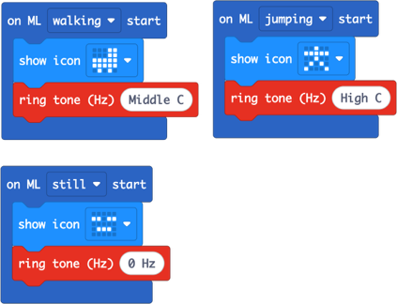
Using ML models in MakeCode - steps
Step 1: Select the ‘Edit in MakeCode’ button.
Step 2: Go to the Music section and select three ‘ring tone’ blocks to make a:
  low-pitched sound when walking
  high-pitched sound when jumping
  be silent when still
Step 3: Select ‘Download’ and follow the instructions on screen to download the code and ML model to your micro:bit.
Step 4: Unplug the micro:bit and attach a battery pack.
  Step 5: Test your program – hold or wear your micro:bit in the same orientation as you did when you collected the training data.
  Step 6: Analysis – How accurate is your ML model? How quickly does it respond when you change your activity? ​

Slide 13

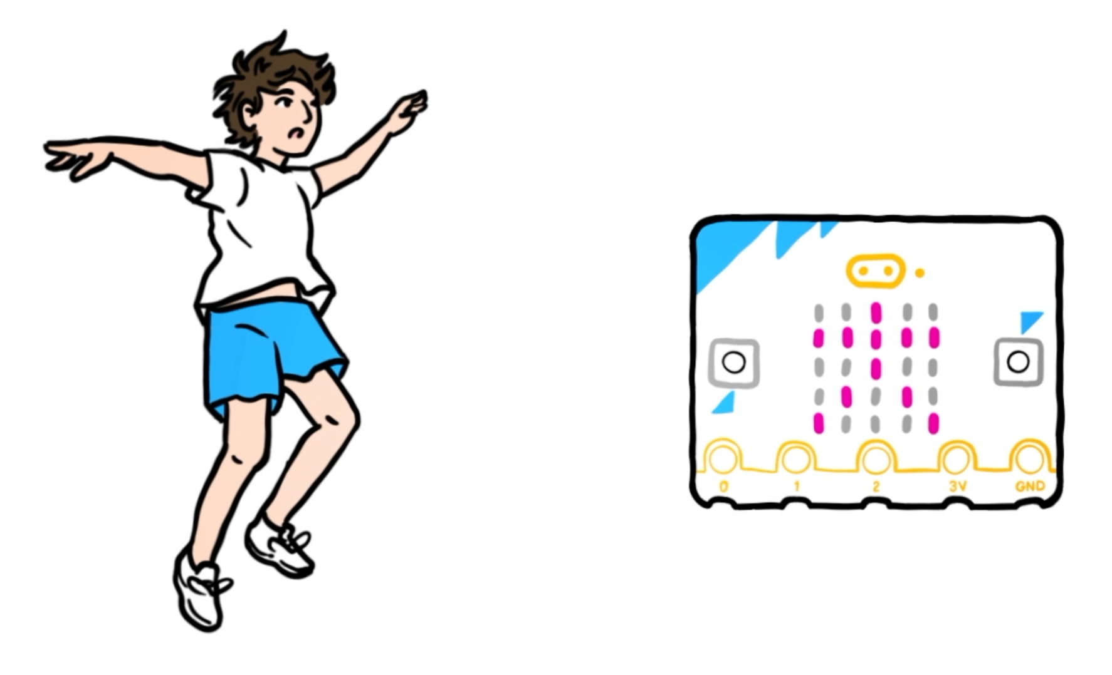
Improve your model
Step 1: Ask a friend to test your project on your micro:bit – they need to wear or hold the micro:bit in the same orientation you used when collecting training data.
Step 2: Analyse your ML model:
  Does it work as well for different people? If not, why not?
  It could be because your friend moves differently to you, and you did not collect the training data from them. This is an example of bias caused by not collecting training data from a diverse group of people. How can you fix it?
Step 3: Go back and collect more data from different people who move in different ways. Retrain and retest the model.

Slide 14

Reflect on your learning
I can collect data, and train and test a machine learning (ML) model to react to different kinds of movements.
I can describe that an ML model matches new data to types of data it has been trained on.
I know that an ML model can only match movements it has been trained on.

Slide 15


Look ahead...
Explore other CreateAI project ideas.
What ideas do you have for projects that you could create using micro:bit CreateAI?

Slide 16




Visit microbit.org/teach for more lessons, projects, courses and help
This content is published by the Micro:bit Educational Foundation under a Creative Commons Attribution-ShareAlike 4.0 International (CC BY-SA 4.0) licence

