Slide 1
Night safety
Flashing wheel light

Slide 2
Night safety for wheelchair users
What are the main problems around road safety for people who are wheelchair users?
What risks are increased at night?
How could travelling at night be made safer?

Slide 3
Flashing wheel light
You are going to create a prototype of a Flashing wheel light with the micro:bit.
How can it help people who are wheelchair users be safer at night?
How do you think it is working?

Slide 4
Flashing wheel light algorithm
Write an algorithm to create a Flashing wheel light using the micro:bit
You will likely use repetition, iteration and selection
When finished, share and debug your algorithms

Slide 5
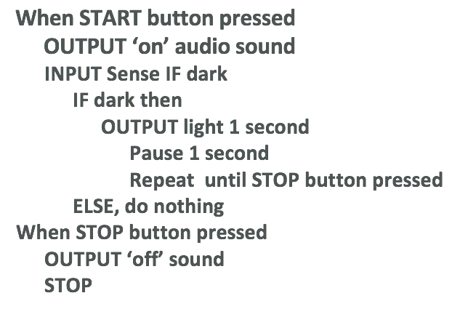
Flashing wheel light algorithm examples
Simple Flashing wheel light algorithm
More complex Flashing wheel light
algorithm

Slide 6
Programming your Flashing wheel light
Using the MakeCode editor and your algorithm, write your Flashing wheel light program.
Remember to test and debug regularly.
Once finished, download and copy to your micro:bit to test and run.
Compare your programs and Flashing wheel light.

Slide 7
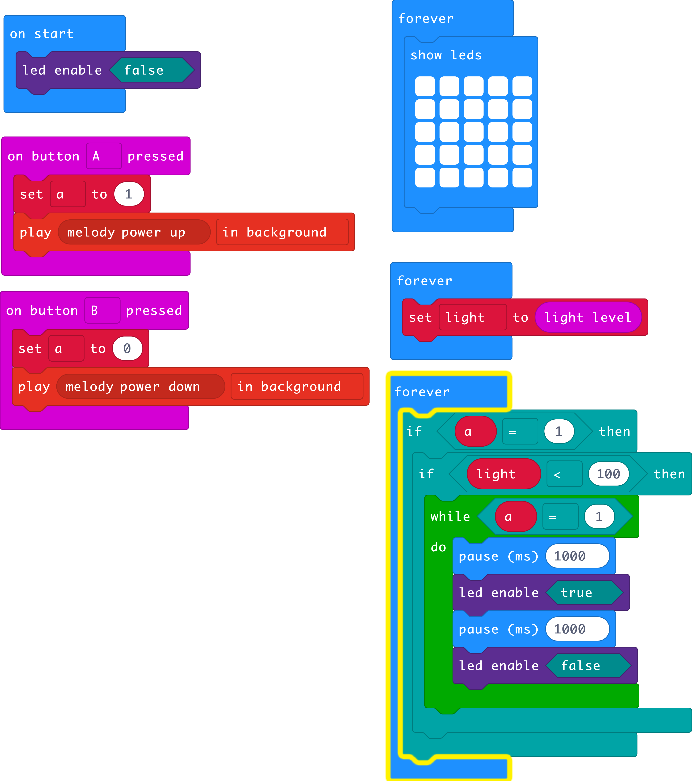
Flashing wheel light program example

Slide 8
Evaluation & Presentation
What have you learnt from creating your flashing wheel light?
What went well with your project?
What would make your project better?
Consider your algorithm, code, prototype, any problems you encountered and how you solved them.

Slide 9
Licensing information
Published by the Micro:bit Educational Foundation microbit.org
Licence: Attribution-ShareAlike 4.0 International (CC BY-SA 4.0)

