Slide 1
Data handling
Teacher lesson guide
Lesson 5

Slide 2
Learning objectives:
To read and write algorithms.
To identify how a digital assistant might work.
To write a program to use a micro:bit as a digital assistant.

Slide 3
Algorithms and programs
FOREVER
IF you are wearing a green band
THEN clap 5 times
ELSE put your finger on your lips and say ‘shh’

Slide 4
Algorithms and programs
FOREVER
IF you are wearing a red band
THEN clap 5 times
ELSE IF you are wearing a yellow band
THEN bark like a dog 5 times
ELSE put your finger on your lips and say ‘shh’

Slide 5
Algorithms and programs
FOREVER
IF you are wearing a blue band
THEN clap 7 times
ELSE IF you are wearing a green band
THEN meow like a cat 7 times
ELSE put your finger on your lips and say ‘shh’

Slide 6
Algorithms and programs
FOREVER
IF you are wearing a yellow band
THEN click your fingers 3 times
ELSE IF you are wearing a red band
THEN squeak like a mouse 3 times
ELSE put your finger on your lips and say ‘shh’

Slide 7
Can you write your own algorithm?
FOREVER
IF you are wearing a
THEN
ELSE IF you are wearing a
THEN
ELSE

Slide 8
Digital assistants
Digital assistants are devices that carry out actions when instructions are given by a human voice.
What examples of digital assistants do you know?

Slide 9
A micro:bit digital assistant
We are going to write a program to use micro:bit as a digital assistant.
The micro:bit is going to use sensors and data to select what clothes we should wear.
How might we do this?

Slide 10
micro:bit, what should I wear today?
Temperature greater than 20℃ | Temperature between 5 and 20℃ | Temperature less than 5℃
You should wear: | You should wear: | You should wear:

Slide 11
Temperature cards
7℃ | 21℃ | 12℃
-2℃ | 11℃ | 1℃
0℃ | 8℃ | 37℃

Slide 12
Digital assistant algorithm
FOREVER
WHEN asked
IF
THEN say
ELSE IF
THEN say
ELSE say

Slide 13
Digital assistant algorithm
FOREVER
WHEN asked
IF
THEN say
ELSE IF
THEN say
ELSE say
what shall I wear today?
temperature is greater than 20℃
flip-flops, shorts, hat
temperature is less than 4℃
boots, gloves, scarf
shoes, jumper, trousers

Slide 14
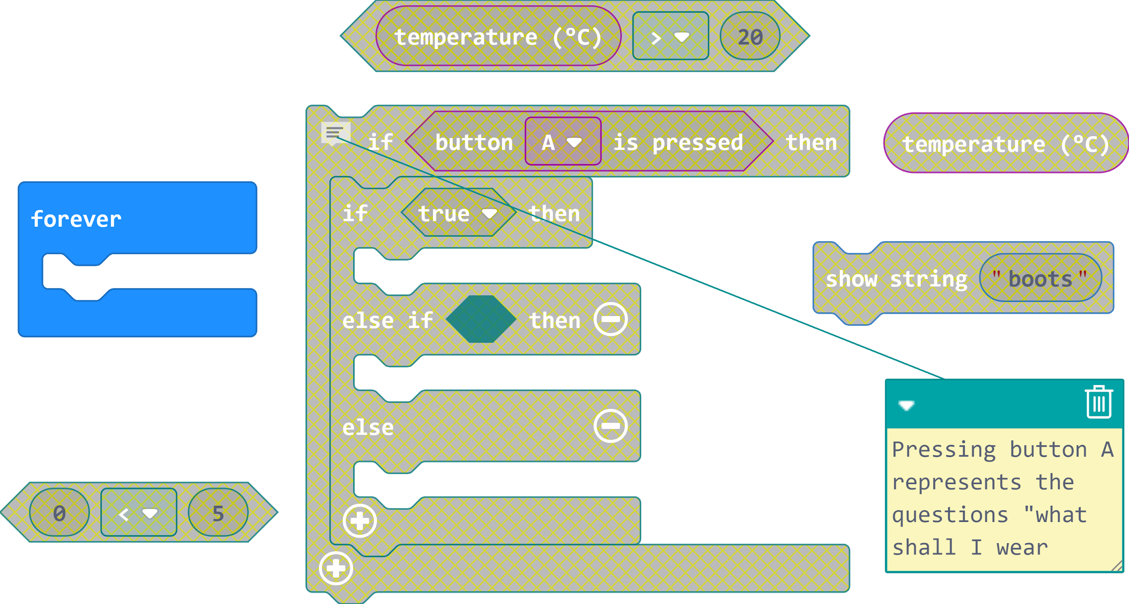
Writing programs

Slide 15
Comparing digital assistants
Digital assistants use the weather forecast when suggesting what clothes the user should wear.
Do you think this is a better method than using a temperature sensor? Justify your reasoning.
Notes:
Weather forecast takes into account rain as well as temperature
Weather forecast can look at the entire day’s weather/temperature
Temperature sensor suggestions are based on current temperatures
Temperature sensor would need to be placed outside.

Slide 16
Learning objectives revisited:
To read and write algorithms.
To identify how digital assistants might work.
To write a program to use a micro:bit as a digital assistant.

Slide 17
Licensing information:
Published by the Micro:bit Educational Foundation microbit.org under the following Creative Commons licence:
Attribution-ShareAlike 4.0 International (CC BY-SA 4.0) https://creativecommons.org/licenses/by-sa/4.0/

