Slide 1
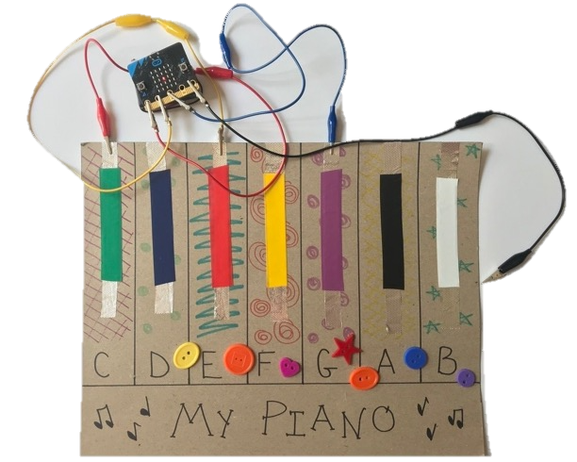

Music Cards
Music Cards
Play a Note
Play a Chord
Sound Effects
Make an Instrument
Wire the Instrument
Program the Pins
Attach the micro:bit
Set the Stage

Slide 2


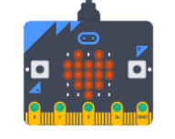
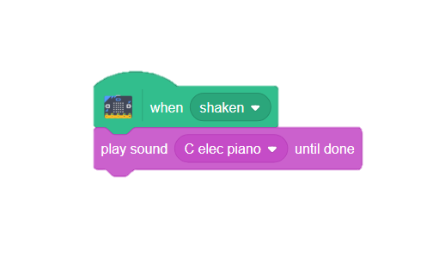
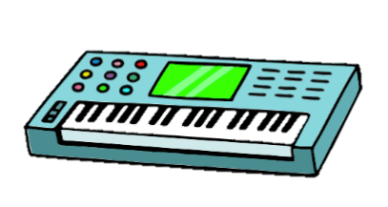
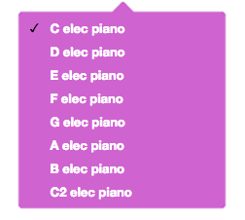
Play a Note
Play a Note
GET READY
Make your sprite play a sound.
Corresponding notes appear in the Sound blocks.
Add a sprite.
ADD THIS CODE
TRY IT
Shake your micro:bit. Does the note play?
CHALLENGE: What happens when you add multiple notes?
1

Slide 3



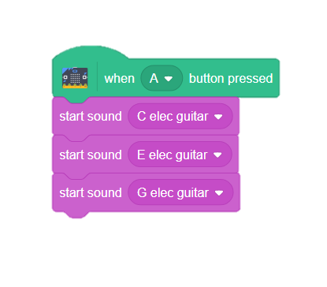
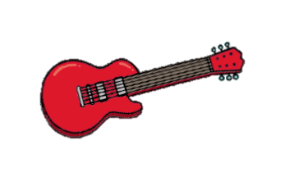
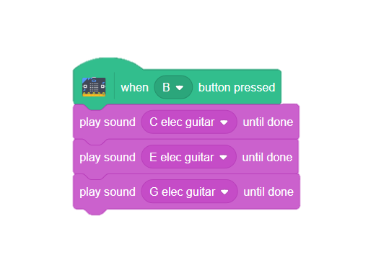
Play a Chord
Play a Chord
GET READY
Make your sprite play multiple notes at once.
Look closely at these two blocks. What is the difference between them?
ADD THIS CODE
All three notes will play at the same time.
TRY IT
CHALLENGE: Can you make any other chords?
What happens when you use these blocks instead?
2

Slide 4

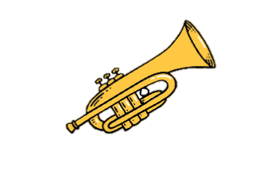
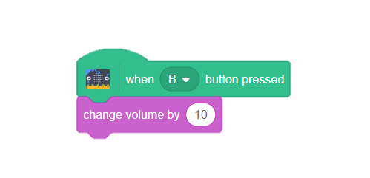
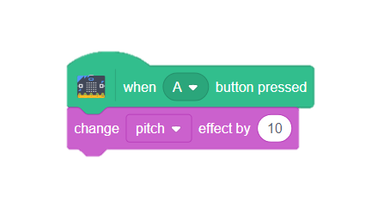

Sound Effects
Sound Effects
GET READY
Change the pitch and volume of your notes.
Add a sprite.
Corresponding notes appear in the Sound blocks.
ADD THIS CODE
TRY IT
Press the A and B buttons to change the sound.
What other sound effects can you add?
CHALLENGE: Can you add a RESET block to make your sounds go back to their original notes?
3

Slide 5



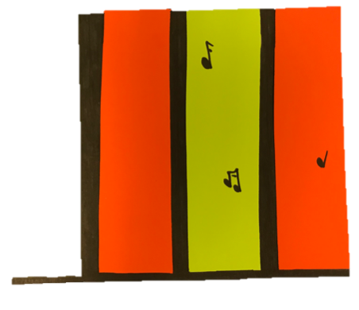
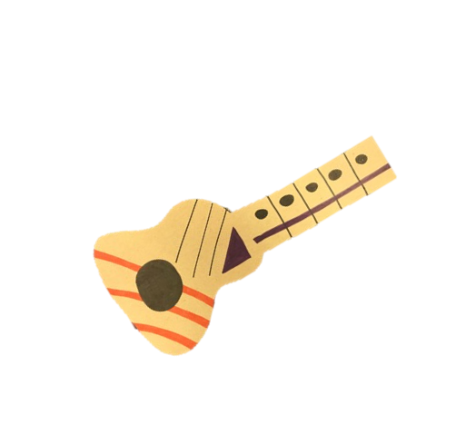
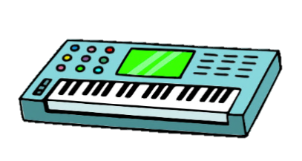
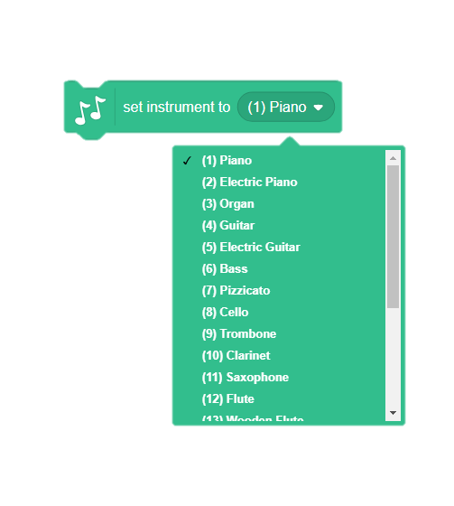
Make an Instrument
Make an Instrument
MATERIALS
Create your own instrument using cardboard and craft materials and play music via your micro:bit.
Cardboard or heavy paper.
Scissors
Markers or crayons
Glue stick
Craft
materials
PROCEDURE
Using cardboard or heavy paper, draw your favorite instrument.
Decorate with craft supplies.
Leave room to add conductive materials. The micro:bit will work by creating circuits that close and open as you touch the keys on your instrument!
TRY IT
What instruments can you make?
Scratch offers sounds for the following instruments:
4

Slide 6
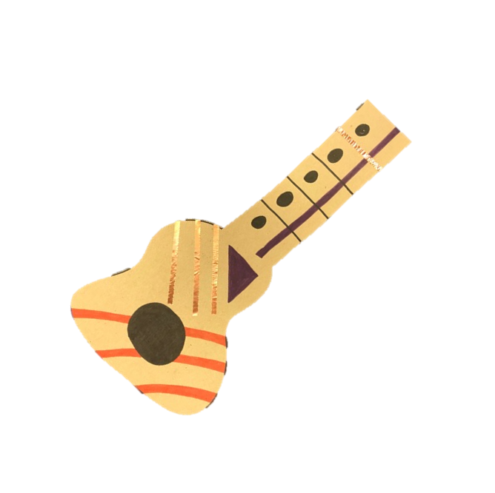

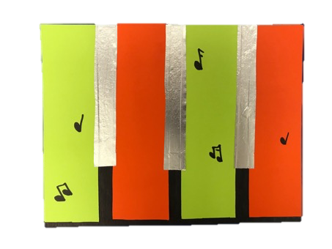
Wire the Instrument
Wire the Instrument
MATERIALS
Use your instrument to create a circuit using conductive materials.
or
Glue stick
Craft
materials
Tinfoil
Copper
Tape
Scissors
PROCEDURE
Cut strips of tinfoil, or add copper tape to each key or string.
Make sure the metal touches an edge on your instrument so that it can be connected to the micro:bit.
TRY IT
Decorate. Make sure to leave your metal areas open!
Tinfoil and copper tape are both metal, which means they will conduct electricity. When your micro:bit is attached and you touch a conductive area, the computer will play the note!
5

Slide 7
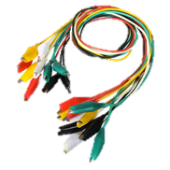
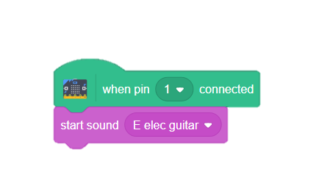
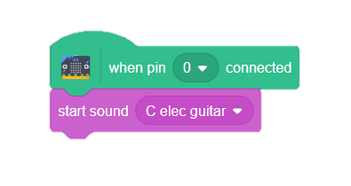
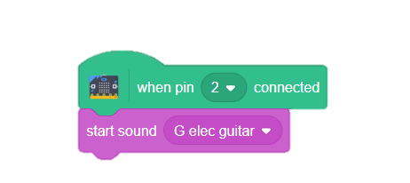
Program the Pins
Program the Pins
MATERIALS
Create codes that will correspond to the keys or strings on your instrument.
Alligator Clips
ADD THIS CODE
PIN 0
PIN 1
PIN 2
GROUND WIRE
(Connects you to the circuit)
TRY IT
Clip your wires onto the pins as shown. Hold the ground wire in one hand and touch the metal end of one of the other wires. Does a note play?
CHALLENGE: Can you play multiple notes at once?
6

Slide 8
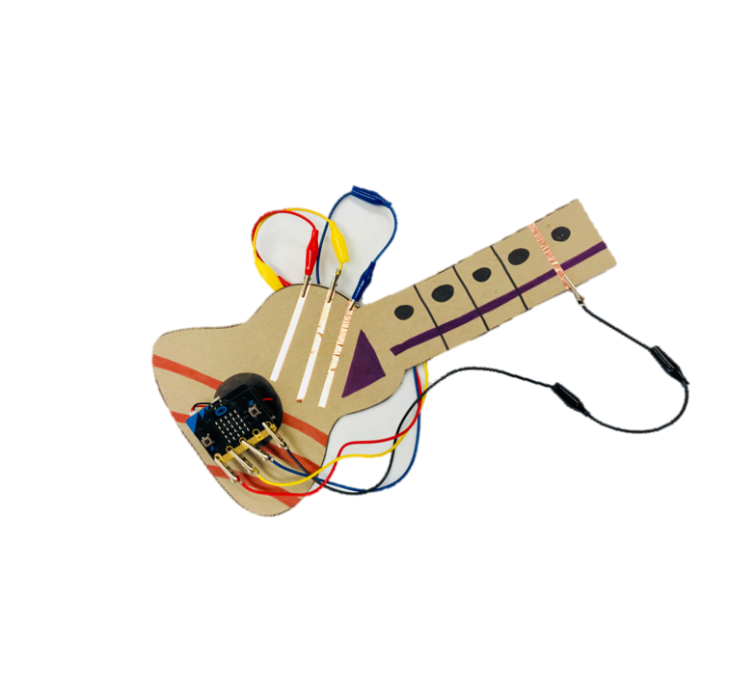
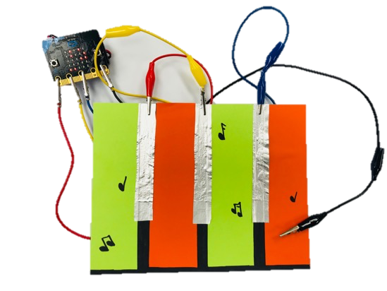
Attach the micro:bit
Attach the micro:bit
GET READY
Attach the end of each alligator clip to the conductive areas of your instrument.
Use wires to connect the micro:bit to your instrument.
Either hold the ground wire in your hand, or attach it to a conductive spot on the instrument that you know you will touch.
PROCEDURE
Ground Wire
Ground Wire
TRY IT
Rock on! Practice playing music on your instrument!
When you hold the ground wire and touch a key, you create a completed circuit between you and your computer, causing Scratch to play,
7

Slide 9
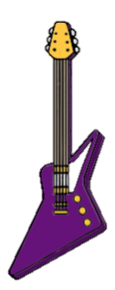
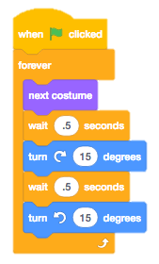
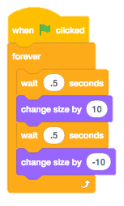



Set the Stage
Set the Stage
GET READY
Make the sprites move on the screen as you play your instrument.
Add sprites and a background.
ADD THIS CODE
TRY IT
Put it all together!
Can you play your instrument while the animation plays on the screen?
8

