Slide 1
Electrical conductors
Teacher lesson guide
Lesson 5

Slide 2
Learning objectives:
To decompose a problem into smaller steps.
To write a flowchart algorithm that uses selection.
To know and identify inputs and outputs.

Slide 3
Algorithms
What are algorithms?
What types of algorithms have you written?
What was the purpose of the algorithms you have written?
Notes:
An algorithm is a sequences set of steps, instructions or rules, written for a human to follow to allow them to complete a task or solve a problem.

Slide 4
Flowchart algorithm thinking map
Flowchart Algorithm

Slide 5
Creating algorithms
We are going to write a flowchart algorithm for someone to follow to use the micro:bit to test electrical conductivity.
What steps did we undertake to allow us to test is materials were conductors with the micro:bit?
What do you remember about decomposition?
How can we use decomposition to help create our flowchart algorithm?
Notes:
Decomposition is the process of breaking down a larger task or problem into smaller tasks. Pupils need to break down the task of using micro:bit to test materials’ conductivity into smaller tasks they completed. They should identify: planning their selection program using a decision box and the LED planner, writing the program using the makecode editor, downloading the program and transferring to micro:bit, testing the material with microbit.

Slide 6
Reviewing learning
inputs
outputs

Slide 7
Learning objectives revisited:
To decompose a problem into smaller steps.
To write a flowchart algorithm that uses selection.
To know and identify inputs and outputs.

Slide 8
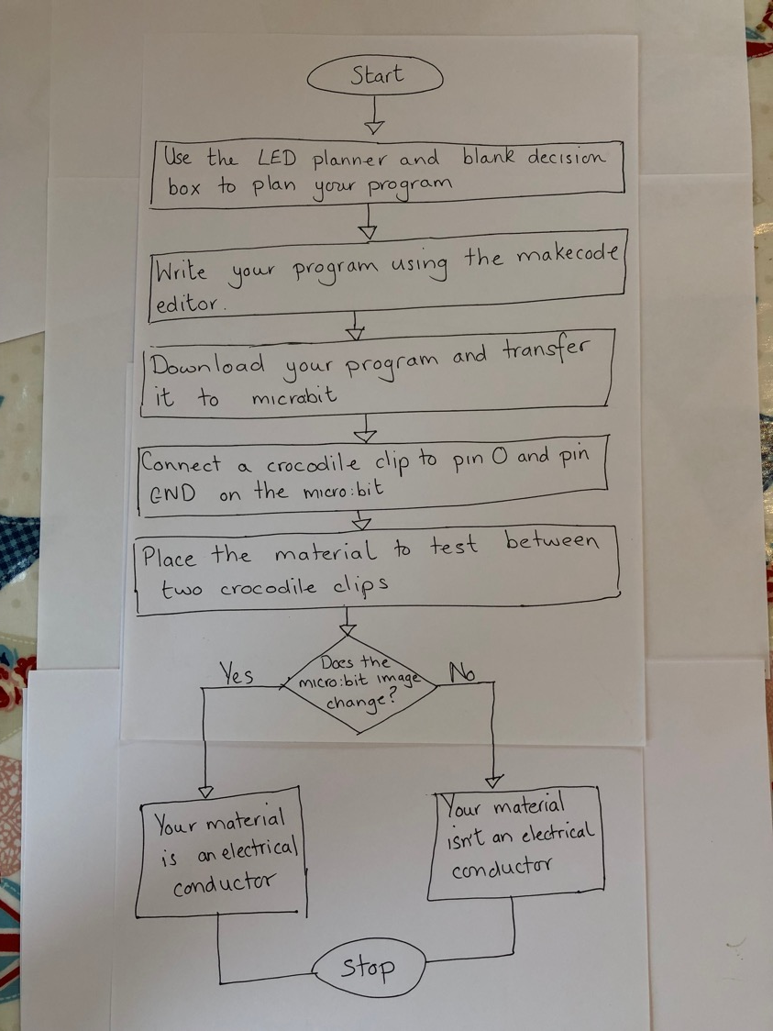
Example algorithm

Slide 9
Licensing information:
Published by the Micro:bit Educational Foundation microbit.org under the following Creative Commons licence:
Attribution-ShareAlike 4.0 International (CC BY-SA 4.0) https://creativecommons.org/licenses/by-sa/4.0/

